Slide 1



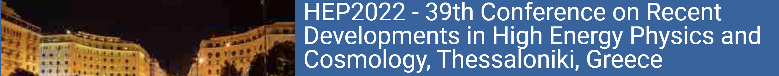
FCC
Accelerator and Detector Aspects
M. Koratzinos
17 June 2022
LHC
PS
SPS
FCC
photo: J. Wenninger

Slide 2
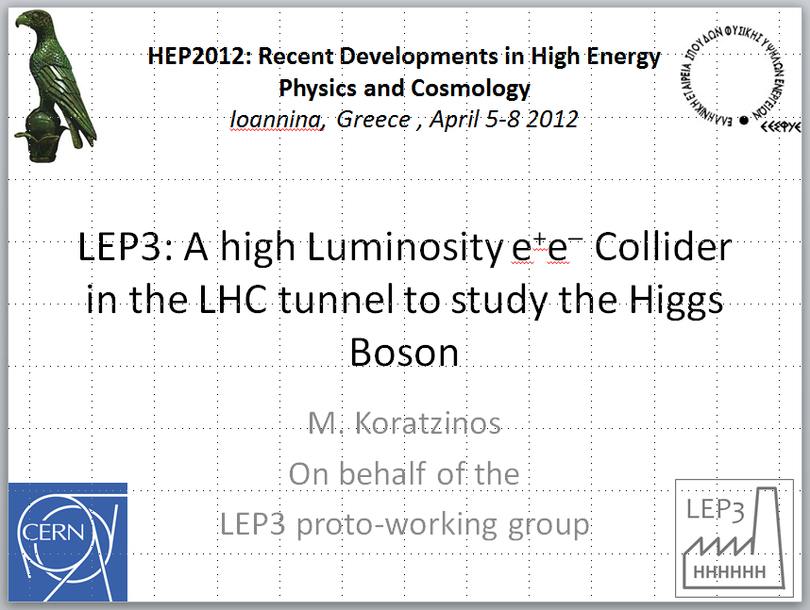
You have heard it here first!

Slide 3
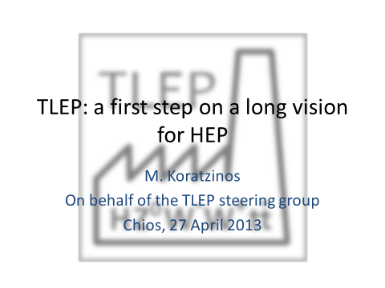
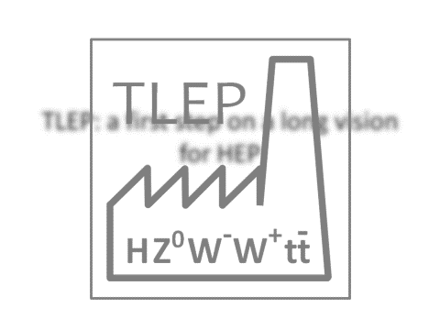
…and you have heard it again in Chios in 2013

Slide 4
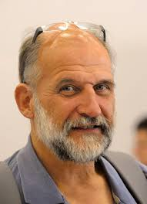
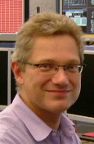
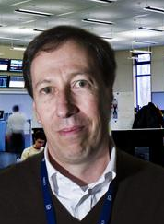

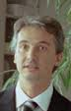
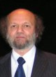
Acknowledgements
We should not forget the pioneers of the modern circular Higgs factory idea: Roy Aleksan, Alain Blondel, John Ellis, Patrick Janot, Frank Zimmermann, that promoted the idea when it was not fashionable
A. Blondel F. Zimmermann M. Koratzinos J. Ellis P. Janot R. Aleksan
I have taken material liberally from the latest FCC week in Paris https://indico.cern.ch/event/1064327/
FCC in this conference:
Michelangelo Mangano: FCC Physics prospects
Emmanuel Tsesmelis: he FCC and Global Collaboration
(Mike Koratzinos: FCC accelerator and detector aspects)

Slide 5
The FCC accelerator at a glance
FCC-ee
  Large tunnel
  Four beam energy regions: 45GeV (Z), 80GeV (W), 120GeV (H), 182.5 (t)
  Synchrotron radiation power 100MW for both beams at all energies
  Full size ‘booster’ ring, continuous injection, since luminosity lifetime is only a few minutes
  ‘crab waist’ collision scheme to maximize luminosity
  Four experiments (baseline) can go to two if need be
  FCC-ee is not just a bigger LEP! It is a state-of-the-art, 21st century accelerator
Followed by FCC-hh in the same tunnel
  100TeV+ proton collider
  Still 40+ years away

Slide 6

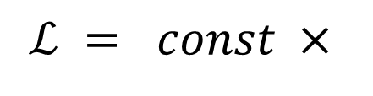
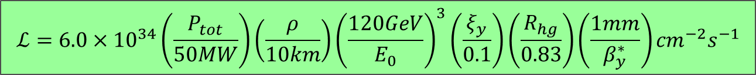
Luminosity of a circular lepton collider
$$ℒ=\frac{3}{8π}\frac{{\left(m_{e}c^{2}\right)}^{2}}{{r_{e}}^{2}} P_{tot}\frac{ρ}{{E_{0}}^{3}} ξ_{y} \frac{R_{hg}}{β_{y}^{∗}}$$
The maximum luminosity is bound by the total power dissipated, the maximum achievable beam-beam parameter, the bending radius, the beam energy, the amount of vertical squeezing $β_{y}^{∗}$ , and the hourglass effect, a geometrical factor (which is a function of σ_{z} and $β_{y}^{∗}$)
Crab waist
$$ℒ = const ×$$
Power fixed to 100MW
Proportional to ring size
Steep drop with E_{beam}
$$ℒ={6.0×10}^{34}\left(\frac{P_{tot}}{50MW}\right)\left(\frac{ρ}{10km}\right){\left(\frac{120GeV}{E_{0}}\right)}^{3}\left(\frac{ξ_{y}}{0.1}\right)\left(\frac{R_{hg}}{0.83}\right)\left(\frac{1mm}{β_{y}^{∗}}\right){cm}^{−2}s^{−1}$$

Slide 7
The circular $e^{+}e^{−}$ collider approach
$e^{+}e^{−}$ colliders cannot compete with linear colliders in terms of energy. But they can compensate in terms of luminosity
For the high luminosities aimed at, the beam lifetimes due to natural physics processes (mainly radiative Bhabha scattering) are of the order of a few minutes – the accelerator is ‘burning’ the beams up very efficiently
A “top-up” scheme (a la B factories) is a must
Booster ring
injector
Main ring
A. Blondel
Booster ring the same size as main ring, tops up the main ring every ~O(10s)
Main ring does not ramp up or down

Slide 8
FCC-ee Parameters - 2022
K. Oide, D. Shatilov
Parameter [4 IPs, 91.1 km,T_{rev}=0.3 ms] | Z | WW | H (ZH) | ttbar
beam energy [GeV] | 45 | 80 | 120 | 182.5
beam current [mA] | 1280 | 135 | 26.7 | 5.0
number bunches/beam | 10000 | 880 | 248 | 40
bunch intensity [10¹¹] | 2.43 | 2.91 | 2.04 | 2.37
SR energy loss / turn [GeV] | 0.0391 | 0.37 | 1.869 | 10.0
total RF voltage 400 / 800 MHz [GV] | 0.120 / 0 | 1.0 / 0 | 2.08 / 0 | 2.5 / 8.8
long. damping time [turns] | 1170 | 216 | 64.5 | 18.5
horizontal beta* [m] | 0.1 | 0.2 | 0.3 | 1
vertical beta* [mm] | 0.8 | 1 | 1 | 1.6
horizontal geometric emittance [nm] | 0.71 | 2.17 | 0.64 | 1.49
vertical geom. emittance [pm] | 1.42 | 4.34 | 1.29 | 2.98
horizontal rms IP spot size [μm] | 8 | 21 | 14 | 39
vertical rms IP spot size [nm] | 34 | 66 | 36 | 69
beam-beam parameter ξ_{x} / ξ_{y} | 0.004 / 0.159 | 0.011 / 0.111 | 0.0187 / 0.129 | 0.093 / 0.140
rms bunch length with SR / BS [mm] | 4.38 / 14.5 | 3.55 / 8.01 | 3.34 / 6.0 | 1.95 / 2.75
luminosity per IP [10³⁴ cm⁻²s⁻¹] | 182 | 19.4 | 7.26 | 1.25
total integrated luminosity / year [ab⁻¹/yr] | 87 | 9.3 | 3.5 | 0.65
beam lifetime rad Bhabha + BS [min] | 19 | 18 | 6 | 9

Slide 9
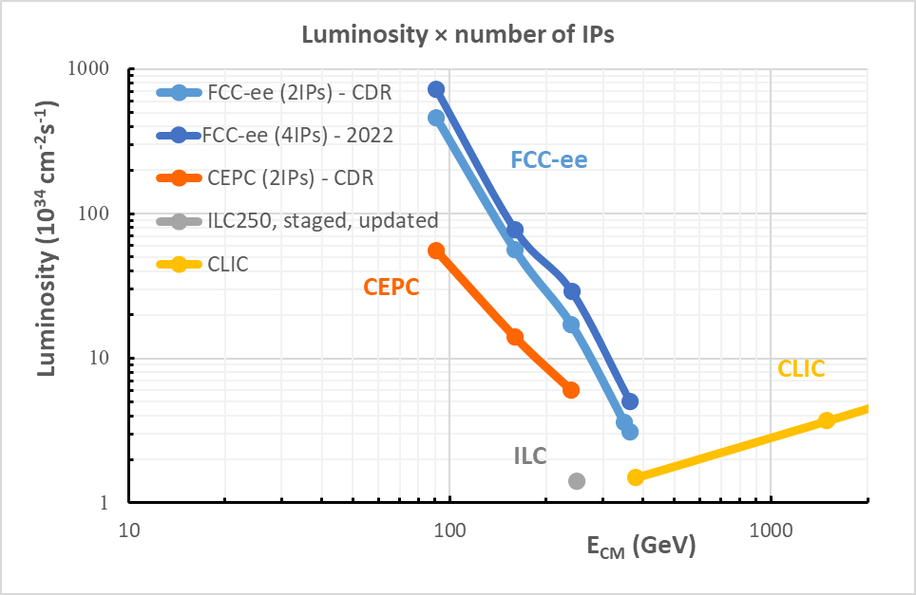
Luminosity compared to other projects
Luminosity of FCC-ee compares favourably to projects of similar cost and complexity

Slide 10
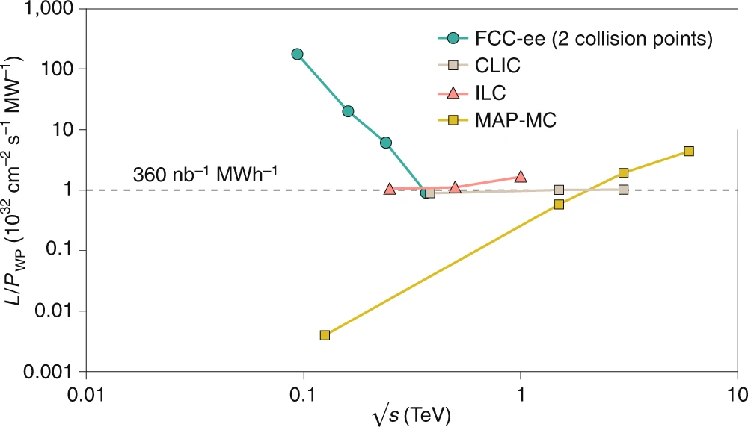
FCC-ee Luminosity
Luminosity vs. electricity consumption
FCC-ee efficient L from Z to 𝑡𝑡 ̅
  Thanks to twin-aperture magnets, SRF, efficient RF power, top-off injection
Accumulate >2.5 ab⁻¹ with ~0.5x10⁶ H produced per IP
Accumulate >75 ab⁻¹ with ~2x10¹² Z produced per IP
Run plan naturally starts at Z but is under discussion
Highest lumi per AC site power of all proposals
Electricity cost ~200 CHF per Higgs boson
Tor Raubenheimer

Slide 11

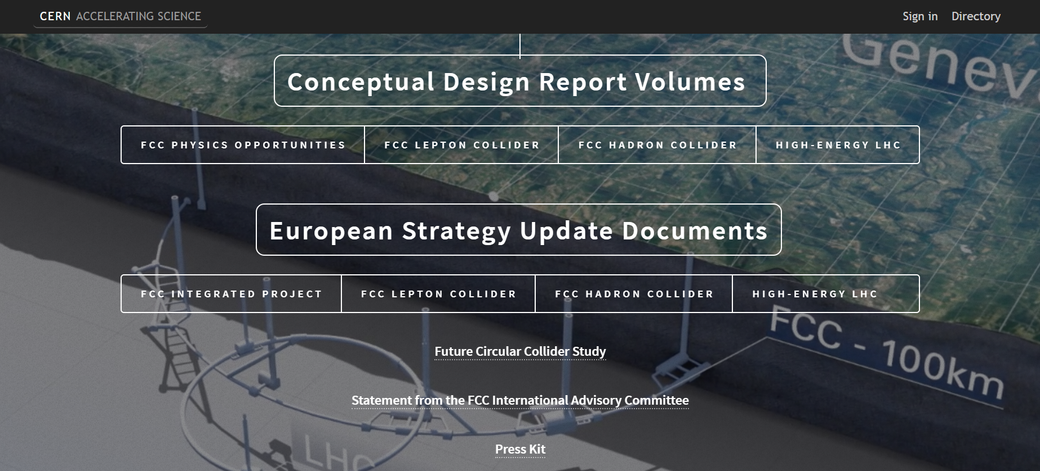
FCC study: CDR released on 15 January 2019
Four CDR volumes
10-page documents

Slide 12
Placement studies

Slide 13
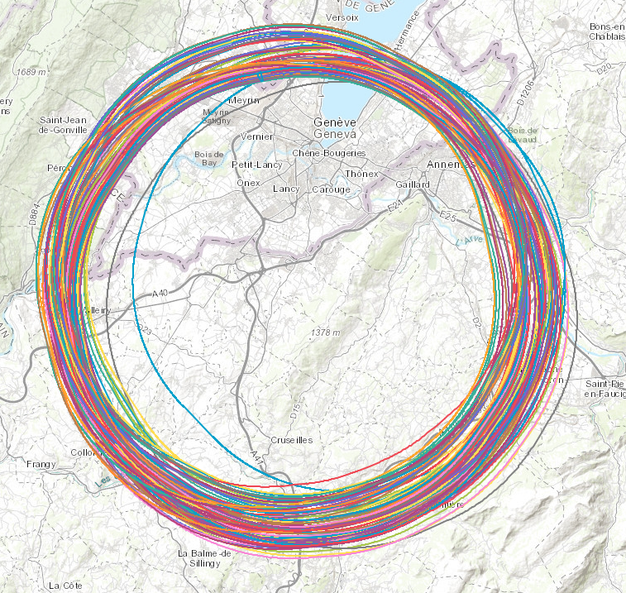
New layout for the tunnel!
He old (CDR) layout suffered a series of drawbacks
The new layout
  allows for 4 experiments
  Has four-fold symmetry
  Is compatible with the terrain constraints
  Is smaller
Many different possibilities studied
New circumference: 91,174.1 m
(cf M_{z} = 91,188 MeV )

Slide 14
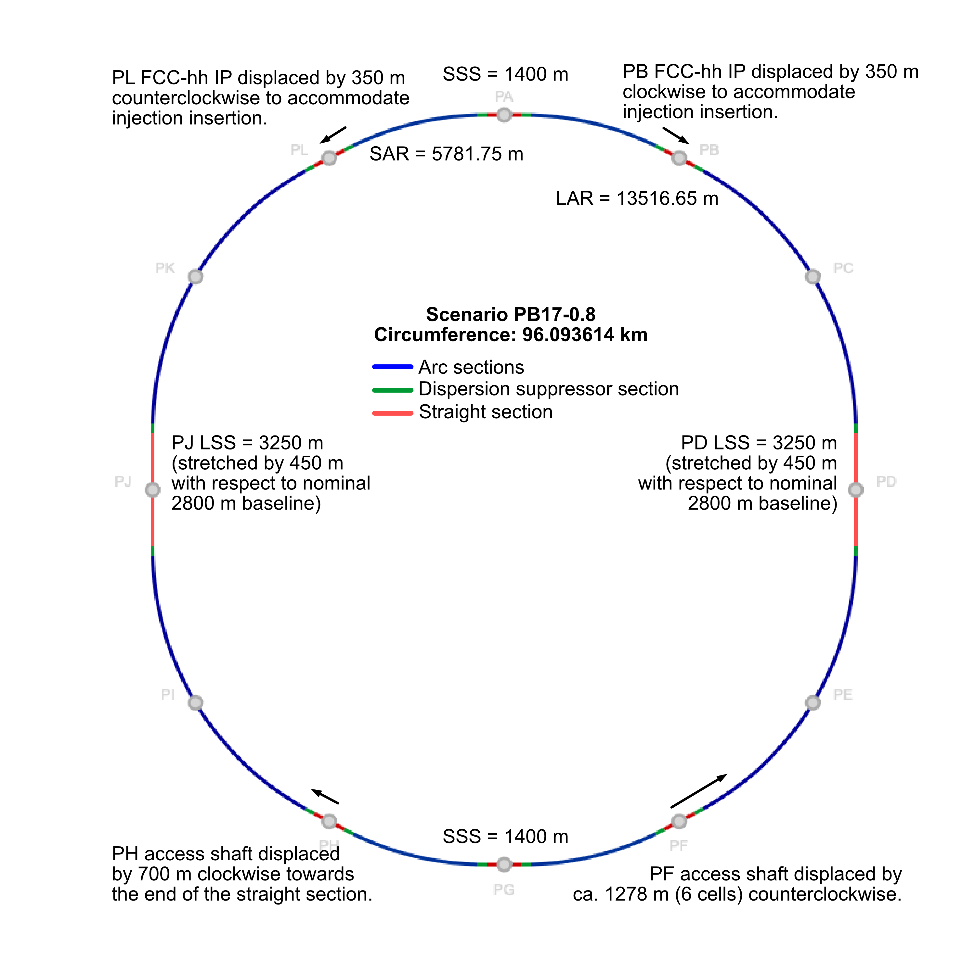
Evolution since CDR documentation baseline
CDR layout with 12 sites (97.75 km) turned out to have various drawbacks to serve as basis for a feasibility study.
Conclusions after ~ 50 scenarios studied:
Layout limited to 2 IPs for FCC-ee
At the very limit with respect to the subsurface conditions known so far
Straight sections artificially stretched
2 major site displacements due to deep shafts
Challenging to find a scenario with surface areas that are sufficiently likely to be implementable from a territorial perspective
J. Gutleber

Slide 15

Topography and geology
limit circumference to << 100 km
Lac Léman
300 – 372 m/mer
Jura 900 – 1680 m/mer
Plaine du Genevois
350 – 550 m/mer
Vallée du Rhône
∼330 m/mer
Valée de l’Arve
400 – 600 m/mer
Mont Salève 550 - 1380
Mont Vuache
550 - 1100
Plateau du Mont Sion
550 – 860 m/mer
Plateau des Bornes
600 – 850 m/mer
Mandallaz

Slide 16
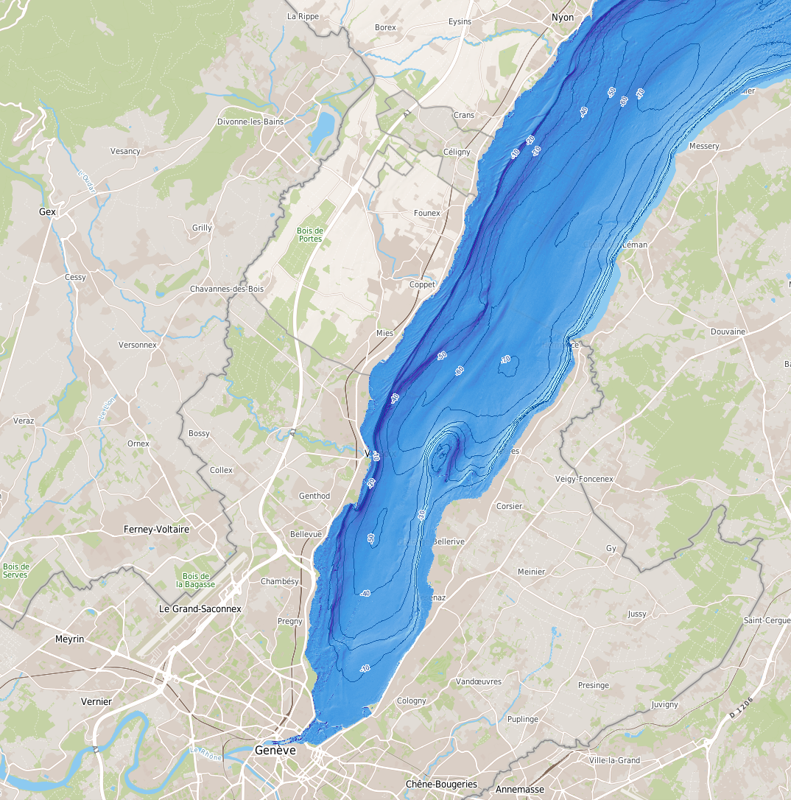
Lake depth
The lake is 50 m deep at the Versoix – Corsier line
To avoid that the tunnel is too deep throughout the entire trace, the placement needs to remain south of this line.
It is preferrable to traverse the lake at the narrowest location to reduce the distance of instable ground and to limit risks linked to the presence of water.
J. Gutleber

Slide 17
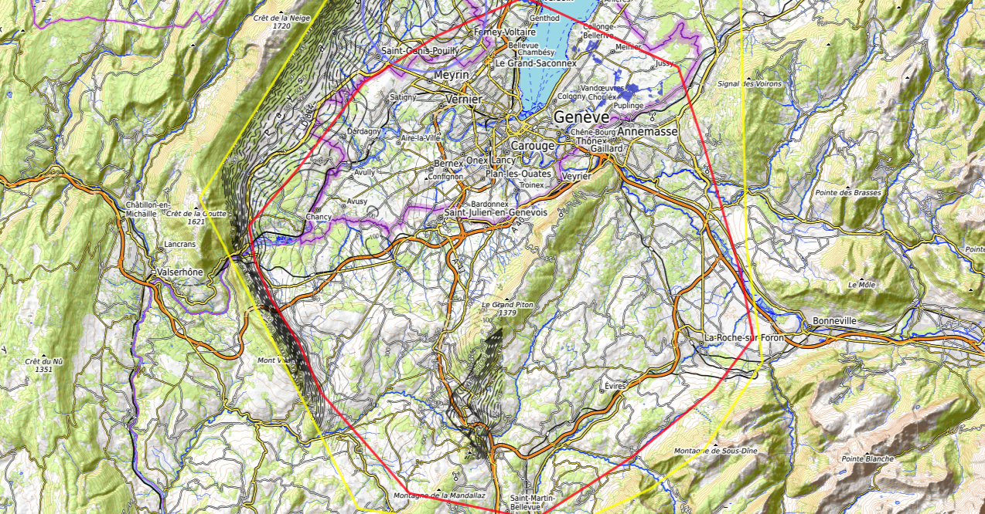
17
Discouraged due
to likely opposition
Densely urbanized
and agriculture/nature
Strict landscape protection
and re-naturalization areas
Jura limestone
Protected forest
Densely urbanized
and emerging areas
Densely urbanized
Clustered residential
areas and farm areas
Terrain difficult to
access and water
reservoirs
Known water reservoirs and
protected nature in CH
(legal + technical reasons)
Water protection and
natural zones without
developed access
Densely urbanized
and emerging areas
(some spots possible)
Water protection zones,
landscape protection zones,
altitudes
High mountains (900 m)
north of Fillière river valley
Vuache limestone
and faults
Likely major opposition:
local urbanistic planning
for traffic calming &
nature protection
High altitudes
J. Gutleber
Densely populated

Slide 18
8-site layout and placement
< 900 m
Possibility for 2 or 4 IPs for FCC-ee
Less site locations to find, but stricter geometry constraints at the 4 IP locations
All site locations feature straight sections
with specific functions that can be allocated
Conclusions after ~50 scenarios studied:
  Largest possible scenario that is compatible with geological constraints known so far is 91 km long
  Shafts are not too deep. Only PF requires a horizontally displaced access due to depth and accessibility to the inside of the ring by ca. 400 m
  Territorial compatibility seems achievable, but map-based studies are exhausted. Any further activity requires engagement with local actors and stakeholders.
Straight sections
Deep PF shaft: displacement
Curved sections
J. Gutleber

Slide 19
Optics and misalignment strategy

Slide 20
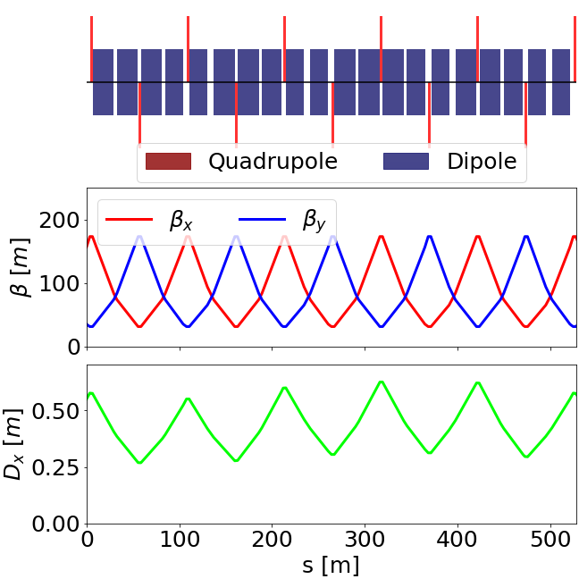
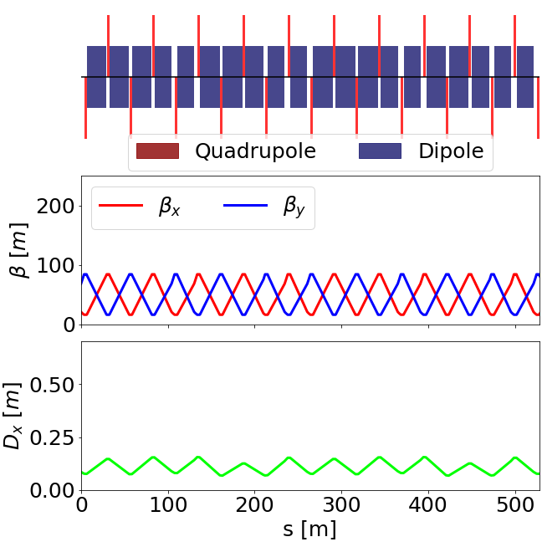
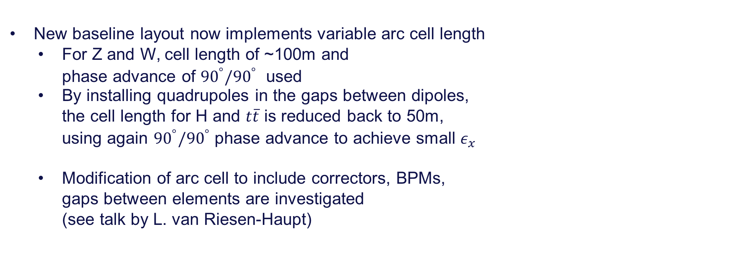


Arc optics in new layout
$$Z$$
K. Oide
New baseline layout now implements variable arc cell length
  For Z and W, cell length of ~100m and
  phase advance of ${90}^{°}/{90}^{°}$ used
  By installing quadrupoles in the gaps between dipoles,
  the cell length for H and $t\overline{t}$ is reduced back to 50m,
  using again ${90}^{°}/{90}^{°}$ phase advance to achieve small $ε_{x}$
  Modification of arc cell to include correctors, BPMs,
  gaps between elements are investigated
  (see talk by L. van Riesen-Haupt)
$$t\overline{t}$$
M. Hofer

Slide 21
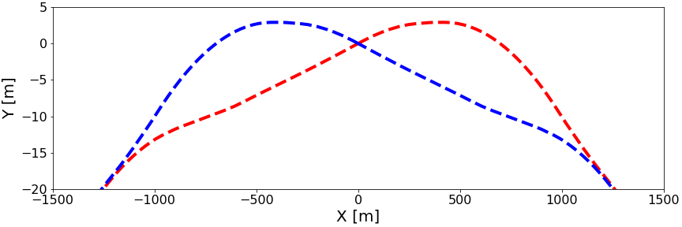
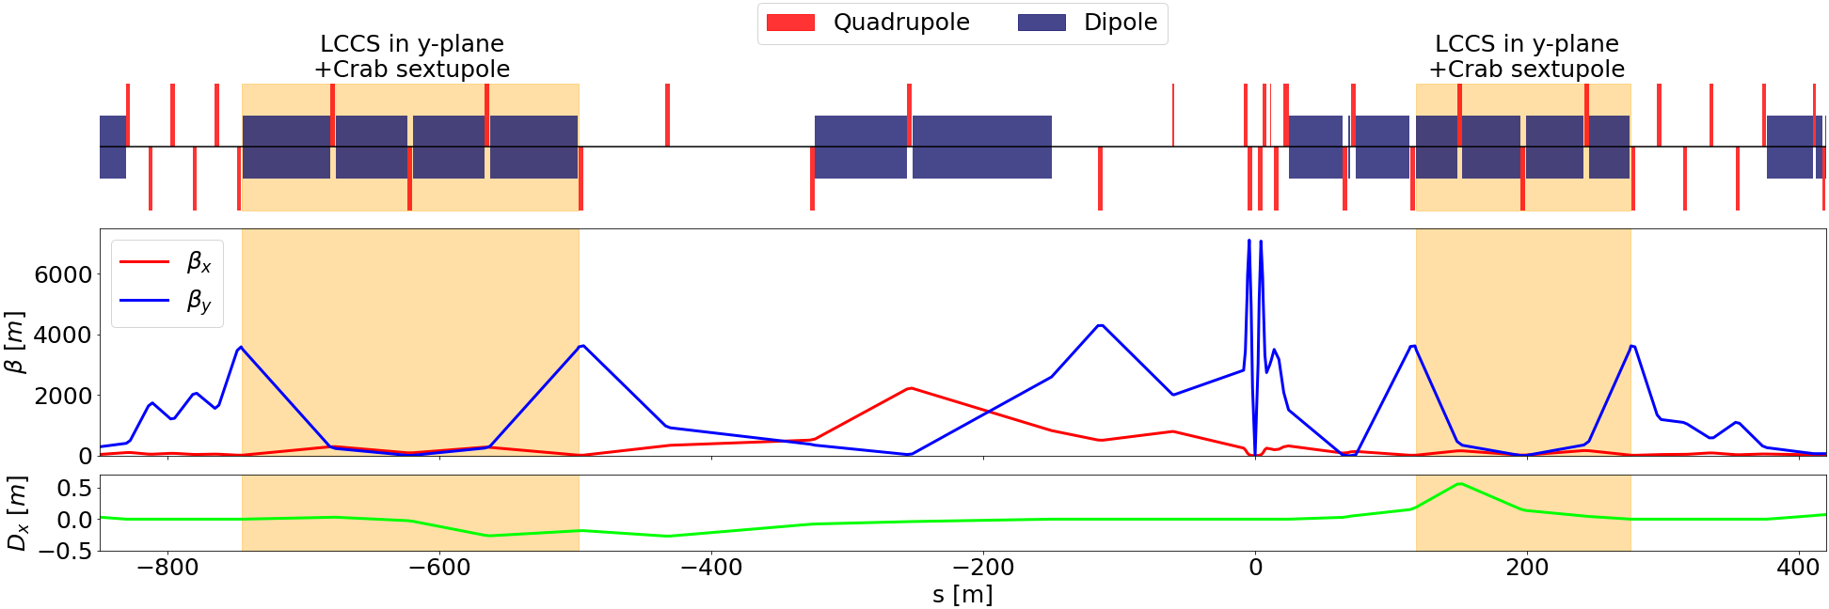
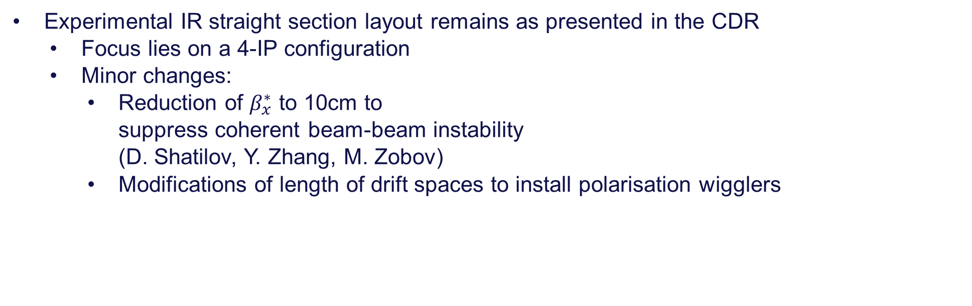
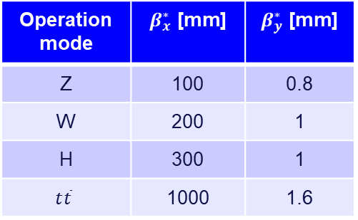
Experimental IR
Experimental IR straight section layout remains as presented in the CDR
  Focus lies on a 4-IP configuration
  Minor changes:
    Reduction of $β_{x}^{∗}$ to 10cm to
    suppress coherent beam-beam instability
    (D. Shatilov, Y. Zhang, M. Zobov)
    Modifications of length of drift spaces to install polarisation wigglers
K. Oide
Operation mode | $β_{x}^{∗}$ [mm] | $β_{y}^{∗}$ [mm]
Z | 100 | 0.8
W | 200 | 1
H | 300 | 1
$$t\overline{t}$$ | 1000 | 1.6
M. Hofer

Slide 22
Basic principles for high luminosity
Use the so-called “crab waist” scheme for collisions: the two beams cross at an angle of 30mrad. The idea is to avoid beam disruption to the absolute necessary. “crab” sextupoles make sure that beams maximise the probability of interacting to produce luminosity
4 IP collision scheme is much more complex than a 2 IP collision scheme (each electron bunch only collides with one positron bunch in the case of 2IPs, but with 4 positron bunches in the case of 4 IPs)
Eventually, the luminosity obtained from 4 IPs is 1.7 the luminosity obtained with 2 IPs

Slide 23
31 May 2022 / FCC Week 2022
D. Shatilov
Basic Equations
x
Piwinski angle:
Length of overlap:
Luminosity:
+
-
e
L_{i}
e
θ
φ ∙σ_{x}
z
2σ_{z}
2σ_{x}
Collision scheme with large Piwinski angle
linear density
There is no sense to optimize the luminosity per bunch (or per collision). Attention should only be paid to ξ_{y}.
σ_{z} is one of the most variable parameters: it depends on many factors, including the bunch population N_{p}. Accordingly, N_{p} should be adjusted to obtain the desired ξ_{y}.
The number of bunches n_{b} ∝ 1/N_{p}. We don't need to worry about this (except for Z) since the range of valid values is quite wide.
The beam-beam limit in the Crab Waist collision scheme can be high, but to obtain it, a small vertical emittance and a sufficiently high bunch linear density are required. The latter is an important parameter for collective instabilities and impedance-related issues, so this is another limitation.

Slide 24
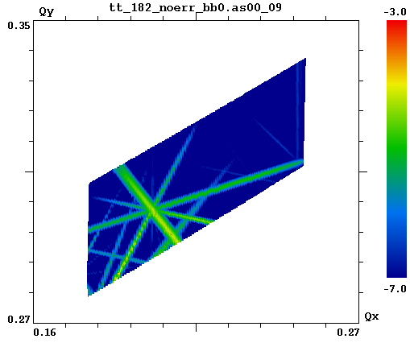
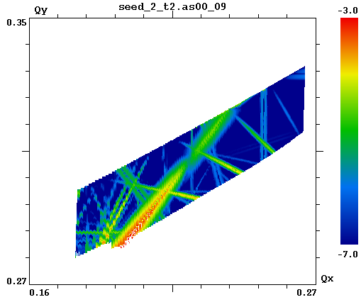
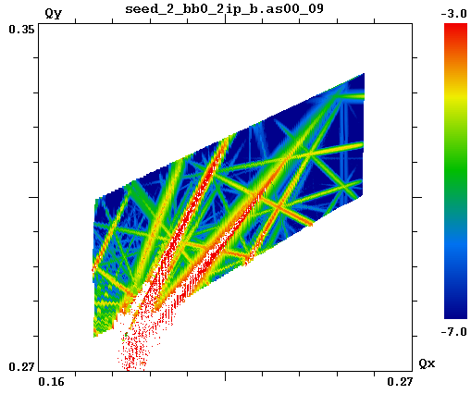
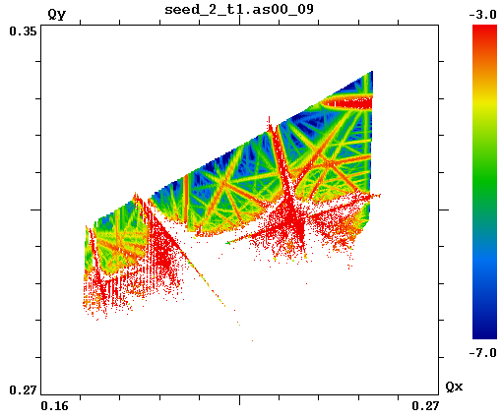
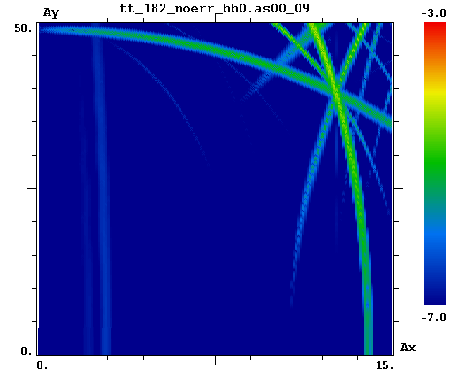
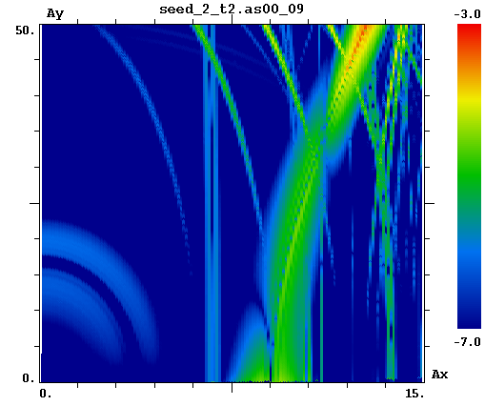
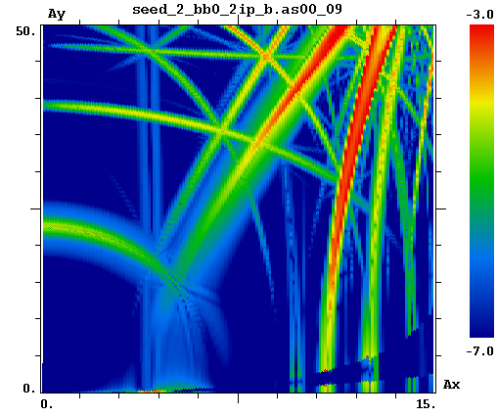
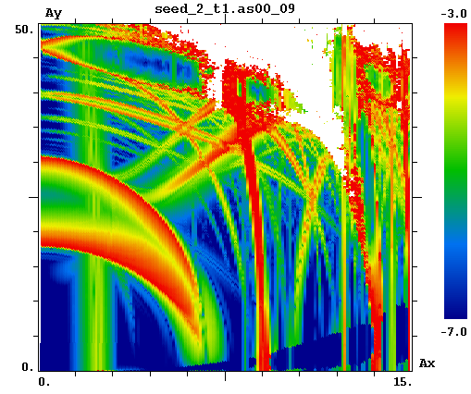
31 May 2022 / FCC Week 2022
D. Shatilov
Footprint Size
(machine resonances w/o beam-beam)
Ideal lattice (4-fold symmetry)
Only the quarter ring footprint matters. For the whole ring, the footprint will be 4 times larger, but most of the resonances it cros-ses will be forbidden.
Seed 2, 1/4 of the ring
A quarter of the ring is artificially repeated 4 times. New resonances appeared due to errors, but many remained forbidden due to symmetry.
Seed 2, 1/2 of the ring
The half ring is artificially repeated 2 times. Two different quarters form a super period, which corresponds to a doubled footprint. And new resonances appeared.
Seed 2, full ring
A realistic situation where there is no sym-metry between quarters, and accordingly all resonances are allowed.
Betatron tunes (footprint)
Normalized betatron amplitudes

Slide 25
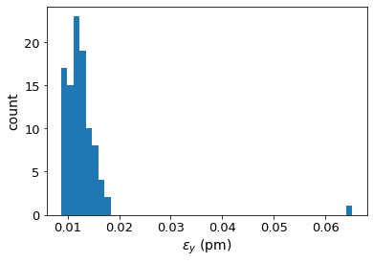
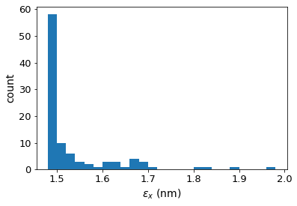
ttbar (182.5 GeV) 4IP lattice,
after correction strategy:
FCC-ee emittance tuning results
without BPM errors and without chromaticity correction
RMS misalignment and field errors tolerances:
Important to note:
BPM errors not included and chrom correction not included.
Radiation not included in correctors and trim and skew quads.
Also note:
Despite well corrected linear optics, the DA is still greatly reduced.
T. Charles

Slide 26
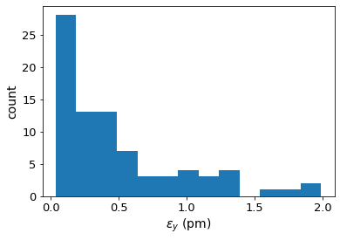
Chromaticity correction added
No chromaticity correction:
Chromaticity correction:
Highest 8 emittances removed, to better view lower end of distribution.
Cf: the spec is ε_{y}=2.98 pm rad

Slide 27
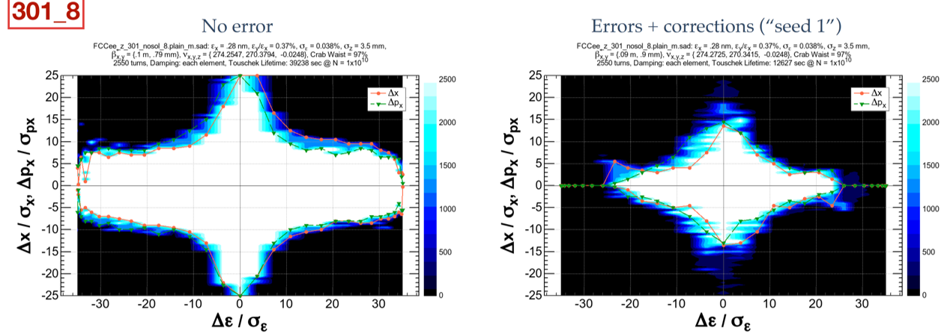
FCC-ee Dynamic Aperture
K. Oide, M. Hofer, D. Shatilov
Large dynamic aperture is needed for top-up injection and lifetime due to high beamstrahlung energy tails
  Dynamic aperture optimized with ~150 families of sextupoles
  Aperture is good without errors but still need to improve error correction

Slide 28
Booster design

Slide 29
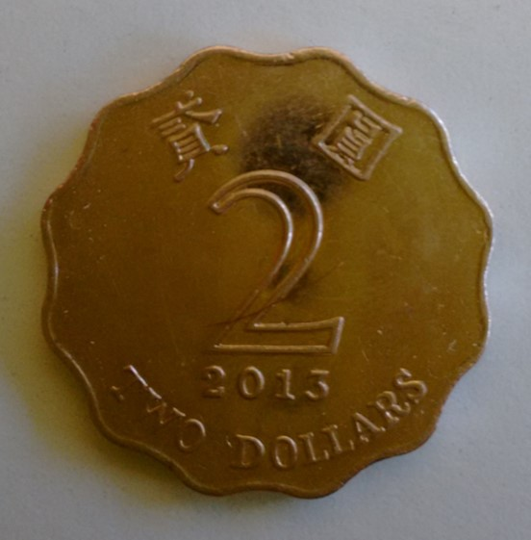
Booster design
The booster, in contrast to the main ring, needs to continuously ramp up in energy from the injector energy (16-20GeV) to the top energy (45GeV to 182.5GeV
The problem is that at low energies the dipole field is very low (comparable to the earth’s magnetic field), non-linearities become important and, crucially, damping times are large
A long time ago, I promoted this idea https://inspirehep.net/literature/1620390 inspired by the shape of the Hong Kong two dollar coin
This idea is now being studied by the booster team

Slide 30
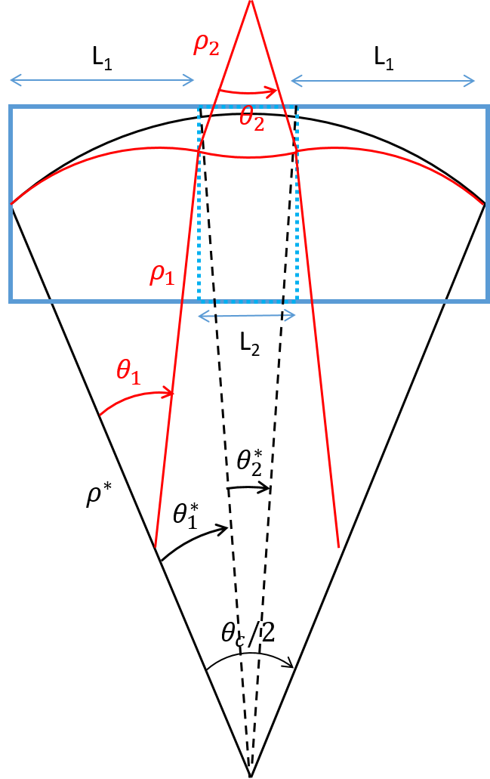



2 dipoles families optics
2 dipoles with two different curvatures,
proposed for the electron-ion collider (EIC)
Damping time can be reduced by playing on the ratio between the two different fields.
Advantages:
No impact on the layout
Increase I2 without damping wigglers
Higher dipole field at injection energy
Drawbacks:
Different reference orbits ⇒ reduction of beam stay clear?
More synchrotron radiation and in opposite direction of foreseen absorber (at injection) ⇒ vacuum quality to be investigated
$$a=\frac{L2}{L0}$$
$$b=\frac{ρ^{∗}}{ρ_{2}}$$
$${I_{i}=I}_{i}(μ_{x}, L_{cell}, θ_{c}/2, a,b)$$

Slide 31
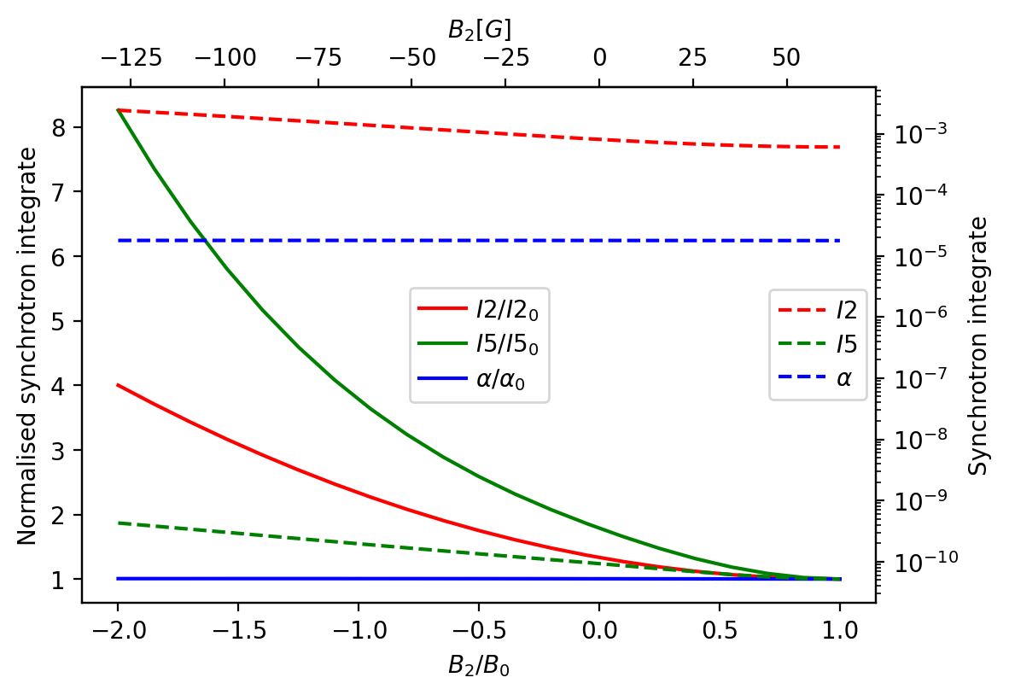
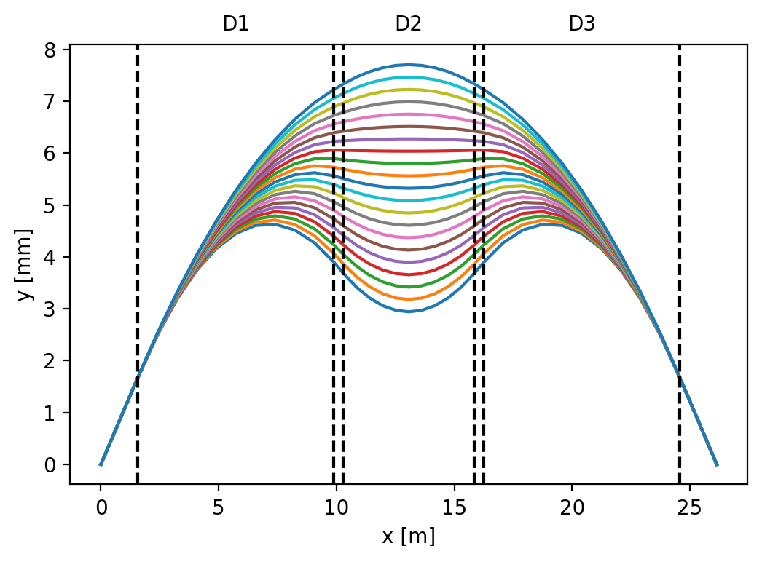
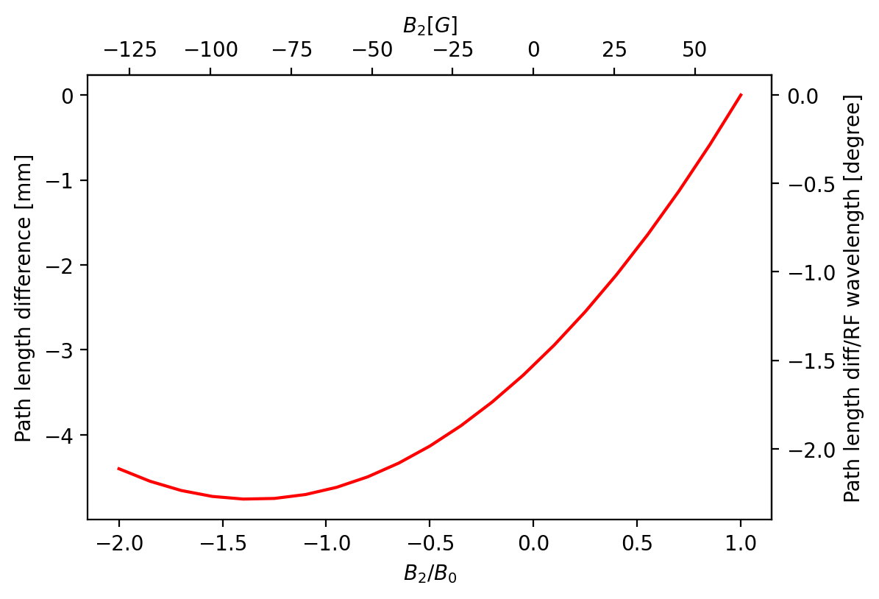
Impact of different field in the magnets
4 × I2 can be obtained with L2 ~5,5 m, B2~-128 G, B1 ~128 G at 20 GeV (to be compared with B~64 G with one single magnet family),
Minimum dipole field at injection ~ 2×present lattice
Momentum compaction ~1.8 10⁻⁵ (~ 60°/60° lattice)
Variation of the path length difference below 5 mm
Difference between the different orbits in the dipoles of 5 mm
Still room for optimization.

Slide 32
Machine-detector interface

Slide 33
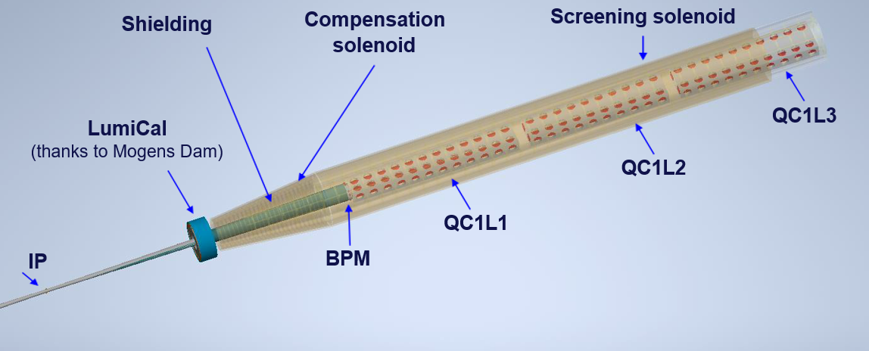
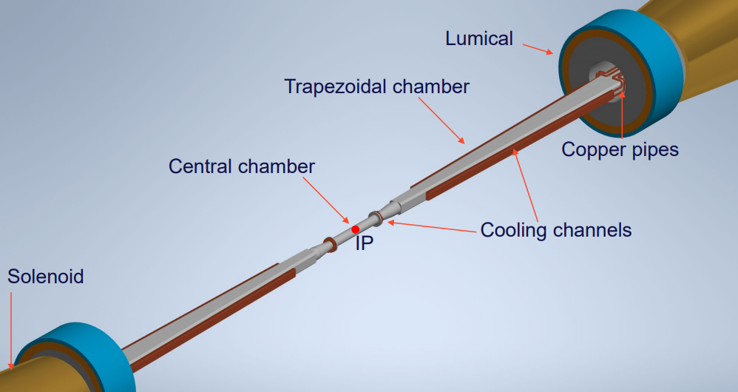
FCC-ee MDI and IR design
M. Boscolo
Complicated integration with SC quadrupoles, solenoids, IR chamber, LumiCal, shielding, and diagnostics
QC1L2
Quadrupoles and compensation scheme
thanks to M. Koratzinos
IR Chamber
thanks to F. Fansesini and INFN
Tor Raubenheimer

Slide 34
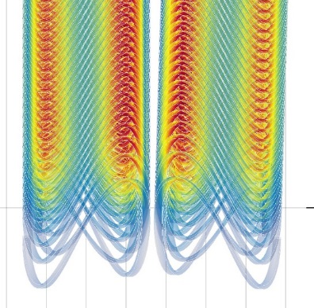
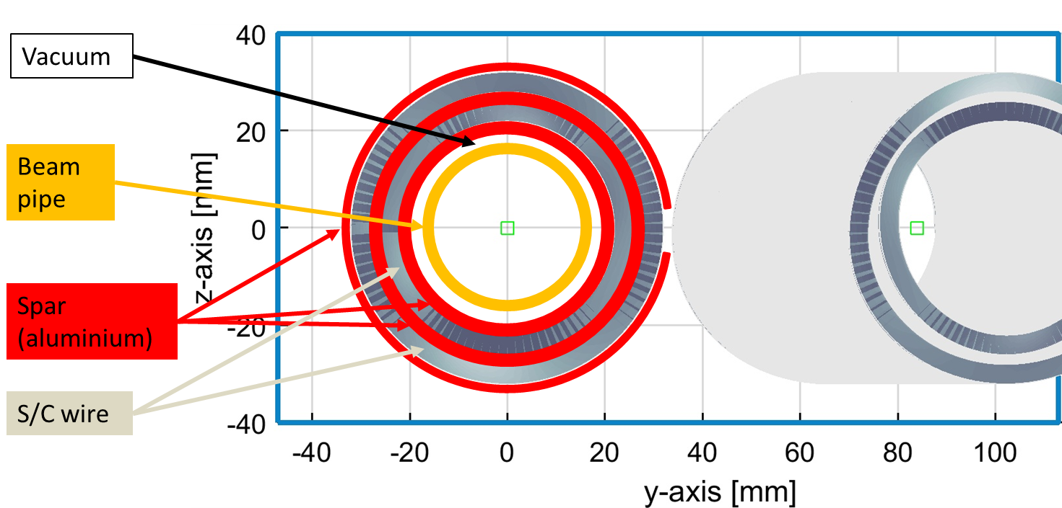

FCC-ee IR magnets
Canted-Cosine-Theta magnets w/ fringe fields fully compensated
  Elegant 2-layer design for inner quadrupoles
  Working to fit within 100 mrad stay-clear cone
  Integration with supports, solenoids, trim coils,
  shielding, cryostat, etc needs to be developed
  Prototype built and warm-tested
External review
of concept April,
2022
M. Koratzinos
Tor Raubenheimer

Slide 35
Energy calibration using resonant depolarization

Slide 36
Energy calibration
Unique to circular colliders, the ECM energy can be measured very accurately using the resonant depolarization method
Direct relation between energy and spin tune
What was achieved at LEP, was a 2MeV systematic error
The statistical error at FCC-ee is 0.004MeV
So we need to do better by orders of magnitude
Very interesting, very beautiful, very tricky measurement

Slide 37
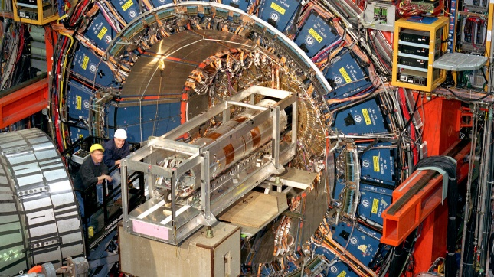
FCC-ee Energy Calibration and Polarization
Recent CDF: m_{W} (MeV)= 80’433.5 ± 6.4 _{stat} ± 6.9_{syst} (10⁻⁴ precision)
-- « could hint at new physics » and surely created a buzz!
-- precision measurements as broad exploration of new physics in quantum corrections, or mixing (SUSY, Heavy neutrinos, etc..)
(-- questions because inconsistent with previous measurements)
CDF measurement is remarkable in two ways:
(after 10 years of work)
systematic errors similar to statistical precision
relies for the precise calibration on J/ψ, ϒ, Z masses
all measured in e+e- colliders... (VEPP-4M, Doris, LEP=
using resonant depolarization!
Resonant depolarization is the cornerstone of the precision programme of FCC-ee
factor 500-75 more precise
than LEP
➔ Improvement by factor 10-1000 on a long list of EW precision measurements.
e.g. W mass down to ±250 keV, Z mass and width ±4 keV, sin²θ_{W} ^{eff} ± 2.10⁻⁶ etc..
➔ explore new physics at 10-100 TeV scale, or 10⁻⁵ mixing with known particles.
~40 times more
precise than CDF
A. Blondel

Slide 38
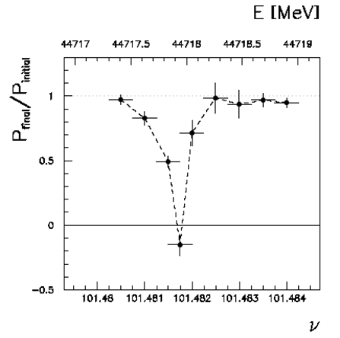
Transverse beam polarization provides beam energy calibration
by resonant depolarization
→ low level of polarization is required (~10% is sufficient)
→ at Z & W pair threshold comes naturally σ_{E} ∝ E²/√ρ
→ at Z use of asymmetric wigglers at beginning of fills
since polarization time is otherwise very long (250h→ ~1h)
→ should be used also at ee → H(126)
→ use ‘single’ non-colliding bunches and calibrate continuously
during physics fills to avoid issues encountered at LEP
→ Compton polarimeters for e+ and e- each
→ should calibrate at energies corresponding to half-integer spin tune
→ must be complemented by analysis of «average E_beam-to-E_CM» relationship
For beam energies higher than ~90 GeV can use ee → Z γ or ee → WW events
to calibrate E_{CM} at ±1-5 MeV level: m_{H} (~3 MeV) and m_{top} (~10-20 MeV) measts
A. Blondel

Slide 39

First set of results obtained in the FCC Design Study:
Polarization and Centre-of-mass Energy Calibration at FCC-ee, arXiv:1909.12245
stat/present
500
400
75
15 (qualitiative!)
40
4
4
2
3
m_{W}(MeV) 0.250 -- 0.300 --
Next challenges for the feasibility study:
-- Ascertain the above with integrated simulations (simulation of polarization and depolarization on real machine)
-- Match systematic errors with statistics.
most relevant targets : the point-to-point systematics, improve the WW energy
– these are effects that would lead to a deviation from relation between
-- the spin tune as measured by resonant depolarization
-- and the center-of-mass energy.
-- examples: 1. interference between depolarizing resonances and the induced depolarizing resonance
because the spin tune varies with energy.
2. effects due to collision offsets folded by opposite sign dispersion
-- designevaluate performance and cost the polarimeter at conceptual level
-- finalize implementation in the realistic machine, study operational aspects
A. Blondel

Slide 40


spin precession
RESONANT DEPOLARIZATION
(ν is the spin tune)
δθ_{spin} = (g-2)/2 . E_{beam} /m_{e} δθ_{trajectory}
δθ_{spin}= ν . δθ_{trajectory}
ν = E_{beam} / 0.4406486
ν = 103.5 at the Z peak
AMPLIFICATION
high precision
sensitivity to misalignements
-- depolarization
-- spurious spin resonances
Once the beams are polarized, an RF kicker at the spin precession frequency (fractional part thereof)
will provoke a spin rotation and depolarization
Simulation of FCC-ee by I. Koop:
can we do as well at W threshold?
A. Blondel

Slide 41






From beam energy to E_{CM}
opposite sign dispersion
$$E_{e^{−}}$$
Experience from LEP: Vernier scans
Relative position of beams measured to +- 80 nanometers from one scan
$$E_{e^{+}}$$
No effect on ECM
NB energy spread is reduced.
$$E_{e^{−}}$$
precision requires going
far from maximum
➔ loose beam?
$$E_{e^{+}}$$
Try deflection scans?
ECM lowered:
A. Blondel

Slide 42
Reducing environmental impact: klystron efficiency

Slide 43
Improving Klystron efficiency
FCC operates at all energies with total synchrotron radiation power of 100MW.
We create this RF power (which is eventually dissipated as heat) using RF Klystrons
Klystron efficiency, surprisingly, is a meagre 65% today
An effort to push this to 80%+ has started
A promising technology is Two-Stage Multi Beam Klystron (TS MBK) Technology, that also results in significantly smaller structures

Slide 44


Average RF power needs of the large-scale HEP Accelerators Studies.
The klystron efficiency impact on the FCC^{ee} power consumption.
Example of the efficiency upgrade from existing 65% to 80%.
 | Klystron eff. 65% | Klystron eff. 80% | Difference
RF power needed for 3TeV CLIC | 105 MW
DC input power | 161.5MW | 131.25MW | -30.25MW
Waste heat | 56.5MW | 26.25MW | -30.25MW
Annual consumption (5500 h assumed) | 888 GWh | 721.9GWh | -166.1 GWh
Annual cost (50MCHF/MWh assumed) | 44.5 MCHF | 36.1 MCHF | -8.4 MCHF
Electricity installation dimensioned for | 161.5MW | 131.25 MW | -20.6%
CV installation dimensioned for | 56.5 MW | 26.25 MW | -53.54%
105 MW
Potential saving are 1.04 TWh in 10 years (84 MCHF in 10 years).
Reduced environmental impact (cooling and ventilation)
Reduced installation cost (stored energy in modulators).
Reduced maintenance cost (klystron life time).
R&D on increasing the useable efficiency is worth every penny/cent invested!
3.0 TeV CLIC^{e+e-} ; pulsed, 1.0 GHz, P_{RF} total = 180 MW

Slide 45



FCC_{ee} (Z) accelerator tunnel integration
Bunker:HV
Klystrons
1.3MW CW, 352MW, 100kV, 20A, eff.=63%.
5.5m
Each Klystron should deliver 1MW @ 400MHz.
Preferably, klystron should be placed vertically in the tunnel.
The total length of Klystron should be about 3m.
The efficiency of Klystron is targeted at 80%.

Slide 46
Two-Stage Multi Beam Klystron (TS MBK) Technology
Commercial HE MBK
Efficiency 70%
Specific features:
Bunching at a low voltage (high perveance). Very compact RF bunching circuit.
Bunched beam acceleration and cooling (reducing Δp/p) along the short DC voltage post-accelerating gap.
Final power extraction from high voltage (low perveance) beam. High efficiency.
V
V₁+V₂
TS HE MBK
Efficiency ~85%
Additional advantages:
HV insulators
The second HV stage can be operated in DC mode. Thus simplifying the modulator topology (cost/volume) and increasing the modulator efficiency (in pulsed mode).
Simplified feedback for the first stage pulsed voltage. Improved klystron RF phase and amplitude stability.
Stage 1
V₁
V₂
Post accelerating gap
Stage 2

Slide 47



1.3 GHz SWELL cavity
SWELL technology:
Made of four independent quadrants, precisely machined and clamped together
Open structures, hence very favourable for Nb coating
“seamless” by its nature: no assembly joints on high electromagnetic field regions
Very stiff mechanical structure, thus robust against frequency detuning due to microphonics and Lorentz forces
Cryogenic cooling by drilled channels, which limits the volume of liquid helium and avoid the construction of a helium tank
F. Peauger
I. Syratchev
Parameters | Values
F (GHz) | 1.3
R/Q linac (Ω) | 122.9
Lacc (mm) | 115.3
Epk/Eacc | 2.01
Bpk/Eacc | 4.61
G (Ω) | 265.56
SWELL = Slotted Waveguide ELLiptical cavity

Slide 48
Alternative Technologies

Slide 49


FCC-ee Alternative technologies
Developing technologies with significant potential impact in parallel to baseline, e.g.
  HTS arc quadrupole/sextupole
  HE linac as a pre-booster
  High Q₀ damped SRF cavities
  High efficiency RF power sources
  Positron target using crystal channeling
  Advanced cooling tower design
  …
M. Koratzinos
Tor Raubenheimer
Combined function HTS magnet

Slide 50
Turning FCC-ee superconducting
The main arc quadrupole and sextupole systems consume ~50MW of power and take up ~7% of the space of dipoles
The main quadrupoles cannot be made shorter (due to synchrotron radiation issues) but if we nest the sextupoles inside the quadrupoles we can:
  Gain ~7% in luminosity
  Simplify logistics by having only one family of dipoles
  Increase flexibility of the optics
If we can make quads and sextupoles superconducting and operate them at 40K, we can potentially gain 80-90% of energy consumption costs at top energy
By using HTS (high-temperature superconductor) materials on a massive scale, we promote the use materials that can have great relevance to society

Slide 51




The project – HTS4
Power consumption: nearly 50MW at top energies for the SSS systems
HTS conductor is the material of choice for a number of society-relevant applications:
Fusion reactors
Next generation wind turbines
Lossless electrical power distribution
If we use HTS conductor for these magnets we
Increase the green credentials of FCC
Increase the relevance of FCC to society
System | Max. power (CDR) |  | Powering scheme
 | magnets | busbars
MB | 13.3MW | ~3.3MW | 12 circuits
MQ | 21.6MW | ~5MW | 48 circuits
MS | 20.5MW | - | Indiv. powered
By making the main quadrupoles and sextupoles superconducting, we gain an estimated 90% in top energy power consumption.
Two projects approved by CHART, the Swiss accelerator R&D
The optics cell
CDR
This proposal
By nesting quads and sextupoles (which is not possible for the CDR warm design) we gain 7% in filling factor +7% in luminosity
Three families of dipoles
By nesting sextupoles and quads, only a single dipole size will be needed

Slide 52








HTS4 preliminary investigations
Magnetic analysis
Choice of operating temperature
FLUKA simulations
Quad and sextupole at full strength
Operate at ~40K (performance is 10 times that at 77K)
Impedance calculations
CAD modelling
Prototype/demonstrator design

Slide 53
Detector concepts

Slide 54


Slide 55


Slide 56


Slide 57


Slide 58


Slide 59


Slide 60


Slide 61


Slide 62
FCC-hh

Slide 63
FCC-hh
FCC offers a fantastic opportunity to move on to a powerful hadron collider
Optics design quite advanced – layout consistent with FCC-ee
Injector can be the LHC or an upgraded SPS
European strategy: “at least 100TeV”
Slightly higher dipole field needed now with the new circumference of 91Km
Dedicated high field magnet research at CERN – the high field magnets (HFM) project

Slide 64
100 TeV FCC-hh
16T CF dipoles (or 17T SF dipoles)
Layout like LHC but with four-fold symmetry (up to 4 IP’s)
Compatible with LHC or upgraded SPS as Injector
Portion of transfer lines in the ring tunnel
Circumference of 91.1 km
400.8 MHz RF 121800 harmonic
consistent with SPS & LHC and
multiple uniform bunch spacings

Slide 65
FCC-hh c.m. energy reach for different arc lengths
J. Gutleber

Slide 66








Main Conceptual Design Highlights:
Variants for the FCC_{h-h} Dipoles
For the first time, all design options of Nb3Sn 16 T magnets were compared with each other
It has been found that all options have their own strengths and weaknesses, although it is not possible to decide which magnet design is the best based on conceptual design alone
Collaboration agreements were concluded for the infrastructure development and construction of magnets in 4 national laboratories
OD = 600 mm
L = 2 m
50 mm aperture
B_{ultimate} = 16 T
 |  | cos(θ) | block | common coil | CCT
Current | (A) | 10000 | 11230 | 16100 | 18055
Inductance | (mH/m) | 50 | 40 | 19.2 | 19.2
Stored energy | (kJ/m) | 2500 | 2520 | 2490 | 3200
Coil mass | (tons) | 7400 | 7400 | 9200 | 9770
A. Siemko

Slide 67
HTS magnet technology development plan
Adapted from LDG HFM roadmap chapter, arXiv:2201.07895v3
A. Siemko

Slide 68
Conclusions
FCC is an exciting project!
It is the best Higgs factory on the market, plus a unique EWPO (electro-weak precision observables) laboratory
Paves the way to a 100TeV hadron collider
There are many exciting sub-projects, many of them unique and state-of-the-art, needing YOUR help.
So, come and join us!

Slide 69
Extra slides

Slide 70
Measuring the electron Yukawa coupling
FCC-ee could be envisaged to run at an ECM energy of 125GeV to measure the electron Yukawa coupling, a unique measurement
A number of problems need to be solved:
The energy spread of the beams is much larger than the Higgs width ➔ need to use a “monochromatization” scheme
Careful monitoring of the ECM energy, to always stay at the H mass. Tides, etc. will move the energy by orders of magnitude more. This is difficult, but can be done
Actively looking at monochromatization schemes.

Slide 71




Way to the small CM energy spread: Monochromatization
The CM energy expression：
1.Standard modes
the energy of zero-dispersion is equal to the case of the same value dispersion at the IP:
$$w=2(E_{0}+∆E)$$
  2.Monochromatization
  dispersion has opposite sign at the IP:
  $w=2E_{0}+O{(∆E)}^{2}$
  The CM collision energy spread for mono-schemes
  ${\left(\frac{σ_{W}}{W}\right)}_{\text{c}\text{.}\text{m}\text{.}}=\frac{∆E}{\sqrt{2}}\frac{1}{λ}$
  Monochromatization factor: 𝜆
  Improving the CM energy resolution

Slide 72


Several Monochromatization Schemes
The less feasible schemes:
  RF-Monochromatization scheme( A. A. ZHOLENTS et al.) [2]
    It requires an operation of the RF cavities in a transverse deflecting mode, E₂₁₀ . Reduces the energy spread of each beam prior to the collision. Unacceptable due to the very high voltage of RF cavities.
  Large crossing angle (0.5rad) scheme (V. I. Telnov)[3]
    unacceptable due to the small crossing angle 30mrad and long interaction region at FCC-ee
  Longitudinal scheme (A. Bogomyagkov et al.) [4]
    The longitudinal correlation requires high voltage and
    high frequency RF system, it is hard to build.
The most promising scheme for FCC_ee
  Transversal scheme：
[2] A. A. Zholents, “Sophisticated Accelerator Techniques for Colliding Beam Experiments”, Nuclear Instruments and Methods in Physics Research A265
[3] V. Telnov, “Monochromatization of e+e− colliders with a large crossing angle” 31.08.
[4]A. Bogomyagkov and E. Levichev, “Collision Monochromatization in e+e− Colliders”, Phys. Rev. Accel. Beams 20, 051001 (2017).

Slide 73




The transversal mono-schemes with crossing angle and crab cavities
Standard collision mode:
Transversal mono-schemes:
Without crab cavities
Head-on collision with crab cavities

