Slide 1
Cosmological Insights into Quantum gravity
Avi loeb
Director, institute for Theory & Computation
Harvard university

Slide 2
BIG Bang

Slide 3
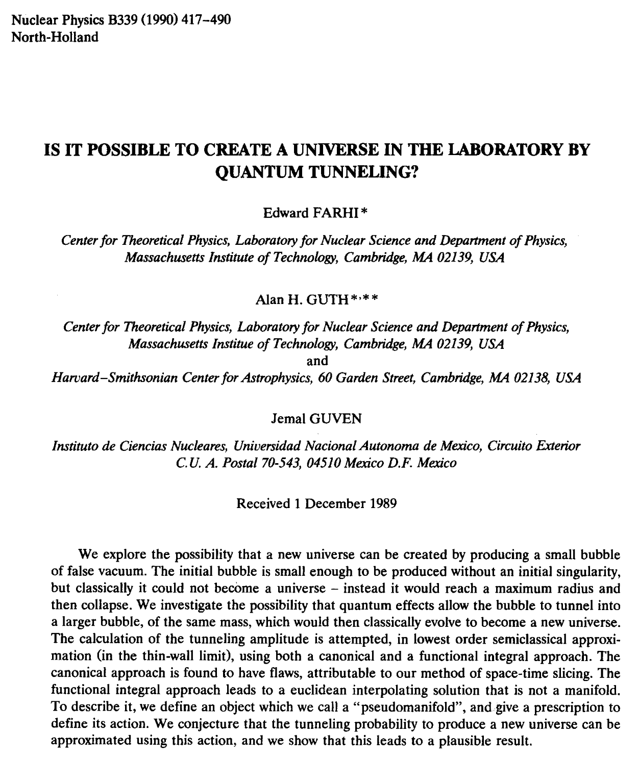
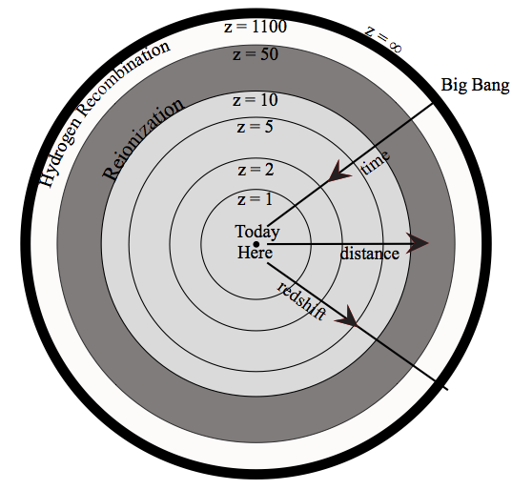
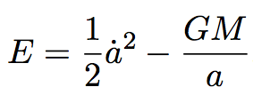
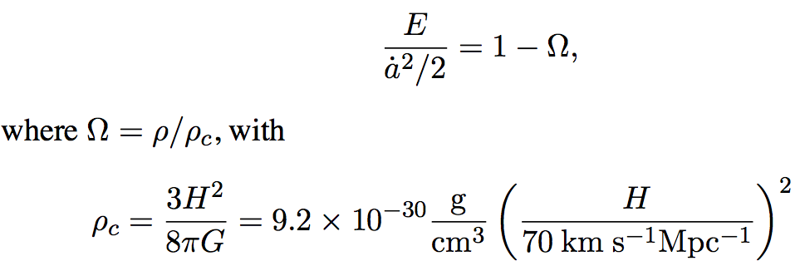
1. can a Big Bang be Created by Quantum-gravity engineers?
Flat Universe: E=0

Slide 4
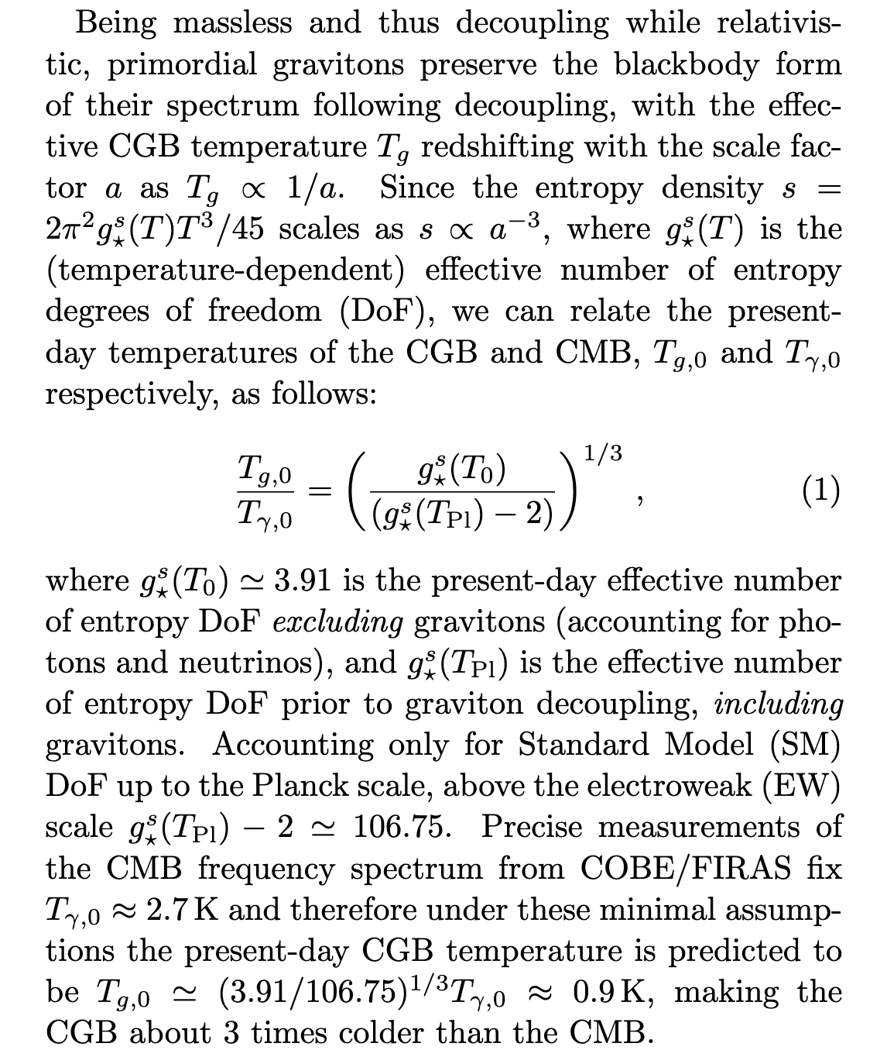
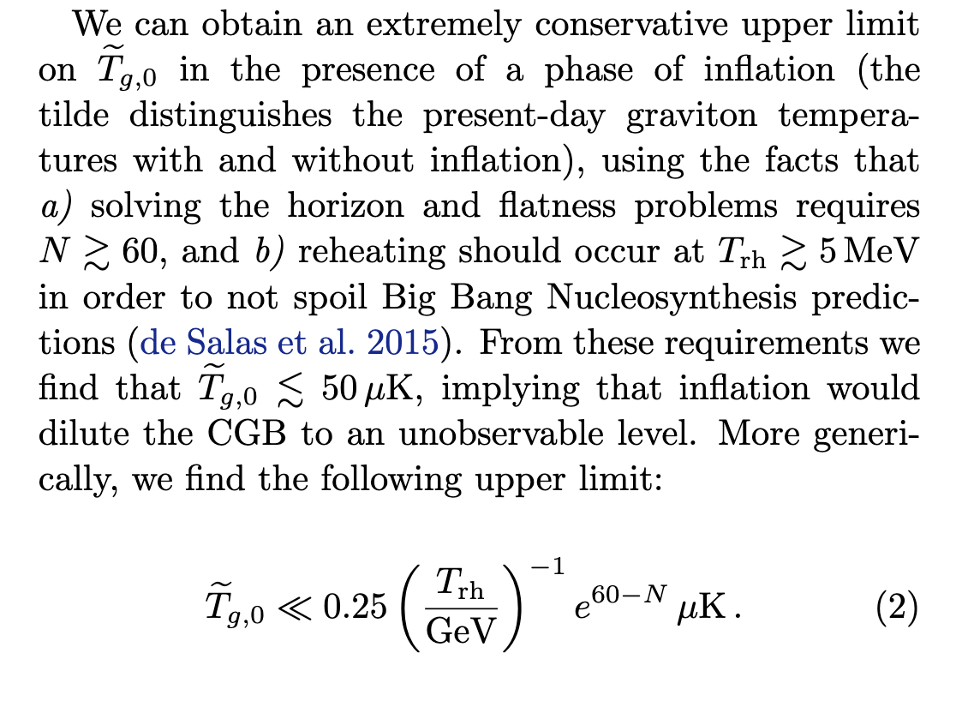
2. The challenge of ruling out inflation via the primordial graviton background
Vagnozzi & Loeb, ApJL 939, L22 (2023)

Slide 5
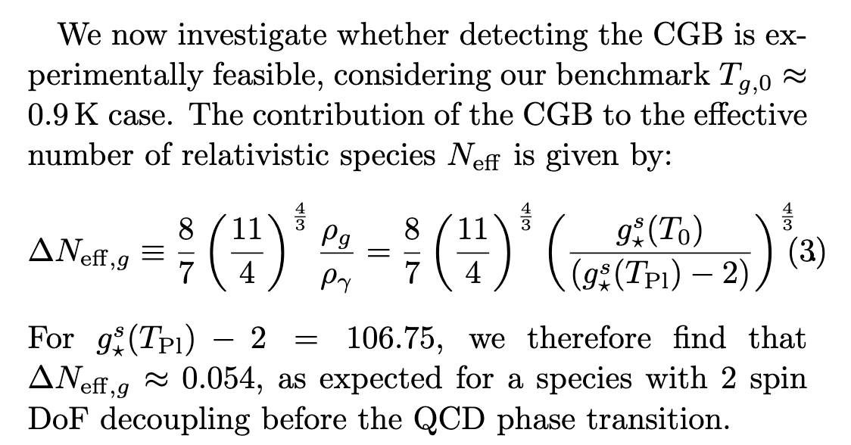
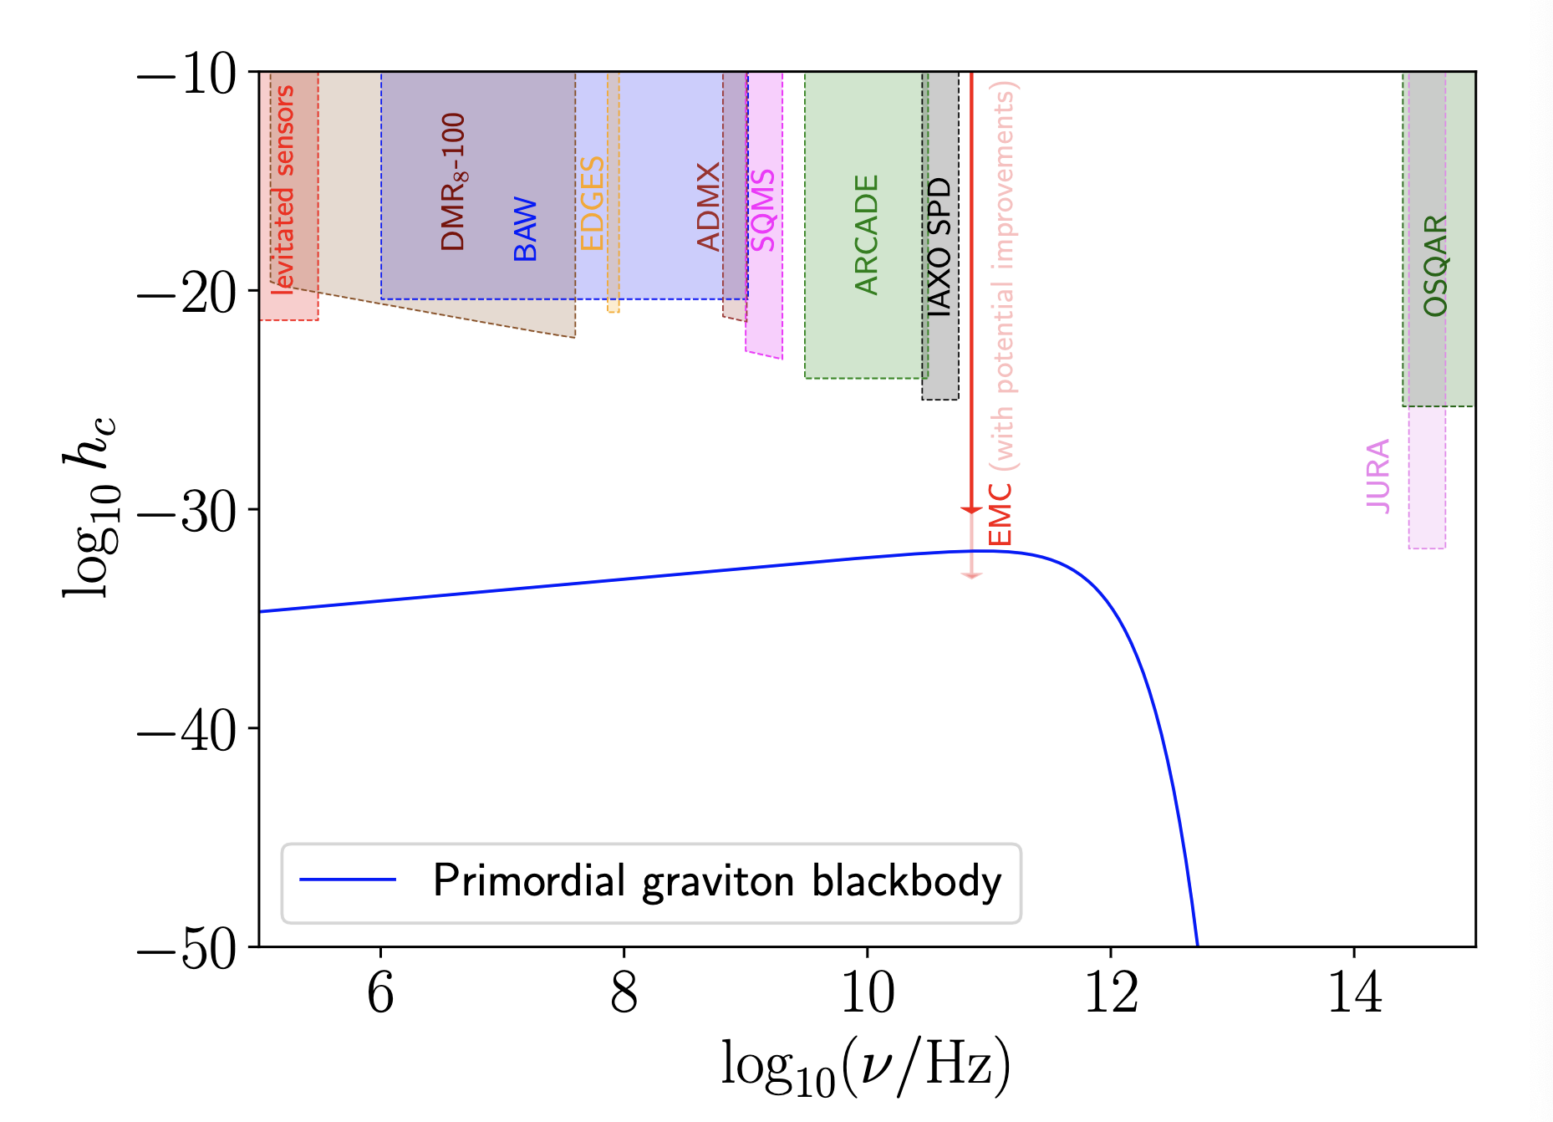
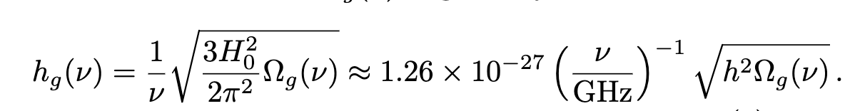
DETECTABILITY OF THE Cosmic GW Background

Slide 6

3. Did the Infant Universe Resemble a Needle or a Sphere?
b²(t)
c²(t)
Anisotropy declines exponentially during vacuum domination (inflation), as ~1/t^{1/2} during radiation domination ~1/t during matter domination.
Standard Big Bang nucleosynthesis implies anisotropy smaller than 10⁻⁶ during recombination, and smaller than primordial quadrupole on horizon scale today.
Current constraints allows a needle-like expansion at earlier cosmic times.
Primordial density perturbations could maintain memory of the initial anisotropy.
Hertzberg & Loeb (2023)

Slide 7
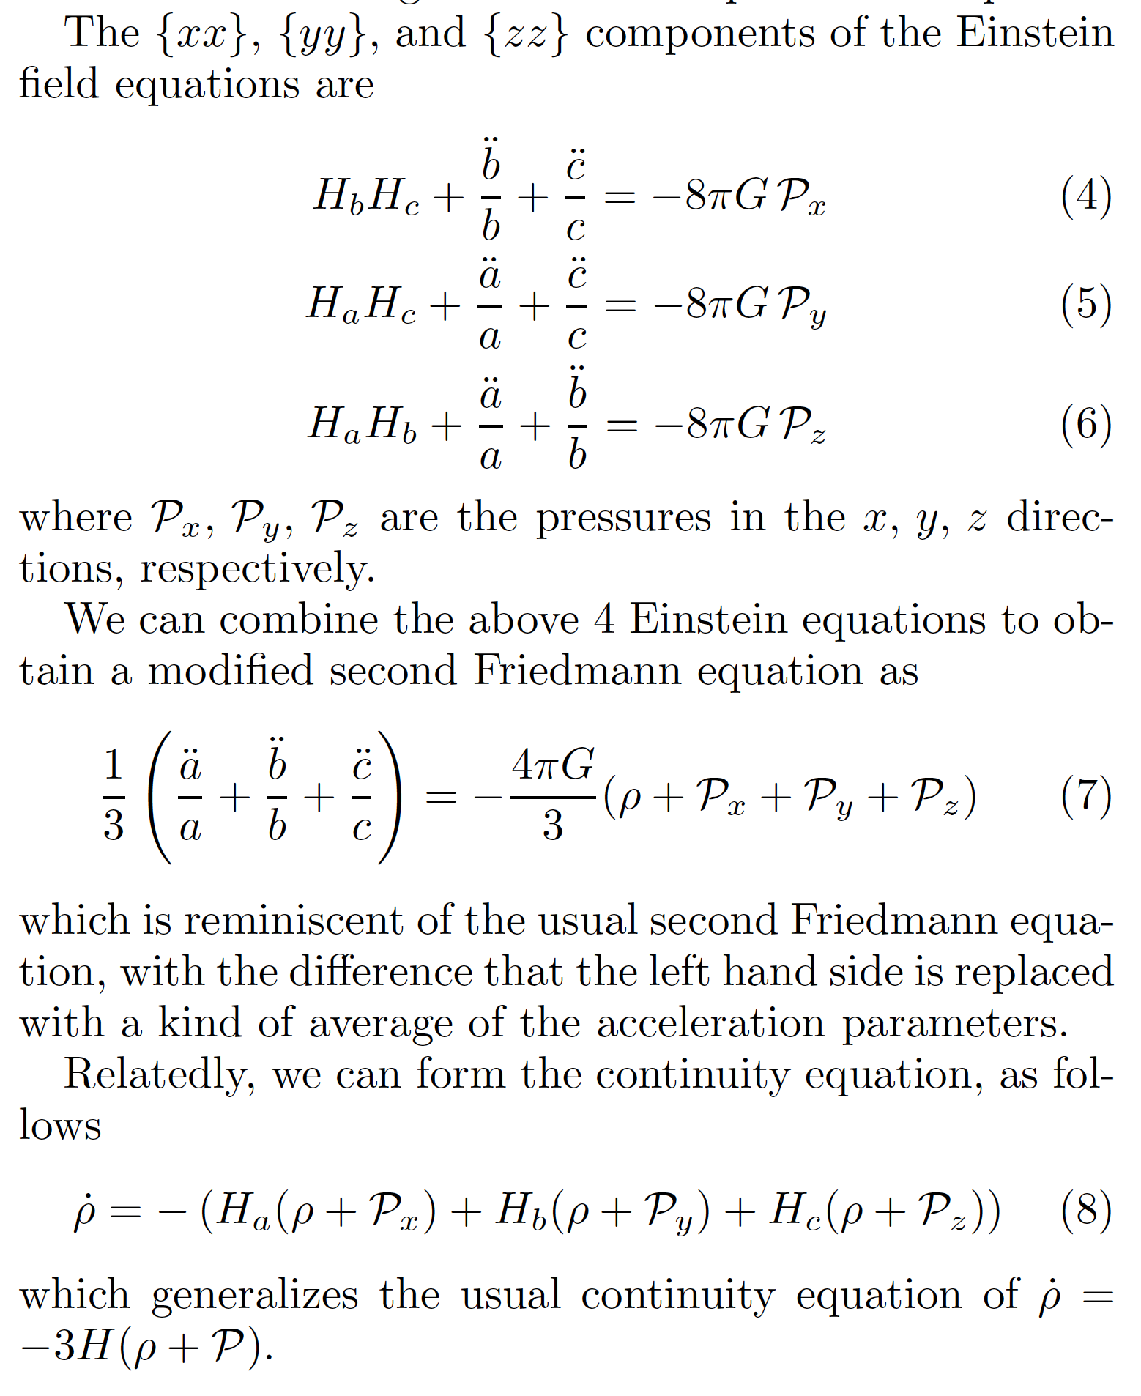
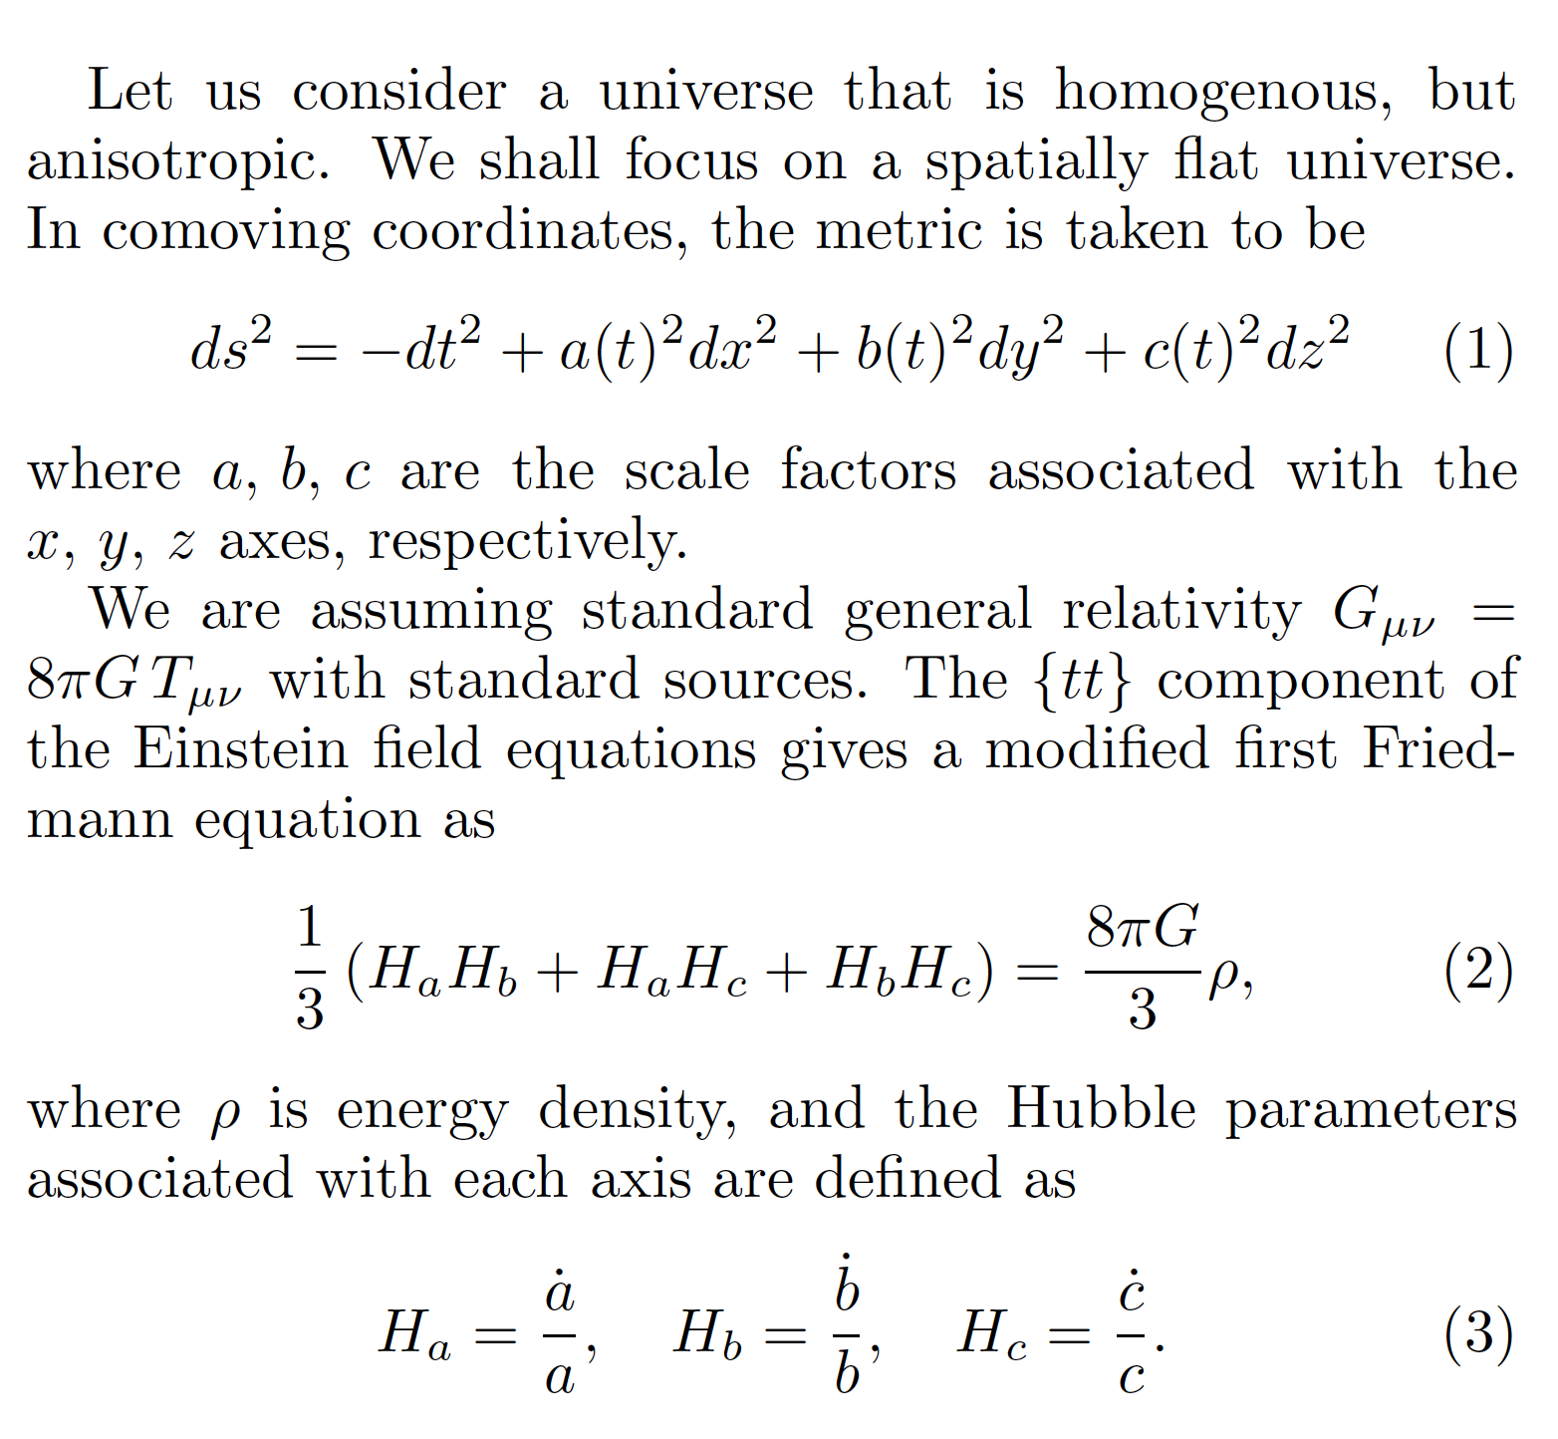
ANISOTROPIC COSMOLOGICAL EXPANSION

Slide 8
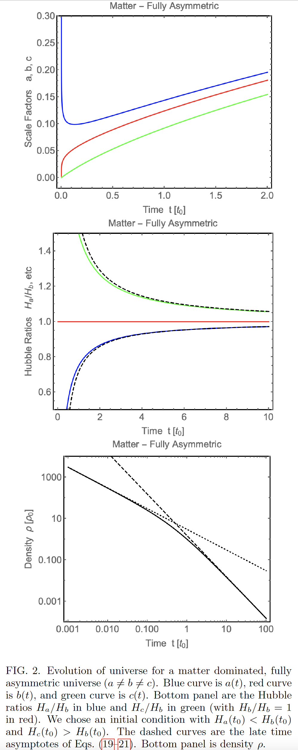
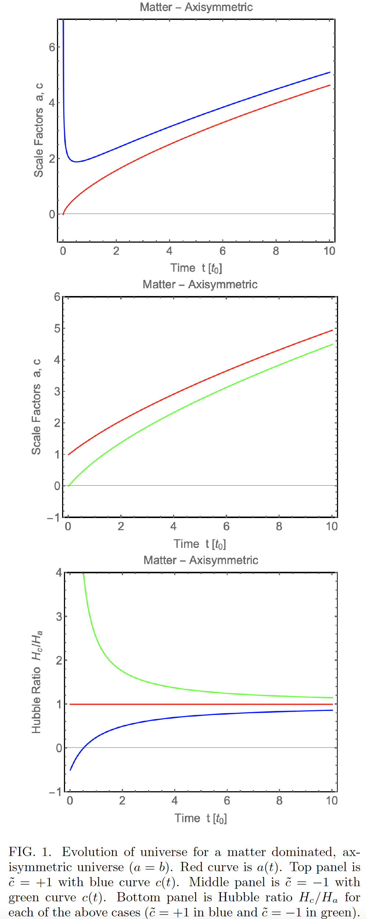
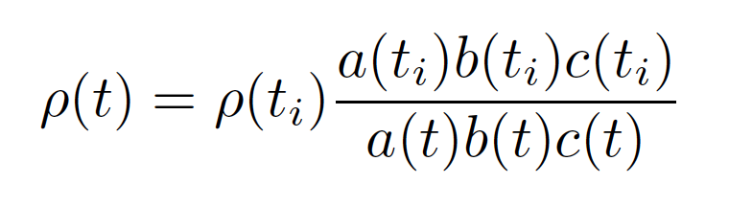
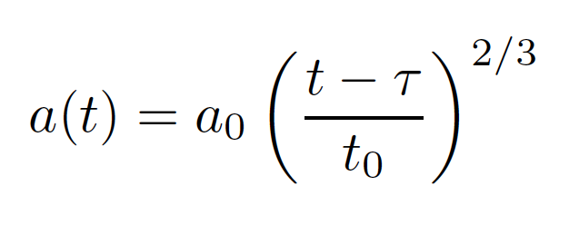
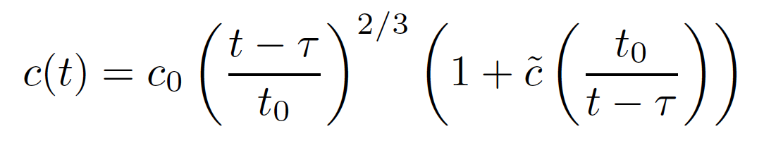
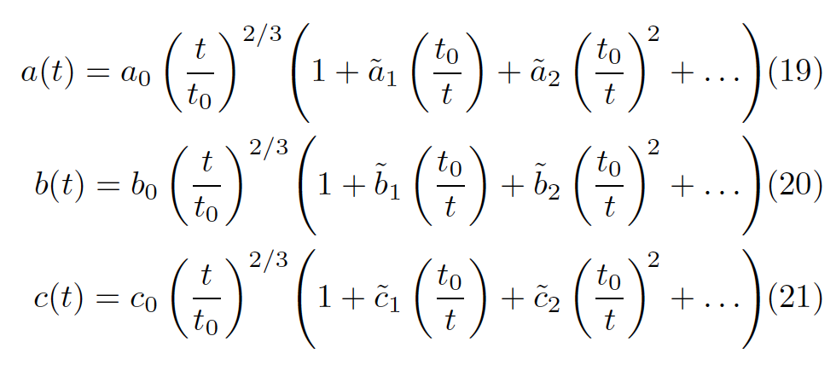
MATTER DOMINATION

Slide 9
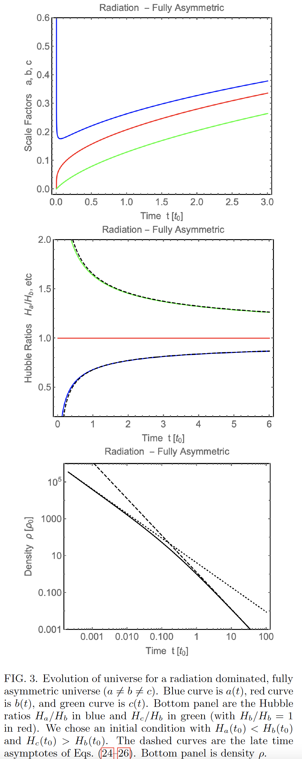
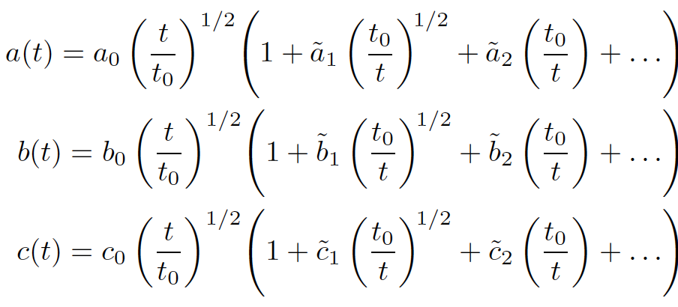

RADIATION DOMINATION

Slide 10
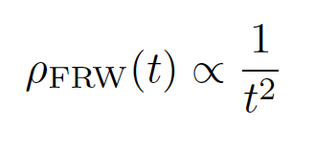
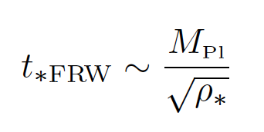
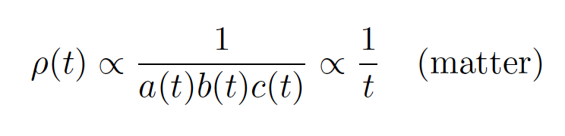
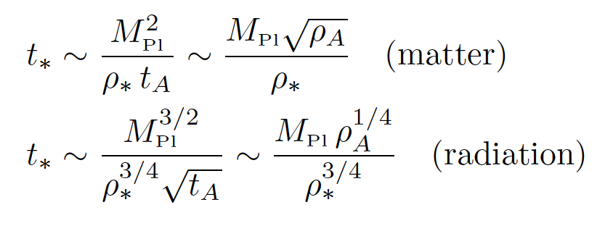
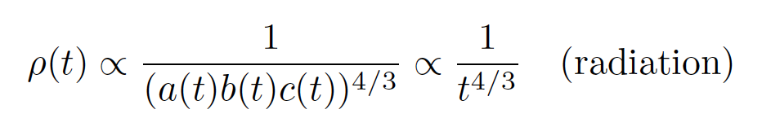
Towards the one-dimensional singularity
ISOTROPIC COSMOLOGY:
ANISOTROPIC COSMOLOGY:

Slide 11
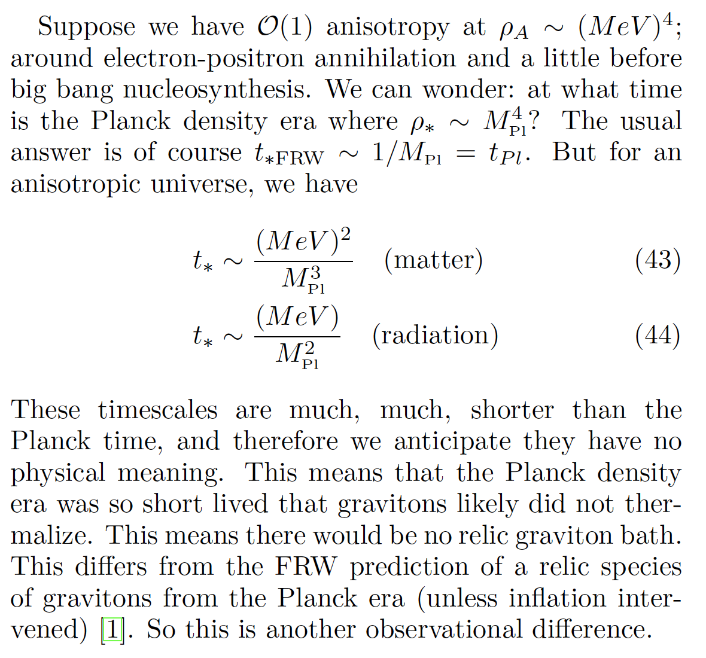
No thermal relics WITH an ANISOTROPic singularity

Slide 12
Dark matter

Slide 13
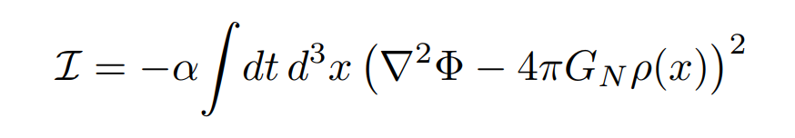
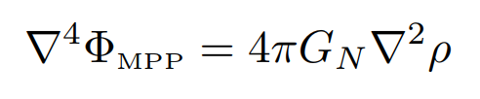
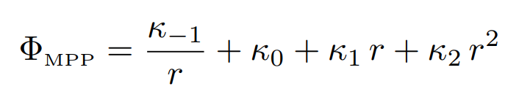

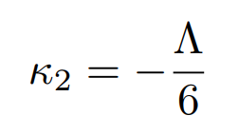
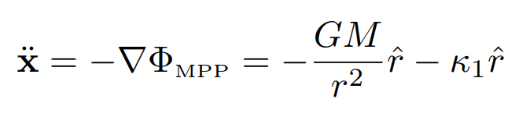
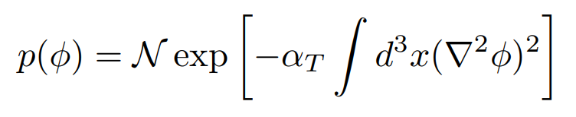
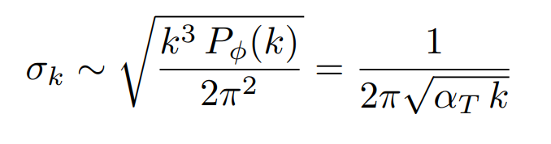
1. Stochastic gravity as an (mond-like) alternative
(J. Oppenheim et al. 2024)
Not MOND or dark matter like
Ruled out!
(M. Hertzberg & A. Loeb 2024)

Slide 14
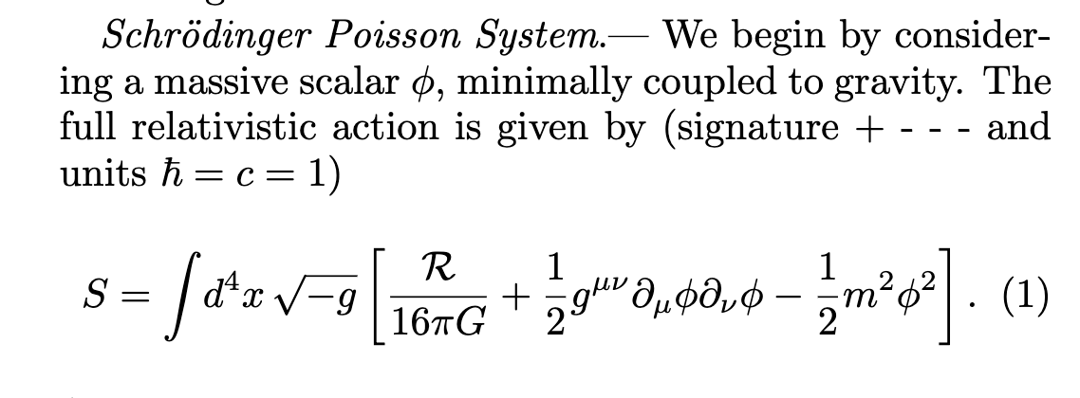
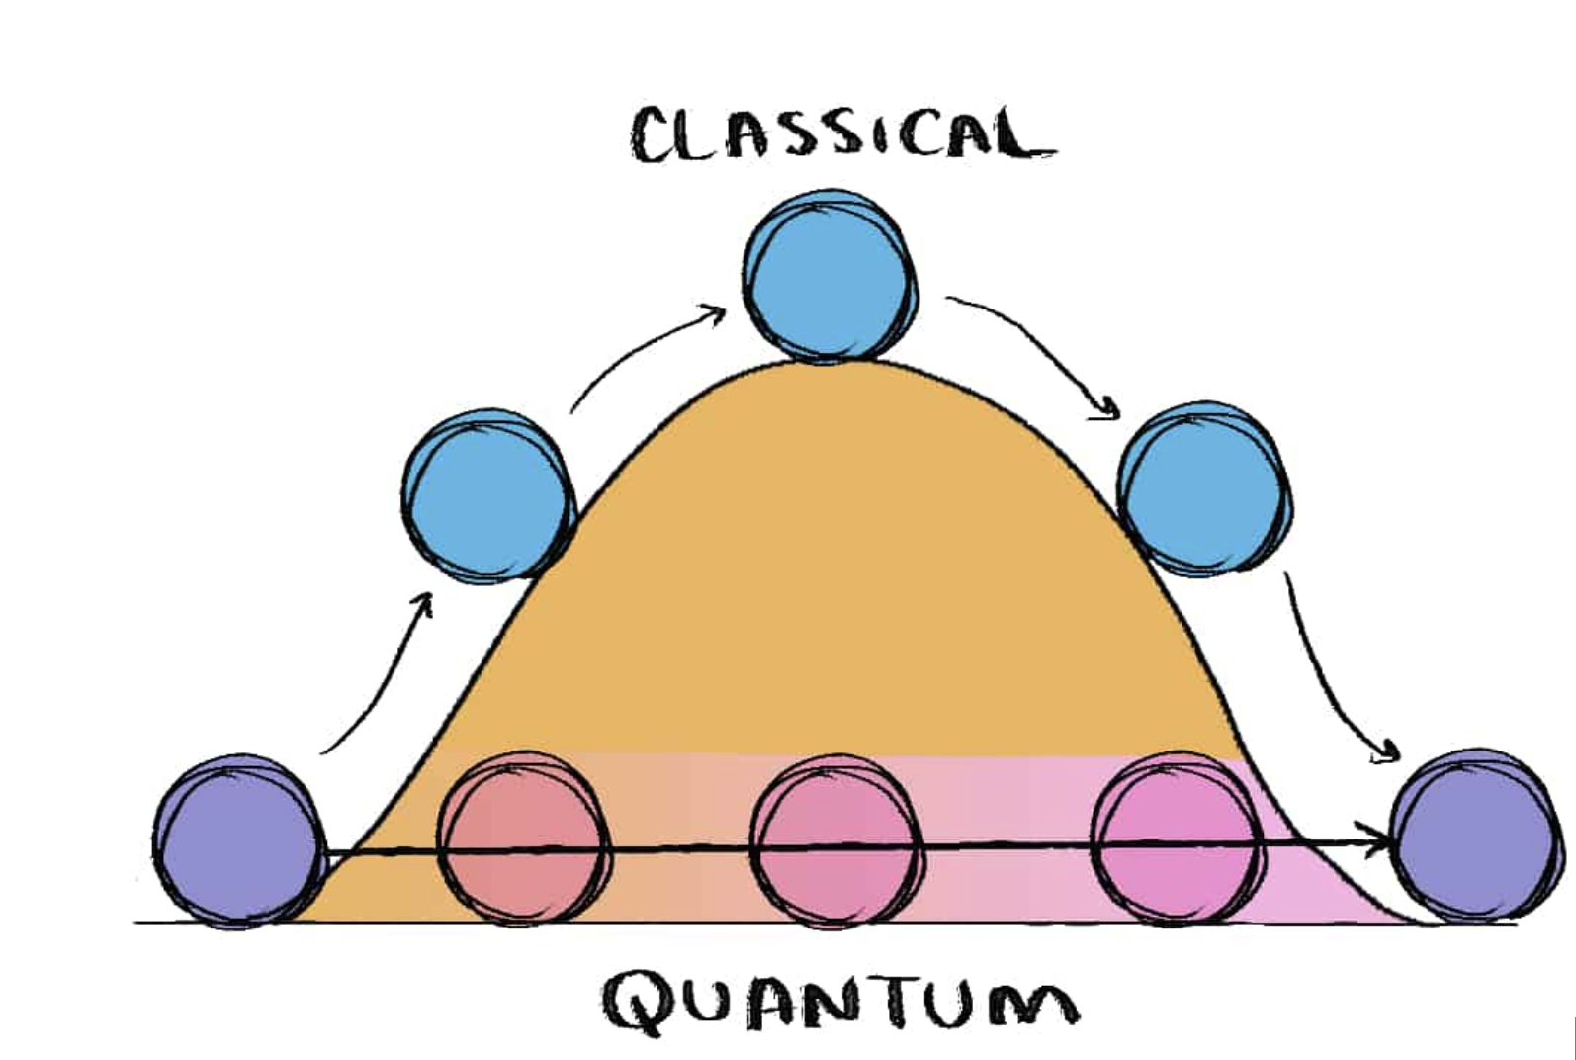
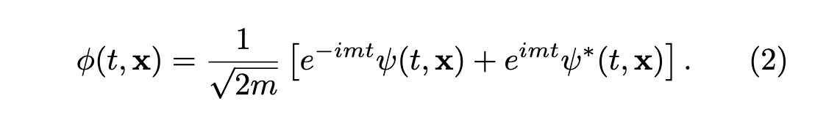
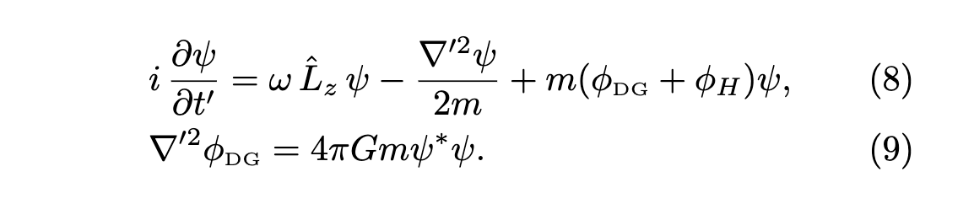
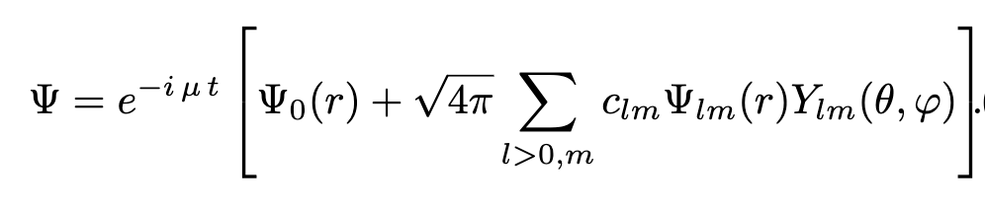
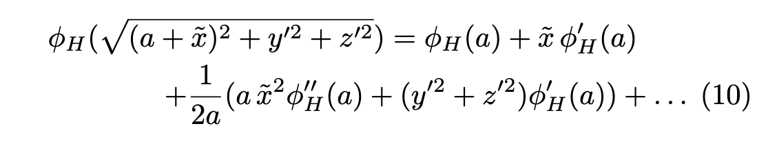
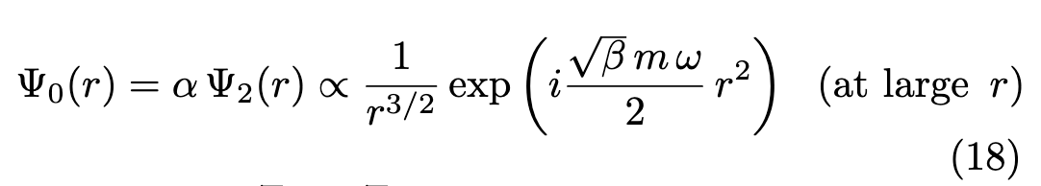
2. Quantum Tunneling of Ultralight Dark Matter Out of Satellite Galaxies
Hertzberg & Loeb, JCAP 02, 059 (2023)

Slide 15
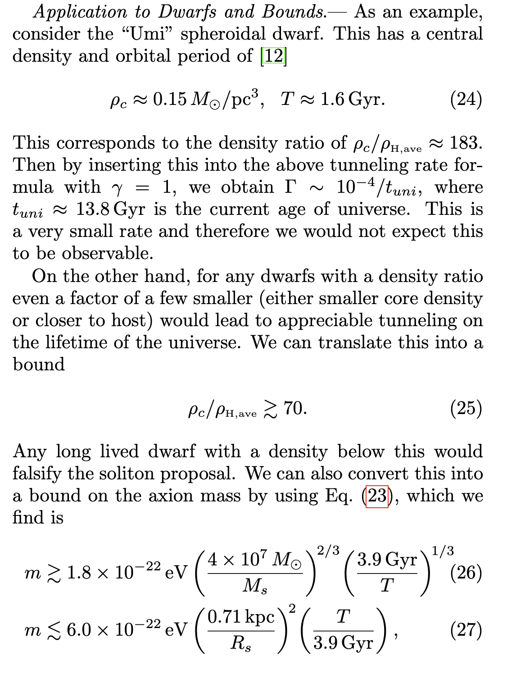

Slide 16
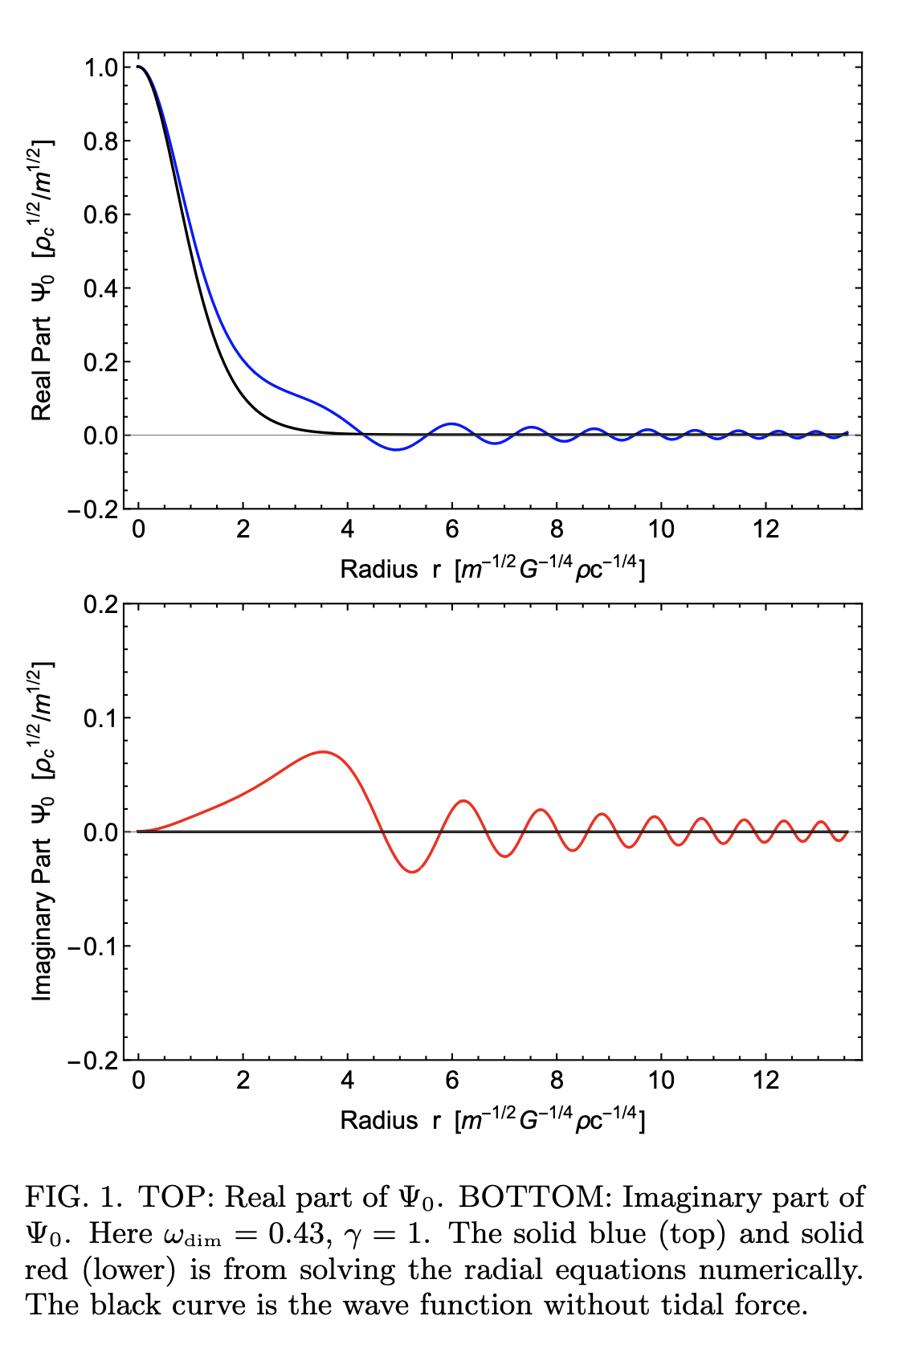
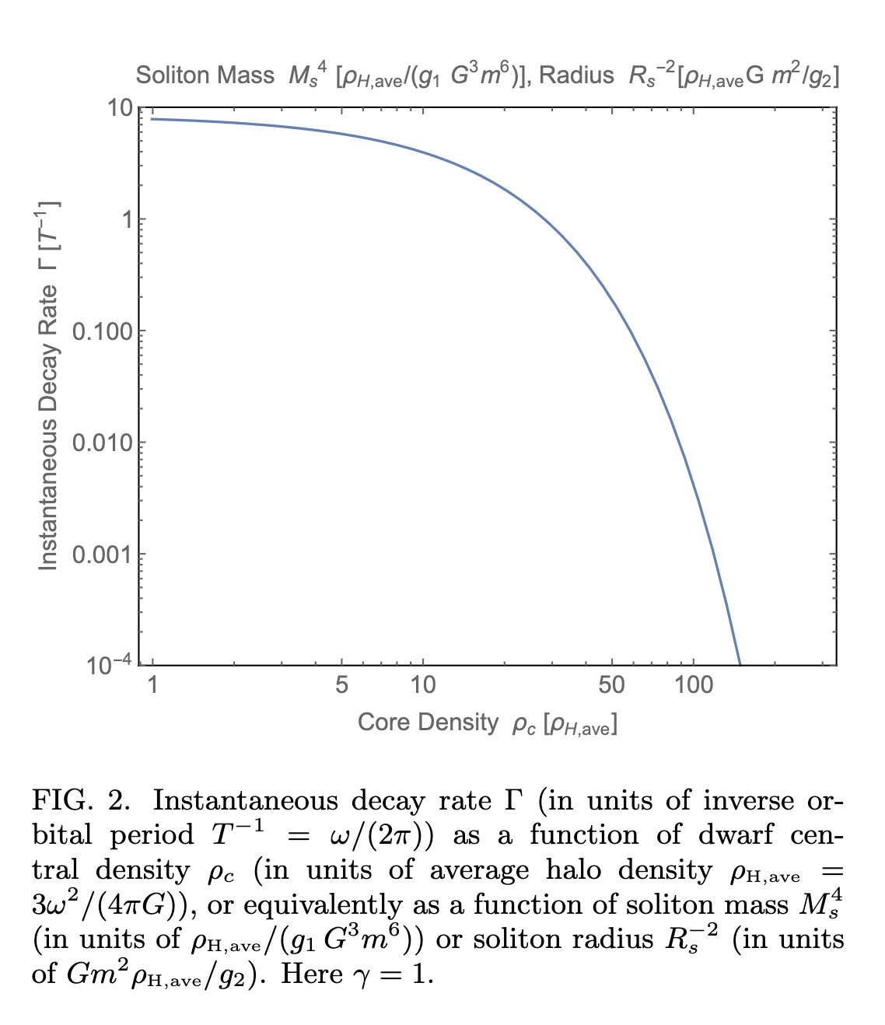

Slide 17
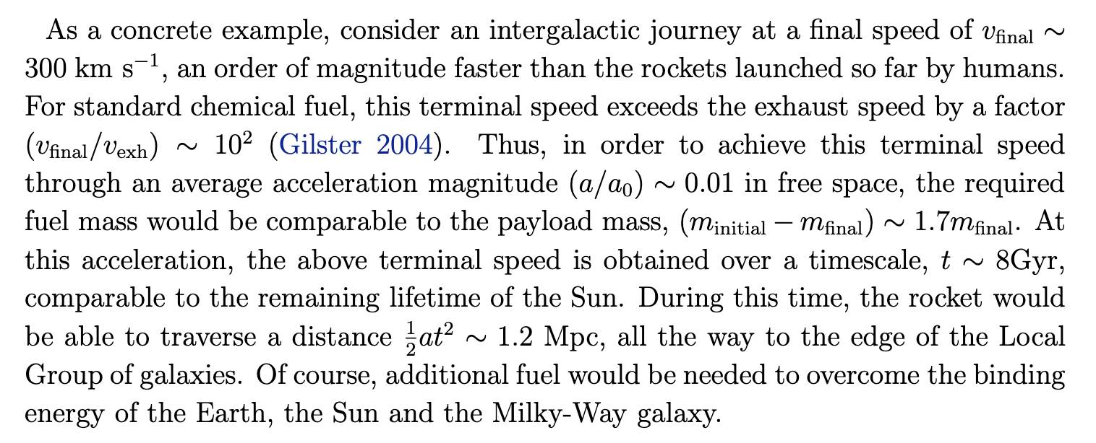
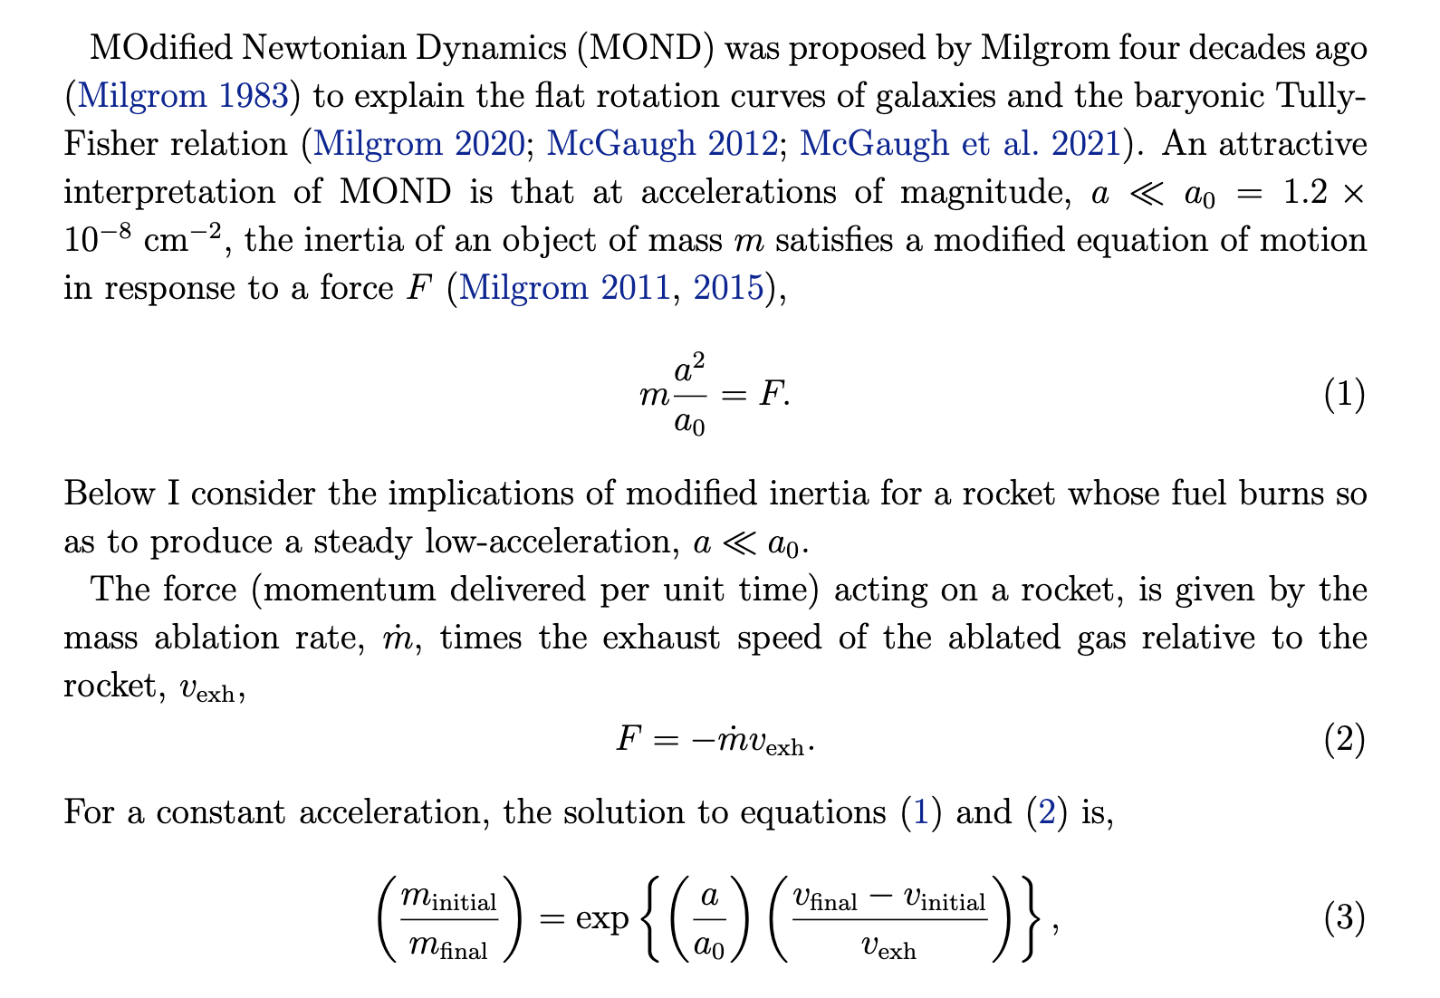
3. Low-Fuel rockets with modified inertia

Slide 18
Dark energy or Cosmological constant

Slide 19
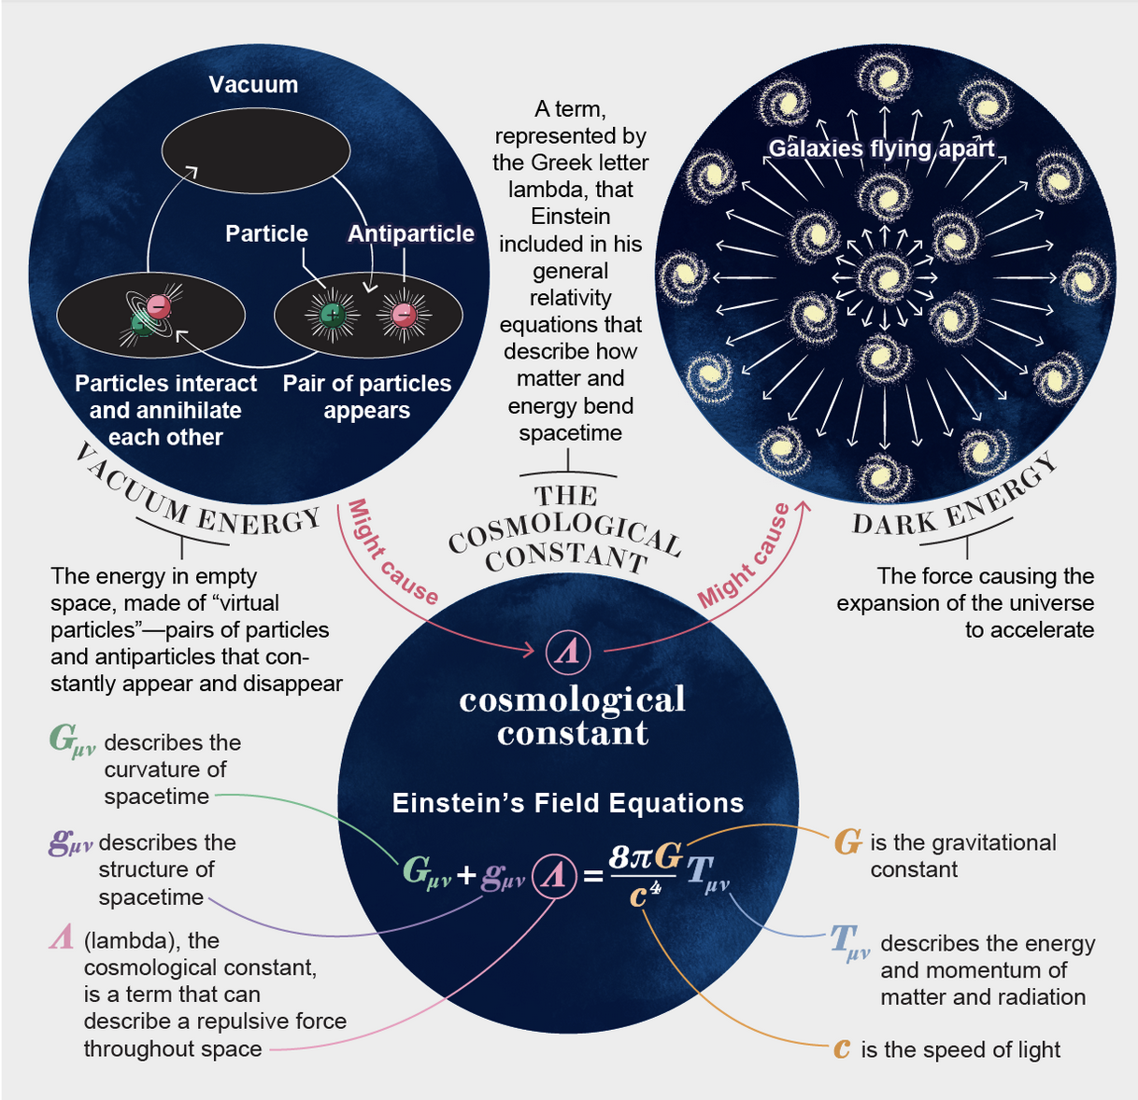
1. Possible Relation between the Cosmological Constant and Standard Model Parameters
Consider the following hypothetical principles that a theory of quantum gravity might impose upon the structure of black holes:
There exists well defined states of black holes with any discrete charge (multiple of electron charge, e).
In de Sitter space, the sharpest defined observables arise from scattering from and to the horizon. Hence, scattering processes must exist that can learn about the black hole’s charge.
Hertzberg & Loeb, Phys. Rev D, 107, 063527 (2023)

Slide 20
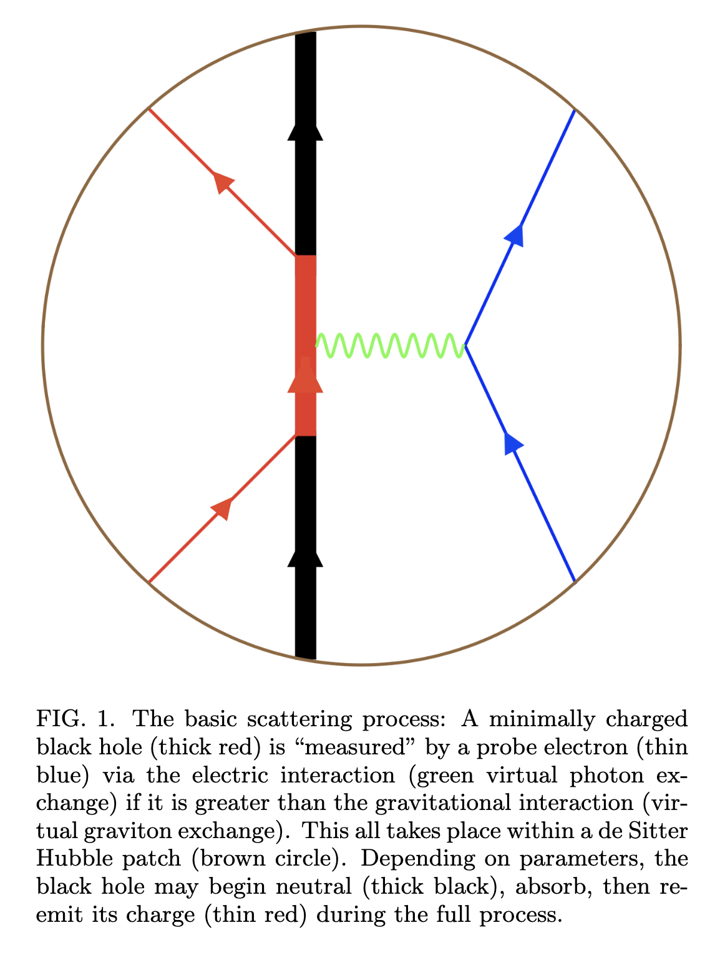
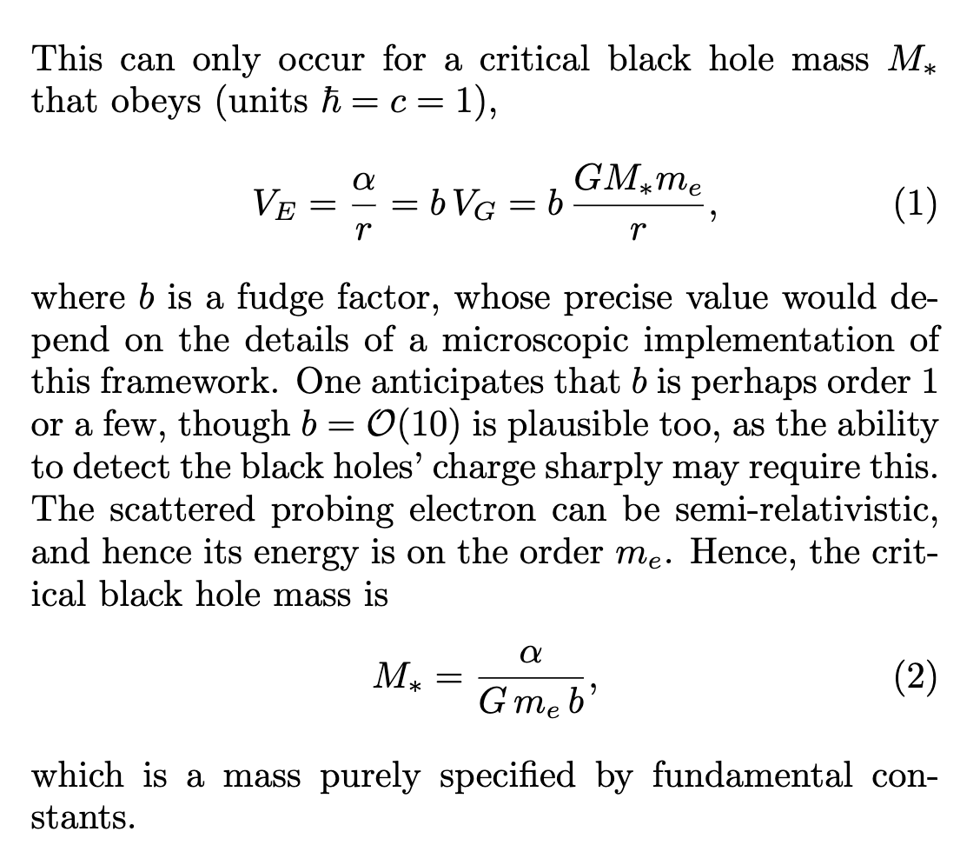

Slide 21
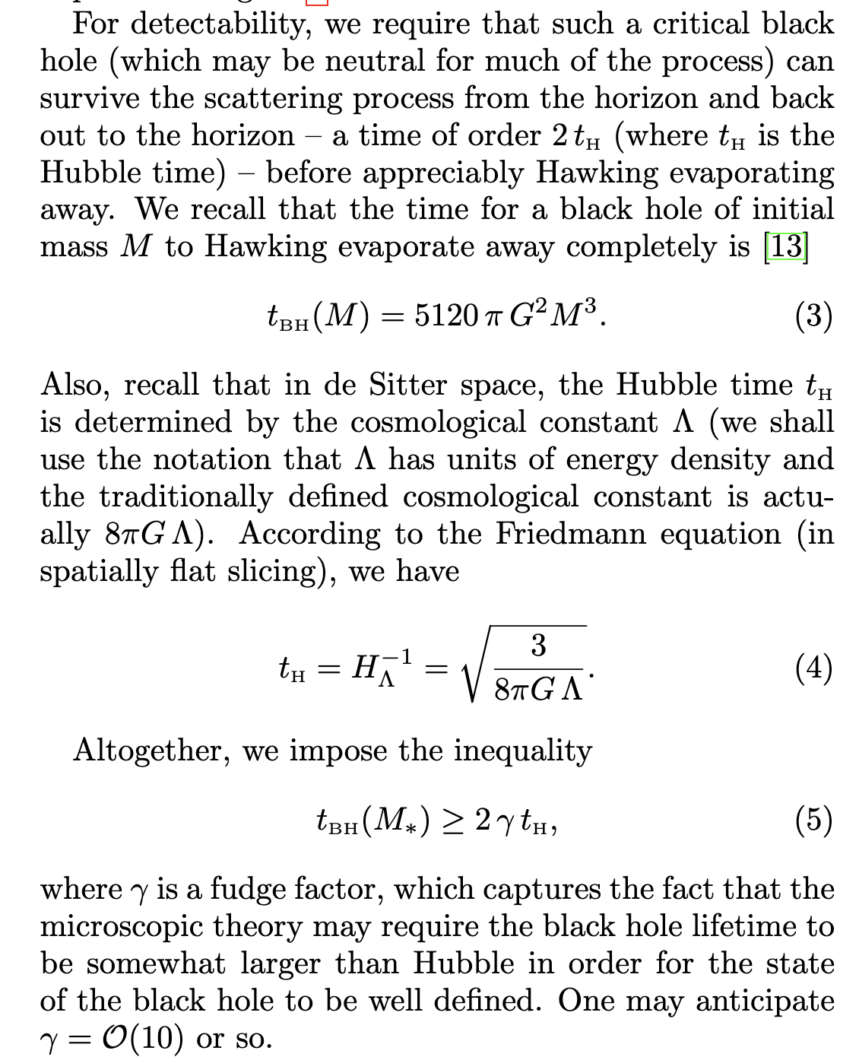
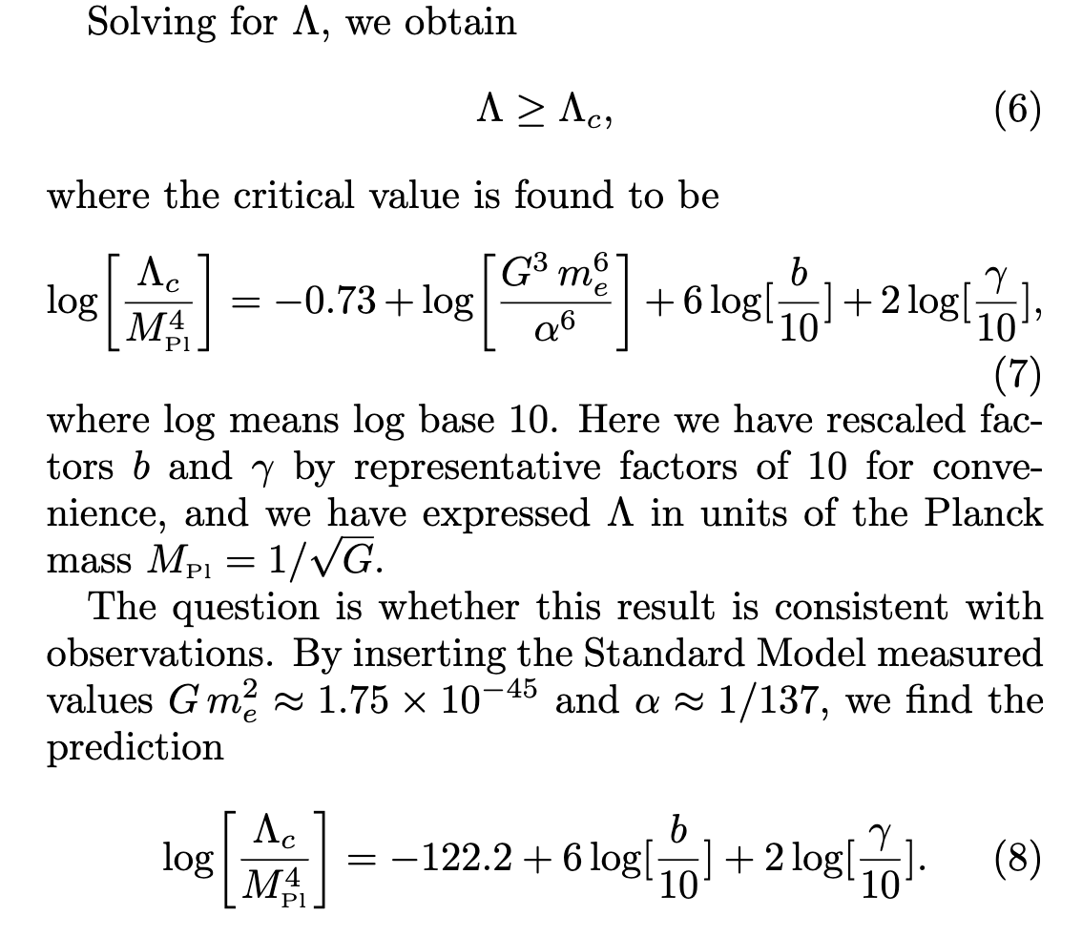


Slide 22
4. Negative mass, w(z) and causality

Slide 23
1. Shapiro-delay → shapiro-advance →time machine
Implication for cosmology (DESI): w(z)>-1
-
+
Bondi (1957): runaway pair
-
Photons: Shapiro advance (tachyon) → Time Machine

Slide 24
Black holes

Slide 25
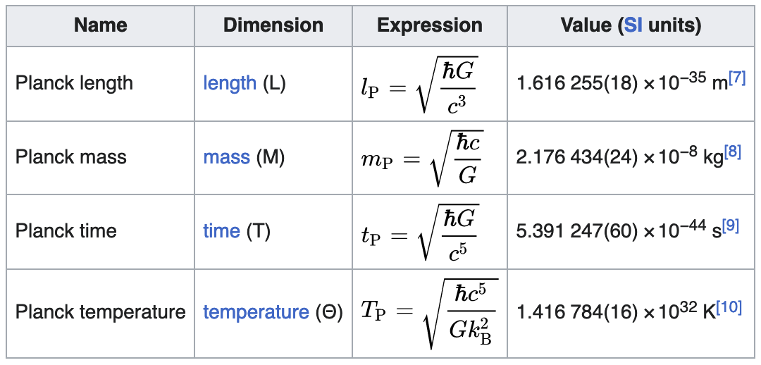
1. The fate of infalling Matter inside a black hole
Conjecture: Planck density cannot be exceeded
Implication: singularity is replaced by a Planck-density star, denser by 79 orders of magnitude than a neutron star.
= 10⁹³ g cm⁻³
R= R_{Pl} (M/M_{Pl})^{1/3}=7x10⁻²¹ cm x(M/M_{sun})^{1/3}
(R/R_{Sch})= (M/M_{Pl})^{-2/3}= 5x10⁻²⁶ (M/M_{sun})^{-2/3}
Quantum gravity effects would be negligible for LIGO and noticeable outside the horizon only for M~M_{Pl}

Slide 26


Slide 27






2. Inconsistency of "Gravitational Pair Production and Black Hole Evaporation"
Energy of particle in Schwinger pair-production:
EM-gravity analogy for Hawking radiation:

Slide 28


Hertzberg & Loeb, PRL (2023)

Slide 29


3. STOCHASTIC GRAVITATIONAL WAVE BACKGROUND?
3

Slide 30



Slide 31


Slide 33




Do the deep fields of jwst suggest new physics beyond lcdm?
?
Modified transfer function
Padmanbhan & Loeb 2023

Slide 34


Ultra Long-Term Cosmology and Astrophysics
Scherrer & Loeb, New Astronomy 99, 101940 (2023)

Slide 35

Long-term evolution of Gravity

Slide 36




The horizon of intergalactic travel
Maximum comoving distance

