Slide 1
Hubble Tension Tomography
Leandros Perivolaropoulos
Department of Physics, University of Ioannina, Greece
Standard Cosmology at the Threshold of Change? Thessaloniki 2024

Slide 2
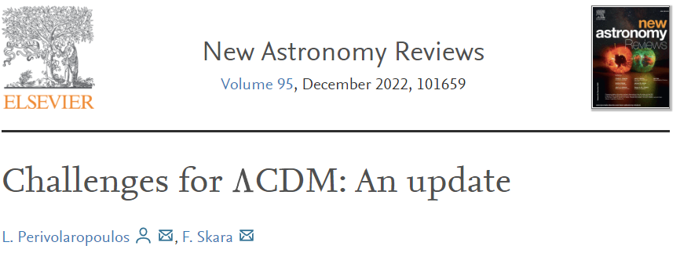
The large scale tensions of the standard model
1. The Hubble crisis (5σ): Local direct measurements of H₀ are in 5σ tension with CMB indirect measurements of H₀. (Sound horizon+CMB+BAO+BBN: H₀=67.4±0.5km/secMpc, SnIa+Cepheids: 73.04±1km/secMpc (5σ, 9%))
2. The growth tension (2-3σ): Direct measurements of the growth rate of cosmological perturbations (weak lensing, peculiar velocities, cluster counts) indicate a lower growth rate than that indicated by Planck-ΛCDM (lower matter density).
3. Cosmic Dipoles (5σ) Quasar+radio galaxies density dipole, large scale velocity bulk flow.
4. CMB anisotropy anomalies (2-3σ): Lack of power on large angular scales, small vs large scales tension (different best fit values of cosmological parameters), cold spot anomaly, hemispherical temperature variance asymmetry, preference for odd parity correlations etc.

Slide 3
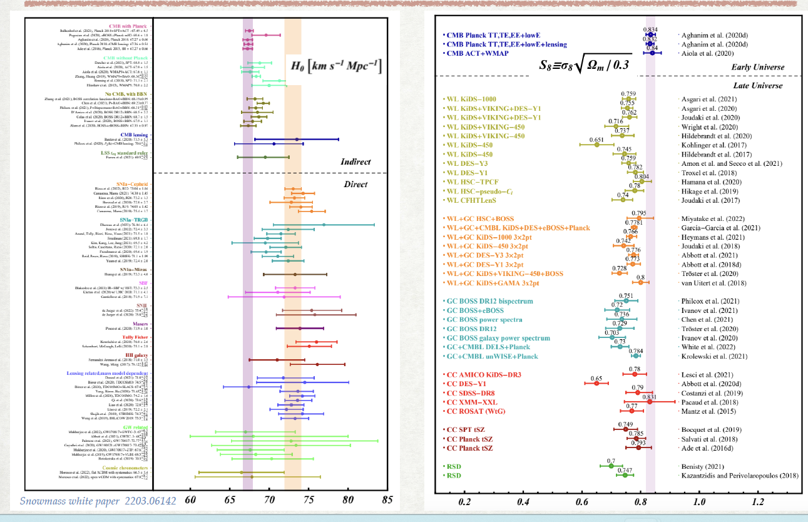
Hubble and Growth Tensions

Slide 4
Measuring H₀–H(z) with standard candles: late time calibrators
Fit SnIa Standard Candles for H₀ , 0.02<z<0.1:
fit with kinematic expansion (0.01<z<0.1)
measure
measure locally (z<0.01, 40Mpc) using relative distance indicators (eg Cepheids)
Fit (assume M is the same in the Hubble flow (z>0.01))
Degeneracy between M (measured at z<0.01) and H₀ (fit at z> 0.01). No E(z)=Η(z)/Η₀ dependence.
H₀ measurement using distance ladder:
H₀ Tension
Assumption: G_{eff}(z<0.01)=G_{eff}(z>0.01)

Slide 5
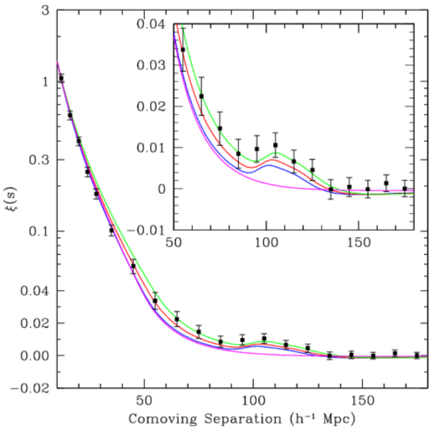
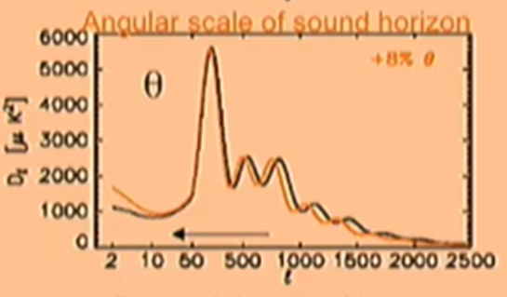
Measuring H₀-H(z) with a standard ruler: early time calibrators
calculated
Sound Horizon at Recombination Standard Ruler (Early Universe):
Depends on ρ_{b}, ρ_{γ} and ρ_{CDM}
1. EDE: Add new fluids to decrease r_{s}. But keep the same E(z).
r_{s}=147.6 Mpc from Planck and BBN
values of ρ_{b}, ρ_{γ} and ρ_{CDM}
inferred
2. Ε(z) deformation: New dark energy. But keep the same r_{s}.
Same with BAO
(projected r_{s} on LSS)
(z_{s}->z_{BAO,}θ_{s}->θ_{BAO} r_{s}->r_{d})
measured
d
comoving
Degeneracy between r_{s} and H₀ and E(z).

Slide 6
Inverse Distance Ladder and the M tension
H₀ measurement using sound horizon standard ruler (inverse distance ladder):
Assumptions: P18ΛCDM E(z), Standard expansion before z_{rec}
Calibrate M from r_{s}
(Inverse distance ladder)
M tension.
or M transition?
In Hubble flow.
Local!
M depends on G_{eff}.

Slide 7
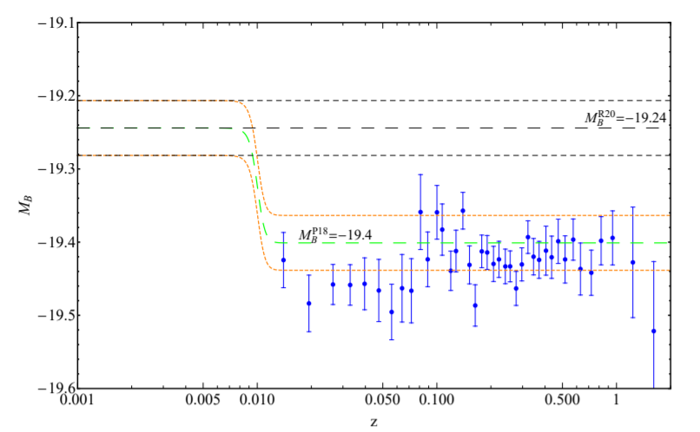
The M transition hypothesis
A fundamental physics transition induces a transition of M (absolute magnitude or luminosity) at z<0.01.
Resolves M tension and Hubble tension.
Can potentially also resolve growth tension if the transition is connected with weaker gravity at z>z_{t}

Slide 8
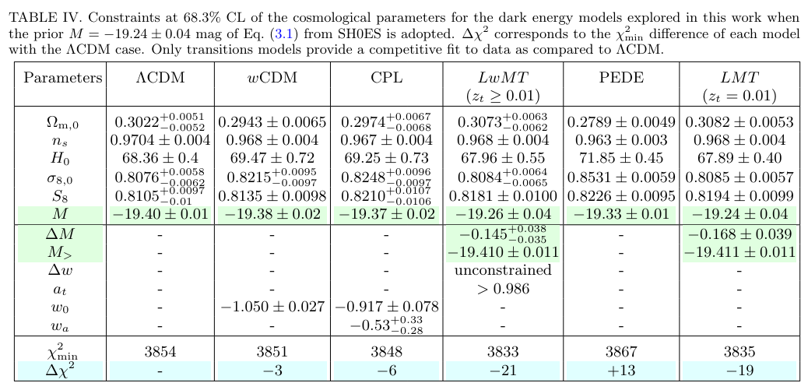
The M transition Model: Fit to the data

Slide 9
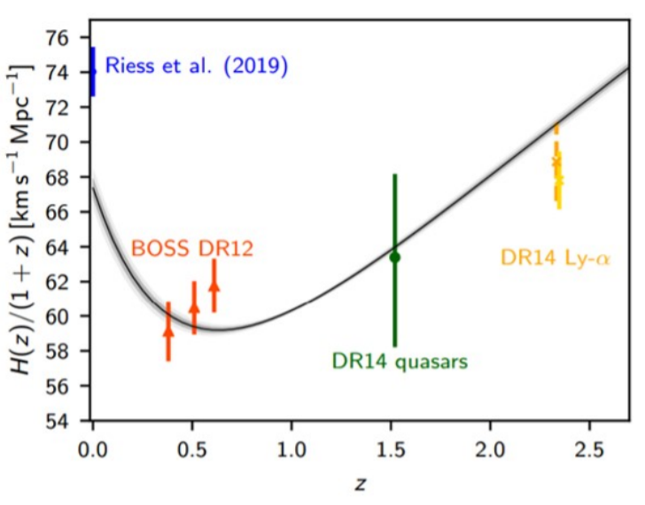
The Hubble Crisis Approaches
Distance Ladder H(z) (M calibrator – Cepheids at z<0.01 )
Inverse distance ladder
+ ΛCDM E(z) (r_{s} or r_{eq} calibrator)
How can H(z) derived from late time calibrators (blue point and SnIa calibrated from it) become consistent with H(z) derived from early time calibrators (black line, CMB+BAO)?
Change SnIa Intrinsic Luminosity (systematics or physics change at 0<z<0.01). (move blue point down)
Change sound horizon scale AND matter equality scale
(Early DE transition at t_{rec} and more new physics at t_{eq}). (shift black line up)

Slide 10
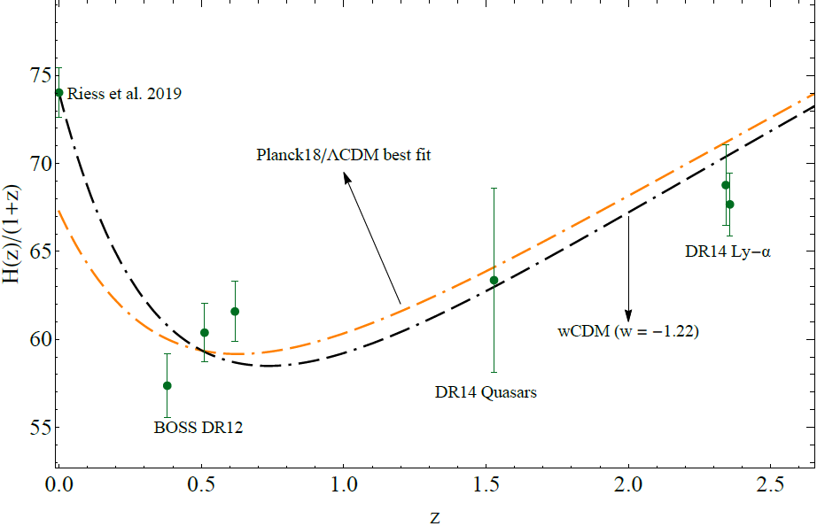
The Hubble Crisis Approaches
How can H(z) derived from late time calibrators (blue point and SnIa calibrated from it) become consistent with H(z) derived from early time calibrators (black line, CMB+BAO)?
Change SnIa Intrinsic Luminosity
(systematics or physics change at 0<z<0.1). (move blue point down)
Change sound horizon scale AND matter equality scale
(Early DE transition at t_{rec} and more new physics at t_{eq}). (shift black line up)
Deform H(z) by eg dynamical dark energy
(problems with BAO, growth, M). (distort black line)

Slide 11
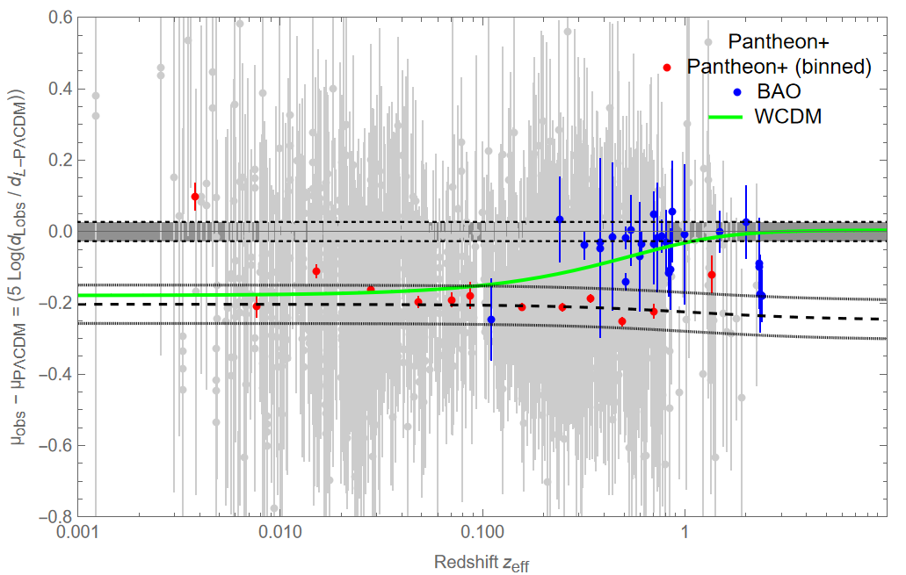
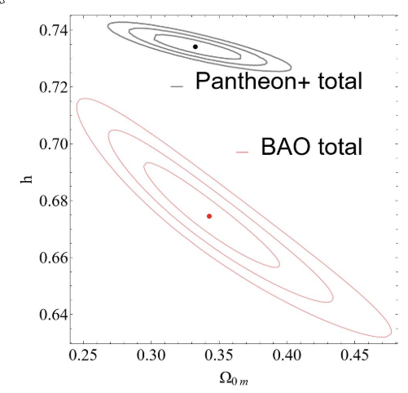
Hubble Tension Tomography: The problem with H(z) deformation models
Planck/ΛCDM Residual SnIa and BAO distance moduli.
The Hubble tension is a
calibrator tension and
can not be resolved by H(z) deformation.
Planck ΛCDM distance residual Sound Horizon Calibration
w=-1.2
Pantheon+ ΛCDM distance residual Cepheid Calibration

Slide 12
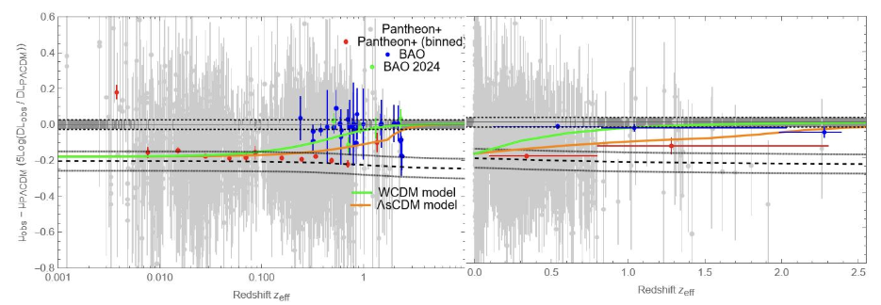
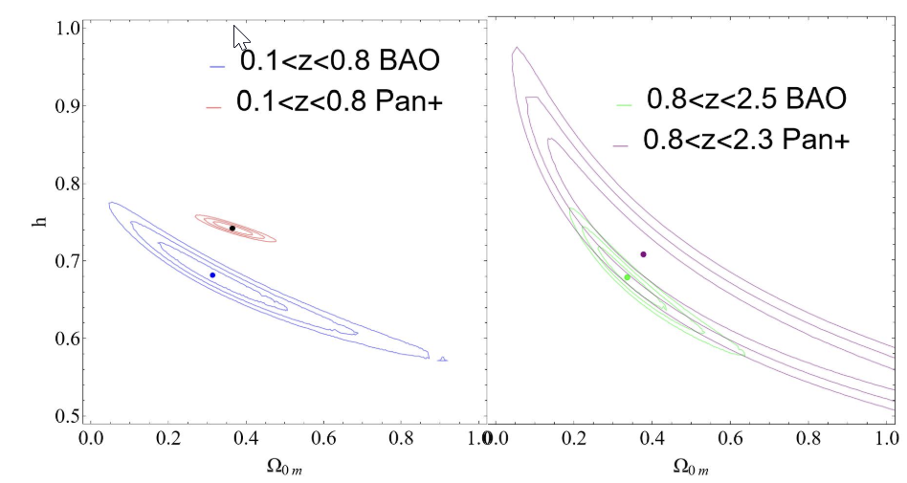
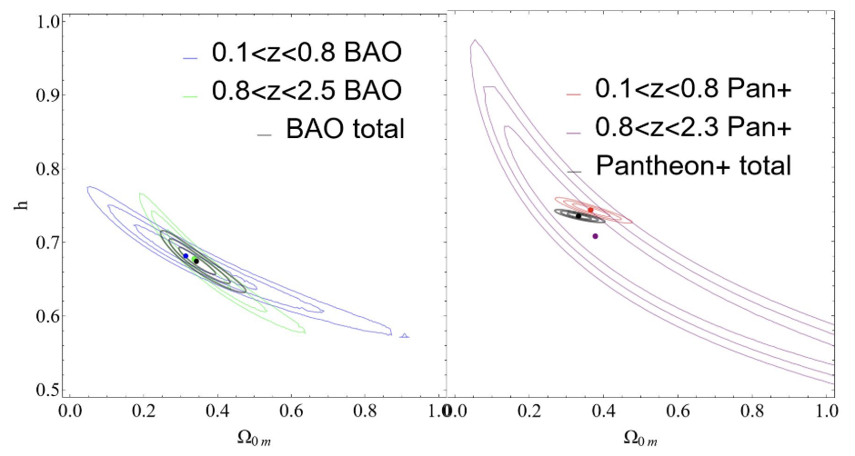

Slide 13
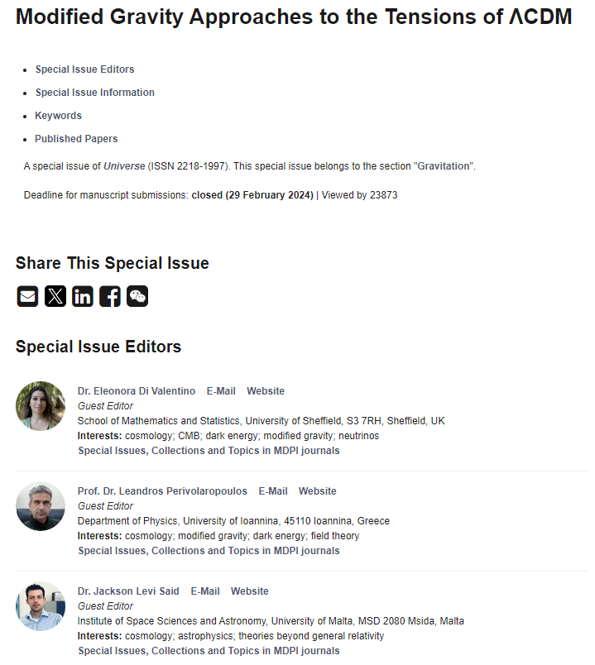
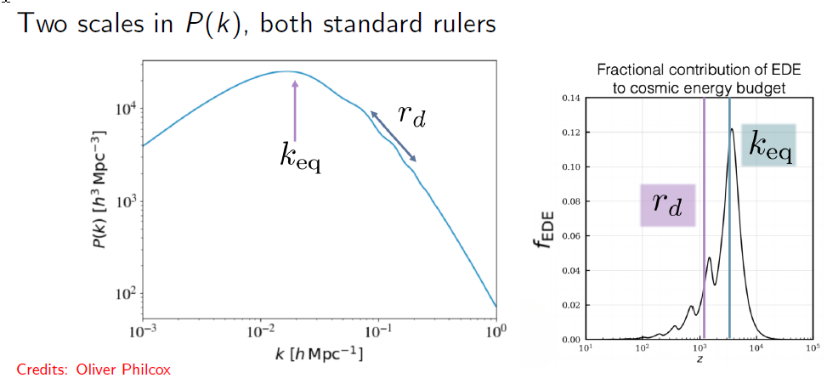

Slide 14
Horizon at t_{eq}: An independent early time standard ruler hint at with CMB H₀
Parameter degeneracies:
Measured with Hubble free expansion rate E(z)=H(z)/H₀ 1100>z>0.01 (CMB, BAO, SnIa): Accurate-no tension here
Obtained from ΛCDM E(z) from t_{eq} using shape of LSS power spectrum.
Measured with ultralate time calibrators (Cepheids, TRGB etc) at z<0.01 (no Hubble flow)
Measured from CMB, BBN assuming ΛCDM E(z)
before recombination.

Slide 15
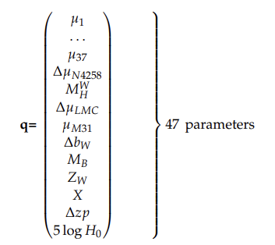
Reanalyze the Local SH0ES Calibrator
Calibrate Cepheids in anchor galaxies and in SnIa hosts 3492 equations fit for 47 unknown parameters (including M of SnIa)
jth Cepheid in ith galaxy
Cepheid calibration
SnIa calibration
m=μ(Η₀)+Μ_{Β} ->Hubble flow SnIa
Express the system as linear vector transformation
The latest SH0ES measurement of H₀ : The distance ladder in practice
Minimize χ²:

Slide 16
Generalizing the baseline SH0ES modeling analysis: New degrees of freedom
Allow for a change (transition) of the SH0ES modeling parameters M_{W}, b_{W}, Z_{W}, M_{B} at a given distance D_{c} (cosmic time t_{c}).
For example if M_{B} was allowed to change, the Cepheid modeling would have to change as:
The new matrix equation Y=L q would have the same data/constraints Y (labeled with their distance) the same covariance matrix C but different model matrix L and parameter vector q.

Slide 17
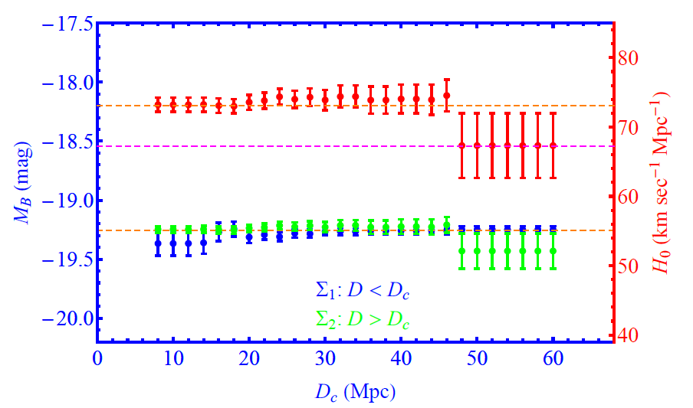
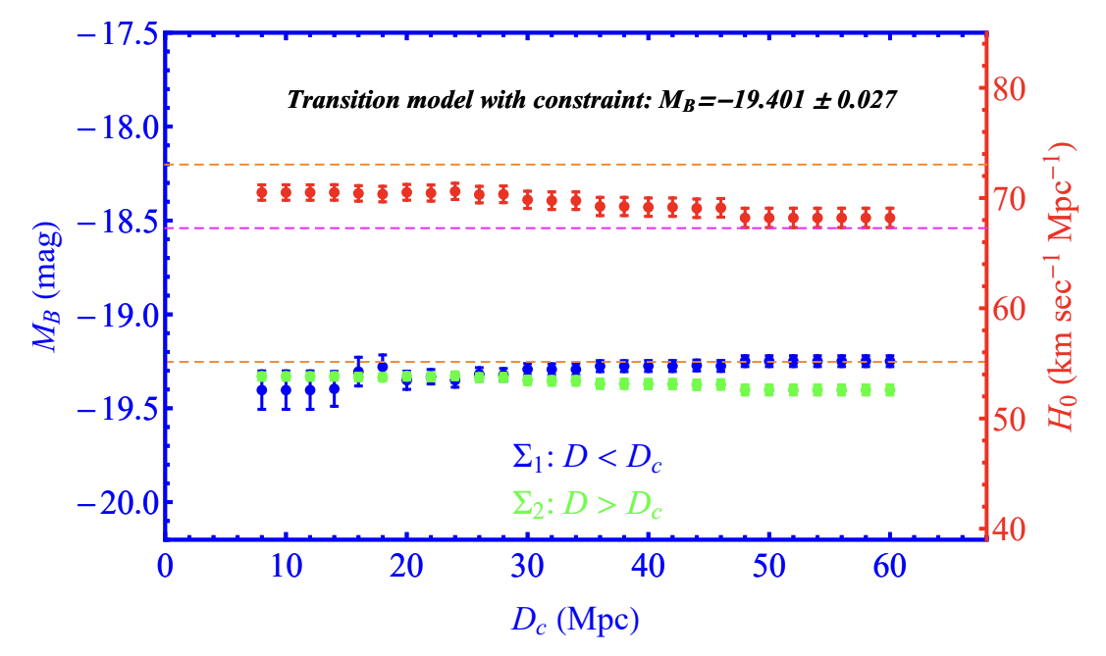
Results of the Generalized Analysis
H₀(D_{c})
M_{B}<
M_{B}>
Spontaneous transition of the best fit value of H₀
when a transition at D_{c}~50Mpc is allowed. Η₀=(67.3 ± 4.6) km/secMpc
Using Inverse distance ladder input Η₀=(68.2 ± 0.9) km/secMpc

Slide 18
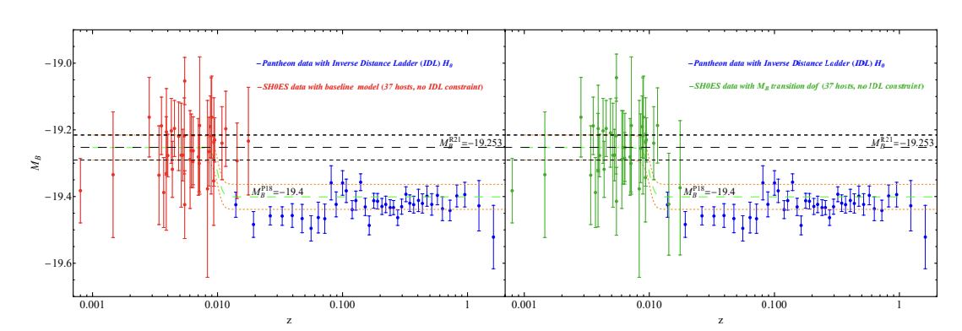
Hints for an M transition in SH0ES?
Allow (but do not enforce) an M transition at 50Mpc (new degree of freedom approach)
Derive μ_{i} and do not allow any transition (the original SH0ES approach)

Slide 19
Main Points / Conclusion
The Hubble tension is a tension between early time and late time cosmic distance calibrators. New physics and a change of the standard model is likely to emerge from this tension.
New physics is likely in both the early time calibrators (sound horizon at t_{rec} and horizon at t_{eq}) or late time calibrators (local cosmic physics/astrophysics).
A late transition event involving a sudden change of the SnIa intrinsic luminosity occurring less than 150 million years ago (z_{t}<0.01) is a hypothesis that deserves further investigation by reanalyzing the SH0ES data with new degrees of freedom.
There are hints in the SH0ES data for such an ultralate physics transition.

Slide 20
Extra Slides

Slide 21
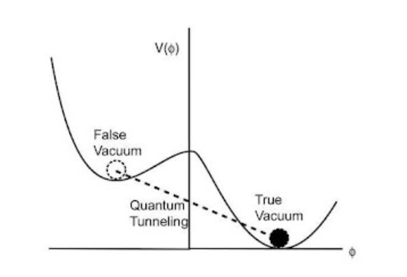
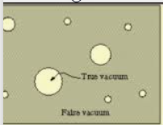
Generic Distance Scale
In the context of false vacuum decay
bubbles of true vacuum form
Predicted bubble scale is close
to favored scale of transition
Scale of True Vacuum Bubbles:
R_{b}~15Mpc
O(1)
Planck mass

Slide 22
Theoretical Model: Scalar Tensor Theory
Scalar Tensor Transition:
8πG ~ 1/F(Ф)
Temporal transition
Field rolling in constant potential
A phase transition (false vacuum decay) would induce a transition in the strength of gravity as well
Spatial transition
In the context of false vacuum decay
bubbles of true vacuum form

Slide 23
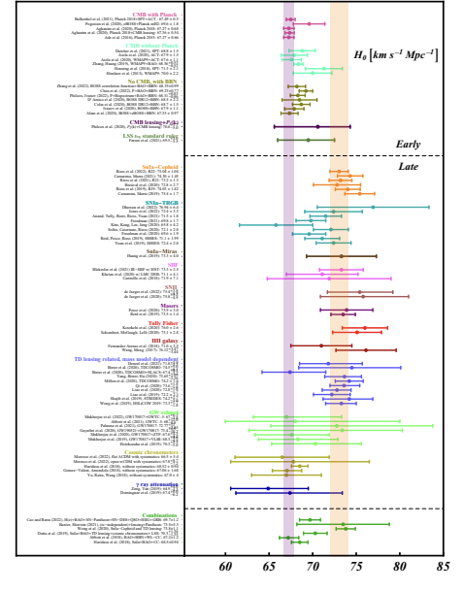
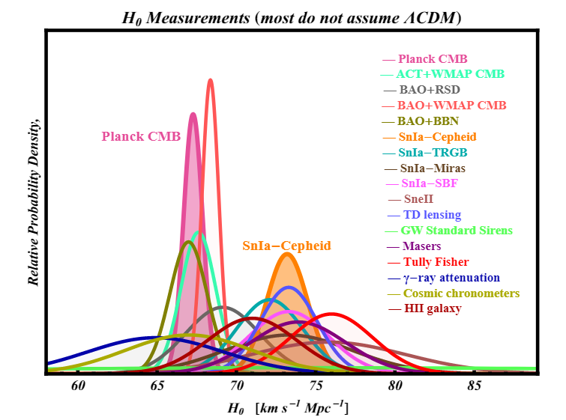
The Hubble tension
Q.: What is the feature that distinguishes the two
groups of H₀ values?
Is it cosmic time of measurements?
or
is it the use of local calibrators (distance ladder)?

Slide 24
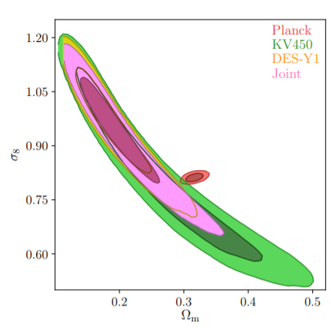
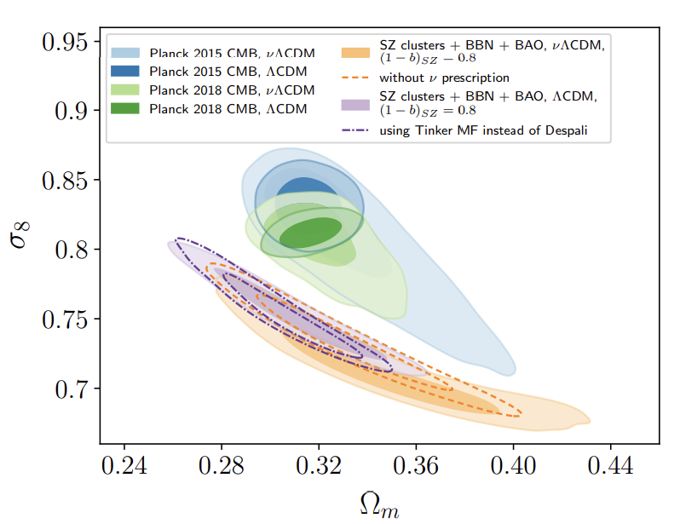
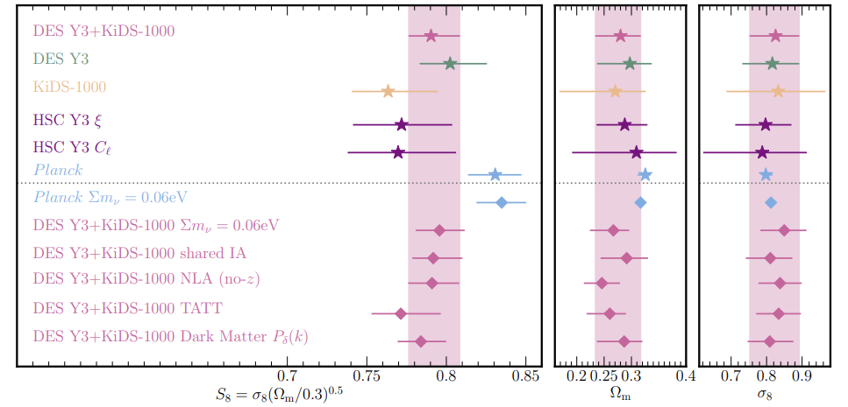
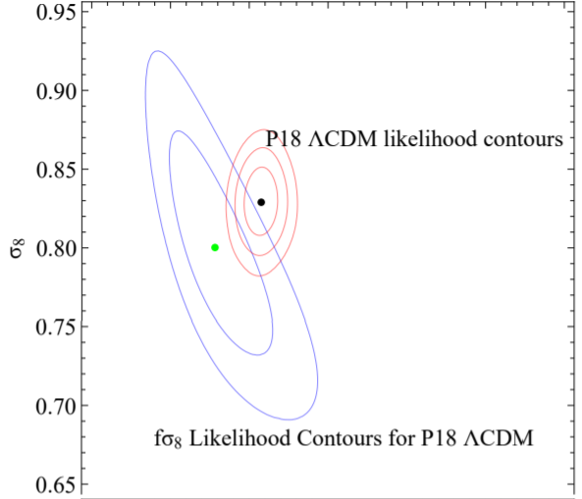
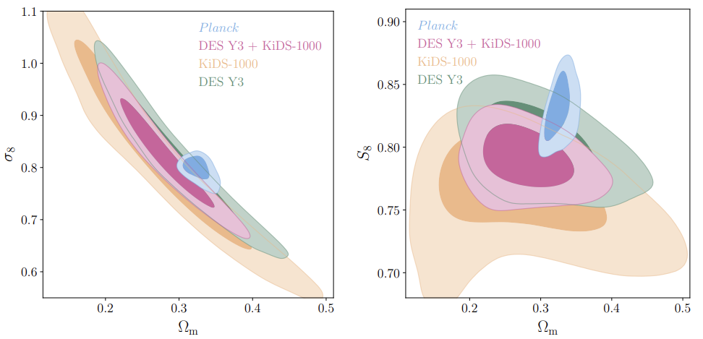
The growth tension
S₈~σ₈ Ω_{0m}^{1/2}
Redshift Space Distortions
(galactic peculiar velocities)
Cluster counts
Weak Lensing
Could gravity be weaker on cosmological scales
compared to local scales (recent times)?

Slide 25
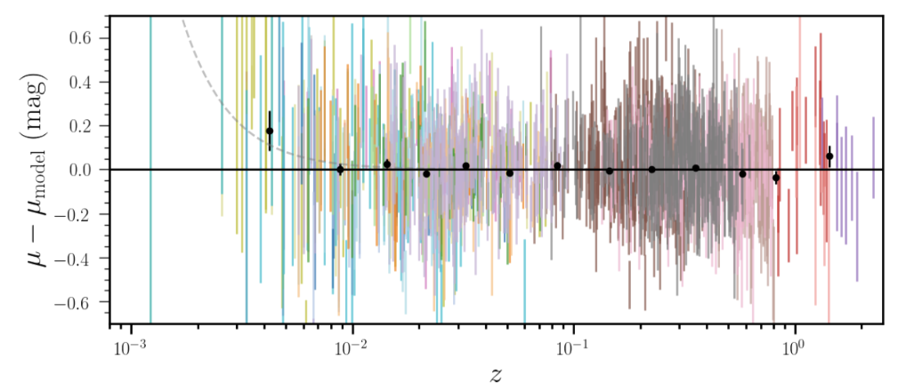
Distance residuals

Slide 26
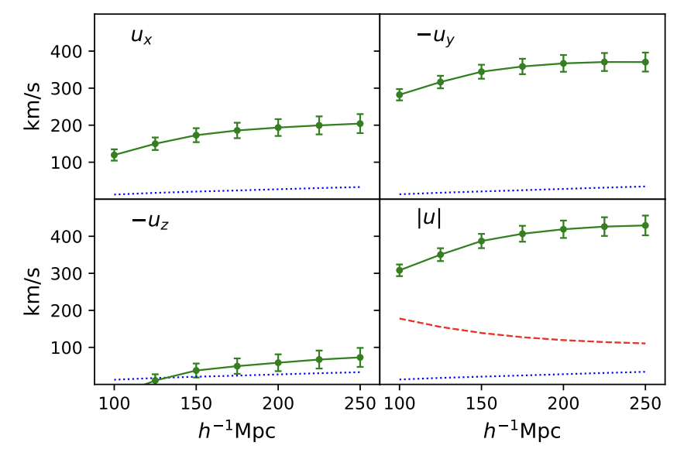
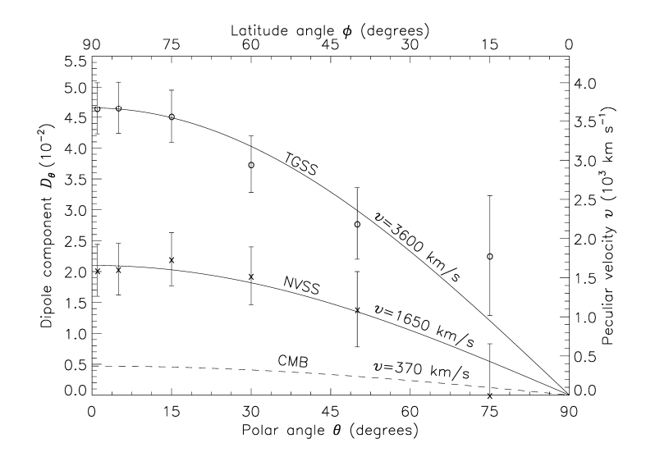
Cosmic Dipoles
Bulk Flows
QSO dipole 5σ
Radio Galaxy dipole 3-5σ
90-θ zones

Slide 27
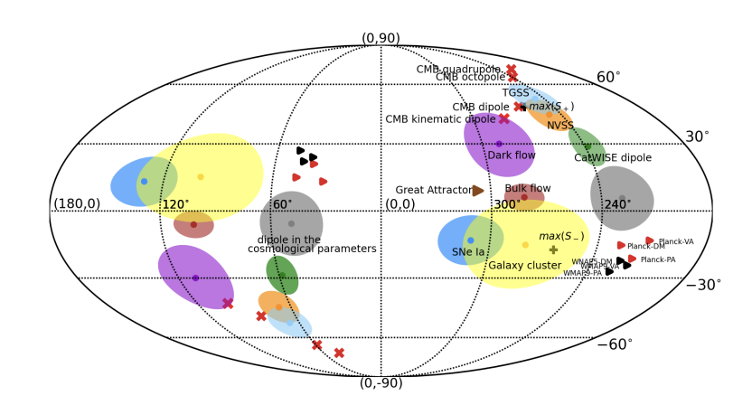
Cosmic Dipoles
Radio Galaxy dipole 3-5σ
QSO dipole 5σ
Bulk Flows 5σ

Slide 28
Local measurements
One step distance methods in Hubble flow (z>0.01, local calibrator and sound horizon free)
Method H₀(km/sec Mpc) Arxiv-link First author
Cosmic Chronometers 66.7±5.3 https://arxiv.org/pdf/2307.09501.pdf Moresco
Cosmic Chronometers + HII gal. 65.9±3.0 https://arxiv.org/pdf/2208.03960.pdf Jianchen Zhang etal
Gravitational Waves + Kilonovae 69.6±5.5 https://arxiv.org/pdf/2205.09145.pdf Bulla etal
Gravitational Waves + Kilonovae 67.0 ± 3.6 https://arxiv.org/pdf/2306.12468.pdf Sneppen etal
Lensing Time Delays TDCOSMO I 74.2±1.6 https://arxiv.org/pdf/1912.08027.pdf Millon etal
Lensing Time Delays TDCOSMO IV 67.4±4 https://arxiv.org/pdf/2007.02941.pdf Birrer etal
Megamasers 66.0 ± 6.0 https://arxiv.org/pdf/1511.08311.pdf Gao etal
Megamasers (SH0ES) 73.9±3.0 https://arxiv.org/pdf/2001.09213.pdf Pesce etal
SZ effect 61±21 https://arxiv.org/pdf/astro-ph/0306073.pdf Reese
Gamma ray attenuation 61.9±2.6 https://arxiv.org/pdf/2306.09878.pdf Domínguez etal
T_{eq} standard ruler 64.8±2.4 https://arxiv.org/pdf/2204.02984.pdf Philcox etal

Slide 29
The Hubble Crisis Approaches
Distance Ladder H(z) (M calibrator – Cepheids at z<0.01 )
Inverse distance ladder
+ ΛCDM E(z) (r_{s} or r_{eq} calibrator)
How can H(z) derived from late time calibrators (blue point and SnIa calibrated from it) become consistent with H(z) derived from early time calibrators (black line, CMB+BAO)?
Change SnIa Intrinsic Luminosity (systematics or physics change at 0<z<0.01). (move blue point down)

Slide 30
Local measurements
Distance ladder methods (local calibrators dependent)
Method H₀(km/sec Mpc) Arxiv-link First author
Tully Fisher + Cepheid + TRGB 76.0 ± 3.4 https://arxiv.org/pdf/2004.14499.pdf Kourkchi etal
SBF + Cepheids + TRGB 73.3 ± 3.1 https://arxiv.org/pdf/2101.02221.pdf Blakeslee etal
SnII + Cepheids + TRGB 75.57±15 https://arxiv.org/pdf/2305.17243.pdf Jaeger etal
Mira calibrators 73.3 ± 4.0 https://arxiv.org/pdf/1908.10883.pdf Huang etal
TRGB (SH0ES) 73.22 ± 2.06 https://arxiv.org/pdf/2304.06693.pdf Scolnic etal
Cepheid (SH0ES) 73.04 ± 1.04 https://arxiv.org/pdf/2112.04510.pdf Riess etal
Could we be missing something with ALL local calibrators??
Could there be a physics change between local calibrator scales (z<0.01) and Hubble flow scales (z>0.01)?

Slide 31
Why is ΛCDM still our standard model?
Inertia due to the several standard model successes (human factor).
Lack of SIMPLE alternative model.
Too many tensions (tension noise).
Comparison with previous standard model changes
From Steady State to Big Bang: Data and Simple alternative supported by simple theory (Friedman equations)
From sCDM to ΛCDM: Data and Simple Alternative (cosmological constant)
Peebles 1984, Efstathiou 1990 and Krauss-Turner 1995 (Universe age, matter power spectrum and peculiar velocities)
Q: What is the new simple and generic replacement of ΛCDM that will release most tensions with just 1-2 parameters?
For model building we need to understand deeply the data and the origins of the assumptions hidden in the tensions.

Slide 32
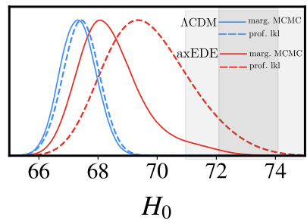
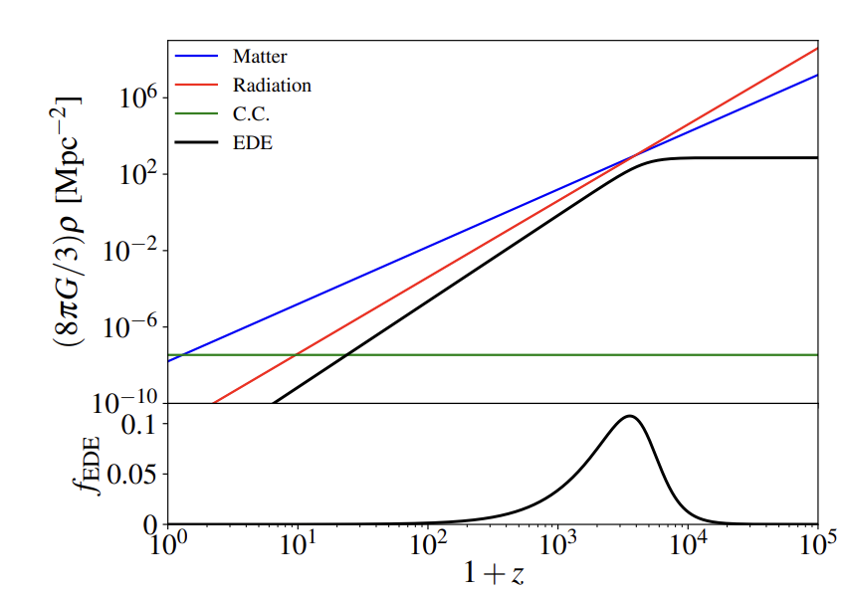
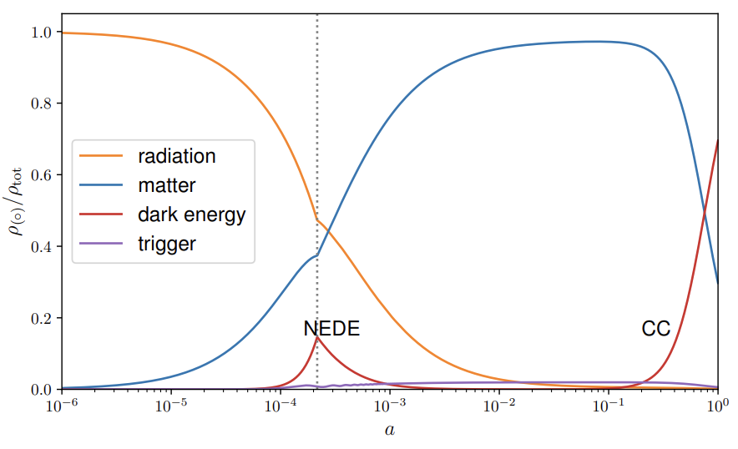
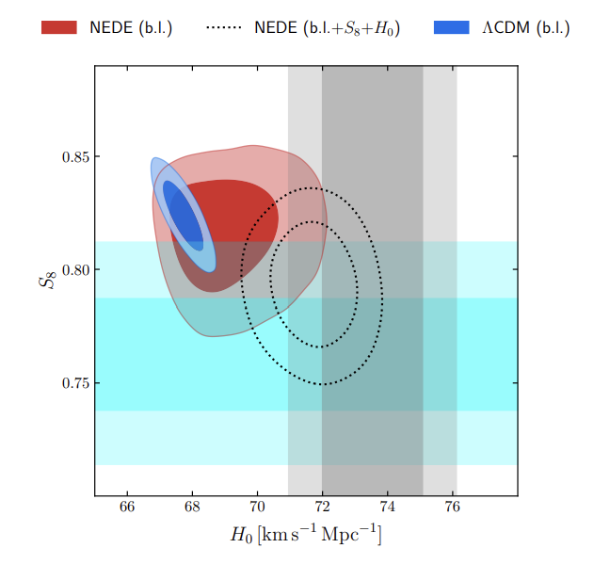
(New) Early Dark Energy Phase Transition
NEDE involves a more abrupt event (transition)
and the DE disappears more efficiently after recombination. Thus, it does not interfere with E(z) after recombination.
Tension resolution mostly
by SH0ES data and increased uncertainty
Axion-like scalar field

Slide 33
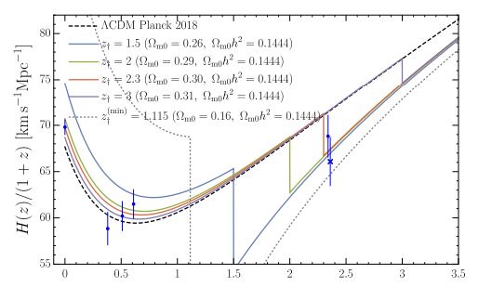
The ΛsCDM Model
How can H(z) derived from late time calibrators (blue point) become consistent with H(z) derived from early time calibrator (black line)?
Change SnIa Intrinsic Luminosity
(systematics or physics change at 0<z<0.1). (move blue point down)
Change sound horizon scale
(Early DE transition at t_{rec}). (shift black line up)
Deform H(z) by eg dynamical dark energy
(problems with BAO, growth, M). (distort black line)
An abrupt transition event may be needed to resolve the tension.

Slide 34
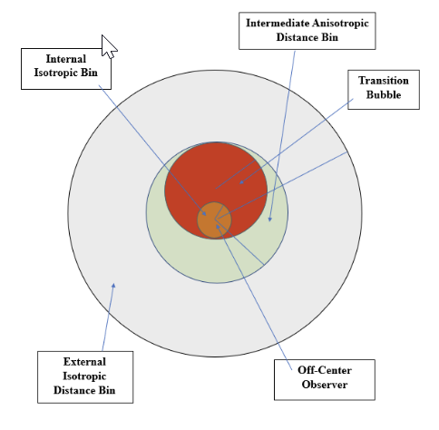
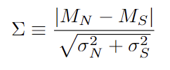
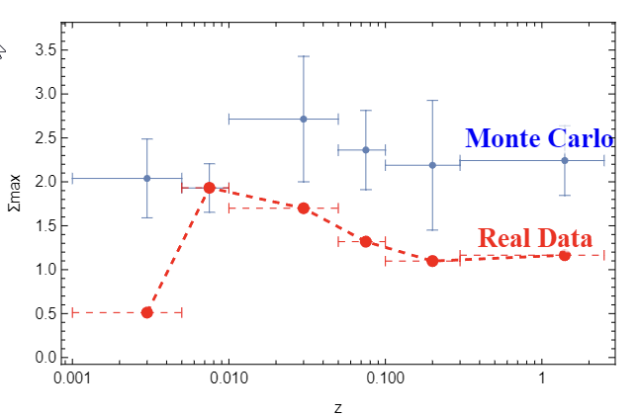
Predicted Anisotropy in the context of Spatial Transition
Off-center observer in a bubble of distinct transition physics
or
systematics

Slide 35
Issues on the SH0ES Analysis for H₀
Q1: What are the SnIa calibration parameters?
A: The SnIa (bolometric) absolute magnitude M (or M_{B}).
Also, the SnIa color and stretch parameters c and s, and the Cepheid calibration parameters b_{W} (period-luminosity), Z_{W} (metallicity-luminosity), M_{W} (Cepheid zero-point amplitude), R_{W} (Cepheid color-luminosity)
Q2: Are the best fit values of these parameters consistent among different subgroups of the SnIa+Cepheid data
A2: There are hints for inhomogeneities which affect the best fit value of H₀.
Q3: What could be the origin of these inhomogeneities?
A3: Statistics, Systematics or New Physics.

Slide 36
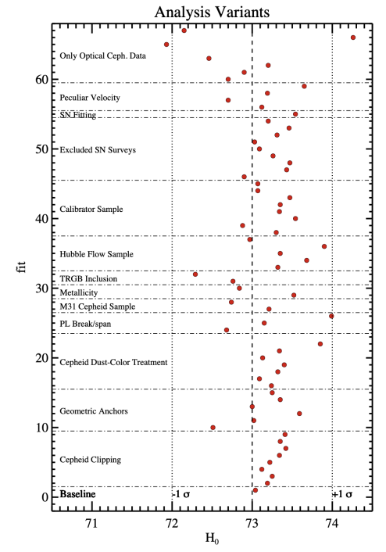
Variants of the SH0ES Analysis for H₀ considered by SH0ES team
No variant allows for a break in the calibrator parameter values at some distance or with other criteria
(except period luminosity with break at 10 days).

Slide 37
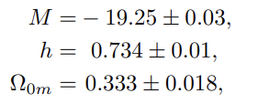
Measuring H(z) with the 2022 Pantheon+ dataset
Pantheon+ likelihood: Utilizing the 77 Cepheid distance moduli μ_{Cephj} of SnIa in Cepheid hosts (no transition allowed):
Best fit parameter values:
Broken degeneracy between H₀ and M due to the 77 SnIa distance moduli in Cepheid hosts
A way to fit H₀ along with other cosmological parameters without prior knowledge of M!
Agreement with Brout et.al. 2022
Brout et al 2022: M not included in fit.

Slide 38
New degrees of freedom in the Pantheon+ likelihood
Allow for a transition of M
at some distance d_{c}
New likelihood for Patheon+:
Q:
1. What is the quality of fit of ΛCDM with the new likelihood?
2. Are the best fit M>, M< consistent with each other and with the best fit M of the standard likelihood?

Slide 39
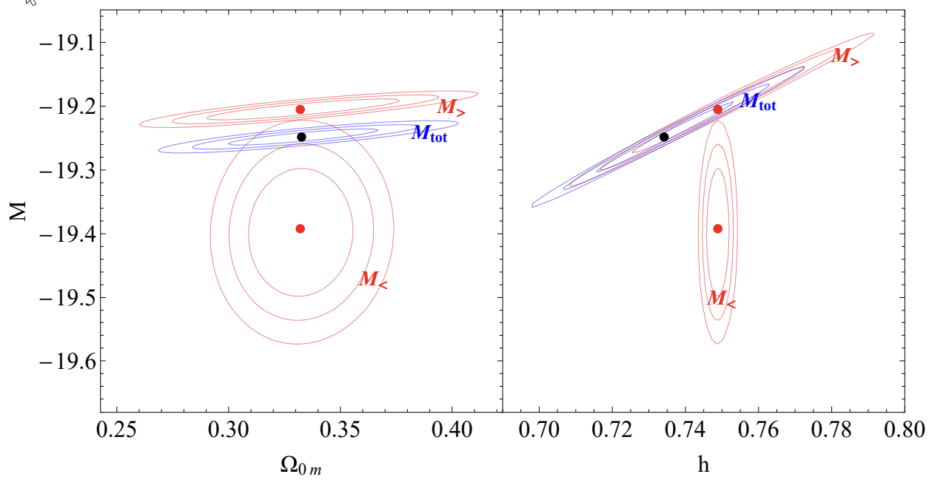
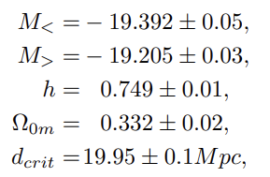
New degrees of freedom in the Pantheon+ likelihood
Q: Does this modeling of M<, M> affect the best fit values of other cosmological parameters?
Best fit Ω_{0m} remains unchanged in the new likelihood
h shifts to
somewhat higher values!
A₁: Δχ²=-19
Α₂:No! Significant tension!
Q: What is the origin of this tension? Systematics? New Physics? Both?

Slide 40
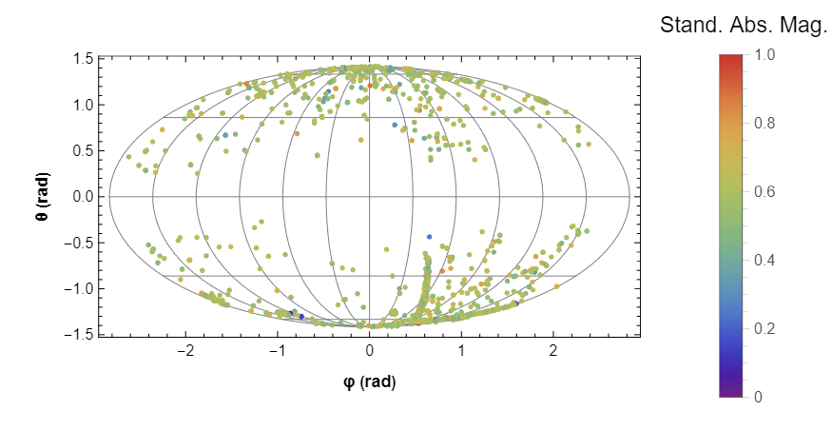
Hemisphere Comparison Method: Isotropy of SnIa Absolute Magnitudes
1. Select random direction and split sky in North-South hemispheres in given redshift bin.
2. Find weighted average of absolute magnitudes in each hemisphere (M_{N}, M_{S}) and their uncertainties.
3. Define anisotropy level statistic:
Standardized SnIa absolute magnitudes
of Pantheon+.
4. Find direction of maximum anisotropy level Σ_{max} .
5. Repeat for N isotropic Monte-Carlo samples to find anticipated range of Σ_{max}.

Slide 41
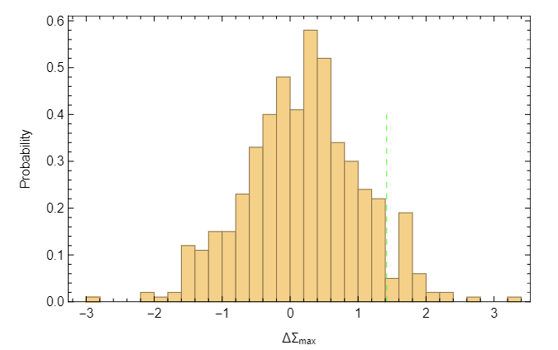
Comparison of Pantheon+ M-anisotropy with isotropic Monte-Carlo samples.
How frequent are these changes in Monte-Carlo isotropc data?
7%
Monte-Carlo simulated data are more anisotropic than real data (overestimated uncertainties?)
Real data
1->2 bin
Sudden changes appear of anisotropy level appear at low redshift bins

Slide 42
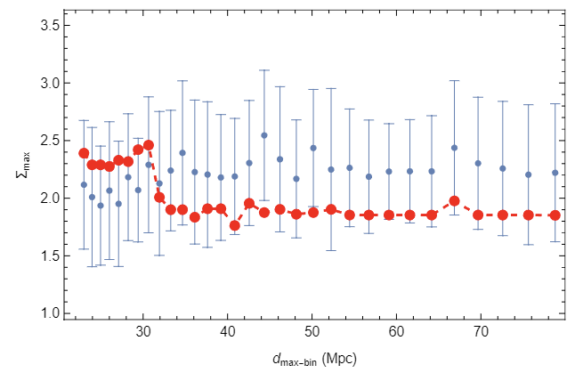
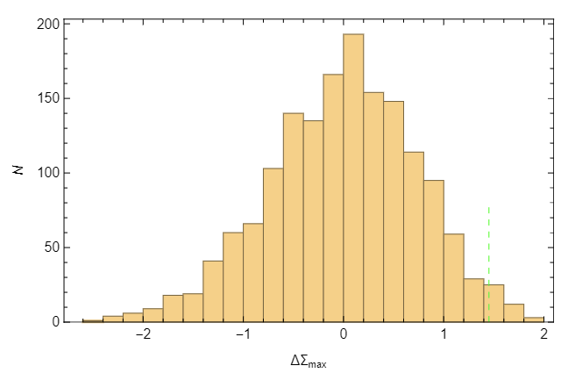
Comparison of SH0ES M-anisotropy with isotropic Monte-Carlo samples.
How frequent are these changes in Monte-Carlo isotropc data?
2%
Cumulative low distance bin
Real data
Sudden change appear in anisotropy level of cumulative bin appear at about 30Mpc

Slide 43
Measuring H(z) with the 2022 Pantheon+ dataset
from SnIa in Cepheid hosts at z<0.01
1701 SnIa datapoints (z_{i},m_{Bi},μ_{Cephj}), i=1,…,1701, j=1,…,77, 0.001<z_{i},<2.26
Also provided μ_{SH0ESi}=m_{Bi}-M_{Cepheid}
Standard maximum likelihood of previous Pantheon sample (no μ_{Cephj})
Degeneracy between H₀ and M
(no way to fit H₀ without prior knowledge of M)

Slide 44
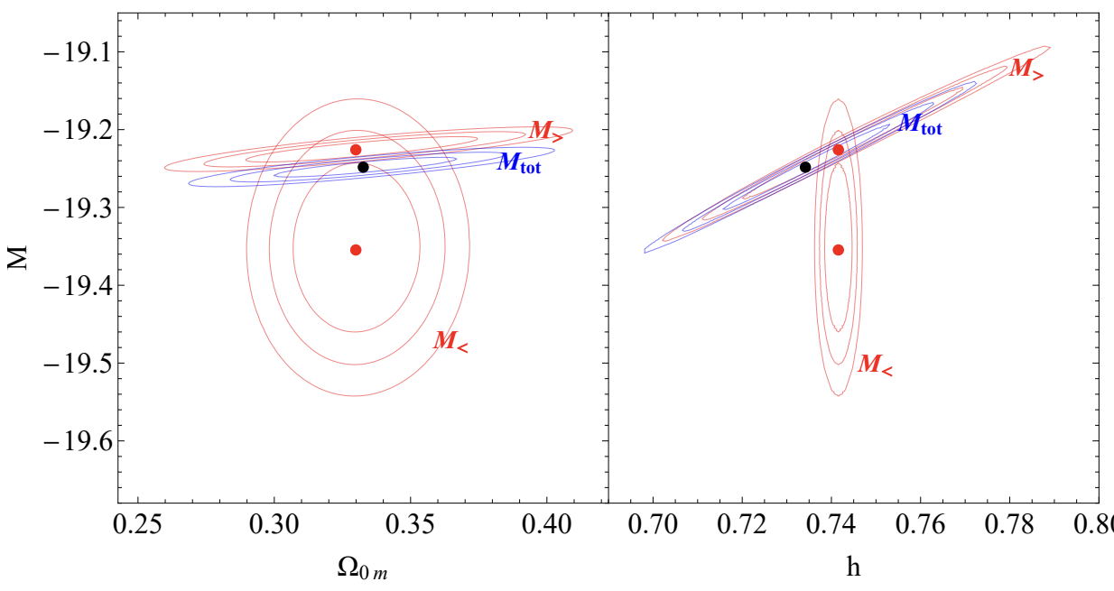
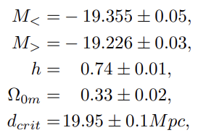
Another new likelihood for Pantheon+
Remove Hubble diagram distance moduli data with z<0.01 but keep distance moduli data of SnIa in Cepheid hosts.
The tension between M< and M> is smaller but a significant part of it remains

Slide 45
SnIa luminosities in Pantheon+
Closeby SnIa (d<d_{c}=20Mpc)
in Cepheid hosts
are systematically brighter more distant SnIa
(M<M_{SH0ES}=M_{best-fit})
Q: How often could this happen by chance?

Slide 46
Monte Carlo Simulation
A: 94% of the simulated datasets have Σ_{max} smaller than the Σ_{max} of the real data and only about 6% have Σ_{max} larger than the real data.
Thus, the part of the M<-M> inconsistency that is due to actual SnIa luminosity mismatch is at about 2σ level.

Slide 47
Generalizing the baseline SH0ES modeling analysis: New degrees of freedom
Allow for a change (transition) of the modeling parameters M_{W}, b_{W}, Z_{W}, M_{B} at a given distance D_{c} (cosmic time t_{c}).
For example if b_{W} was allowed to change, the Cepheid modeling would have to change as:
The new matrix equation Y=L q would have the same data/constraints Y (labeled with their distance) the same covariance matrix C but different model matrix L and parameter matrix q.

Slide 48
Results of the Generalized SH0ES Analysis
H₀(D_{c})
M_{B}<
M_{B}>
Spontaneous transition of the best fit value of H₀
when a transition at D_{c}~50Mpc is allowed.

Slide 49
The volumetric redshift bias: A known but uncorrected systematic in Pantheon+
Δz> : Random peculiar velocities in outer shell compared to a given shell at redshift z.
If Δz> < 0 then the outer shell galaxies are incorrectly projected on the z shell leading to smaller distance estimate than the true distance d> .
d
Δz< : Random peculiar velocities in inner shell compared to a given shell at redshift z.
If Δz> > 0 then the outer shell galaxies are incorrectly projected on the z shell leading to larger distance estimate than the true distance d> .
d<
d>
Problem: There are more galaxies in the outer shell than in the inner shell due to larger volume of the outer shell!
More galaxies at higher distances are incorrectly projected to lower distance in the Hubble diagram due to peculiar velocities! Thus: d-d_{ΛCDM}(z)>0 for z<0.01 where the effect is important.

Slide 50
The volumetric redshift bias
The volumetric redshift bias is dominant at low redshifts where the volume difference is more prominent.
For z<0.01
μ<-μ_{model}(z)>0
m_{B}-M<-μ_{model}(z)>0
m_{B<}-μ_{model}(z)>M<
This is the observed M from the Hubble diagram
assuming ΛCDM for z<0.01.
For z>0.01: m_{B>}-μ_{model}(z)=M>
Q: Is this the only reason for the M>-M< inconsistency or there is also a physical transition
of SnIa luminosity?
Thus, we expect: M>>M<

Slide 51
Monte Carlo Simulation
Steps:
1. Group SnIa that are in the same host and find the weighted mean absolute magnitude corresponding to each j host:
2. For a critical distance d_{c} split the host absolute magnitudes in low distance and high distance bins e.g.
3. For each critical distance d_{crit}, define the M transition statistic:
4. In the real data we have Σ_{max} = 2.75, at d_{crit}=22.4Mpc.
Q: How often would a larger Σ_{max} occur in Monte Carlo simulated SH0ES/Pantheon+ SnIa in Cepheid host data?

Slide 52
Theoretical Model: Scalar Tensor Theory
Scalar Tensor Transition:
v: potential minimum
Cosmological Constant: Λ=V(v)
A phase transition (false vacuum decay) would induce a transition in the strength of gravity as well
Hubble scale
Global monopole field dark energy
(natural dipoles)
Alternative: Topological Quintessence
Observer

Slide 53
Main Questions
Q1: Is a G_{eff} late gravity transition consistent with current constraints of G_{eff}?
A1: Yes. Only the current/local time derivative of G_{eff} is heavily constrained.
Q2: Are there hints for a gravitational fundamental physics transition in astrophysical data
on scales less than 70Mpc (z_{t}<0.02)?
A2: Yes, there are some 2σ level hints in the Cepheid, Patheon+ and Tully-Fisher data. (LP recent work)
Q3: Are there theoretical models that naturally and generically predict this type of transition?
A3: Yes, a false vacuum decay of a non-minimally coupled scalar field
(eg chameleon or symmetron field)
can generically induce it (first order phase transition)

