Slide 1
Gravitational collapse, cosmic web and (almost) spherical cows
Leonardo Giani (he,him)
The University of Queensland
Standard Cosmology at the threshold of a change
Aristotle University – Thessaloniki 4/6/24

Slide 2
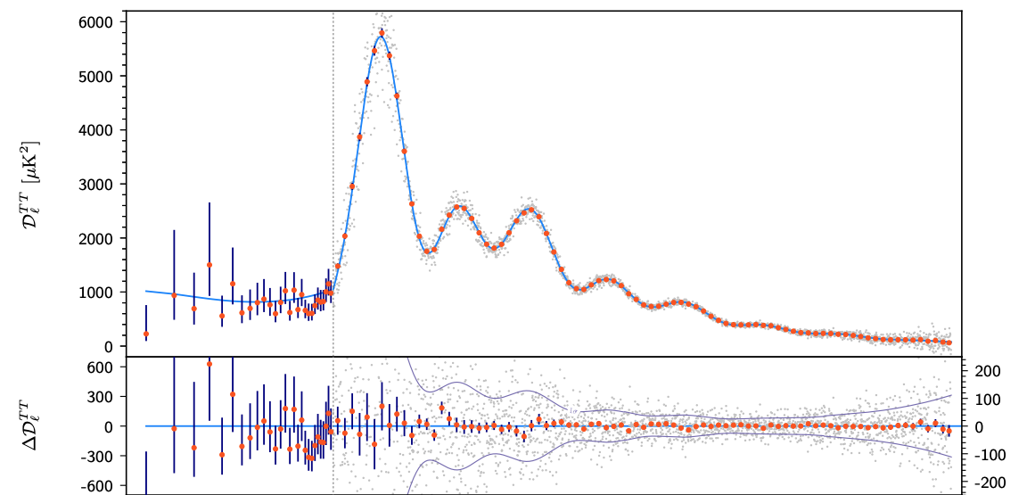
“We have two well-tested fundamental theories of nature: particle physics on small scales and the ΛCDM cosmology on large scales”
(Jim Peebles, 2405.18307)
6 parameters for $≈$ 14 Gyr
($Ω_{b}$, $Ω_{DM}$, $Ω_{DE}$, $n_{s}$, $∆_{R}$, $τ_{re}$)
(Fig. 57 and Tab. 20
from Planck 2018 1907.12875)

Slide 3
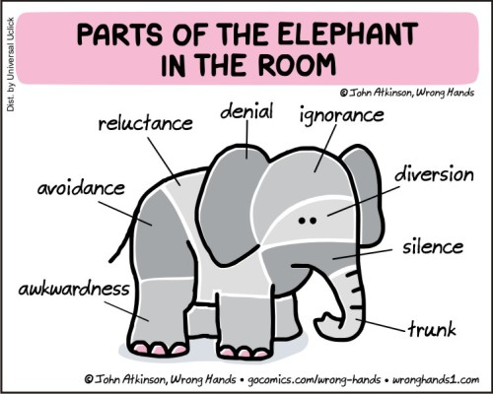
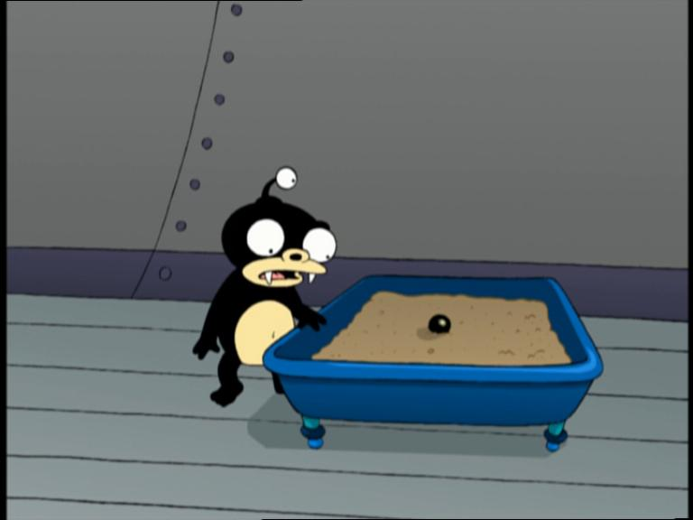
Problems sourced by ignorance:
What is the cosmological constant?
"If you're puzzled by what dark energy is, you're in good company.”
(Saul Perlmutter)
What is the Dark Matter?
”..if you’re so smart, why don’t you tell me what that dark matter is? And I’ll have to confess, I don’t know.”
(Jim Peebles)
(Futurama S1 E4, Image from Futurama Wiki)

Slide 4
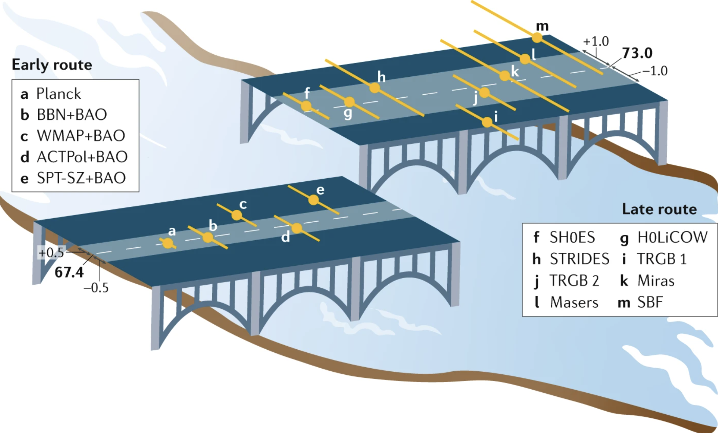
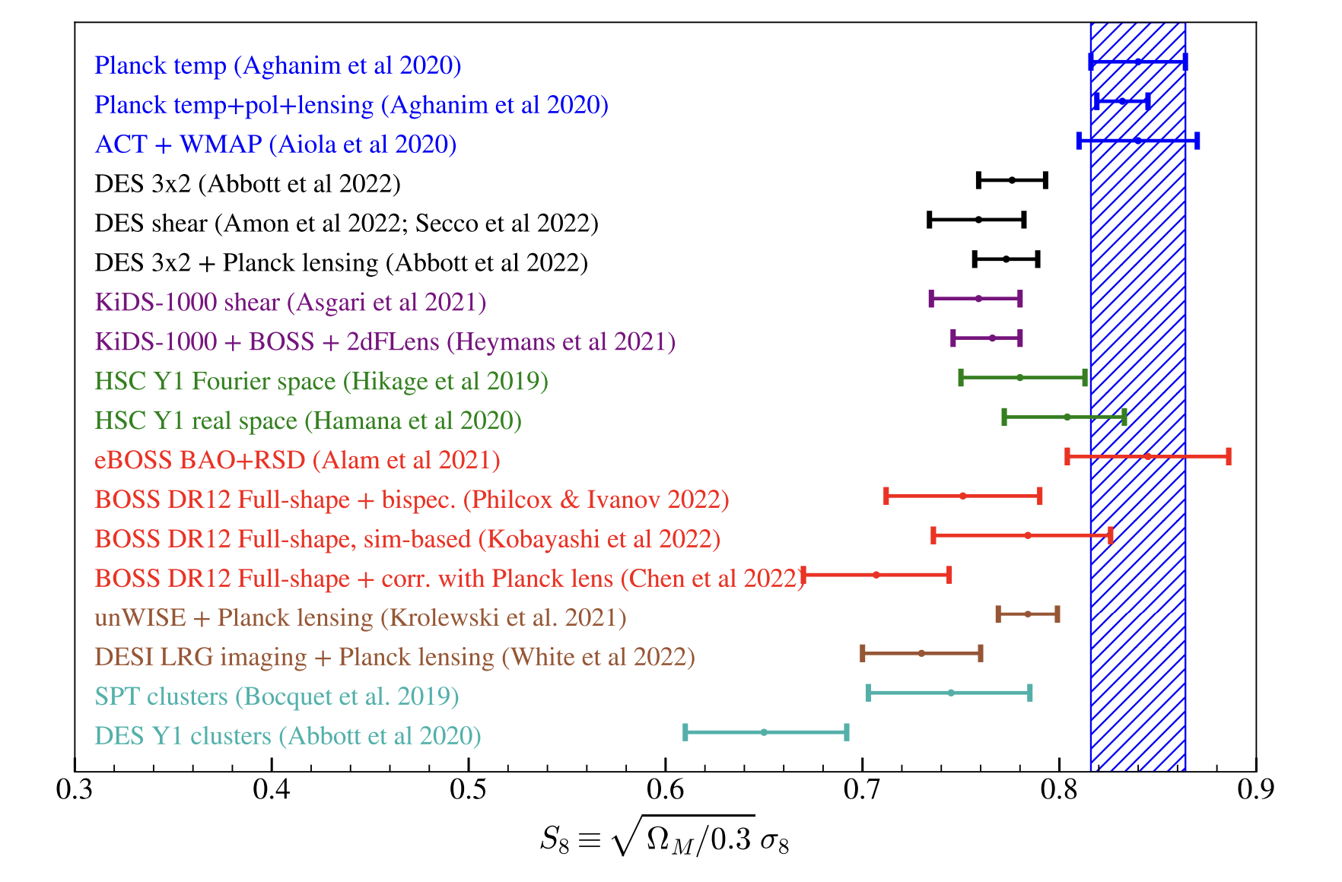
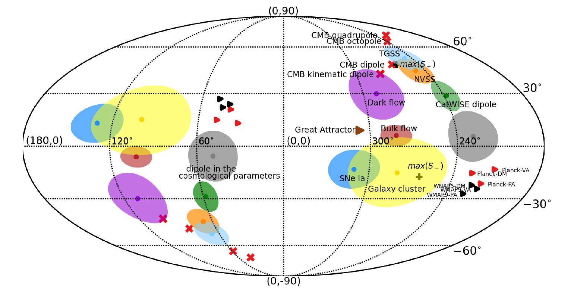
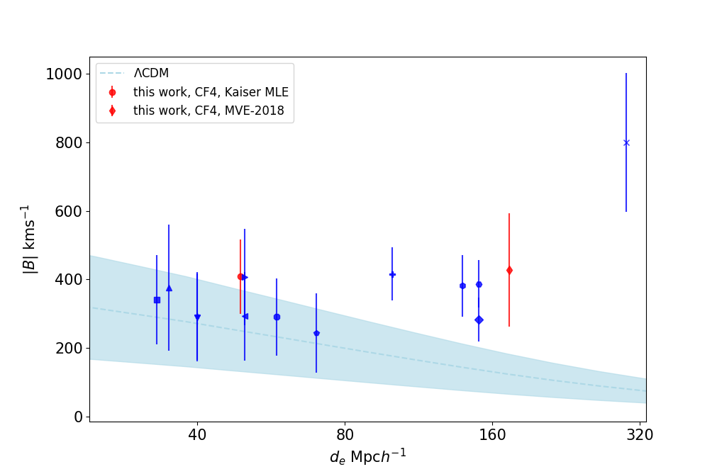
$$H_{0}$$
A. Riess, Nat Rev Phys 2, 10–12 (2020)
Problems sourced by knowledge
“Confidence is what you have before you understand the problem”
(Woody Allen)
(+ CMB anomalies, DES Y5 + DESI evidence for phantom DE etc. etc.)
$$σ_{8}$$
$$BF$$
$$CP$$
Huterer, Astron.Astrophys.Rev. 31 (2023)
(Aluri et. al, 2023 Class.Quant.Grav. 40)
Whitford et. al, (2306.11269)

Slide 5
Status of Cosmology
“Indeed, it has been said that democracy $ΛCDM$ is the worst form of government Cosmology except all those other forms that have been tried from time to time.”
(Winston Churchill-ish)
How to move forward?
My advice is to go for the messes — that's where the action is.
(Steven Weinberg,
Four golden lessons, [Nature 426, 389 (2003)] )

Slide 6
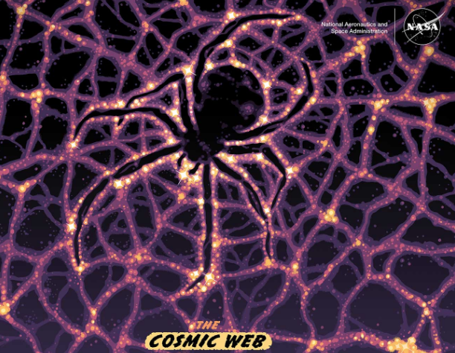
Status of Cosmology
How to move forward?
My advice is to go for the messes — that's where the action is.

Slide 7
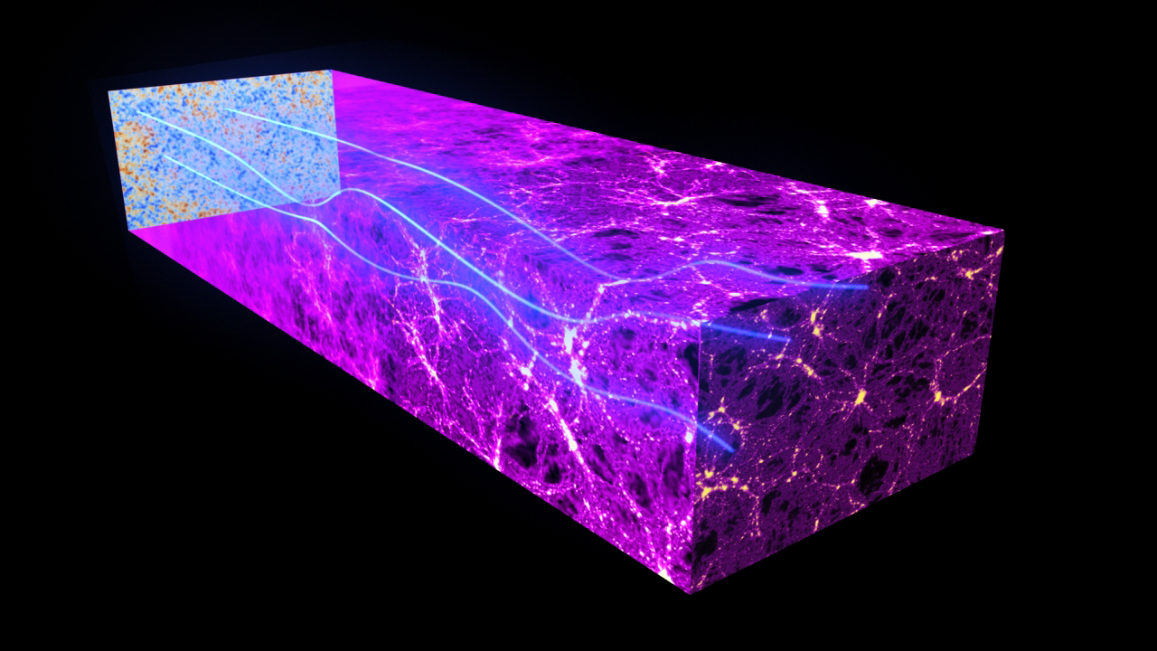
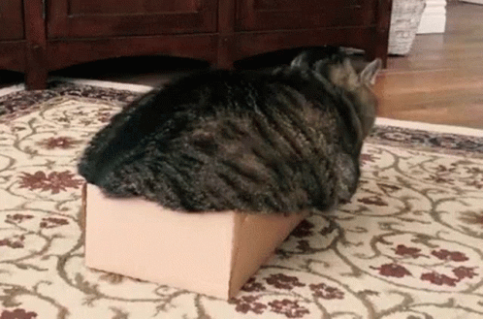
Evolution of the Cosmic Web
First (free) light waves surfing the Universe
Cat = Overdensity
(ESA & Planck Collaboration, https://sci.esa.int/s/84eom0A)
Box = Perturbed FLRW

Slide 8
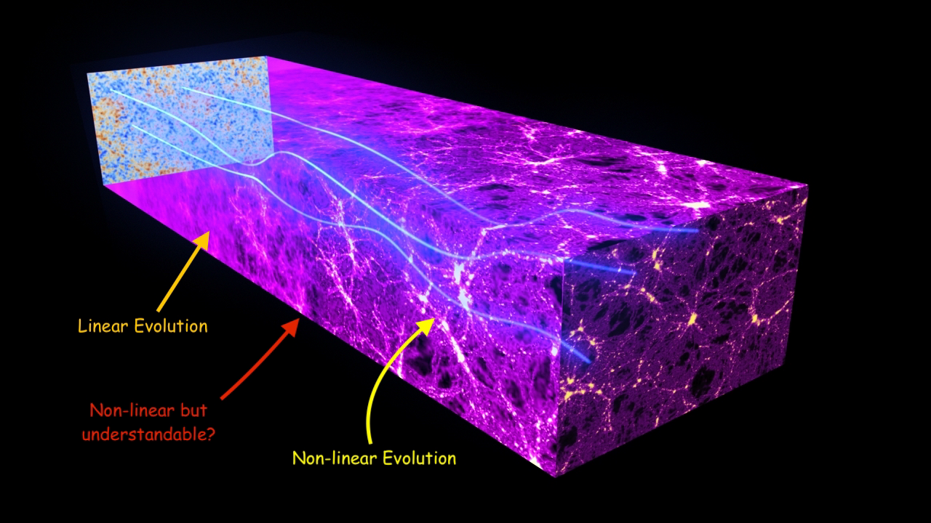
Evolution of the Cosmic Web
First (free) light waves surfing the Universe
Spherical collapse
Zeldovich Solution
Simulations
(ESA & Planck Collaboration, https://sci.esa.int/s/84eom0A)

Slide 9
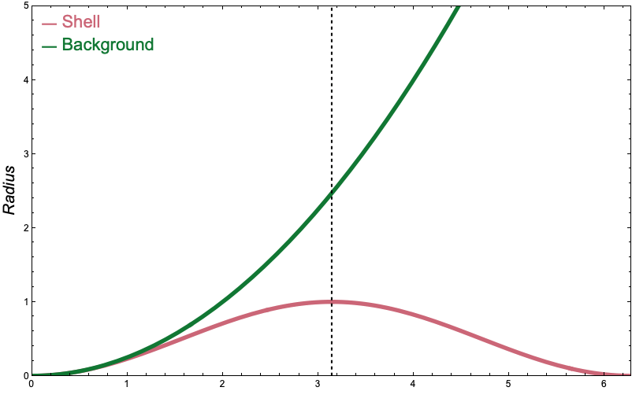
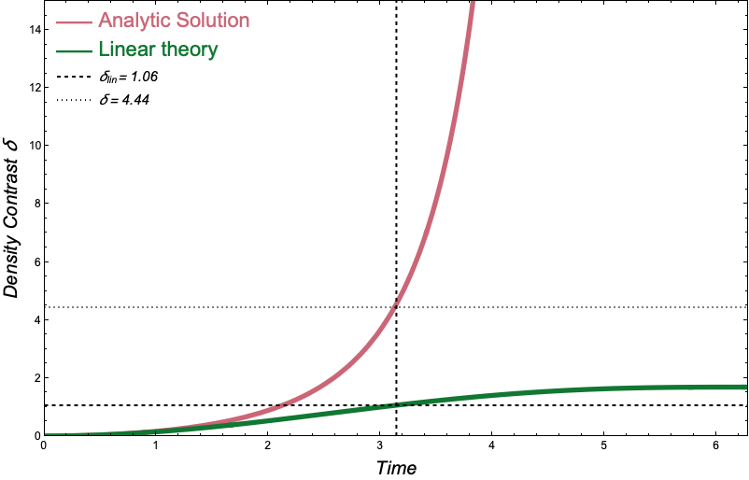
Spherical Collapse
The overdensity is a single spherical shell of radius $R\left(t\right)$
evolving like a non-flat FLRW
$$\frac{{\dot{R}}^{2}}{R^{2}}=\frac{8πG}{3}ρ_{sh}− \frac{K}{R^{2}}$$
$$\frac{{\dot{a}}^{2}}{a^{2}}=\frac{8πG}{3}ρ_{bg}$$
Initially expands with the background Universe $R \sim a$, but eventually curvature dominates over matter
(turnaround at $\dot{R}=0$)

Slide 10
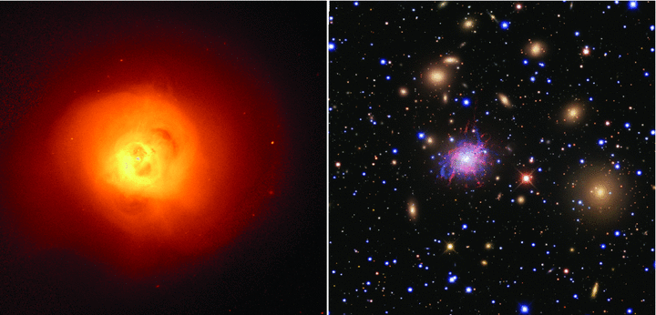
Is the spherical collapse realized in nature?
(The core of the Perseus Cluster in X-ray and optical, [Fabian et. Al MNRAS 418, (2011)] )

Slide 11
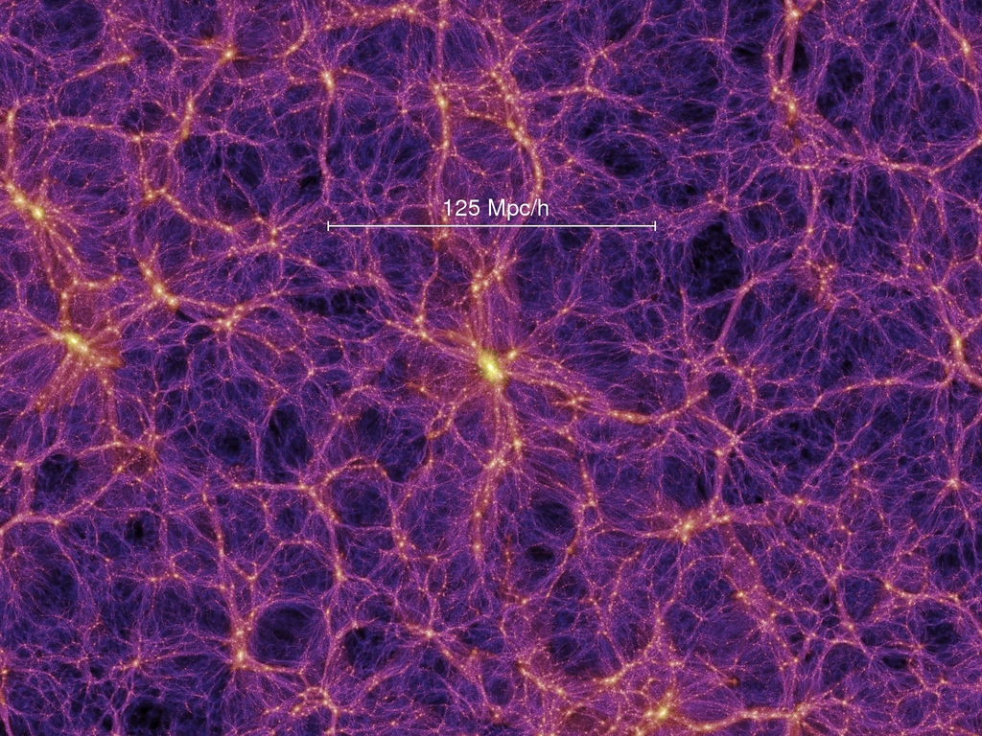
The Zeldovich solution
Describes a 1-dimensional perturbation $λ(t)$:
$$ds^{2}=−dt^{2}+{a\left(t\right)}^{2}\left[\left(1−λ \right)dx^{2}+dy^{2}+dz^{2}\right]$$
in Einstein de Sitter $λ∝ t^{\frac{2}{3}}$
Predicts one-dimensional collapse of
overdensities into “pancakes”
The Millenium Simulation Project
(https://wwwmpa.mpa-garching.mpg.de/galform/virgo/millennium/#refs))

Slide 12
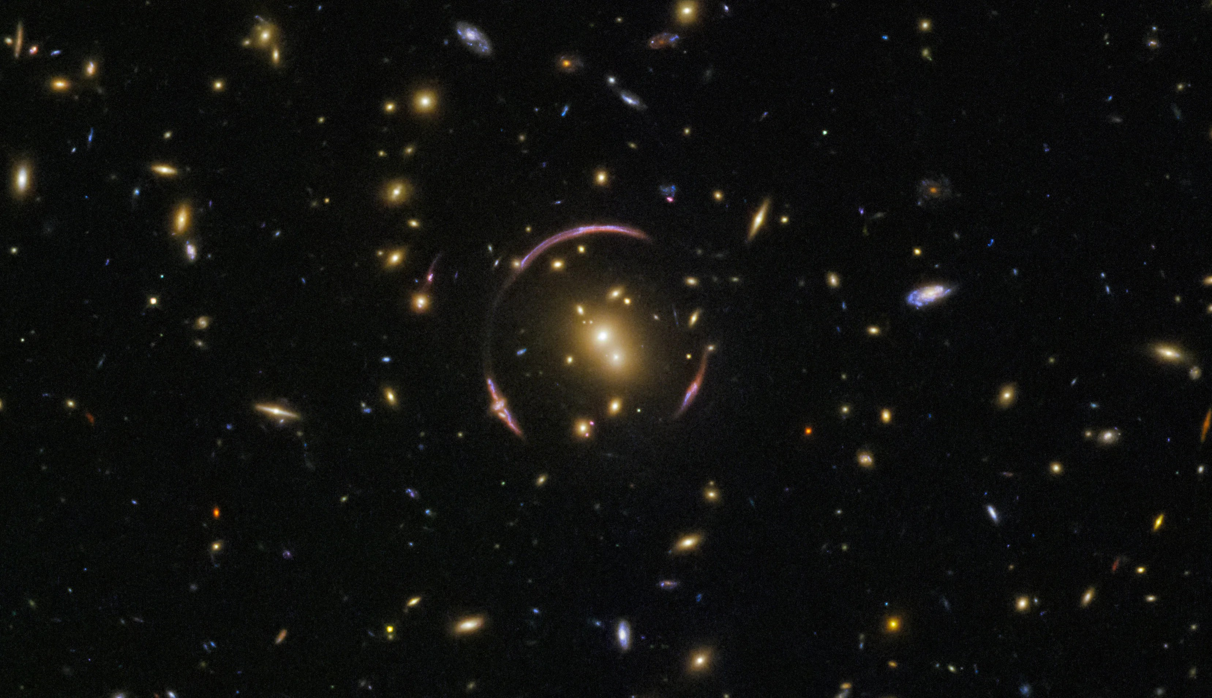
Summarizing: Cosmic Lego Bricks
Pancake
Pancake
Spherical
Cluster
Filament
Filament
Filament

Slide 13
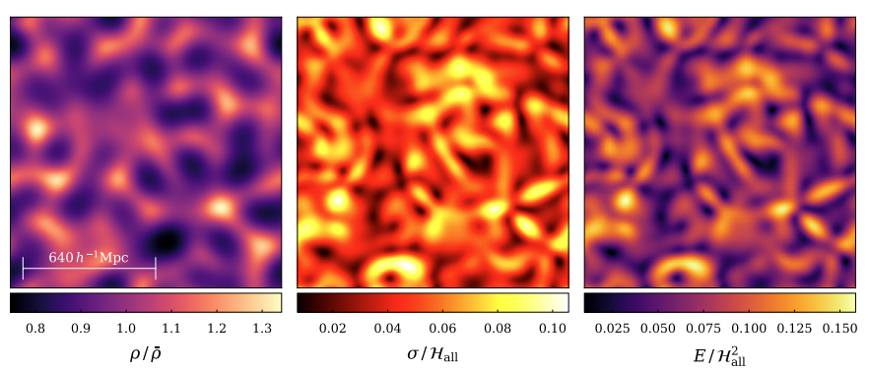
Perfect spheres and pancakes are idealised scenarios.
Deep in the non-linear regime, we can only rely on simulations
[Heinesen and Macpherson, JCAP 03 (2023)]
(Credit: Andrey Kratsov and Anatoly Klypin
http://cosmicweb.uchicago.edu/filaments.html)

Slide 14
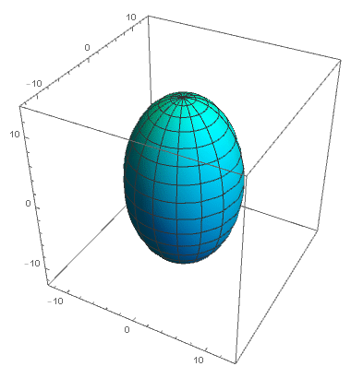
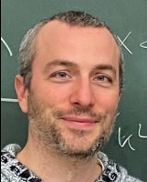
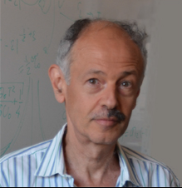
My two cents as a theorist:
Bianchi IX gravitational collapse
Animation From Wikipedia
(https://commons.wikimedia.org/wiki/File:BKLChaotic.gif)
-Fully Anisotropic ☆
- Contains spherical collapse and Zeldovich solutions ☆
LG, O.Piattella and A. Kamenshcik, JCAP 03, 028 (2022)
At least one scale factor contracting (expanding) and one expanding (contracting), switching chaotically

Slide 15
Our results:
Almost spherical Cows: BIX perturbations of spherical collapse
Anisotropies behaves effectively as spatial curvature
Modified Press-Schechter and additional pressure at virialization
- Miscooked Pancakes: BIX perturbations of the Zeldovich solution
The 1-dimensional collapse becomes 2-dimensional, suitable for the description of filaments!
Very interesting follow-up work Malkievichz et al, PRD 109 (2024):
Relativistic modelling of cosmological structures with Bianchi IX spacetimes,
with a rigorous treatment of the matching of BIX in FLRW

Slide 16
Cosmic Lego Bricks (again)
1D BIX
1D BIX
Almost spherical
BIX
2D BIX
2D BIX
2D BIX

Slide 17
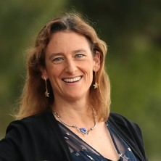
Cosmology from the perspective of an almost spherical cow
-Can our cosmic environment be described as a BIX spacetime?
-What does the Universe look like from one of these structures?
An effective description of Laniakea: Impact on Cosmology and the local determination of the Hubble constant
LG et al. , JCAP 01 , 071 (2024)
C. Howlett
K. Said
S. Vagnozzi
T. Davis

Slide 18
Data-driven approach:
Data: Peculiar velocities
Peculiar motions and cosmic expansion are degenerate (i.e. indistinguishable without distance indicators)
Theory: BIX
The expanding structure should have an ellipsoidal shape (Kasner-like epoch)

Slide 19
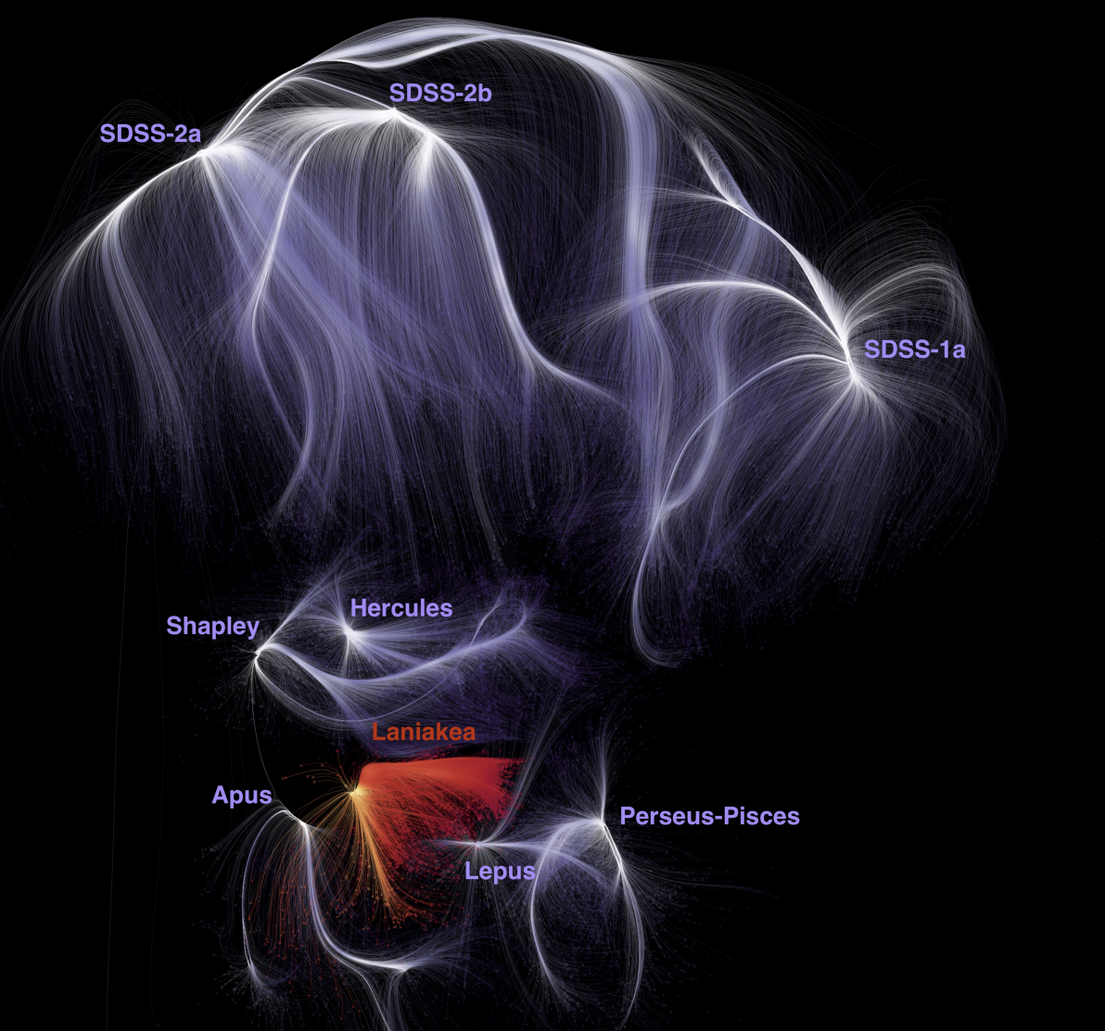
Where do we live?
Dupuy et al. MNRAS 489 (2019) show that it is possible to partition the Universe into gravitational basins of attraction using streamlines.
Streamline = Curve tangent to a time-independent velocity field at any point
Gravitational basin = Volume of space enclosing all the streamlines originating within it
Fig.1 from Dupuy and Courtois, A&A 678 (2023)

Slide 20
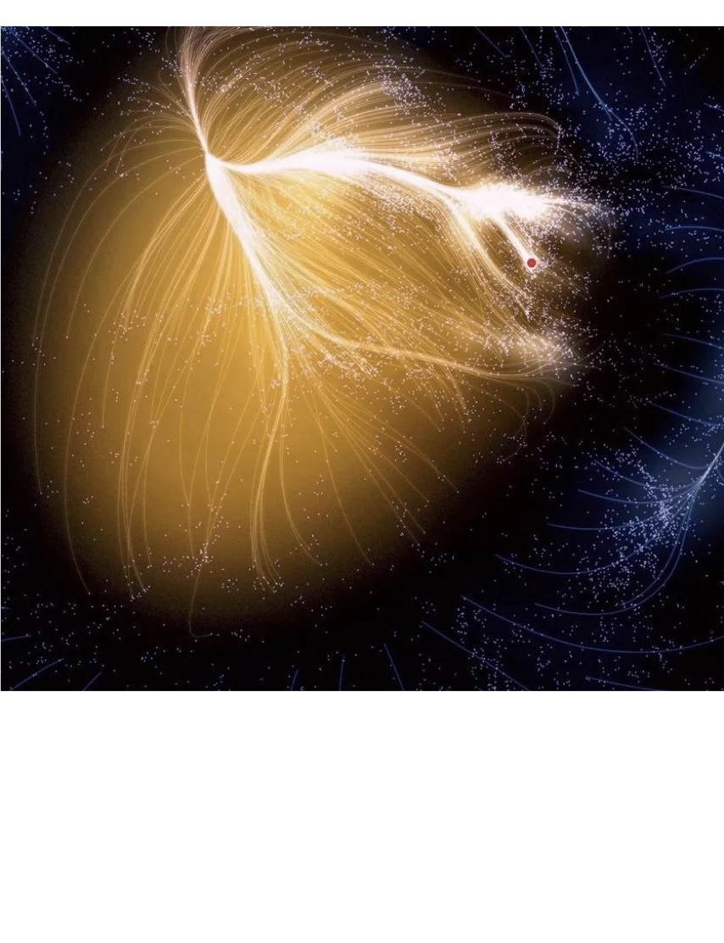
Laniakea: our home in the cosmos
Using Laniakea’s mask from Dupuy and Courtois, A&A 678 (2023)
Tully et al, Nature 513 (2014)
Best fit ellipsoid for its surface

Slide 21
Our model assumes a different Hubble rate
for each principal axe of the ellipsoid
Peculiar velocities
Anisotropic expansion
The best fit values for the expansion rates are:
$$H_{a}≈ H_{0}−3.40$$
$$H_{b}≈ H_{0}−0.65$$
$$H_{c}≈ H_{0}+0.69$$
Radial velocities CF4
(the data)
Best fit Triaxial model
(the theory)
Courtois et al, A&A 670 (2023)

Slide 22
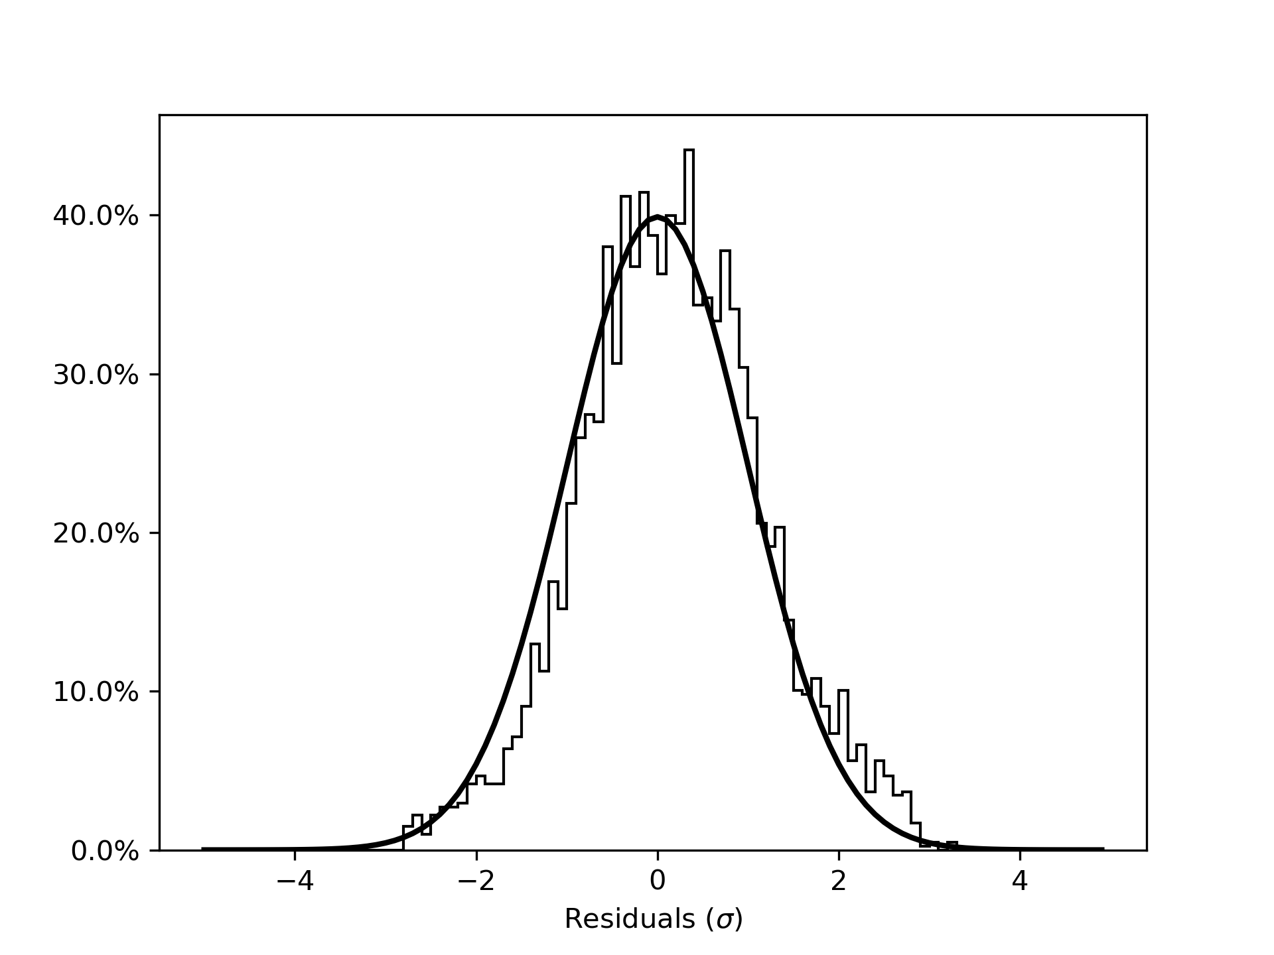
The fit is remarkably good!

Slide 23
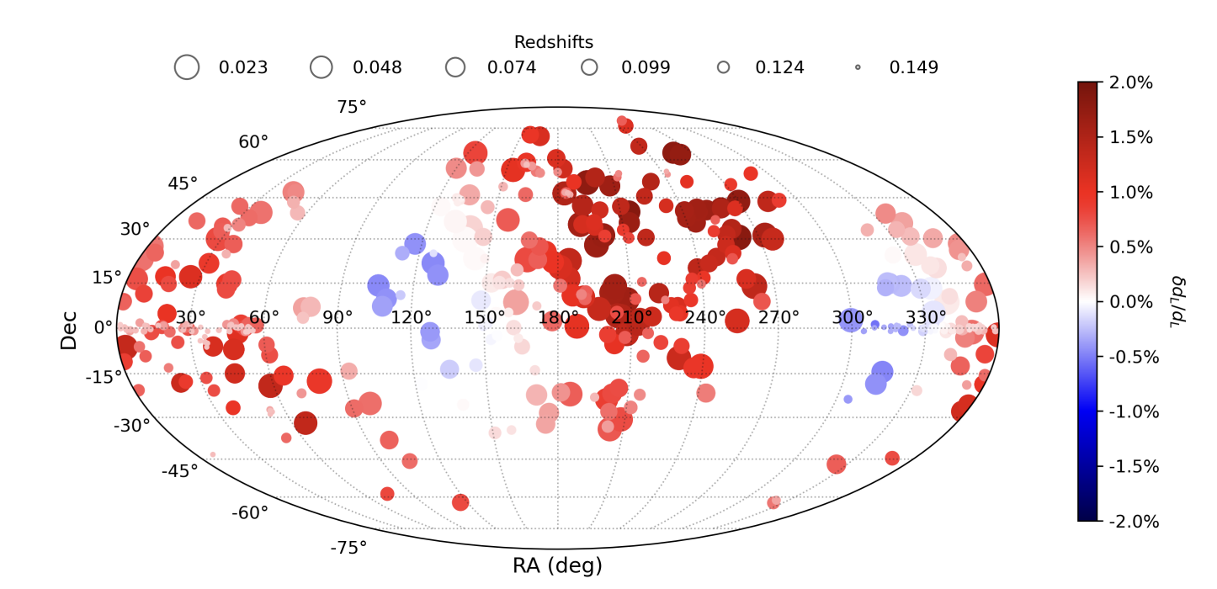
Impact on Cosmology?
Cosmological distances need to be corrected for the different directional expansion rate:
$$Δχ\left(\overline{z},θ,φ\right)=\int_{0}^{\overline{z}}{dz}\frac{1}{H\left(z,θ,φ\right)} −\frac{1}{\overline{H}\left(z\right)}$$
$$δd_{L}\left(\overline{z},θ,φ\right)={\overline{d}}_{L}\frac{Δχ\left(\overline{z},θ,φ\right)}{\overline{χ}\left(\overline{z}\right)}$$
Corrections for the Pantheon+ SnIa between 0.023 < z < 0.15

Slide 24
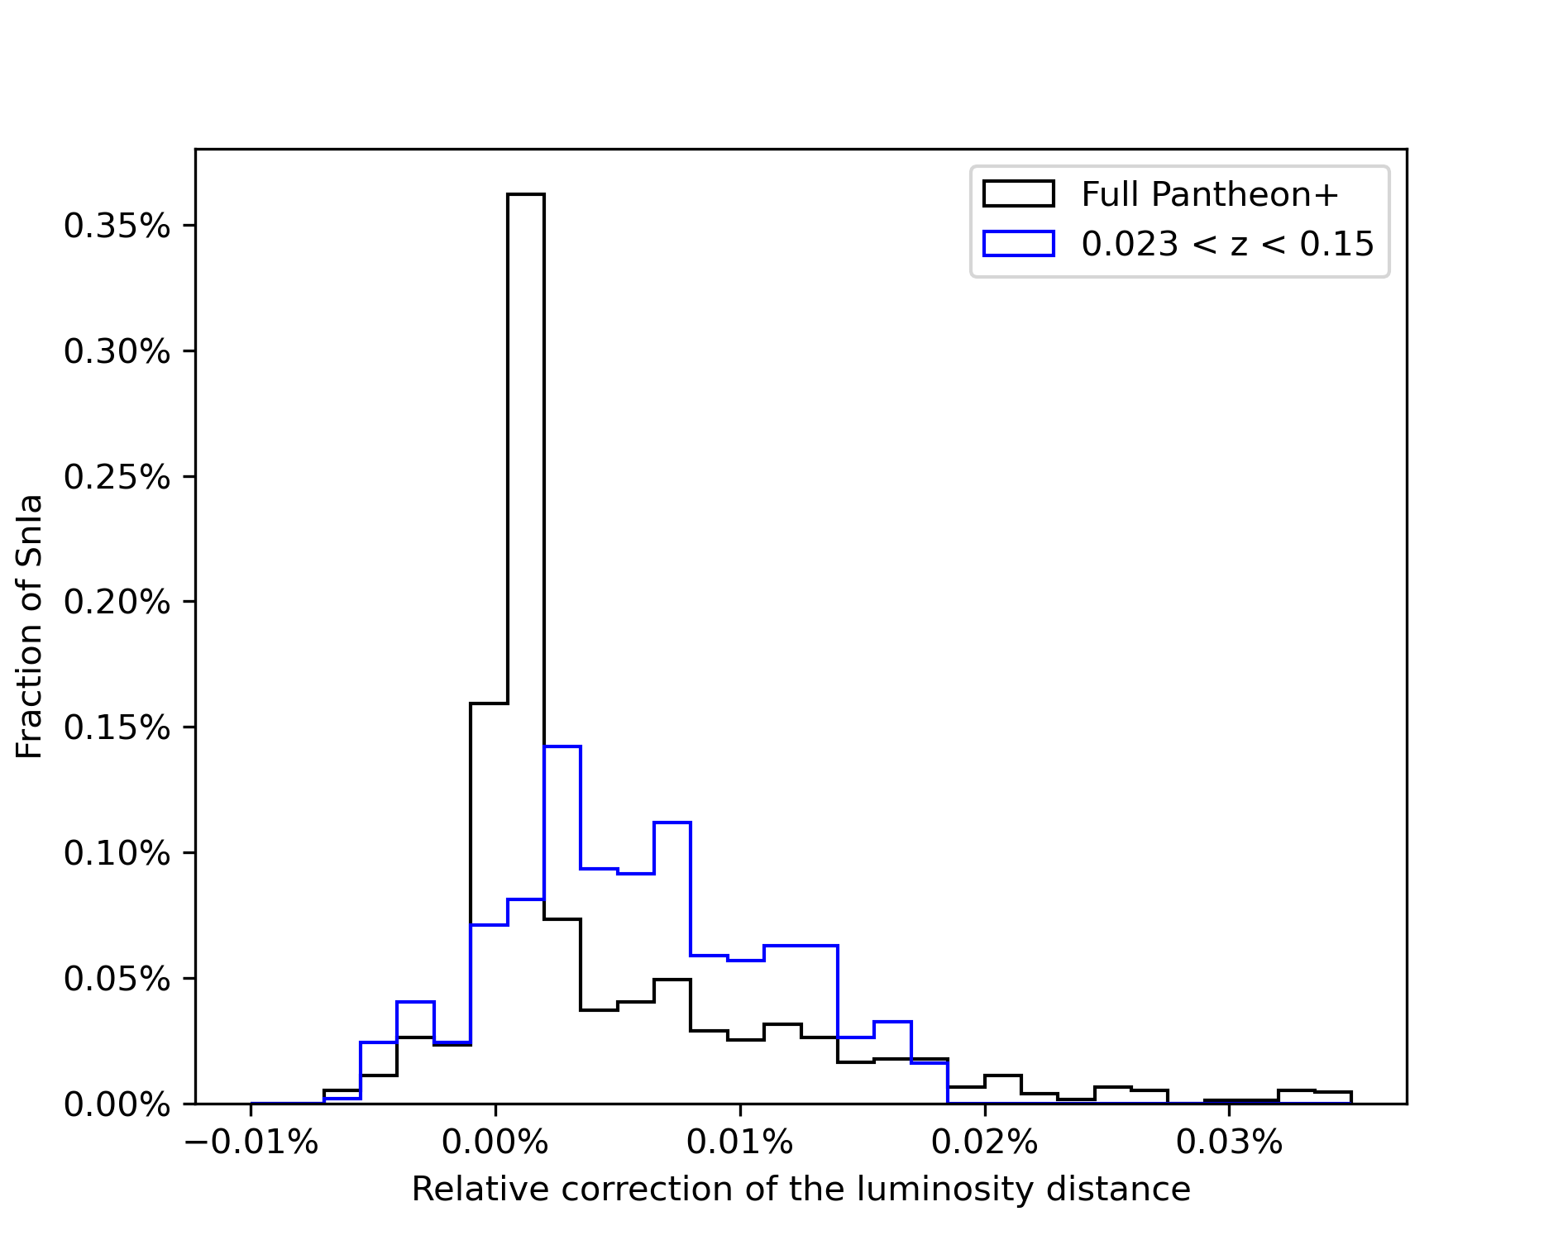
Impact on Cosmology?
The closer the source, the larger the correction
For lowz Pantheon+ $ΔH_{0} \sim 0.5 \frac{km}{s Mpc}$
...in the wrong direction! Laniakea’s backreaction slightly increases the tension

Slide 25
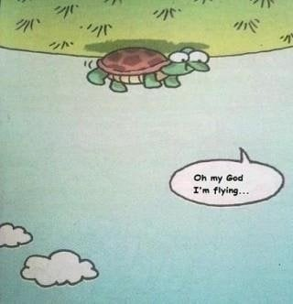
Summary and Take aways :
We need better analytical modelling for the formation of LSS in the Universe. Elliptical cows might be a good starting point!
(Comic by Ingrid Kallick for the program cover of the 1996 American Astronomical Association meeting [Wikipedia])
Our cosmological inference might be systematically biased by our cosmic environment. High-precision cosmology might require high-precision modelling

Slide 26
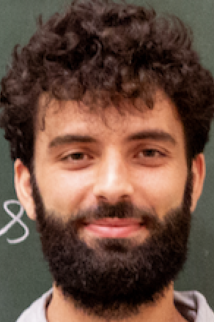
Self-Advertisement
“Much of this research requires large teams that must focus on specific goals. This is essential but it hinders recognition of other possibly interesting hints to the nature of reality.
It is worth widening your vision on occasion to see if you can spot one, while keeping your day job.”
(Jim Peebles)
Dr. Leo
I’m on the job market,
If you liked my science, please feel free to reach out!
(MCSA season is almost there)

Slide 27
Thanks for your attention! Looking forward to your questions!

Slide 28
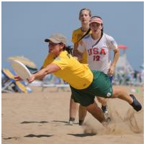
Backup: Cosmic Web or Cosmic Crystal?
It seems that scientists are often attracted to beautiful theories in the way that insects are attracted to flowers.
Not by logical deduction, but by something like a sense of smell
(Steven Weinberg)
Based on arXiv: 2205.05235 (LG, T. Davis)
(honorable mention at the Gravity Research Foundation 2022 Awards for Essays on Gravitation)

Slide 29
Ingredients:
-Structures in the cosmic web inherit intrinsic “quantum” spin from the BIX SU(2) symmetry
-At late times, these “spinors” are distributed on a static lattice
(The cosmic web is “frozen” in comoving coordinates)
-The “Background” Universe can be thought of as a thermal bath approaching
its minimum temperature $≈\sqrt{Λ}$

Slide 30
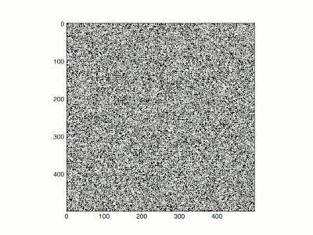
Taking these speculations semi-seriously, is there any phenomenological implications?
Well, Quantum Physicists have been studying spin lattices for more than a century now.
The simplest example is the Ising model, a lattice of spin $↑$ and $↓$
The spins are randomly distributed at high temperatures, but at low ones (close to the critical temperature T) they align coherently
(Time evolution correspond to decreasing temperature)

Slide 31
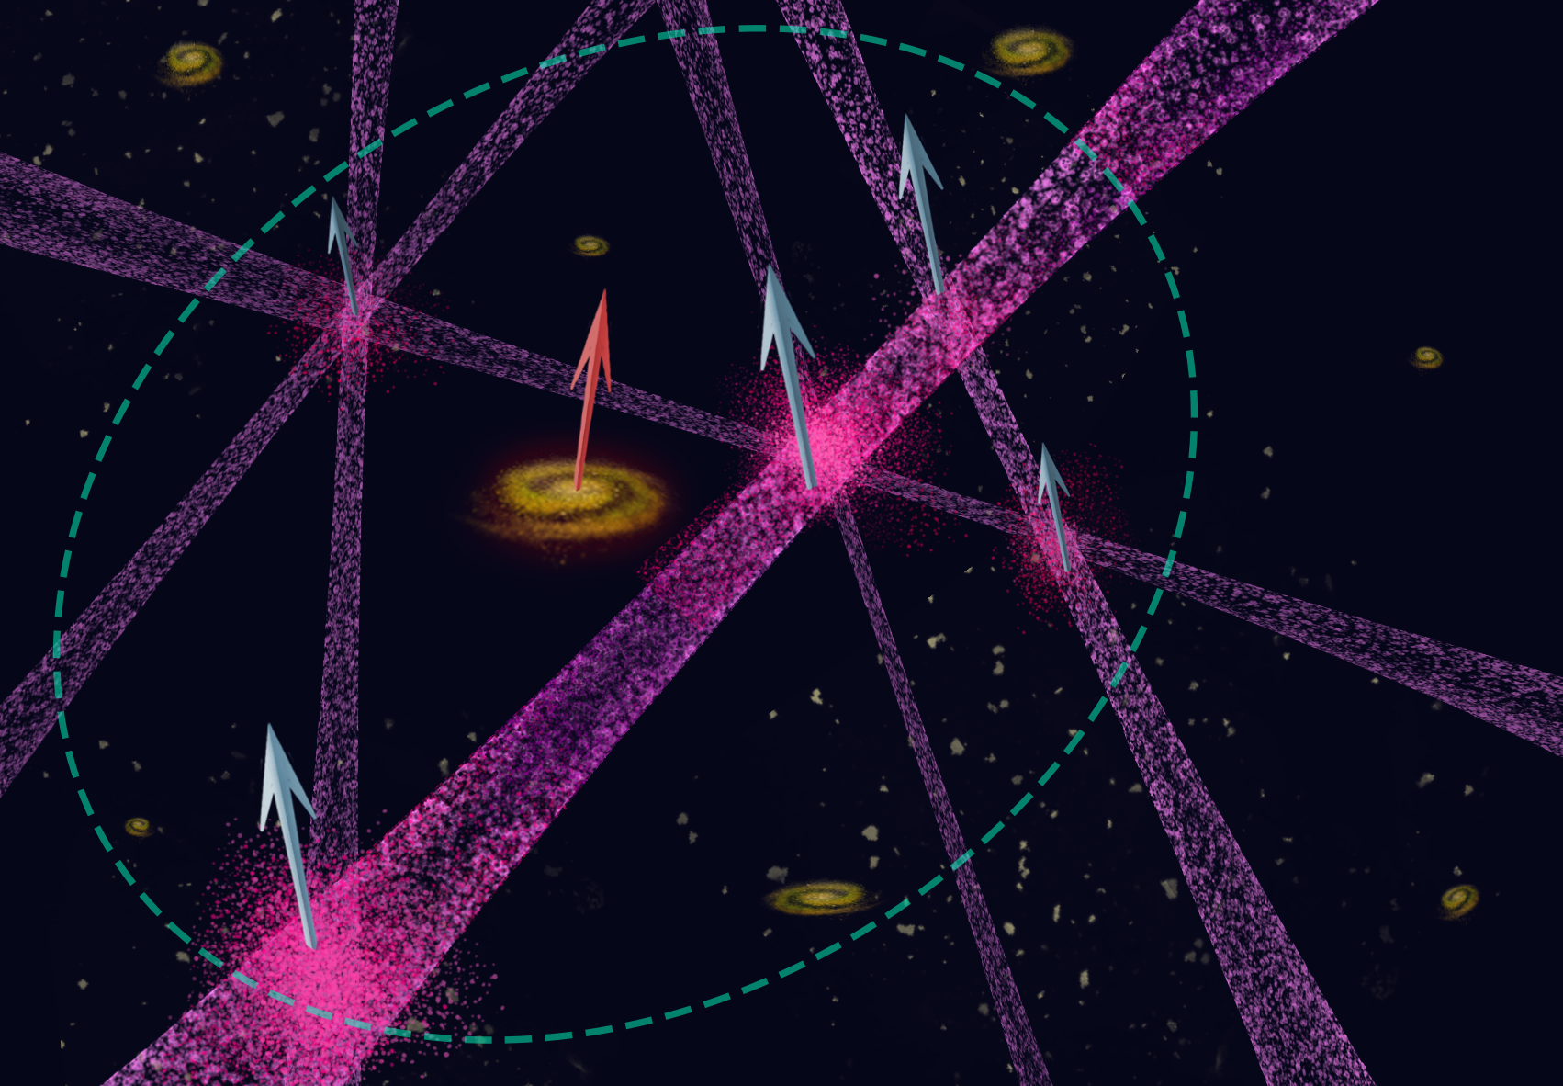
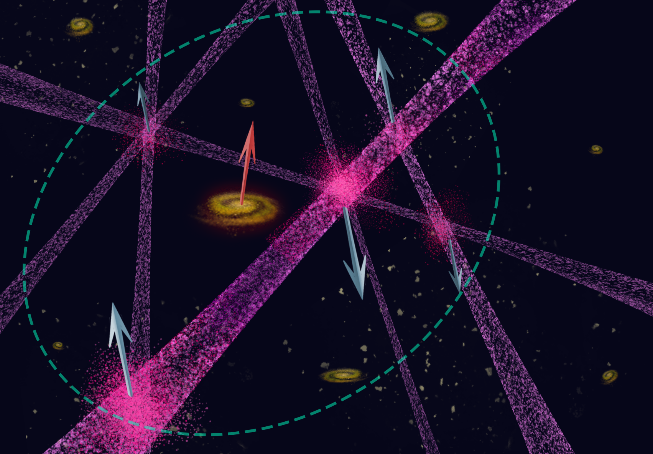
Ising Model for the cosmic web!
Ferromagnetic Cosmic web
Anti-Ferromagnetic Cosmic web
Gravitoelectromagnetism would naturally predict a velocity dipole!

Slide 32
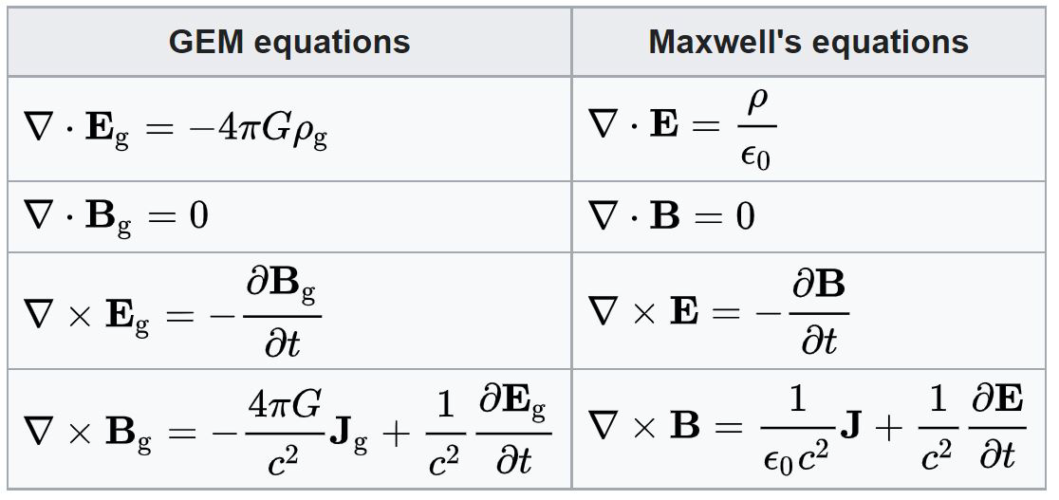
If the Cosmic Web is in a ferromagnetic state, a spontaneous “gravitomagnetization” occurs, implying long-range (large-scale) correlations
Every galaxy with mass $m$ and velocity $v$ feels a Lorentz force proportional to $B_{g}v\sin\left(θ\right).$
In other words, a cosmic dipole!
Ever

