Slide 1
Cosmological models with peculiar velocities from solutions of Einstein’s equations
Sebastián Nájera & Roberto A Sussman
ICN-UNAM, ICF-UNAM sussman@nucleares.unam.mx

Slide 2
Most common choice in Cosmology: comoving frames
Comoving frame: align coordinates with
“time” = proper time of comoving observers
“space” = rest frames of comoving observers
Non-comoving frames define peculiar velocities
Peculiar velocities are spacelike vectors
Lorentz boost

Slide 3
There is no UNIQUE frame that splits spacetime into “time” & “3-d space”
$${\overset{̂}{u}}^{a}=\frac{u^{a}}{\sqrt{1-g_{ab}v^{a}v^{b}}}$$
Time = Wordlines of observers (tangent to uª)
$$v^{a}$$
$$u^{a}$$
$$g_{ab}u^{a}v^{b}=0$$
$${\overset{̂}{u}}^{a}$$
$$h^{ab}=g^{ab}+u^{a}u^{b}$$
$${\overset{̂}{h}}^{ab}=g^{ab}+{\overset{̂}{u}}^{a}{\overset{̂}{u}}^{b}$$
3-d spaces = hyper surfaces orthogonal to uª
Different observers see different fluxes

Slide 4
Consider T^{ab} in a comoving frame uª
$$T^{ab}=(ρ+Λ)u^{a}u^{b}+(p-Λ)h^{ab}+Π^{ab}+2q^{(a}u^{b)}$$
In another frame ${\overset{̂}{u}}^{a}$ NOT comoving with uª
$$[{\overset{̂}{u}}^{a}=γ(u^{a}+v^{a})]$$
the relation between the “hat” and “no hat” variables is
$$ρ=\overset{̂}{ρ}+Λ+2γ{\overset{̂}{q}}^{a}v_{a}+\left\{γ^{2}v^{a}v_{a}(\overset{̂}{ρ}+\overset{̂}{p})+{\overset{̂}{Π}}^{ab}v_{a}v_{b}\right\},$$
$$p=\overset{̂}{p}-Λ+\frac{2}{3}γ{\overset{̂}{q}}^{a}v_{a}+\frac{1}{3}\left\{γ^{2}v^{a}v_{a}(\overset{̂}{ρ}+\overset{̂}{p})+{\overset{̂}{Π}}^{ab}v_{a}v_{b}\right\}$$
$$q^{a}={\overset{̂}{q}}^{a}+(\overset{̂}{ρ}+\overset{̂}{p})v^{a}+(γ-1){\overset{̂}{q}}^{a}-γ{\overset{̂}{q}}^{b}v_{b}{\overset{̂}{u}}^{a}+γ^{2}v^{b}v_{b}(\overset{̂}{ρ}+\overset{̂}{p})v^{a}$$
$$+{\overset{̂}{Π}}^{ab}v_{b}-{\overset{̂}{Π}}^{ab}v_{b}v_{c}{\overset{̂}{u}}^{a}$$
$$Π^{ab}={\overset{̂}{Π}}^{ab}+γ^{2}(\overset{̂}{ρ}+\overset{̂}{p})v^{⟨a}v^{b⟩}-2u^{(a}{\overset{̂}{Π}}^{b)c}v_{c}+{\overset{̂}{Π}}^{cd}v_{c}v_{d}{\overset{̂}{u}}^{a}{\overset{̂}{u}}^{b}$$
$$-\frac{1}{3}{\overset{̂}{Π}}^{cd}v_{c}v_{d}{\overset{̂}{h}}^{ab}-2γ{\overset{̂}{q}}^{c}v_{c}u^{(a}v^{b)}+2γv^{⟨a}{\overset{̂}{q}}^{b⟩}$$

Slide 5
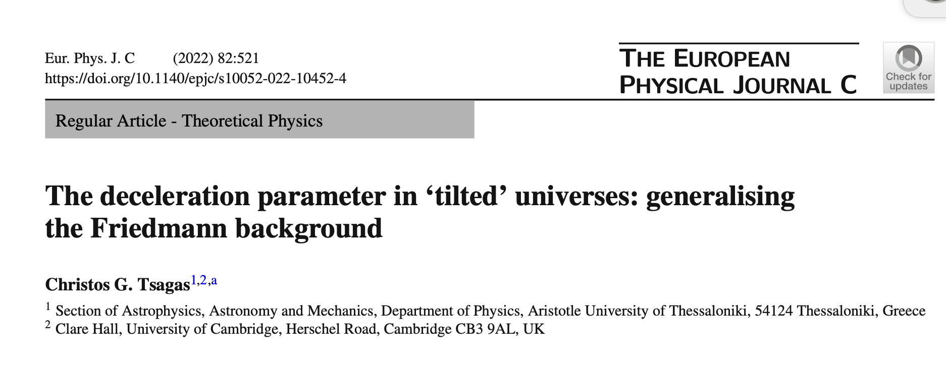
Pioneering work on “tilted” frames based on GR but assuming a linear perturbation regime
Find exact solutions of Einstein’s equations compatible with this idea

Slide 6
Simplify matters:
Hatted fluid is DUST:
$${\overset{̂}{T}}^{ab}=\overset{̂}{ρ}{\overset{̂}{u}}^{a}{\overset{̂}{u}}^{b}$$
How does this fluid is seen from the frame ?
$$u^{a}$$
What are we modeling?
Non-hatted frame is comoving with the CMB
Hatted fluid is CDM + baryons that is not comoving with the CBM frame:
Further assumptions
Neglect CMB & baryons $Ω_{γ}≪Ω_{b}≪Ω_{cdm}$
Non relativistic velocities
$$v^{a}≪1,γ≈1$$

Slide 7
$${\overset{̂}{T}}^{ab}=\overset{̂}{ρ}{\overset{̂}{u}}^{a}{\overset{̂}{u}}^{b}$$
$$T^{ab}$$
If
what is the form of ?
$$p=\frac{1}{3}γ^{2}v^{a}v_{a}(\overset{̂}{ρ}+\overset{̂}{p})$$
$$ρ=\overset{̂}{ρ}+γ^{2}v^{a}v_{a}(\overset{̂}{ρ}+\overset{̂}{p}),$$
$$q^{a}=(\overset{̂}{ρ}+\overset{̂}{p})v^{a}+γ^{2}v^{b}v_{b}(\overset{̂}{ρ}+\overset{̂}{p})v^{a}$$
$$Π^{ab}=γ^{2}(\overset{̂}{ρ}+\overset{̂}{p})v^{⟨a}v^{b⟩}$$
Eliminating higher order terms on peculiar velocities
$$v^{a}≪1,γ≈1$$
$$ρ=\overset{̂}{ρ},$$
$$q^{a}=\overset{̂}{ρ}v^{a},$$
$$p=0,Π^{ab}=0$$
To handle this approximation we need cosmological models with
$$T^{ab}=ρu^{a}u^{b}+2q^{(a}u^{b)},q^{a}=ρv^{a}$$

Slide 8
Solutions of Einstein’s equations compatible with
$$T^{ab}=ρu^{a}u^{b}+2q^{(a}u^{b)},q^{a}=ρv^{a}$$
Szekeres models of class II
$$ds^{2}=-dt^{2}+a^{2}\left[X^{2}dw^{2}+\frac{dx^{2}+dy^{2}}{f^{2}}\right],$$
$$a=a(t),X=X(t,w,x,y),f=1+\frac{1}{4}(x^{2}+y^{2})$$
$$u^{a}=δ_{t}^{a},{\overset{·}{u}}_{a}=0,σ_{ab}≠0$$
Nájera, S., & Sussman, R. A. (2020). Pancakes as opposed to Swiss cheese. Classical and Quantum Gravity, 38(1), 015016
Nájera, S., & Sussman, R. A. (2021). Non-comoving cold dark matter in a ΛCDM background. The European Physical Journal C, 81(4), 1-14

Slide 9
Shear-free models
$$ds^{2}=-\frac{N^{2}}{L^{2}}dt^{2}+\frac{dx^{2}+dy^{2}+dz^{2}}{L^{2}},$$
$$N=N(t,x,y,z),L=L(t,x,y,z),$$
$$u^{a}=\frac{Lδ_{t}^{a}}{N},{\overset{·}{u}}_{a}=h_{a}^{b}∇_{b}\left[ln\frac{N}{L}\right]σ_{ab}=0$$
R A Sussman. New solutions for heat conducting fluids with a normal shear-free flow. Class. Quantum Grav. 10, 2675 (1993)
B. V. Ivanov. Collapsing shear-free perfect fluid spheres with heat flow. Eur. Phys. J. Plus 135, 377 (2020)
Some Bianchi models
$$ds^{2}=-dt^{2}+g_{ij}(t)ω^{i}ω^{j},dω^{i}=\frac{1}{2}C_{jk}^{i}ω^{j}ω^{k}$$
$$u^{a}=δ_{t}^{a},{\overset{·}{u}}_{a}=0,σ_{ab}≠0$$

Slide 10
Szekeres class II models
Line element
$$ds^{2}=-dt^{2}+S^{2}(t)\left[X^{2}dw^{2}+\frac{dx^{2}+dy^{2}}{f^{2}}\right],f=1+\frac{k[x^{2}+y^{2}]}{4},$$
$$X=X(t,x^{i}),x^{i}=w,x,y$$
Orthonormal canonic tetrad
$$e_{(0)}^{a}=δ_{0}^{a},e_{(w)}^{a}=\frac{1}{SX}δ_{w}^{a},e_{(x)}^{a}=\frac{f}{S}δ_{x}^{a},e_{(y)}^{a}=\frac{S}{f}δ_{y}^{a},$$
Admits general energy momentum tensor
Kinematics
$$Θ={\overline{∇}}_{a}u^{a}=\frac{\overset{·}{X}}{X}+\frac{3\overset{·}{S}}{S}$$
Hubble expansion scalar
$$σ{}_{b}^{a}=Σ\text{diag}[0,-2,1,1],Σ=-\frac{\overset{·}{X}}{3X},$$
Shear tensor

Slide 11
Anisotropy of fundamental observers through eigenvalues of the expansion tensor: $Θ{}_{b}^{a}=λ_{(i)}δ_{b}^{a}$
$$λ_{(1)}=Θ_{z}^{z}=\frac{\overset{·}{S}}{S}+\frac{\overset{·}{X}}{X},λ_{(2)}=λ_{(3)}=Θ_{x}^{x}=Θ_{y}^{y}=\frac{\overset{·}{S}}{S}$$
2 equivalent directions: leads to cigar & pancake collapse
$$e_{(1)}$$
$$e_{(2)}$$
$$e_{(3)}$$

Slide 12
Field equations
$$κρ=κ\overline{ρ}-\frac{f^{2}(X_{,yy}+X_{,xx})}{S^{2}X}+\frac{2\overset{·}{S}\overset{·}{X}}{SX},κ\overline{ρ}=\frac{3{\overset{·}{S}}^{2}}{S^{2}}+\frac{3k}{S^{2}}-3Λ,$$
$$κp=κ\overline{p}+\frac{1}{3}\frac{f^{2}(X_{,yy}+X_{,xx})}{S^{2}X}-\frac{2}{3}\frac{S\overset{··}{X}+3\overset{·}{S}\overset{·}{X}}{SX},κ\overline{p}=-\frac{2\overset{··}{S}}{S}-\frac{{\overset{·}{S}}^{2}}{S^{2}}-\frac{k}{3S^{2}}+Λ,$$
$$κq^{x}=\frac{f^{2}{\overset{·}{X}}_{,x}}{S^{2}X}$$
$$κq^{y}=\frac{f^{2}{\overset{·}{X}}_{,y}}{S^{2}X}$$
$$κq^{w}=0$$
$$κπ^{xx}=\frac{1}{3}\frac{f^{4}(2X_{,yy}-X_{,xx})}{S^{4}X}-\frac{1}{2}\frac{f^{3}k(xX_{,x}-yX_{,y})}{S^{4}X}-\frac{1}{3}\frac{f^{2}(S^{2}\overset{··}{X}+3S\overset{·}{S}\overset{·}{X}-kX)}{S^{4}X},$$
$$κπ^{yy}=-\frac{1}{3}\frac{f^{4}(X_{,yy}-2X_{,xx})}{S^{4}X}+\frac{1}{2}\frac{f^{3}k(xX_{,x}-yX_{,y})}{S^{4}X}-\frac{1}{3}\frac{f^{2}(S^{2}\overset{··}{X}+3S\overset{·}{S}\overset{·}{X}-kX)}{S^{4}X}$$
$$κπ^{ww}=-\frac{1}{3}\frac{f^{2}(X_{,yy}+X_{,xx})}{S^{4}X^{3}}-\frac{2}{3}\frac{k}{S^{4}X^{2}}+\frac{2}{3}\frac{S\overset{··}{X}+3\overset{·}{S}\overset{·}{X}}{S^{3}X^{3}},$$
$$κπ^{xy}=-\frac{f^{3}{\left(fX\right)}_{,xy}}{S^{4}X},$$

Slide 13
Solution k = 0 compatible with
$$T^{ab}=ρu^{a}u^{b}+2q^{(a}u^{b)},q^{a}=ρv^{a},Π^{ab}=p=0,$$
$$π^{xy}=0→X_{xy}=0$$
$$→X=F(t,w)+Φ(t,w,x)+Ψ(t,w,y),$$
$$π^{xx}=π^{yy}=π^{ww}=p=0$$
$$→X=F(t,w)+A(w,x,y)+Q(t,w)B(w,x,y)$$
$$A(w,x,y)=α_{0}(w)+α_{1}(w)x+α_{2}(w)y+α_{3}(w)(x^{2}+y^{2}),$$
$$B(w,x,y)=β_{0}(w)+β_{1}(w)x+β_{2}(w)y+β_{3}(w)(x^{2}+y^{2}),$$
where $α_{i}(w),β_{i}(w)$ are arbitrary free parameters and:
$$\overset{··}{F}+\frac{3\overset{·}{S}}{S}\overset{·}{F}-\frac{2(β_{3}Q+α_{3})}{S^{2}}=0$$
$$\overset{··}{Q}+\frac{3\overset{·}{S}}{S}\overset{·}{Q}=0$$

Slide 14
Kantowski-Sachs limit
$$ds^{2}=-dt^{2}+S^{2}(t)\left[X^{2}dw^{2}+\frac{dx^{2}+dy^{2}}{f^{2}}\right],f=1+\frac{k[x^{2}+y^{2}]}{4},$$
$$X(t,w,x,y)→X(t)$$
FLRW limit: quasi-flat case k = 0, f = 1
$$ds^{2}=-dt^{2}+S^{2}(t)\left[X^{2}dw^{2}+dx^{2}+dy^{2}\right],$$
$$X(t,w,x,y)→1,S(t)=a(t)$$
Smooth matching with spatially flat FLRW
$$w=w_{b}=constant,X(t,w_{b},x,y)=1,S(t)=a(t)$$
$$[X_{,w}]_{w_{b}}=[X_{,x}]_{w_{b}}=[X_{,y}]_{w_{b}}=[\overset{·}{X}]_{w_{b}}=[\overset{··}{X}]_{w_{b}}=0$$

Slide 15
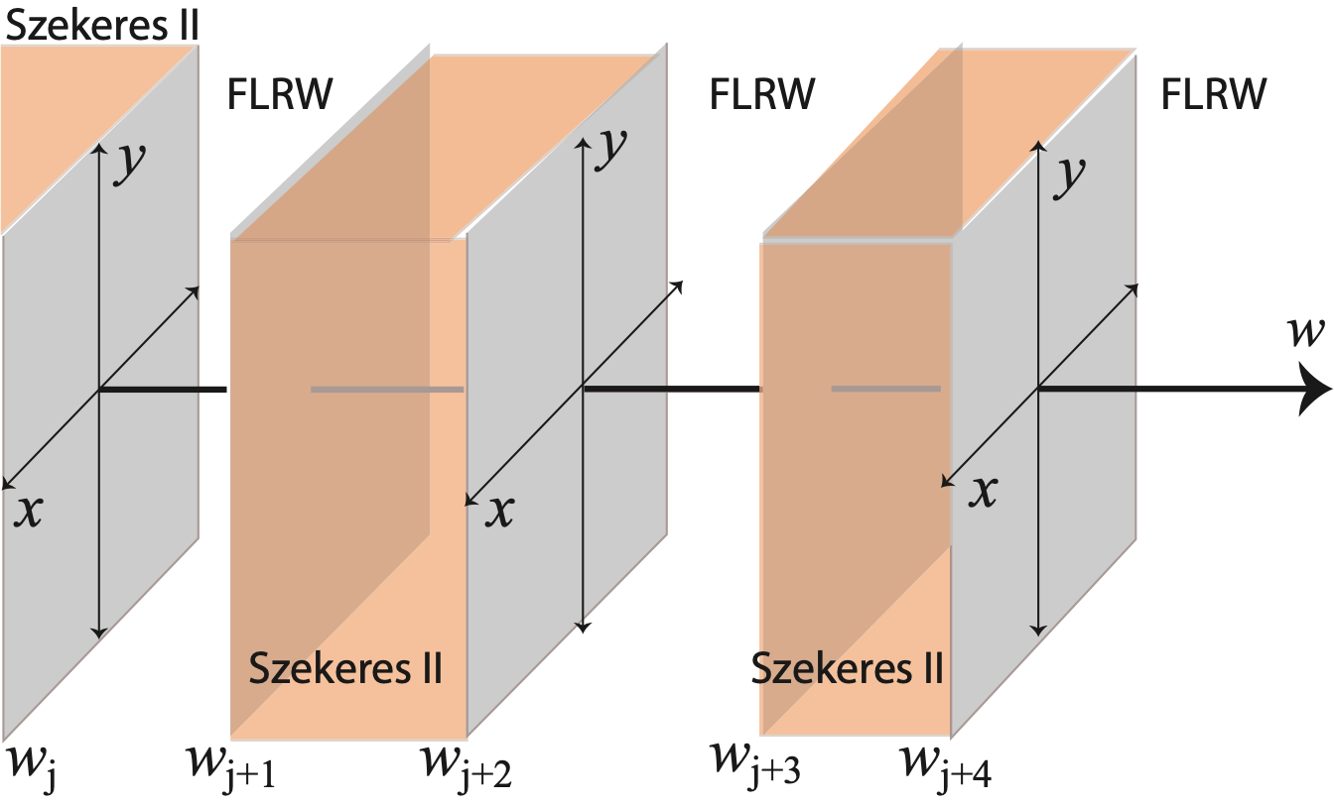
“Pancake” slab models with an arbitrary number of inhomogeneities
Spatially quasi flat analogues of “Swiss cheese” models

Slide 16
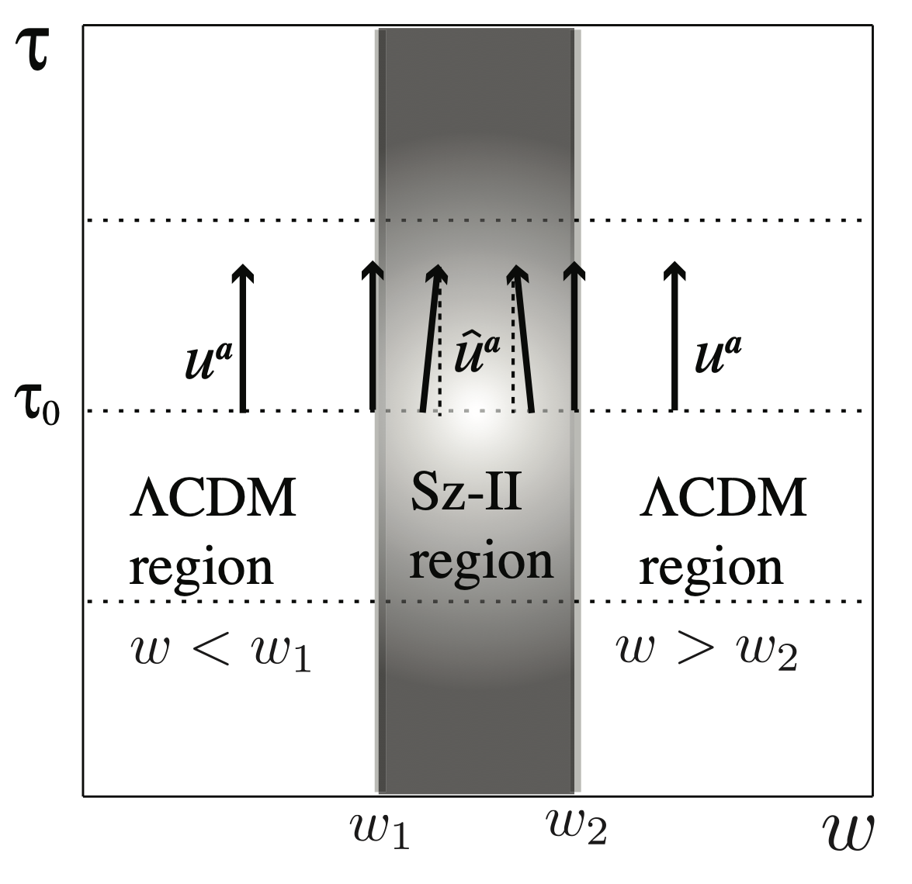
Szekeres II region: non-comoving CDM dust with non-relativistic peculiar velocities

Slide 17
Dimensionless variables
$$τ={\overline{H}}_{0}t,H≡\frac{Θ}{3}→Normalizewith{\overline{H}}_{0}=100hKm/sMpc$$
Background variables & exact fluctuations
$$\frac{8π}{3{\overline{H}}_{0}^{2}}ρ(t,x^{i})=\frac{8π}{3{\overline{H}}_{0}^{2}}\overline{ρ}(t)-\frac{f^{2}(X_{,yy}+X_{,xx})}{S^{2}X}+\frac{2\overset{·}{S}\overset{·}{X}}{SX},$$
$$Ω(t,x^{i})=$$
$$\overline{Ω}(t)+$$
$$δ^{ρ}(t,x^{i}),$$
FLRW dynamics
$$\frac{H(t,x^{i})}{{\overline{H}}_{0}}=\frac{\overline{H}(t)}{{\overline{H}}_{0}}+\frac{\overset{·}{X}}{3{\overline{H}}_{0}X}$$
$$\overline{H}(t)=\frac{\overset{·}{S}}{S}$$
$${\overline{H}}^{2}=\frac{8π}{3}(\overline{ρ}+Λ)$$
$$H(t,x^{i})=\overline{H}(t)+δ^{H}(t,x^{i})$$

Slide 18
Peculiar velocities
$$v_{a}=\frac{q_{a}}{ρ},q_{a}=[0,0,q_{x},q_{y}]$$
$$Ω_{x}^{q}≡\frac{8πq_{x}}{3H_{0}^{2}}=\frac{X_{x,τ}}{3H_{0}^{2}S^{2}X}$$
$$Ω_{y}^{q}≡\frac{8πq_{y}}{3H_{0}^{2}}=\frac{X_{y,τ}}{3H_{0}^{2}S^{2}X}$$
$$v_{x}=\frac{Ω_{x}^{q}}{Ω}=\frac{Ω_{x}^{q}}{\overline{Ω}+δ^{ρ}}$$
$$v_{y}=\frac{Ω_{y}^{q}}{Ω}=\frac{Ω_{y}^{q}}{\overline{Ω}+δ^{ρ}}$$

Slide 19
Covariant exact fluctuations
$$δ^{ρ}=-\frac{4π}{3}ξ_{ab}E^{ab}$$
$$Ω=\overline{Ω}(t)+δ^{ρ}$$
Electric Weyl
$$δ^{H}=-ξ_{ab}\frac{σ^{ab}}{{\overline{H}}_{0}}$$
Shear
$$H=\overline{H}(t)+δ^{H}$$
$$v_{a}=\frac{Ω_{a}^{q}}{Ω}$$
$$H_{ab}=\frac{3}{2}Ω{\overline{H}}_{0}^{2}η_{abc}v^{c}$$
Magnetic Weyl
$$ξ_{b}^{a}=h_{b}^{a}-3n^{a}n_{b},n_{a}=n_{x}dx+n_{y}dy$$

Slide 20
Dynamical system
$${\overset{·}{δ}}^{ρ}=-2Hδ^{H}-3[δ^{H}]^{2}-\frac{1}{2}δ^{ρ}$$
$${\overset{·}{δ}}^{H}=-3Hδ^{Ω}-Ωδ^{H}+\overline{Ω}v^{a}\frac{∇_{a}X}{X}-∇_{a}v^{a}Ω$$
$$\frac{{\overset{·}{v}}^{x}}{v^{x}}=\frac{{\overset{·}{v}}^{y}}{v^{y}}=∇_{b}v^{b}-2H$$
Background variables $\overline{Ω},\overline{H},{\overline{Ω}}^{Λ}$ FLRW dynamics

Slide 21
PROBLEMS in Newtonian treatment
CLAIM: Non-relativistic peculiar velocities imply that non-linear density contrasts in inhomogeneous cosmologies is a “gauge effect” that reduces to FLRW + linear perturbations in the Newtonian comoving gauge

Slide 22
Where is the error ?
Work with dust models (LTB) in a comoving frame
$$ds^{2}=-dt^{2}+\frac{R^{′2}dr^{2}}{1-K}+R^{2}(dθ^{2}+\sin^{2}dϕ^{2}),T^{ab}=ρu^{a}u^{b}$$
Transform LTB metric to the linear Newtonian gauge
$$ds^{2}=-(1+Φ)dt^{2}+a^{2}η_{ij}dx^{i}dx^{j},Φ≪1$$
Relate peculiar velocities in this gauge to LTB models as
$$v^{a}=vδ_{r}^{a}=\overset{·}{R}-\frac{\overset{·}{a}}{a}R≪1$$
WRONG: peculiar velocities (even if “small”) are part of the energy momentum tensor: they generate gravity through the magnetic Weyl tensor
$$v^{a}=ρq^{a}∝H_{ab}$$

Slide 23
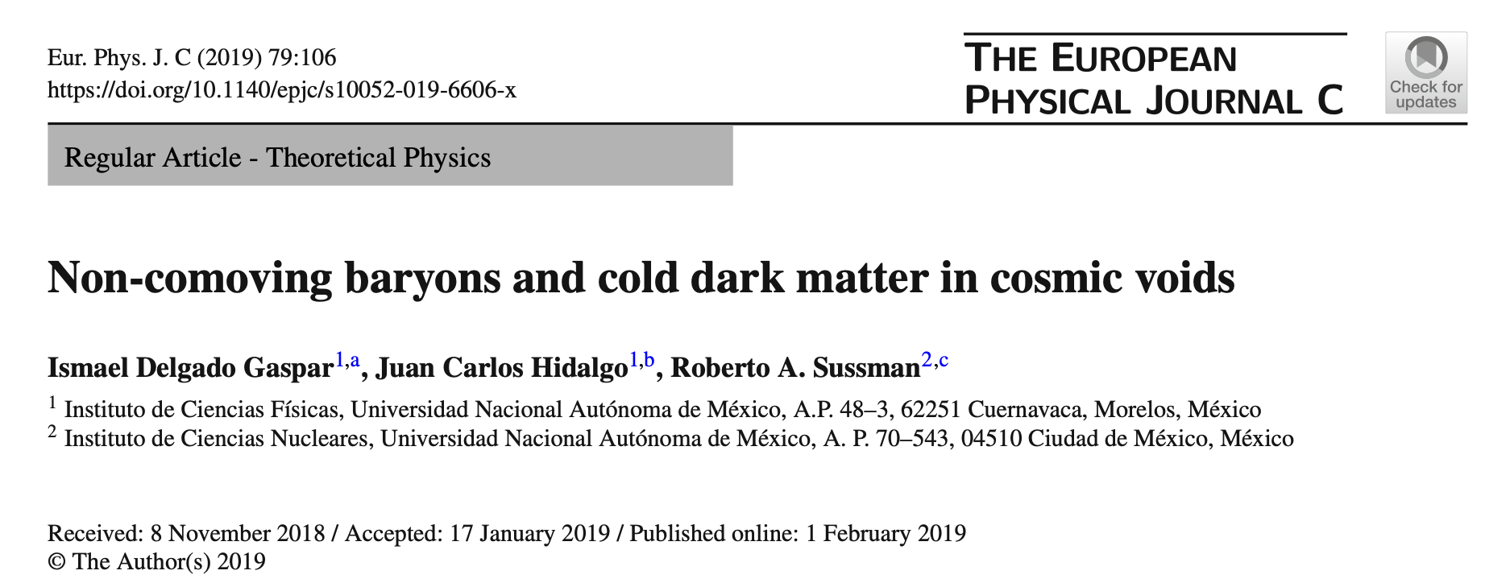
Proven in this article

Slide 24
Numerical results
Polar coordinates
$$x=rcosϕ,y=rsinϕ,τ={\overline{H}}_{0}t$$
Metric function X is necessary to compute
$$δ^{m},δ^{H},Ω^{q_{r}},Ω^{q_{ϕ}}$$
$$X=A+BQ+F,$$
$$A(r,ϕ,w)=α_{3}(w)r^{2}+α_{2}(w)rcosϕ+α_{1}(w)rsinϕ+α_{0}(w)$$
$$B(r,ϕ,w)=β_{3}(w)r^{2}+β_{2}(w)rcosϕ+β_{1}(w)rsinϕ+β_{0}(w)$$
$$\frac{2\overset{··}{S}}{S}+{\left(\frac{\overset{·}{S}}{S}\right)}^{2}-Λ=0→S(τ)={\left(\frac{Ω_{0}^{m}}{Ω_{0}^{Λ}}\right)}^{1/3}\sinh^{\frac{2}{3}}\left(\frac{3}{2}\sqrt{Ω_{0}^{Λ}}τ\right),$$
LCDM
$$Q(t,w)=c_{1}(w)+c_{0}(w)∫\frac{dt}{S^{3}}$$
Numeric
$$\overset{··}{F}+3\left(\frac{\overset{·}{S}}{S}\right)\overset{·}{F}-\frac{2}{S^{2}}[Qβ_{3}+α_{3}]=0,$$
Numeric

Slide 25
Peculiar velocities in the Szkeres II zone
$$w=w_{2}$$
$$w$$
$$ϕ$$
$$r$$
$$w=w_{1}$$
$v^{a}$ in coordinates $[w,r,ϕ]$
$$v^{w}=0,v^{r},v^{ϕ}≠0$$

Slide 26
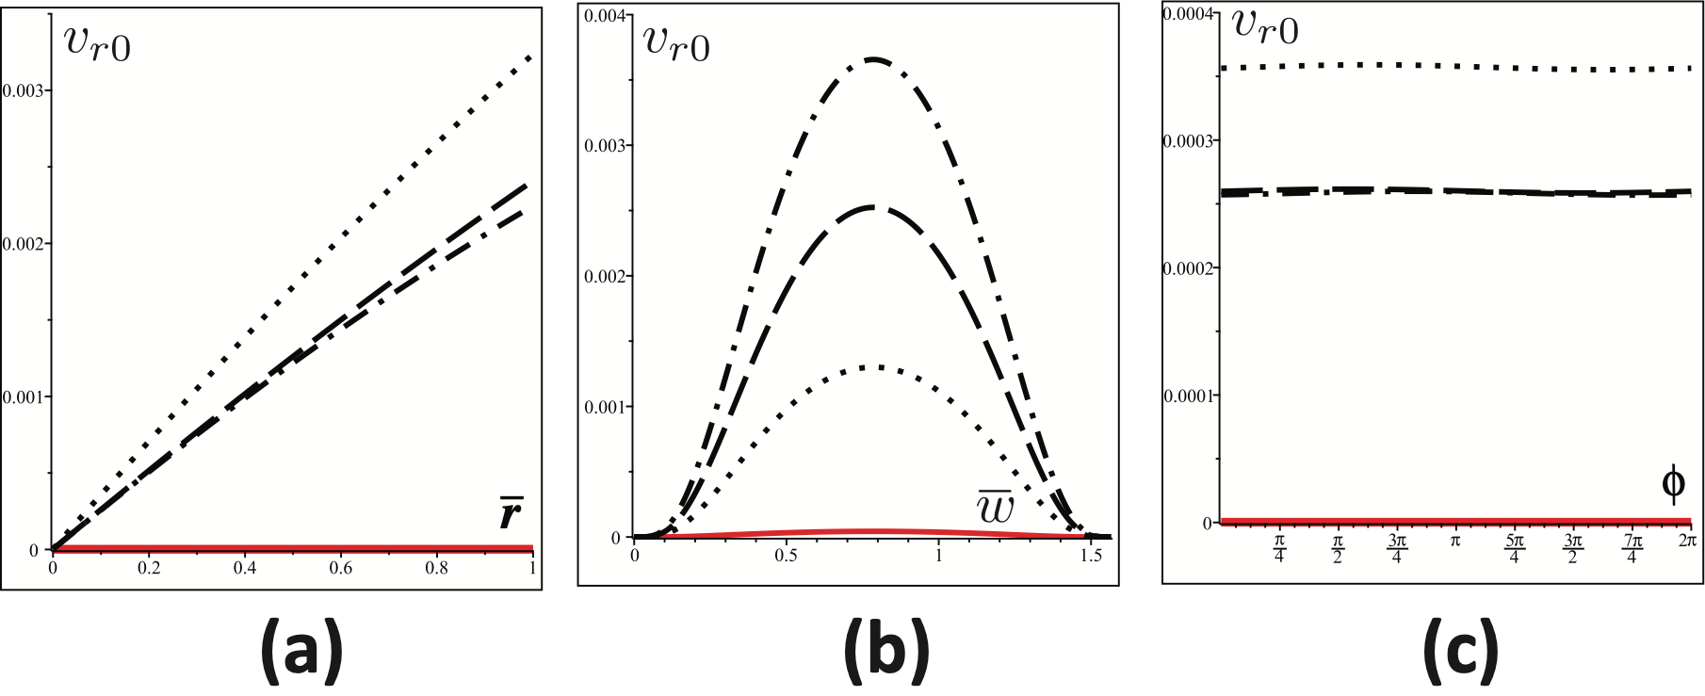
$$v_{r}$$
as function of
as function of
as function of
$$r$$
$$w$$
$$ϕ$$
NOTICE:
$$v_{r},v_{ϕ}→0asw→w_{1},w_{2}$$

Slide 27
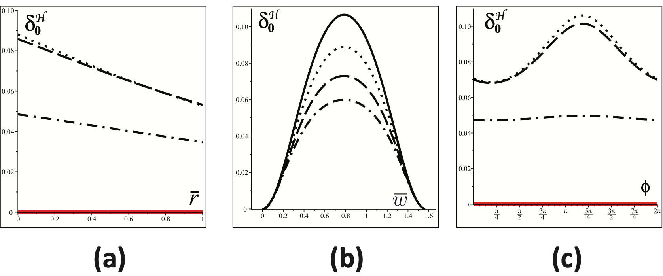
$$δ_{0}^{H}=H_{0}-{\overline{H}}_{0}∼shear$$
as function of
as function of
as function of
$$r$$
$$w$$
$$ϕ$$
NOTICE: along the SzII region we have
$$w_{1}<w<w_{2}$$
$$\frac{δ_{0}^{H}}{{\overline{H}}_{0}}=\frac{H_{0}-{\overline{H}}_{0}}{{\overline{H}}_{0}}between0..10\%$$
Hubble tension ??

Slide 28
THANKS FOR YOUR ATTENTION

