Slide 1
Coupled Early Dark Energy
Mark Trodden
University of Pennsylvania
Invited Talk
Cosmology at the Threshold of Change Conference,
Thessaloniki, Greece, June 6, 2024

Slide 2
Overview
The Hubble tension and possible solutions
Some comments about how theorists think.
Early Dark energy and its coincidence problem
Possible Solutions - coupling to matter species for which equality is an important epoch. In effect modifying the gravity felt by particular types of mass-energy.
Neutrino-Assisted Early Dark Energy
Just give the basics here to get the idea across. We can chat about details.
Some important work remains to be done, so some of this is work in progress.

Slide 3
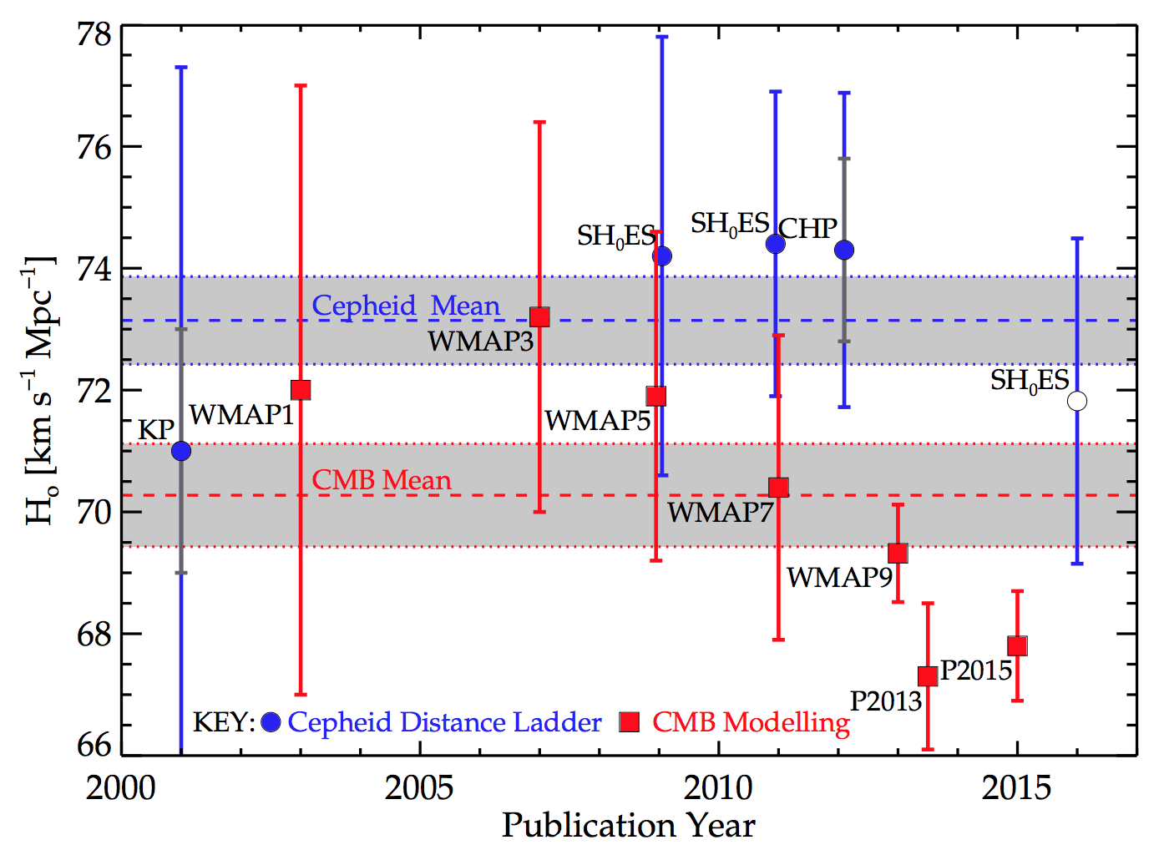
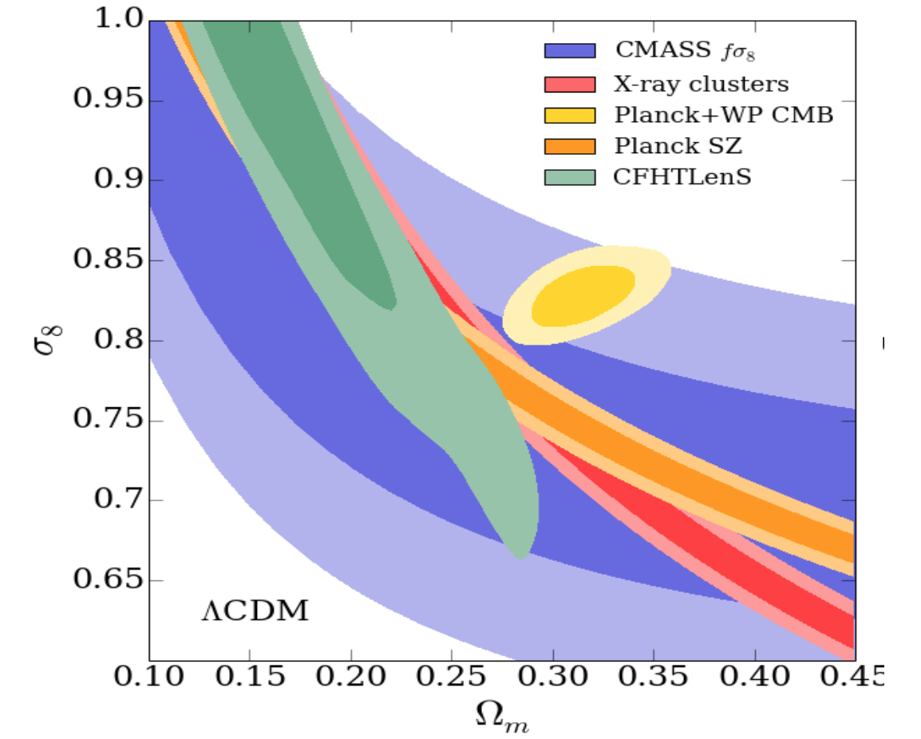
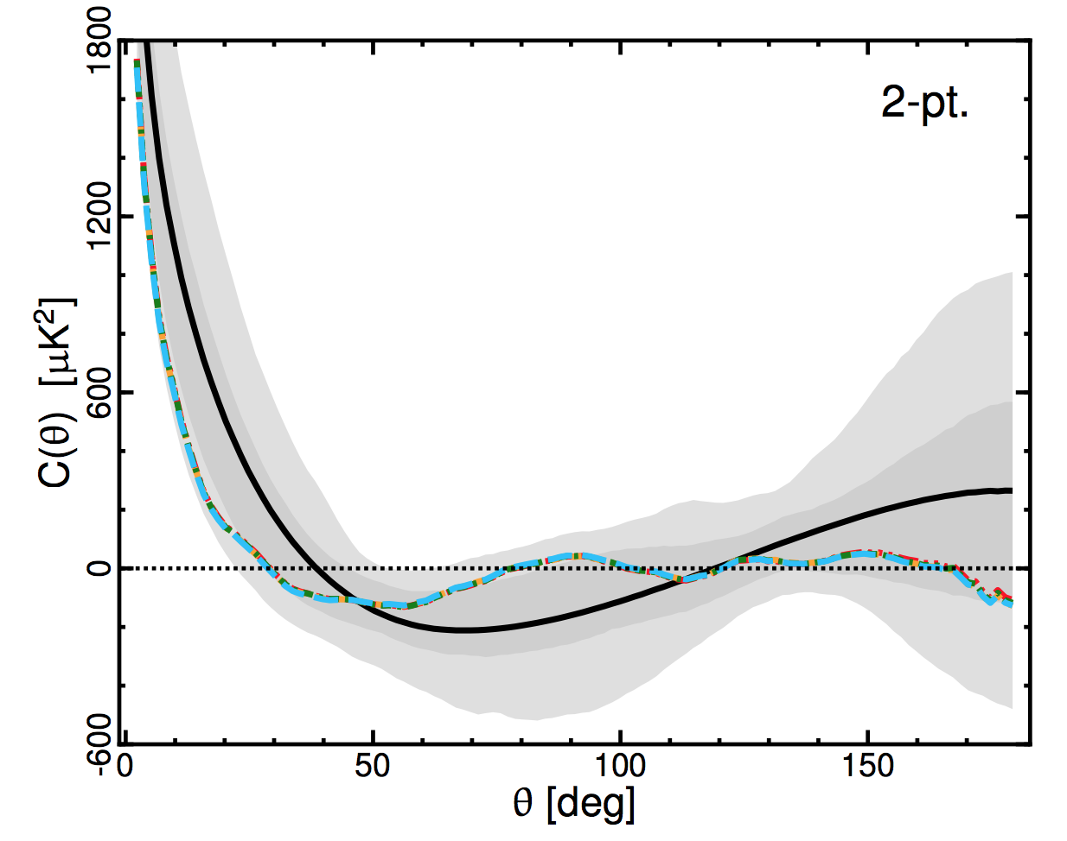
The H0 Problem
Standard cosmological model explains most observations, but several anomalies and tensions have been found between datasets
May point to the presence of new physics.
One much-discussed discrepancy is between measurements of the Hubble parameter at different redshifts.
Local measurement obtained by observing Cepheid variables
[Riess et al. (2019)]
Planck data estimate (LCDM, three 0.06eV neutrinos)
[Planck (2018)]
This is a tension of and it doesn’t seem to be going away!!!

Slide 4
Ways to measure the Hubble constant - I
Locally — by measuring the distances to galaxies
distance
slope ~
redshift (time)

Slide 5
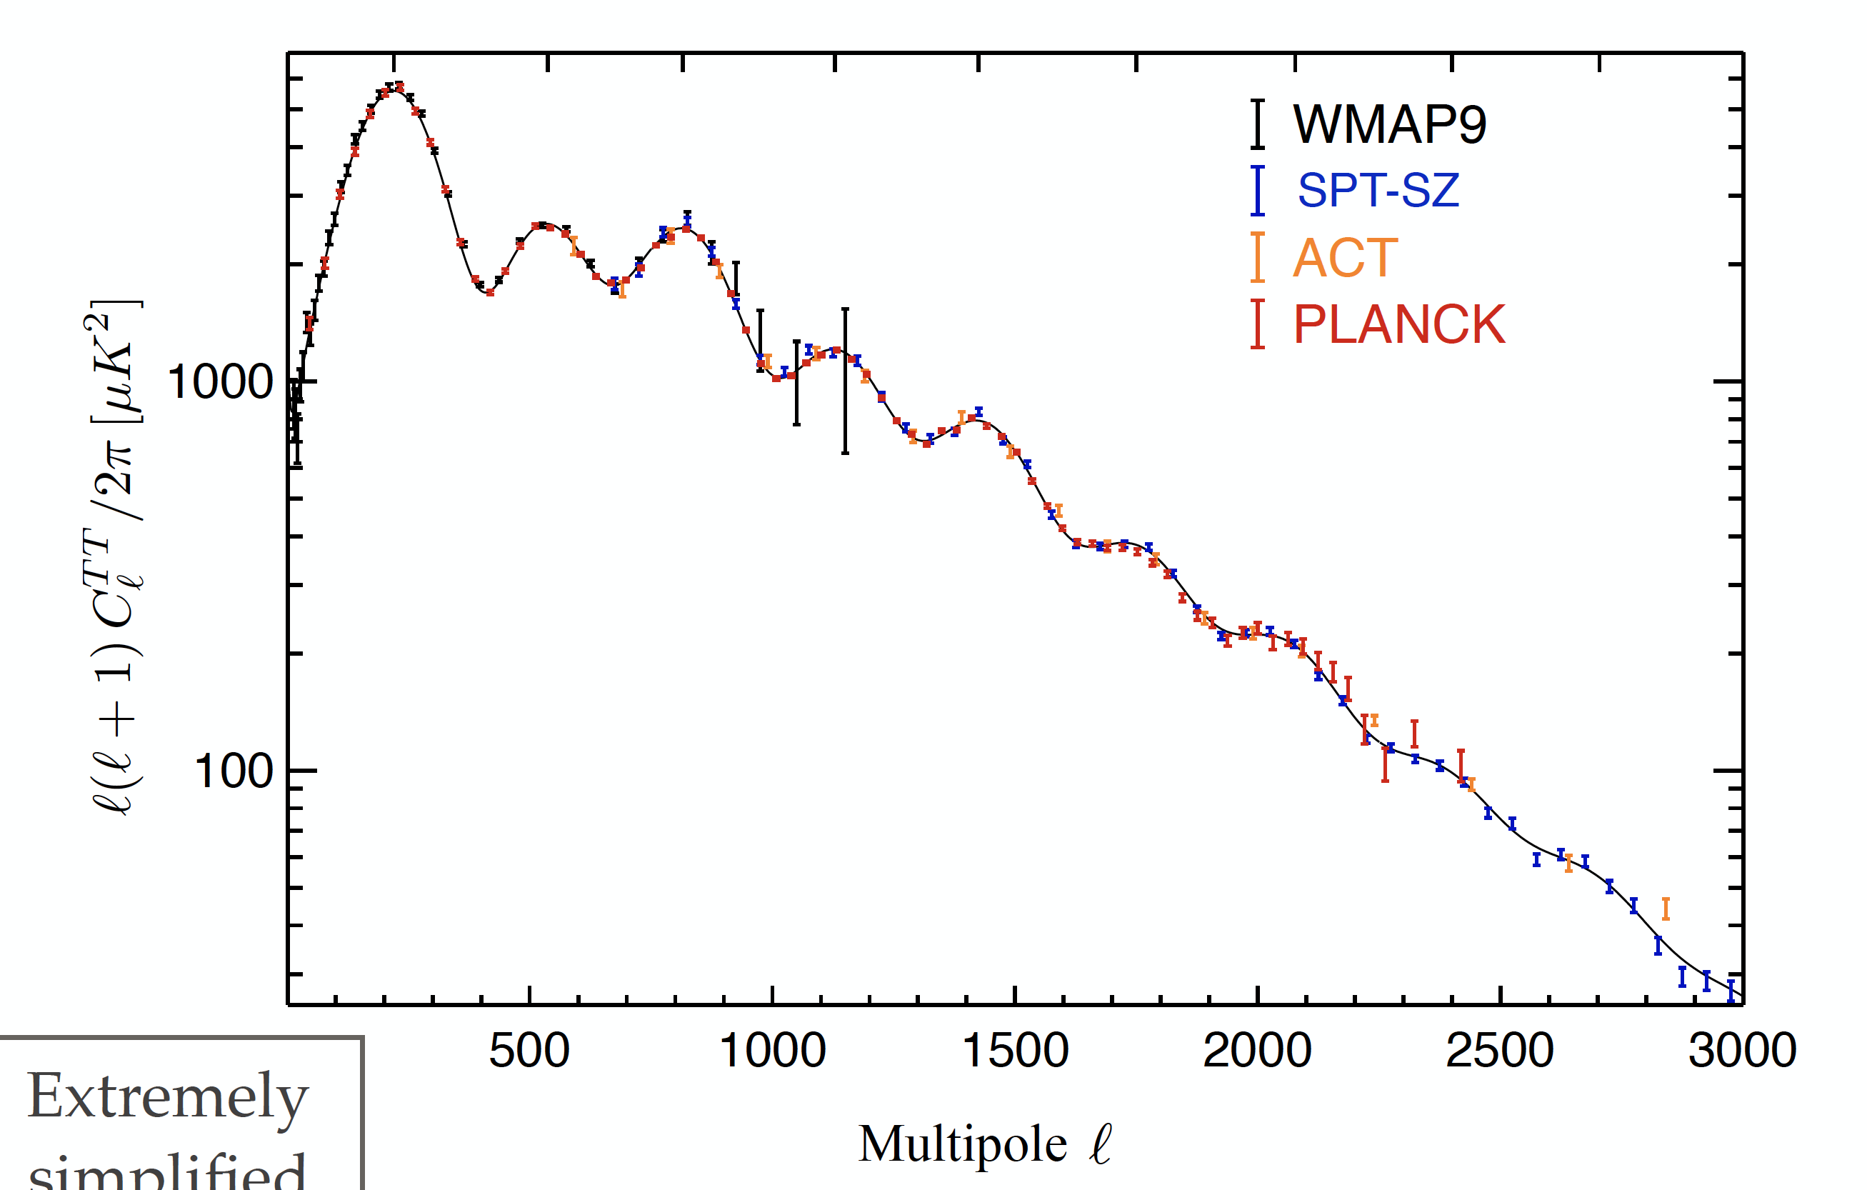
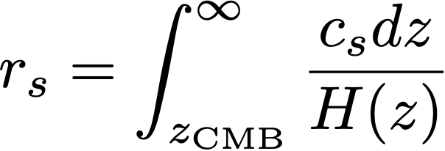
Ways to measure the Hubble constant - II
The CMB — by using the inherent distances in the CMB
Calculate this
Measure this
Infer this

Slide 6
Possible Resolutions:
1) One or more measurements have unknown systematics
Planck calibration issues
Unknown distance ladder systematics
Riess et al.,
Freedman et al.,
…. many more
Efforts to improve this seem to make the tension worse!
2) Statistics need to be refined (tension not as bad as we think)
Change statistical measure of the tension
Different cuts, priors, etc.
Cardona et al.,
Spergel et al.,
…. many more
Different approaches agree, magnitude of discrepancy is getting larger!
3) New physics

Slide 7
An Early Time Resolution
One promising idea is Early dark energy (EDE) as a resolution to the Hubble tension!
(Poulin et al. 2018)
Add new stuff here
Roughly, need ~8% increase in H around equality, cf LCDM. Mostly irrelevant before and after that point.

Slide 8
You can’t always get what you want!
EDE positives
…and negatives
Resolves the Hubble tension
Improves the fit to cosmological data relative to LCDM
Can arise from numerous theoretical scenarios
A simple scalar field (shocking! amazing!!) seems to do quite well
Worsens the LSS tension
Need to include local while fitting
The potentials needed, e.g. seem to be very contrived
Solution is fine-tuned in theoretical parameters
Without dwelling on details in this talk, it is not that easy to make this idea work. Changing the sound horizon comes with other effects (such as on the damping scale of perturbations, which can conflict with observations in many models.

Slide 9
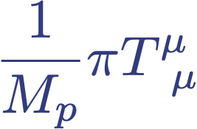
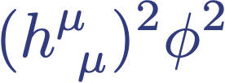
The Concerns of Theorists - EFTs
How do theorists think about all this? Whatever “model” we consider, behind it should be a theory that consists of a set of interacting fields in a Lagrangian. The Lagrangian contains 3 types of terms:
Kinetic Terms: e.g.
Self Interactions (a potential)
Interactions with other fields (such as matter, baryonic or dark)
Depending on the background, such terms might have functions in front of them that depend on time and/or space.
Many of the concerns of theorists can be expressed in this language

Slide 10
One Example Here: Technical Naturalness
When we write down a classical theory, usually implicitly assume effects of higher order operators are small. Must work below strong coupling scale of theory, w/ small perturbative quantum corrections.
Even if your quantum mechanical corrections do not ruin your ability to trust your theory, any especially small couplings you need might be a problem.
Suppose you need a very flat potential, or very small mass for some reason
Then unless your theory has a special extra symmetry as you take m to zero, then quantum corrections will drive it up to the cutoff of your theory.
Without this, requires extreme fine tuning to keep the potential flat and mass scale ridiculously low - challenge of technical naturalness.

Slide 11
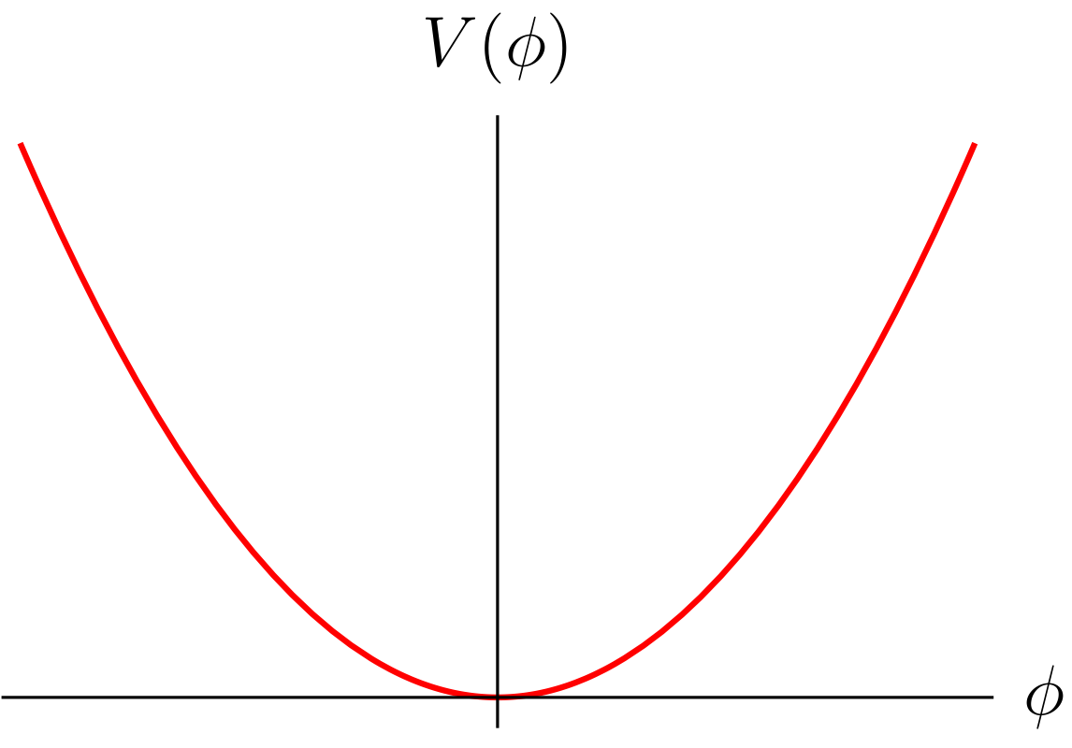
Early DE: Another Coincidence Problem
Why now?
Dark energy has a coincidence problem: field rolls when
Very finely-tuned. Hard to build models.
Could be a pNGB, but don’t want oscillations near minimum
Need to suppress first and second instanton contributions - not natural.

Slide 12
An Idea
Alternative mechanism to trigger onset of EDE, free of fine-tuning.
Instead of balancing scalar mass against Hubble parameter, exploit the fact that EDE must become important at a time that other physics becomes active in the universe
One example: coincidence between energy scale of matter-radiation equality and upper limit on the sum of neutrino masses suggests a coupling to neutrinos. We call this neutrino-assisted early dark energy
Second example: since matter becomes dominant at matter-radiation equality, this suggests that a coupling to matter might be a natural trigger. We call this chameleon early dark energy.

Slide 13
Neutrino-Assisted EDE: A (too) Simple Model
J. Sakstein and M. T., Phys. Rev. Lett. 124 (2020) no.16, 161301, [arXiv:1911.11760]. M. Carrillo Gonzalez, Q. Liang, J. Sakstein and M. T., JCAP 04, 063 (2021), [arXiv:2011.09895]
Couple EDE field to neutrinos through a conformal coupling
(Modifying the gravity felt by neutrinos)
Can expand this action out to yield
With resulting EOM
Energy-momentum tensor of neutrinos

Slide 14
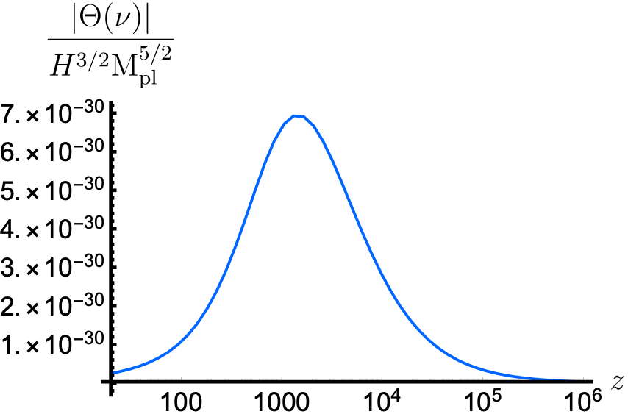
Behavior of EDE Field
Can treat as motion in an effective potential
Where, integrating over the Fermi-Dirac distribution, we have:
At first order the details aren’t too important. What matters is …
Forcing term

Slide 15
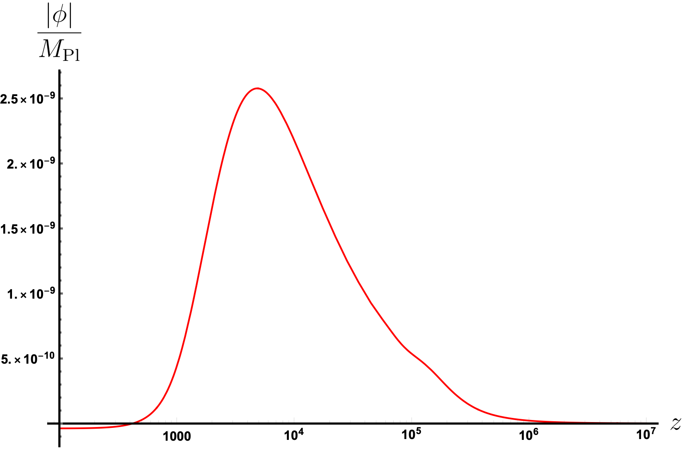
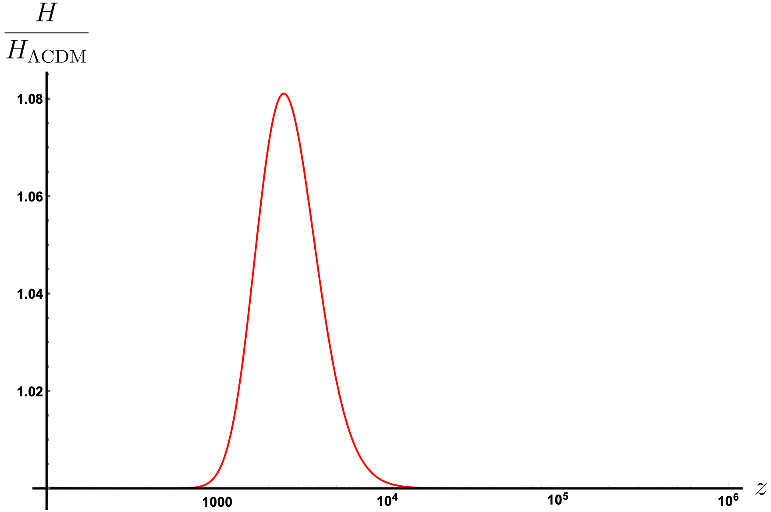
Full Numerical Solutions
Solve EDE EOM in conjunction with Einstein equations
Evolution of the EDE field
And the Hubble parameter
Quick check - can perform a simple analytic estimate of the displacement (kick)
This is the key result

Slide 16
More Complete Model
Don’t specify origin of neutrino mass or whether Dirac or Majorana
Have redefined and generalized conformal coupling
Although quartic potential is excellent fit, EFT suggests including a mass also, even though this is tightly constrained by late time expansion.
Have generalized the coupling function also, because of EFT considerations. If exponential, then effective potential minimized at
This grows with redshift, and eventually exits validity of the EFT

Slide 17
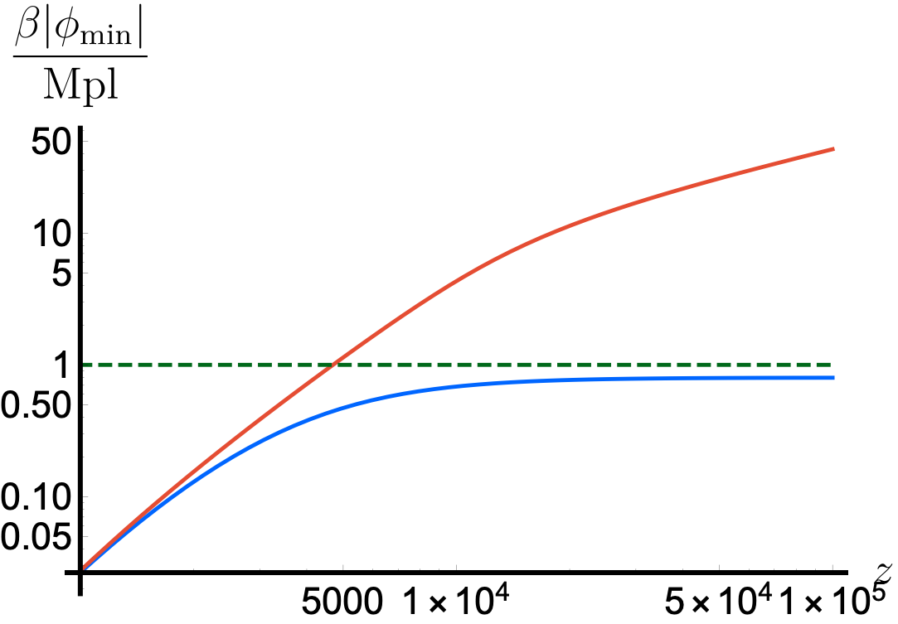
Making the EFT Well-Behaved
Can avoid if make one assumption about generalized coupling function:
When series is resummed, it has a minimum at some (as in some strongly-coupled string theory models)
Then:
e.g. could take
exponential coupling
And remain ignorant about any UV completion.
sample generalized coupling

Slide 18
Radiative Stability
EFT forces a mass term. But can’t be too large. Small value needs to be radiatively stable. Won’t dwell on this, but there is a constraint.
Expand out interactions. Find coupling of EDE to neutrinos reads
Also have cubic and quartic EDE self-interactions
Compute 1-loop quantum corrections to EDE mass
Get
So need

Slide 19
Cosmological Evolution (Qualitative)
At high redshifts, effective potential minimized at . Field is stuck there. Robust initial conditions for later evolution (improves fit)
Universe expands and redshifts until contribution from quartic part of potential is non-negligible. Then minimum adiabatically evolves away from towards zero.
At this point, higher-order terms in the expansion of coupling function are not relevant, and evolution proceeds until , neutrinos become non-relativistic and inject energy into scalar.
Leads to a kick feature in : onset of early dark energy phase, EDE causes Hubble constant to redshift at slower rate than in LCDM, lowering sound horizon, and increasing value of inferred from CMB. Transient effect as field reverts to tracking the minimum of the effective potential, which continues to decrease towards zero as neutrino density redshifts. Eventually, quartic term becomes negligible and mass term dominates

Slide 20
Cosmological Later-Time Behavior
During matter epoch, field can be decomposed into:
an adiabatic component that tracks - acts as additional dark energy
a rapidly-varying component from oscillations about minimum - as an additional dark matter component
Total energy density of dark energy (including a cosmological constant) is
For the masses we need to choose, this is an irrelevant contribution.
Additional dark matter contribution at late times is
Potential tension with data - motivation behind neglecting mass term in EDE models. Important question: can EDE models can include mass large enough to be radiatively stable, but small enough not to be in tension with data.

Slide 21
Comment on Constraints and Probes
Constraints on neutrino self-interactions Can alter cosmological evolution & affect CMB (Planck) Bounds can't be directly applied, since cosmological evolution is different in our case.
But, once we’ve implemented model into cosmological solvers and MCMC codes, similar result could apply.
Weak Equivalence Principle Violations Neutrino-Scalar interaction leads to fifth force x strength gravity. Affects neutrino perturbations.
Might be seen in the future in nonlinear matter power spectrum, or neutrino clustering within voids. Possibly constrained by next generation of lensing surveys.

Slide 22
Summary
EDE promising resolution of Hubble tension, but suffers from a coincidence problem.
Have proposed two new mechanisms to address this problem, both involving coupling to other mass-energy components.
If EDE scalar is coupled to neutrinos then it receives an energy injection when they become non-relativistic - around matter-radiation equality for an eV neutrino mass.
Displaces scalar up its potential yielding onset of EDE without need to tune the scalar's mass.
Proposal on verge of being excluded by neutrino mass bounds (Planck - m<0.54eV; Planck + lensing + BAO - m<0.12eV (for LCDM).
Full MCMC analysis underway (complete this year) - crucial to understand the fit our models have to joint cosmological datasets.
As with other suggestions of new physics, we might expect that it does not exist in a vacuum. These are first attempts to understand the consequences of coupling to other matter.
Thank You!

Slide 23
M. Carrillo González and M.T., “Field Theories and Fluids for an Interacting Dark Sector” Phys. Rev. D97 (2018) no.4, 043508 [arXiv:1705.04737]
V. Miranda, M. Carrillo González, E. Krause and M.T., “Finding structure in the dark: coupled dark energy, weak lensing, and the mildly nonlinear regime” Phys. Rev. D97 (2018) no.6, 063511 [arXiv:1707.05694]
J. Sakstein and M. T., “Early dark energy from massive neutrinos -- a natural resolution of the Hubble tension,” Phys. Rev. Lett. 124 (2020) no.16, 161301, [arXiv:1911.11760].
M. Carrillo Gonzalez, Q. Liang, J. Sakstein and M. T., “Neutrino-Assisted Early Dark Energy: Theory and Cosmology,” JCAP 04, 063 (2021), [arXiv:2011.09895]
T. Karwal, M. Raveri, B. Jain, J. Khoury and M. T., “Chameleon Early Dark Energy and the Hubble Tension,” Phys. Rev. D105 (2022) 6, 063535 [arXiv:2106.13290]
M. Carrillo Gonzalez, Q. Liang, J. Sakstein and M. T. , “Neutrino-Assisted Early Dark Energy is a Natural Resolution of the Hubble Tension,” [arXiv:2302.09091]

