Slide 1
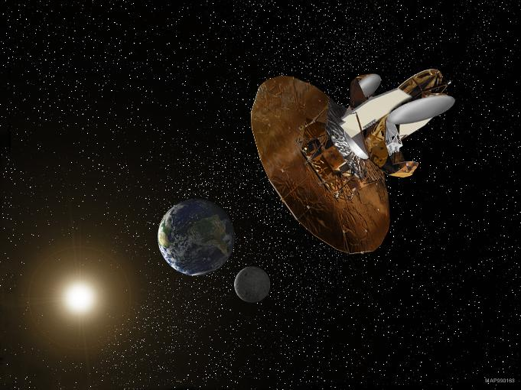
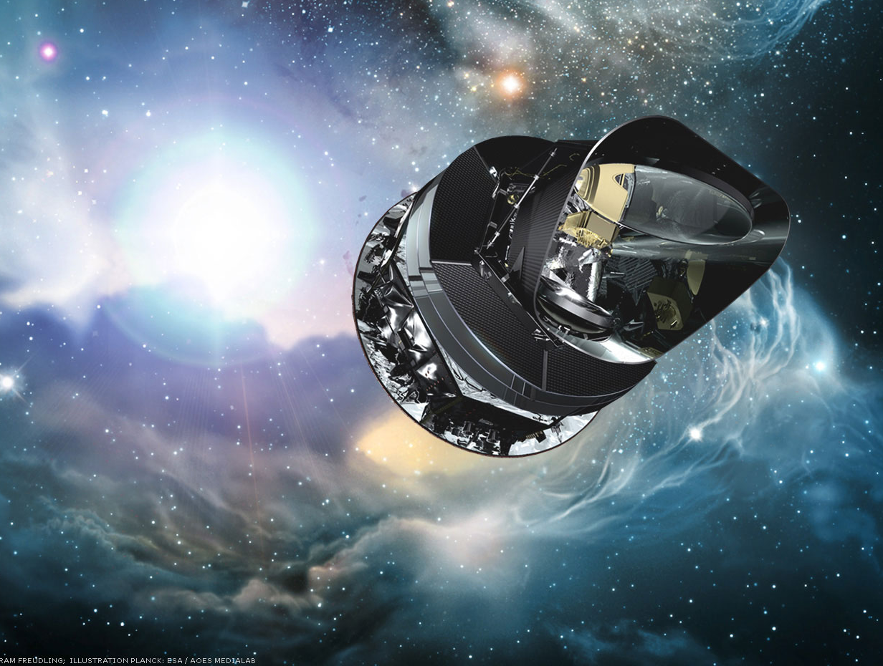
The Universe is Not Isotropic
Glenn Starkman
Case Western Reserve University
Thessaloniki, June 2024
Standard Cosmology at the Threshold of Change
Image: ESA/AOES Medialab

Slide 2
The Universe is Not Isotropic
Y. Akrami, S. Anselmi, C. Copi, A. Jaffe, A. Kosowsky, T. Pereira
Fernando Cornet, Deyan Mihaylov,
Andrius Tomasiunas, Javier Carron
Mikel Martin, Amirhossein Samandar
Joann Jones, Ananda Smith
A. Bernui, N. Cornish, F. Ferrer, D. Huterer, L. Knox, D. Schwarz, D. Spergel
S. Aiola, M. O’Dwyer, O. Gungor, J. Gurian, J. Oskilt, P. Petersen, Samanta Saha,
Quinn Taylor,V. Vardanyan, P. Vaudrevange, A. Yoho,
\
Image: NASA/WMAP

Slide 3
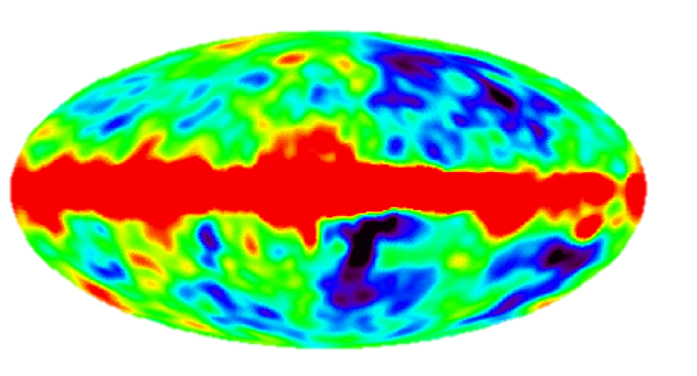
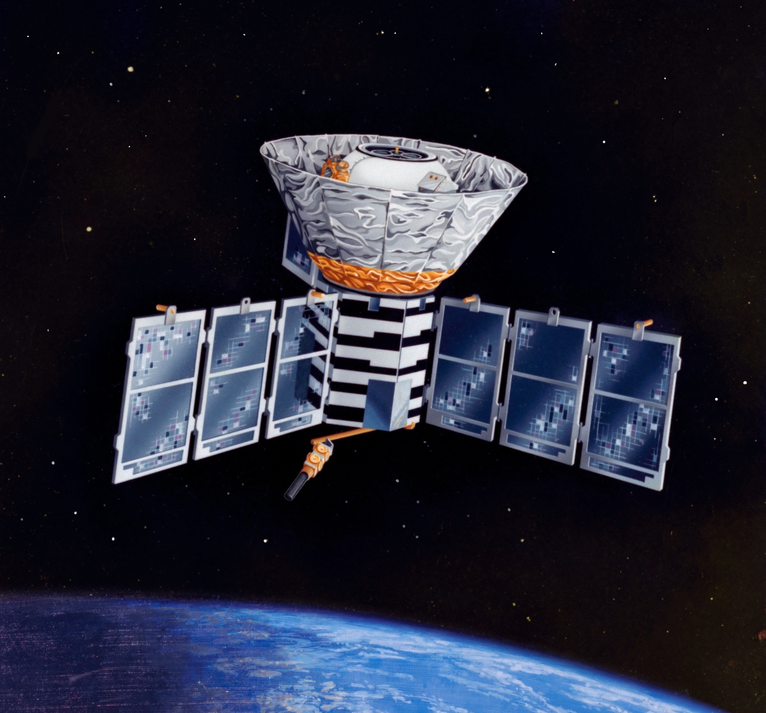
COBE - DMR
T=18μK
NASA/COBE-DMR science team
Notes:
Three layers -- monopole, dipole, fluctuations

Slide 4
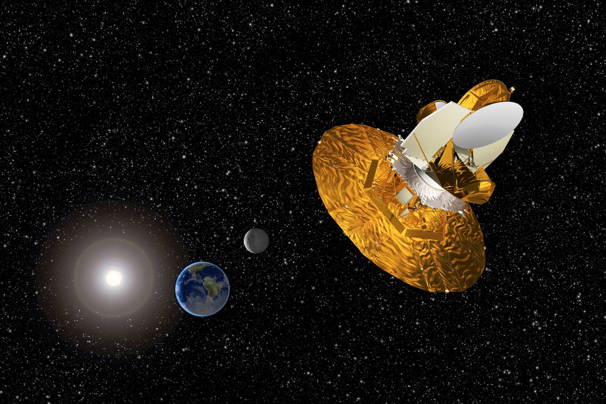
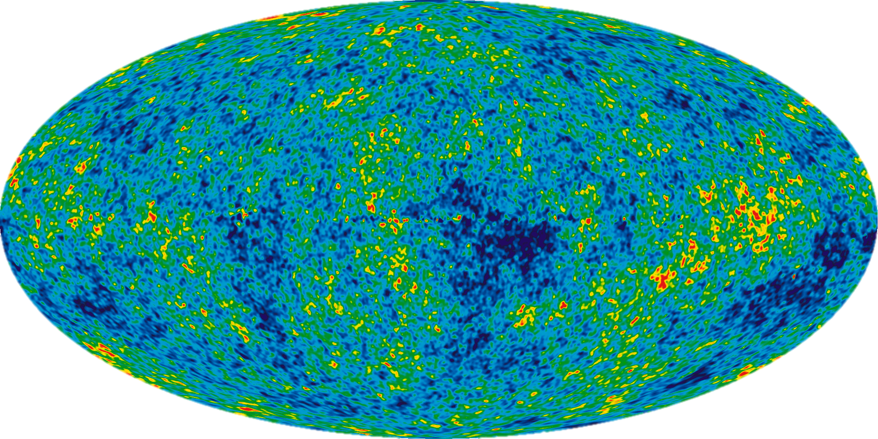
WMAP
NASA/WMAP Science team
Notes:
Galactic foreground removed by taking linear combination of bands.

Slide 5
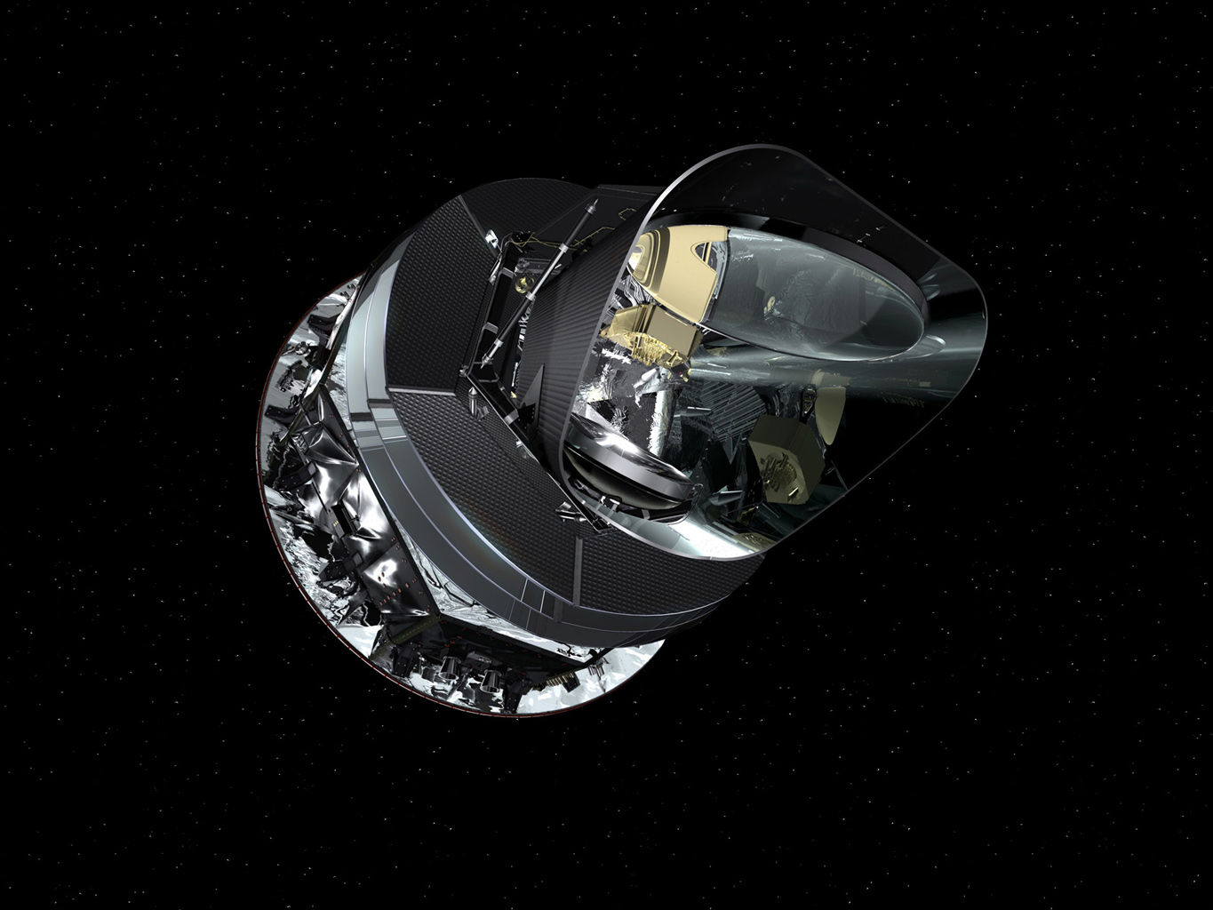
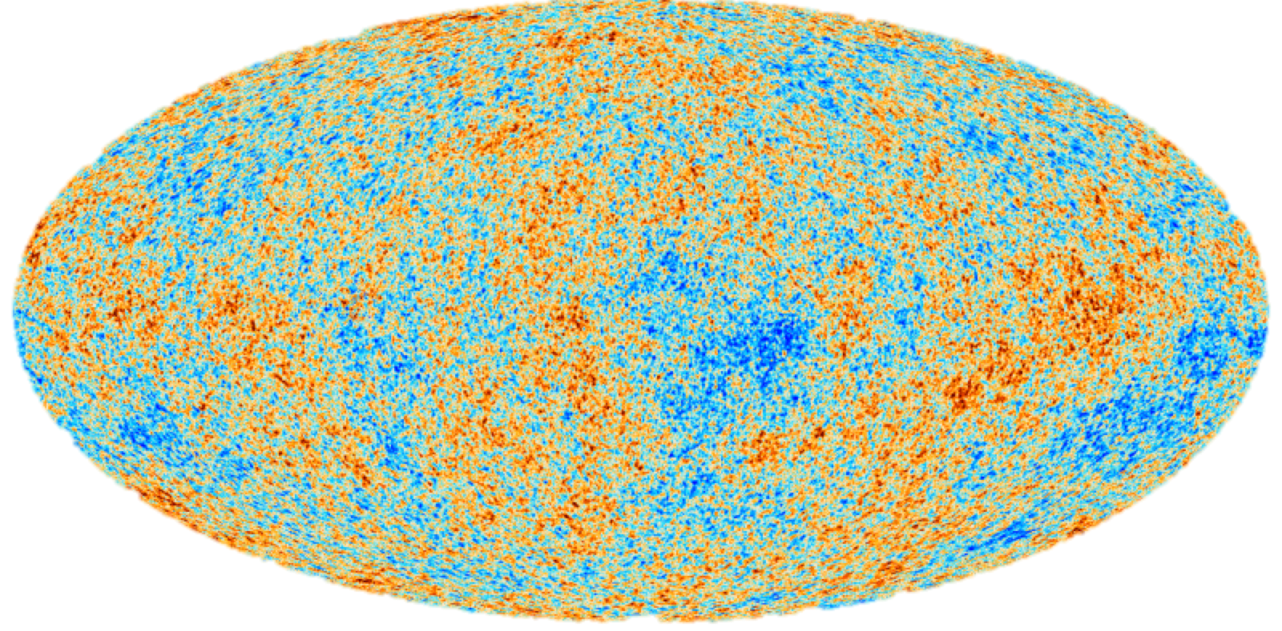
Planck
ESA/Planck Science team
Notes:
Galactic foreground removed by taking linear combination of 5 bands.
share an office with: Alessandro Renzi

Slide 6
Angular Power Spectrum
ΔT = ∑_{l m}a_{l m} Y_{l m}(θ,ϕ)

Slide 7
Angular Power Spectrum
ΔT = ∑_{l m}a_{l m} Y_{l m}(θ,ϕ)
Standard model for the fluctuations (inflation):
Sky is statistically isotropic
a_{l m} are independent Gaussian random variables
< a_{l m} a*_{l’ m’}> = C_{l} δ_{l l ‘} δ_{mm’}
~ALL interesting information is contained in:
C_{l} = (2l +1)⁻¹∑_{m} |a_{l m}|²
C_{l}

Slide 8
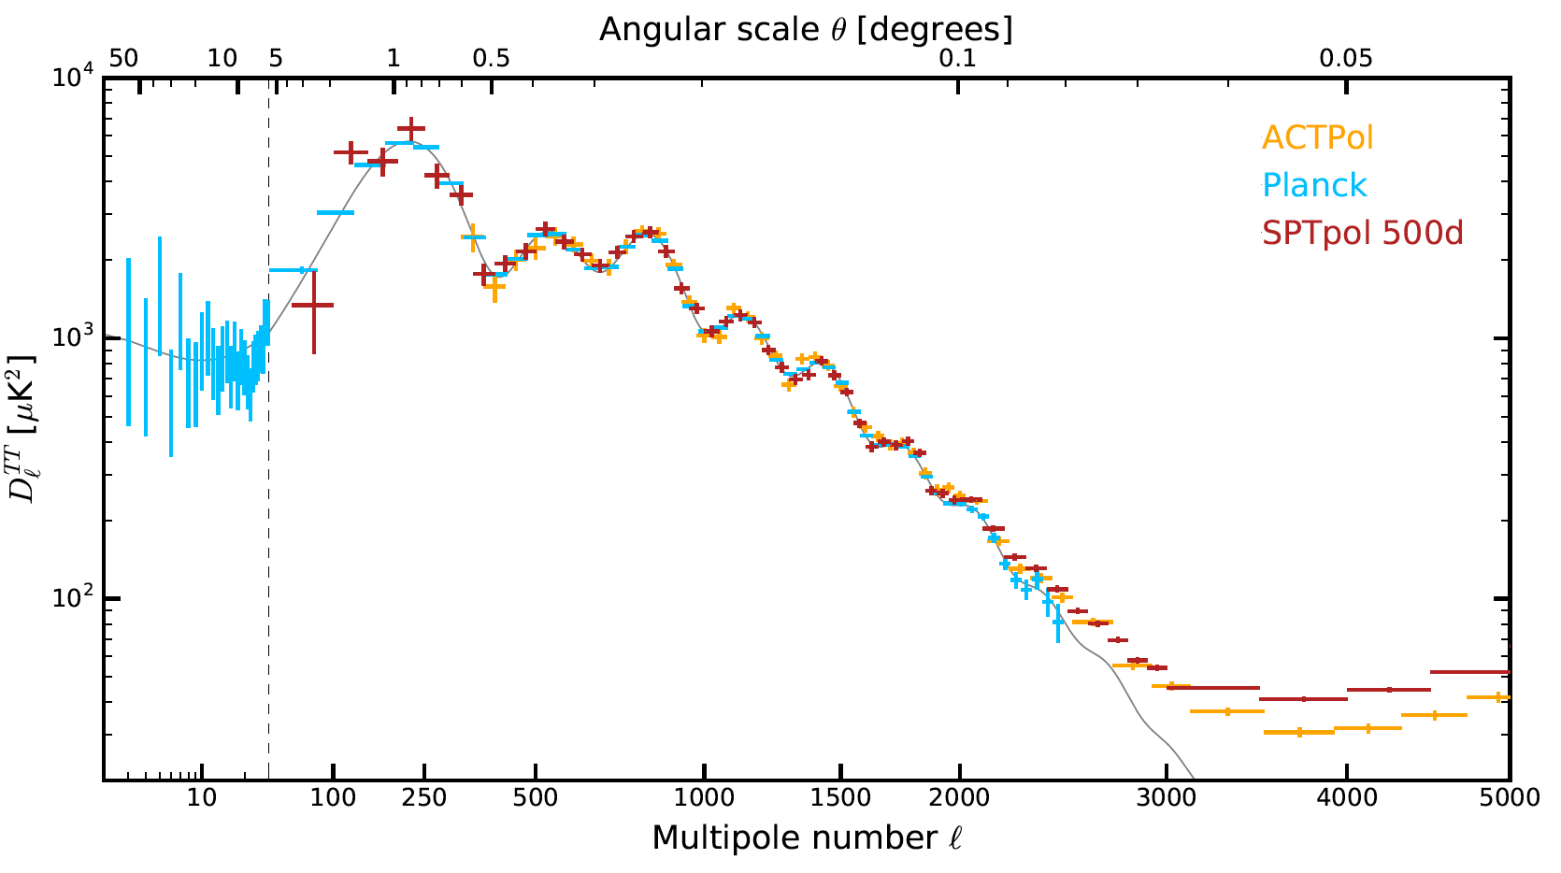
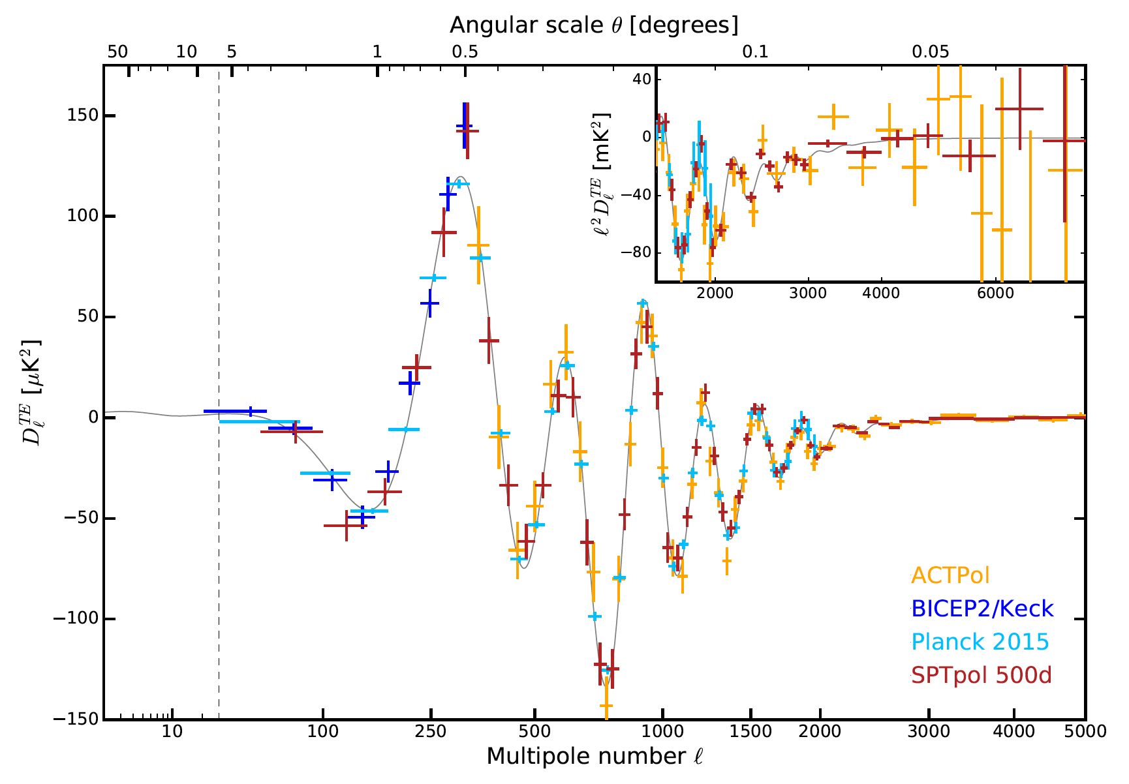
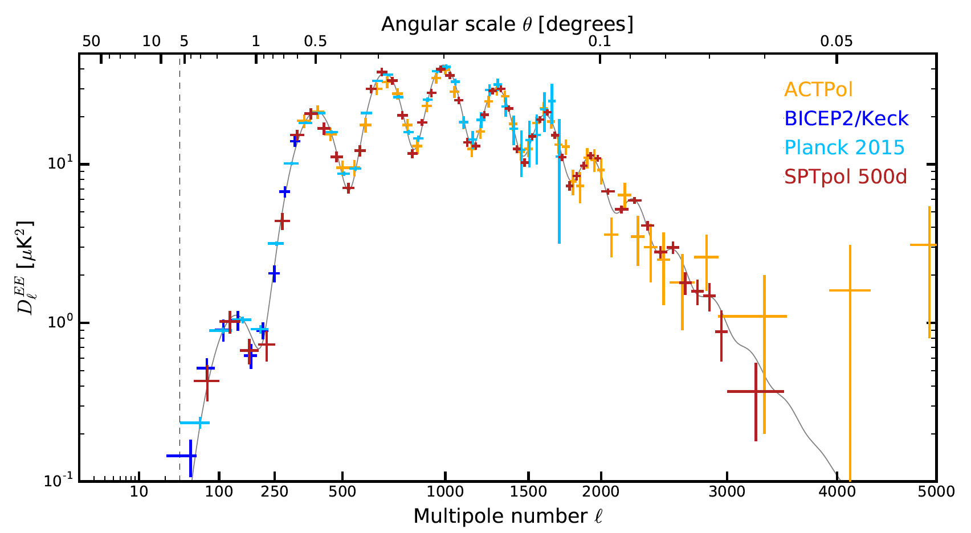
Angular Power Spectrum
6 7 parameter fit
to >>7 points
SPTPol arXiv:1707.09353
Notes:
Plus polarization!!!

Slide 9
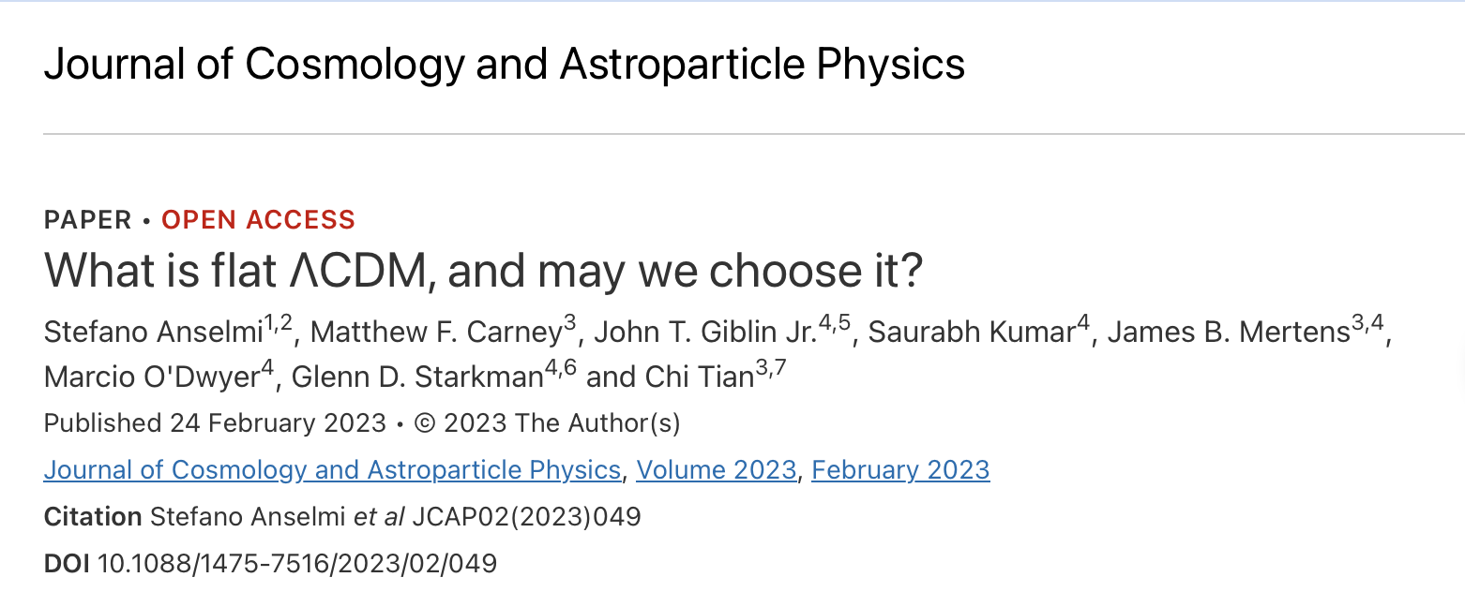
7 parameters not 6

Slide 10
Astonishing
experimental accomplishment
Remarkable
  agreement with theory
BUT !
Notes:
Not talk about: Ho tensions, S8 tensions, curvature (!!!!)

Slide 11
Standard Model for fluctuations (inflation):
Sky is statistically isotropic
a_{l m} are independent (very nearly) Gaussian random variables
< a_{l m} a*_{l’ m’}> = C_{l} δ_{l l ‘} δ_{mm’}
ALL interesting information is contained in: C_{l}
Shouldn’t we check?!

Slide 12
Outline
Troubles in (iso)tropical paradise:
(low-$ℓ$) large-angle problem: $C\left(θ>{60}^{o}\right)≃0$
low-$ℓ$ alignments
hemispheres
parity
Bottom line:
The Universe is not statistically isotropic
Promises of topological musings
Notes:
Not talk about: cold spot (yesterday), SH (not anomalous), …

Slide 13
COBE - DMR
NASA/COBE-DMR science team
Notes:
Three layers -- monopole, dipole, fluctuations

Slide 14
WMAP
NASA/WMAP Science team
Notes:
Galactic foreground removed by taking linear combination of bands.

Slide 15
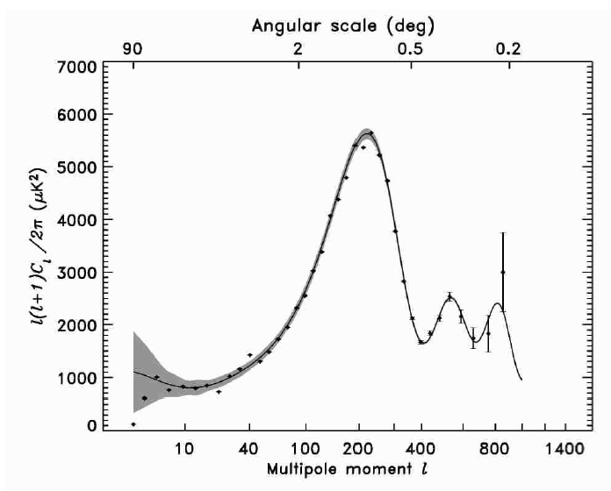

The first hint:
“The low-$ℓ$ Anomaly”
NASA WMAP Science Team
WMAP 1
Notes:
Low quadrupole.
Not actually the first hint!!! (wait a moment)

Slide 16
The uncorrelation …

Slide 17
“The Low-l Anomaly”
The low
quadrupole

Slide 18
“The Large-Angle Anomaly”

Slide 19
Angular Correlation Function C(θ)
C(θ) = < T(Ω₁)T(Ω₂)>_{Ω1.Ω2=cosθ}
But C(θ) = ∑_{l} C_{l} P_{l}(cos (θ))
⇒ Same information as C_{l}, just differently organized
Notes:
Just like Fourier Transforms -- sometimes you transform data to see signals more clearly!

Slide 20
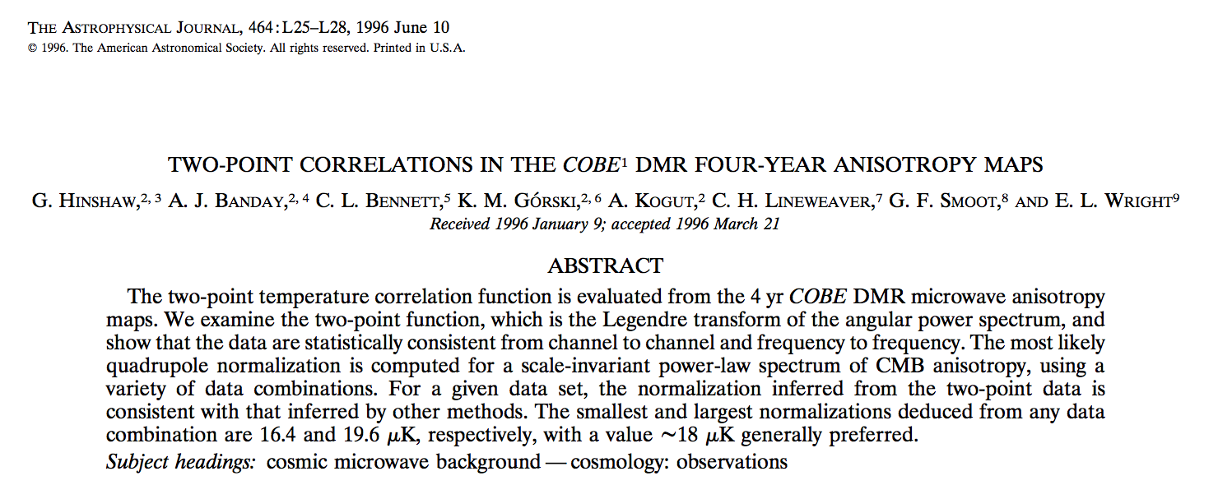
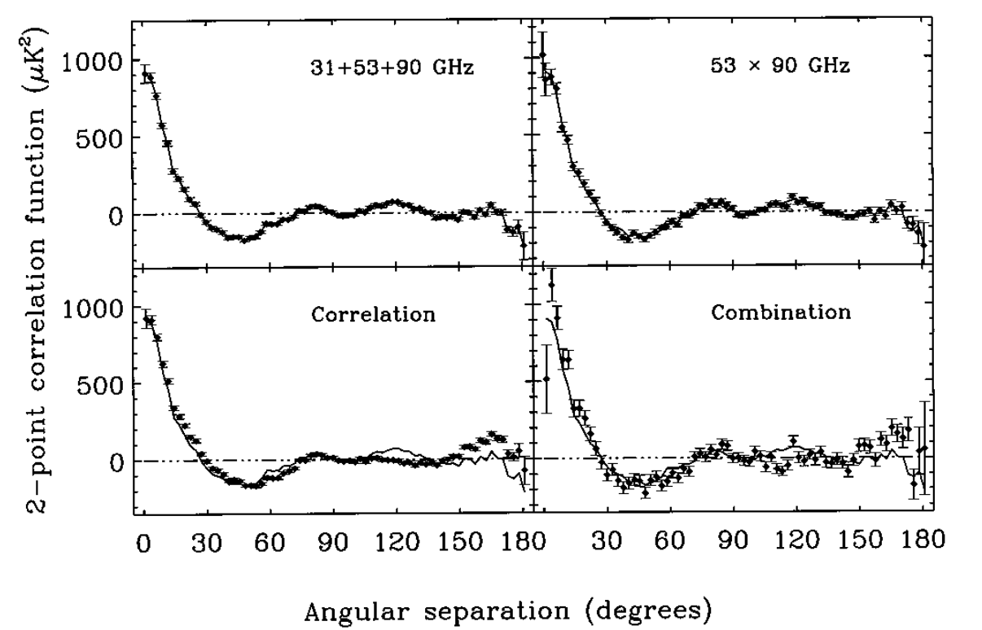
Notes:
COBE 1996

Slide 21
WMAP
NASA/WMAP Science team
Notes:
Galactic foreground removed by taking linear combination of bands.

Slide 22
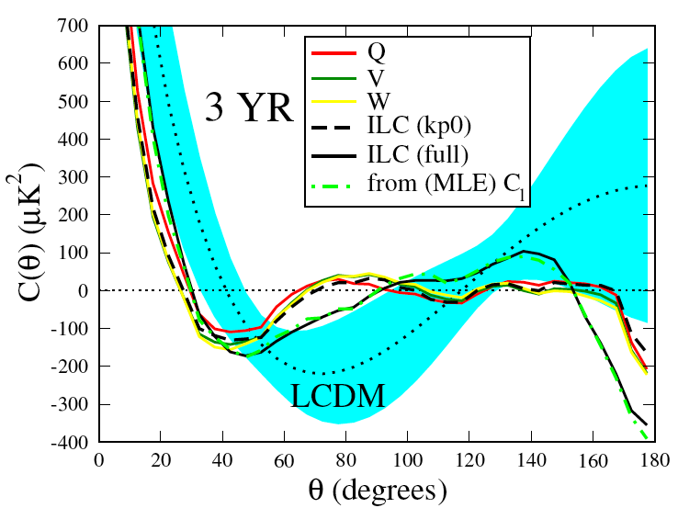
Two-point angular correlation function
Notes:
QVW, ILC (kp0) -- very close to 0
MLE, ILC (full) -- less close to 0, but closer than theory

Slide 23
Is the Large-Angle Anomaly Significant?
One measure (WMAP1):
S_{1/2} = ∫₋₁^{1/2} [C(θ)]² d cos θ

Slide 24
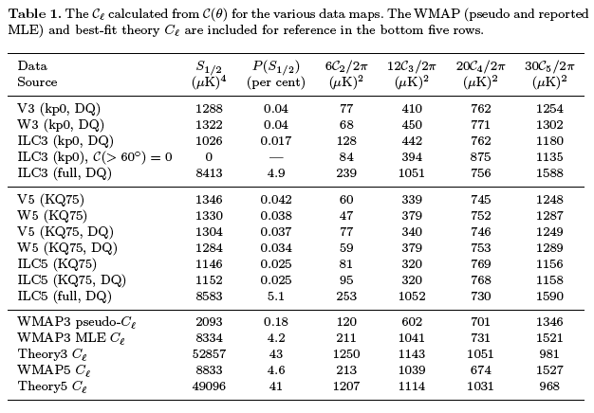
WMAP statistics of C(θ)

Slide 25
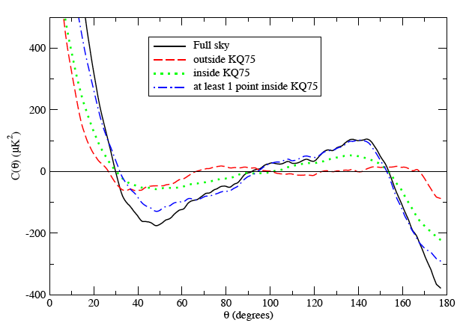
Origin of C(θ)

Slide 26
Did this change in Planck?
No!

Slide 27
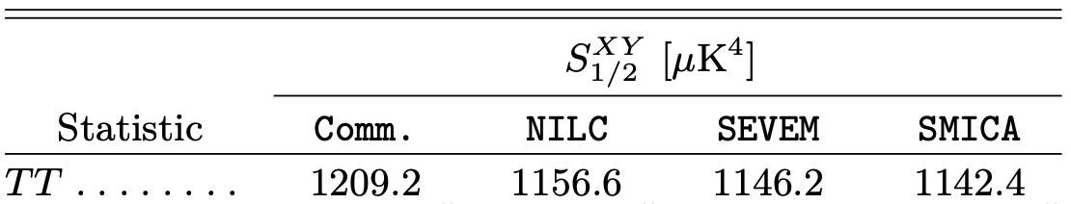
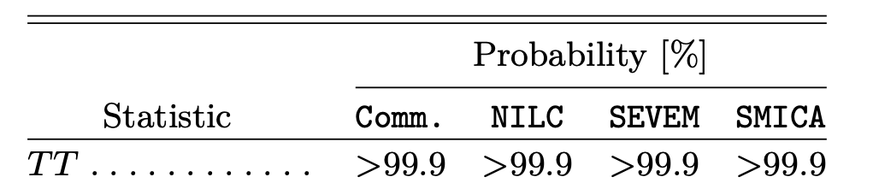
Planck 2018
A&A 641, A7 (2020)

Slide 28

Statistics of C(θ)
0.03-0.1% of realizations of the concordance model of inflationary ΛCDM have so little cut sky large-angle correlation !
and most of those have all low-$ℓ$ C$ℓ$ small

Slide 30
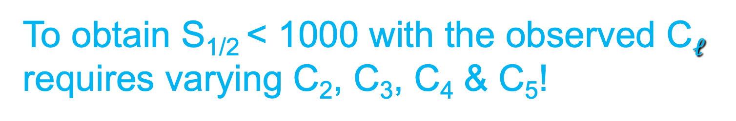
The Conspiracy theory: minimizing S_{1/2}
To obtain S_{1/2} < 1000 with the observed C$ℓ$
requires varying C₂, C₃, C₄ & C₅!
Notes:
Take all the Cl’s above L and fix them to the theoretical/reported values and ask how low can you make S1/2 by varying the ones <=L. Cut sky target: 1200

Slide 31
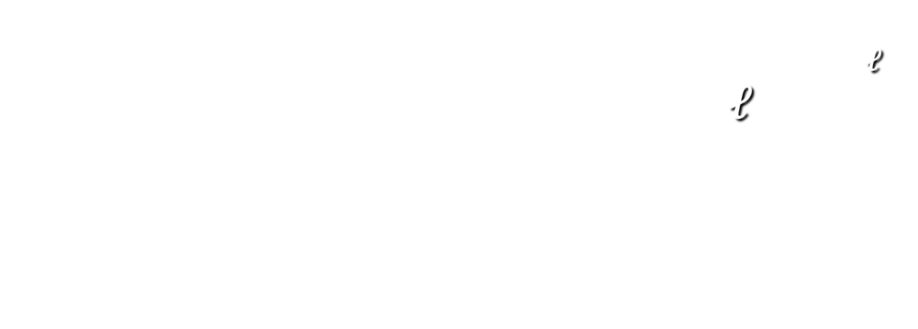
Violation of GRSI
Even if we replaced all the theoretical C$ℓ$ by their measured values up to $ℓ$=20, cosmic variance would give only a 3% chance of recovering so little correlation in a particular realization…
and most of those would be much poorer fits to that theory than is the current data

Slide 32


Explaining small S_{1/2}
“Didn’t that go away?”
“I never believe a posteori statistics.”
Cosmic variance -- “I never believe anything less than a (choose one:) 5σ 10σ 20σ result.”
“Inflation can do that”
New physics that correlates C_{l}’s
$$\left\langle a_{ℓm}a_{ℓ^{′}m^{′}}^{∗}\right\rangle ∝δ_{ℓℓ′}$$
$$⟹ \left\langle a_{ℓm}a_{ℓ^{′}m^{′}}^{∗}\right\rangle ≠C_{ℓ}δ_{ℓℓ′}δ_{mm′}$$

Slide 33
Beyond C_{l}:
Tests of Statistical Isotropy
multipole vector alignment
angular momentum dispersion axes (da Oliveira-Costa, et al.)
Land & Magueijo scalars/vectors
hemispherical variance
north-south asymmetries
dipolar modulations
even/odd C_{l} anomaly
genus curves (Park)
spherical Mexican-hat wavelets (Vielva et al.)
cold hot spots, hot cold spots (Larson and Wandelt)
bispectrum (Souradeep et al.)

Slide 34

Alignments …

Slide 35
Multipole Vectors
Q: What directions are associated w the l ^{th} multipole:
ΔT_{l} (θ,φ) ≡ ∑_{m} a_{l m}Y_{l m} (θ,φ) ?
Dipole (l =1) :
∑_{m} a_{1m}Y_{1m} (θ,φ) = Α⁽¹⁾ û_{x}^{(1,1)} .(sinθ cosφ, sinθ sinφ, cosθ)
Advantages:
  û ^{(1,1)} is a vector, Α⁽¹⁾ is a scalar
  Only Α⁽¹⁾ depends on C₁

Slide 36
Multipole Vectors
General l, write:
∑_{m} a _{l m}Y _{l m} (θ,φ) ≈
Α ^{(l)} [(û ^{(l, l)}⋅ê)…(û ^{(l, l)} .ê )
- all traces]
{{a _{l m,} m=- l ,…, l }, l =(0,1,)2,…} ⇒
{Α^{(l)} ,{û ^{(l,i)}, i =1,… l }, l = (0,1,)2,…}
Advantages: 1) û^{(l,i)} are vectors, Α^{(l)} is a scalar
2) Only Α^{(l)} depends on C _{l}

Slide 37
Maxwell Multipole Vectors
∑_{m} a _{l m}Y _{l m} (θ,φ)
= [(u ^{(l,1)}⋅∇)…(u ^{(l, l)} ⋅∇)r ⁻¹] _{r=1}
J.C. Maxwell,
A Treatise on Electricity and Magnetism, v.1, 1873 (1st ed.)

Slide 38
Area Vectors
Notice:
Quadrupole has 2 vectors,
  i.e. quadrupole is a plane
Octopole has 3 vectors,
i.e. octopole is 3 planes
Suggests defining:
w^{(l,i,j)} ≡ (û ^{(l,i)} x û ^{(l,j)}) “area vectors”
Carry some, but not all, of the information

Slide 39
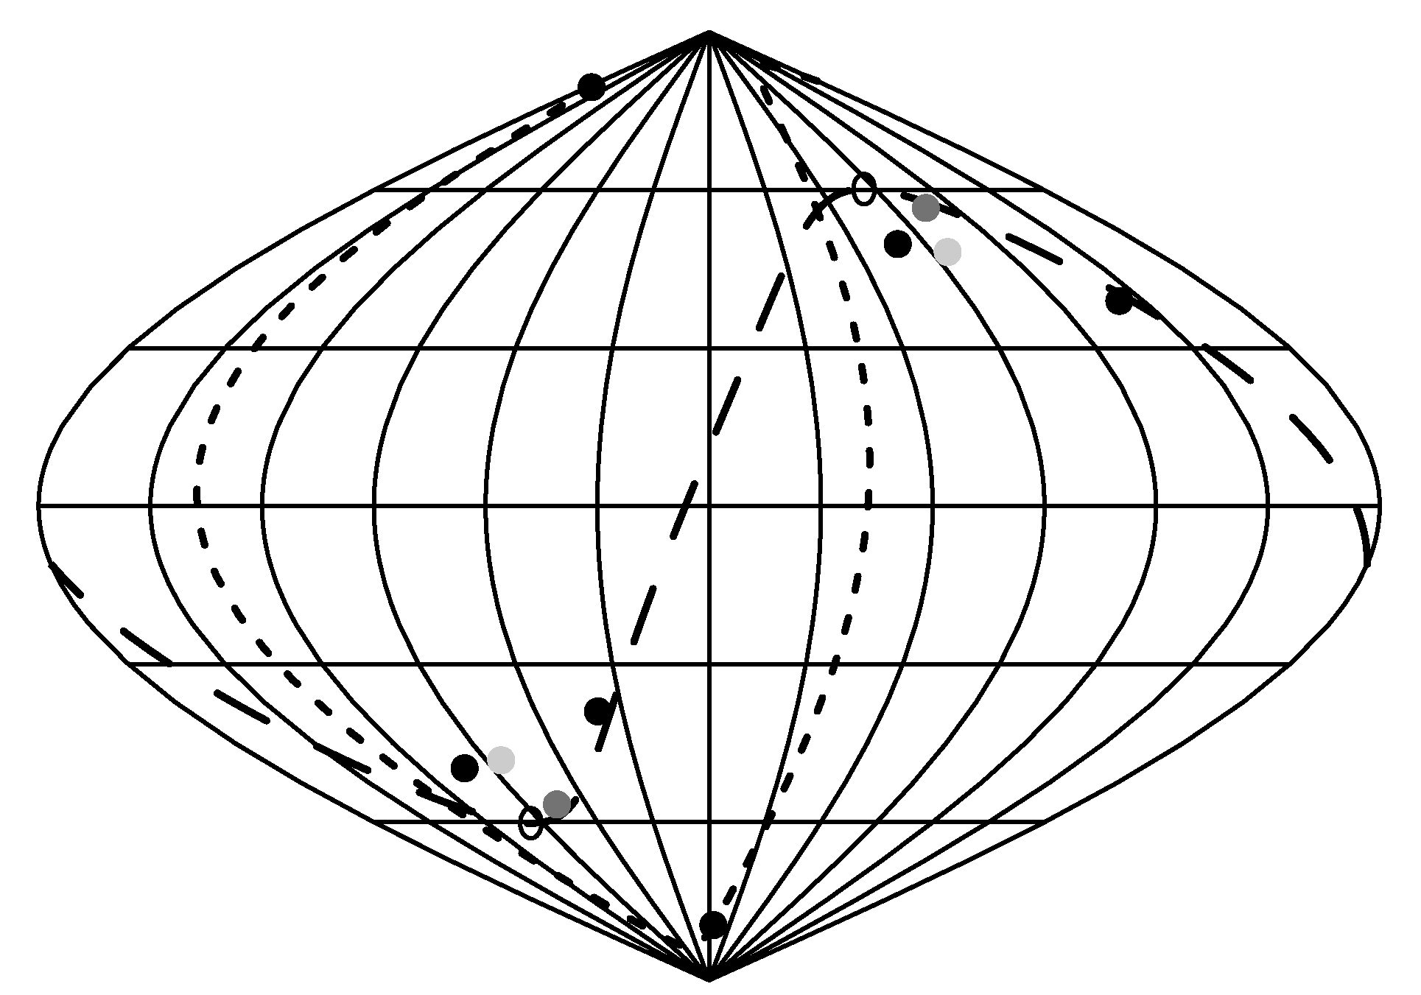
l =2&3 Area Vectors
l=3 normal
l=3 normal
l=2 normal
equinox
l=2
normal
dipole
l=3 normal
ecliptic
l=3 normal
SGP
dipole
equinox
l=3 normal
l=3 normal
Notes:
Quadrupole –octopole axis IS the “Axis of Evil” of Land and Maguejio

Slide 40
Quadrupole plane &
3 octopole planes are
aligned with one another
p-value of the quadrupole & octopole planes being so aligned:
(0.1-0.6)%

Slide 41
Low Northern Variance
Power asymmetry
Dipole modulation
Marcio O’Dwyer (with GDS, Copi, L. Knox)
Notes:
Compare S vs N. North looks much “quieter”

Slide 42
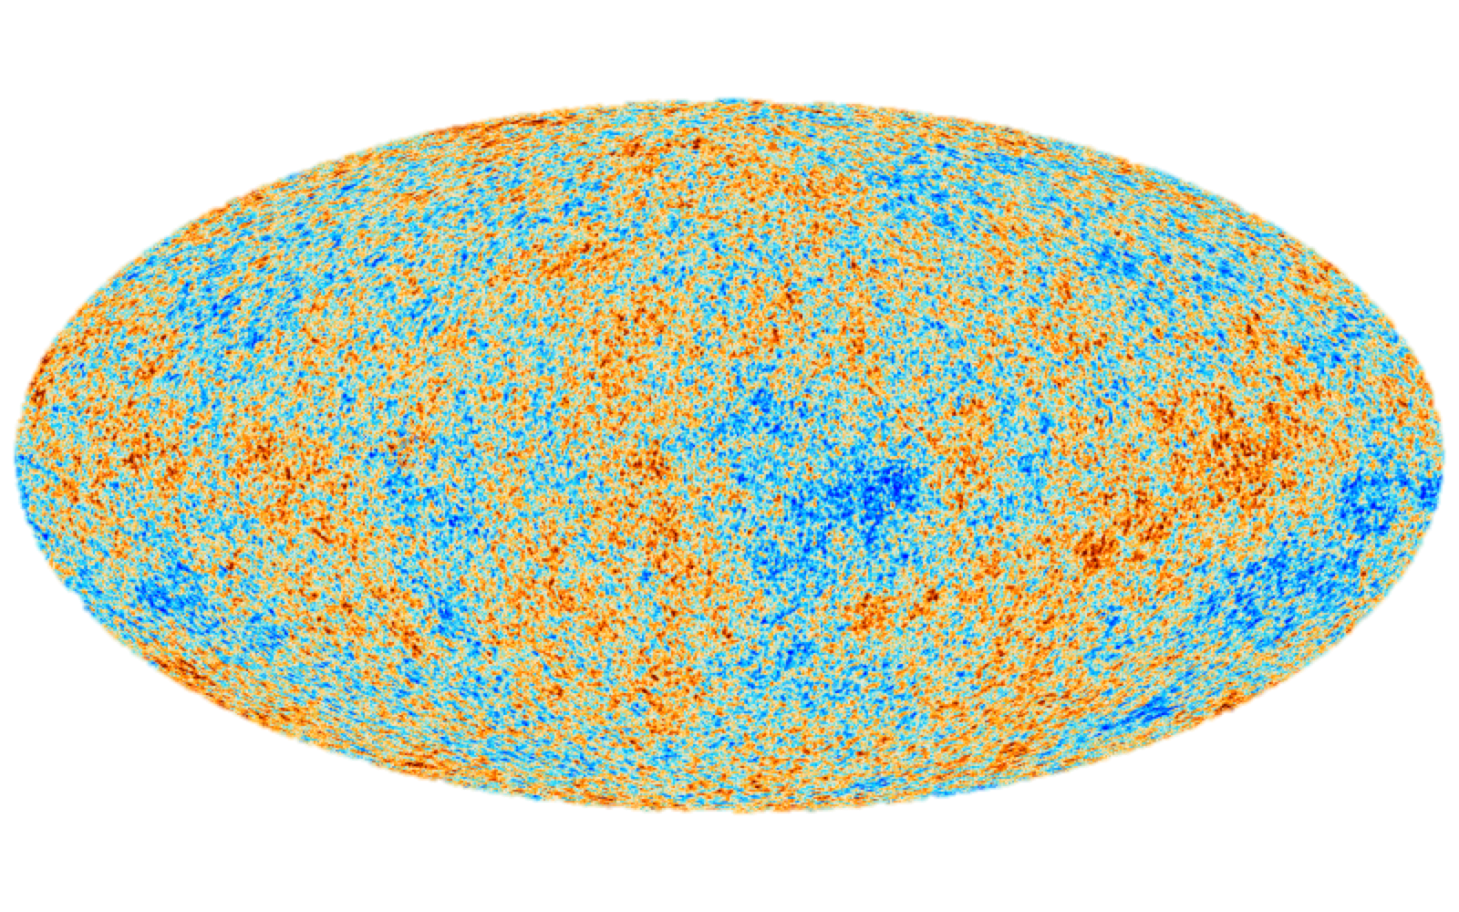
Bennett et al 2003
Eriksen et al 2004, and many others
Notes:
Compare S vs N. North looks much “quieter”

Slide 43
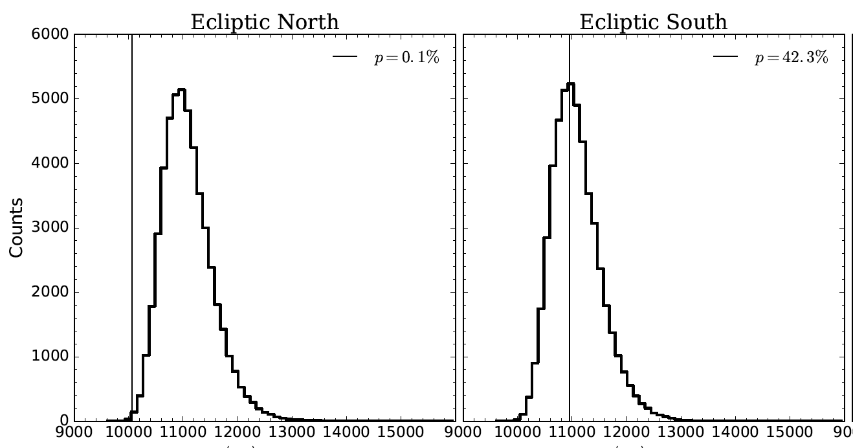
SMICA N vs S variance
p ~ 0.001
Notes:
Temperature variance distributions for the unconditioned-CDM realizations considering three dierent sky coverage scenarios:
pixels in the northern Ecliptic hemisphere (Ecliptic-North, left), southern Ecliptic hemisphere (Ecliptic-South, middle) and the portion of
the northern Ecliptic hemisphere that can be seen from the Chilean Atacama site (Atacama-North, right). The vertical lines represent the
corresponding values calculated from the Planck SMICA temperature map with p-values displayed in the plot legends. The Ecliptic-North
temperature data has an anomalously low variance (p = 0:1 per cent) when compared with unconditioned-CDM while the Ecliptic-
South appears unremarkable (p = 42:3 per cent). The north variance p-value increases to 1:0 per cent when only the Atacama-North
pixels are considered. See section 2.2 for parameters.

Slide 44
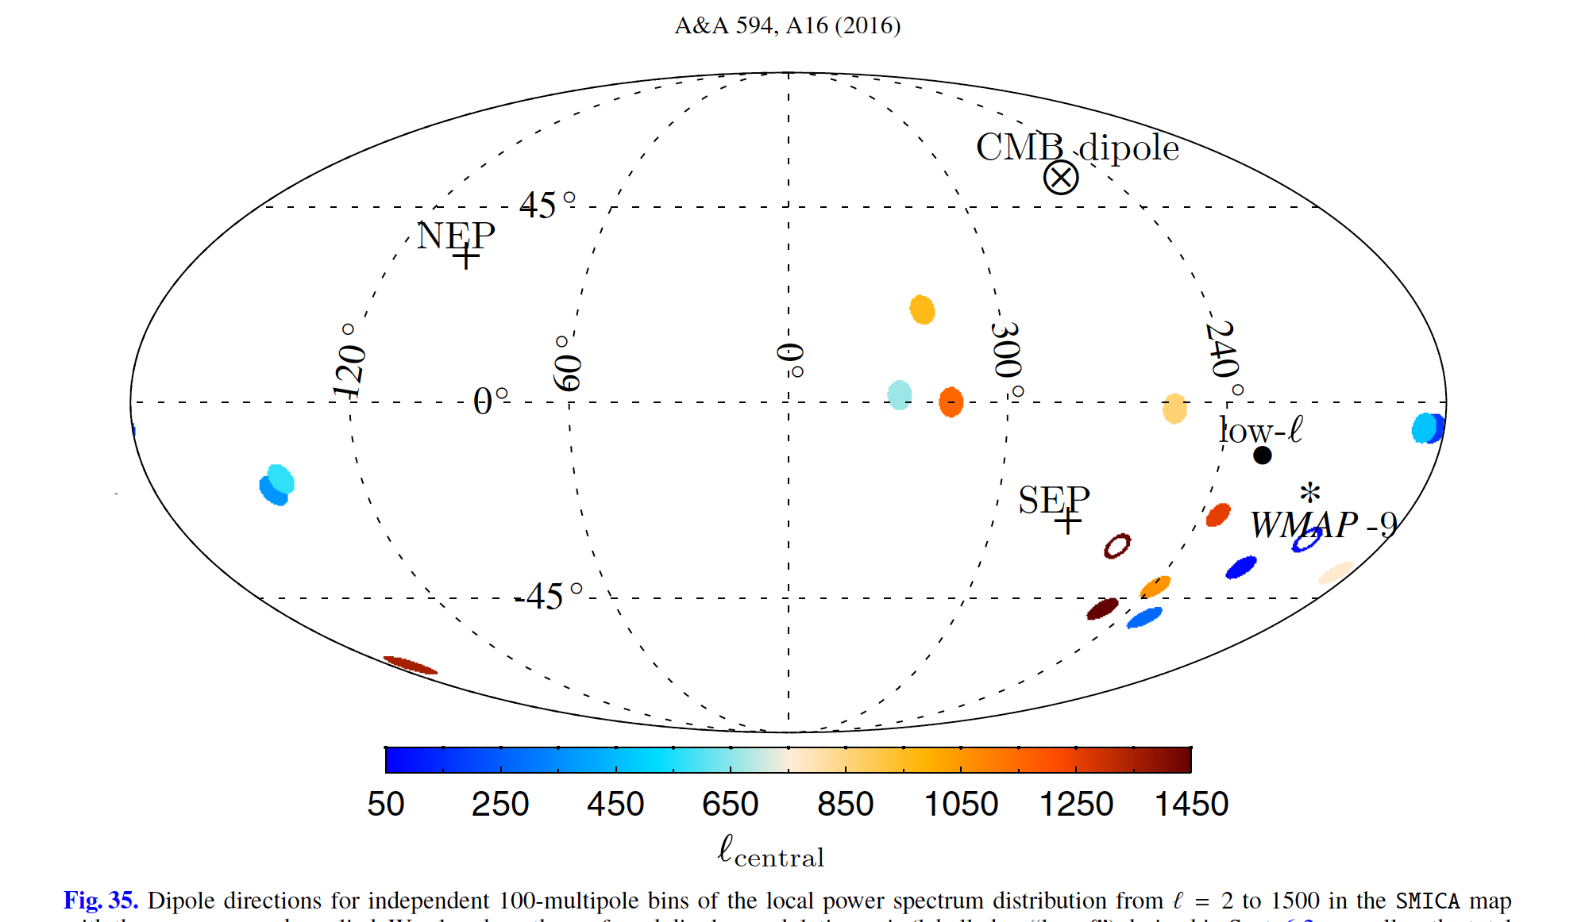
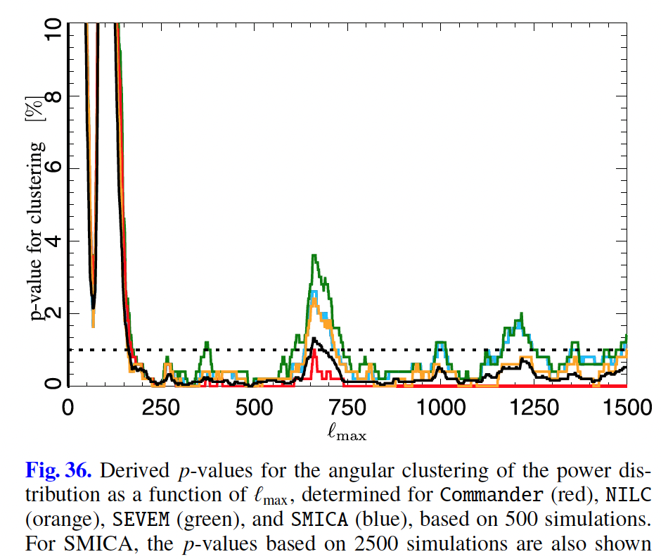
SI violation (“dipole modulation”) extends to high 𝓁
p < 1%
Planck 2015
Notes:
Temperature variance distributions for the unconditioned-CDM realizations considering three dierent sky coverage scenarios:
pixels in the northern Ecliptic hemisphere (Ecliptic-North, left), southern Ecliptic hemisphere (Ecliptic-South, middle) and the portion of
the northern Ecliptic hemisphere that can be seen from the Chilean Atacama site (Atacama-North, right). The vertical lines represent the
corresponding values calculated from the Planck SMICA temperature map with p-values displayed in the plot legends. The Ecliptic-North
temperature data has an anomalously low variance (p = 0:1 per cent) when compared with unconditioned-CDM while the Ecliptic-
South appears unremarkable (p = 42:3 per cent). The north variance p-value increases to 1:0 per cent when only the Atacama-North
pixels are considered. See section 2.2 for parameters.

Slide 45
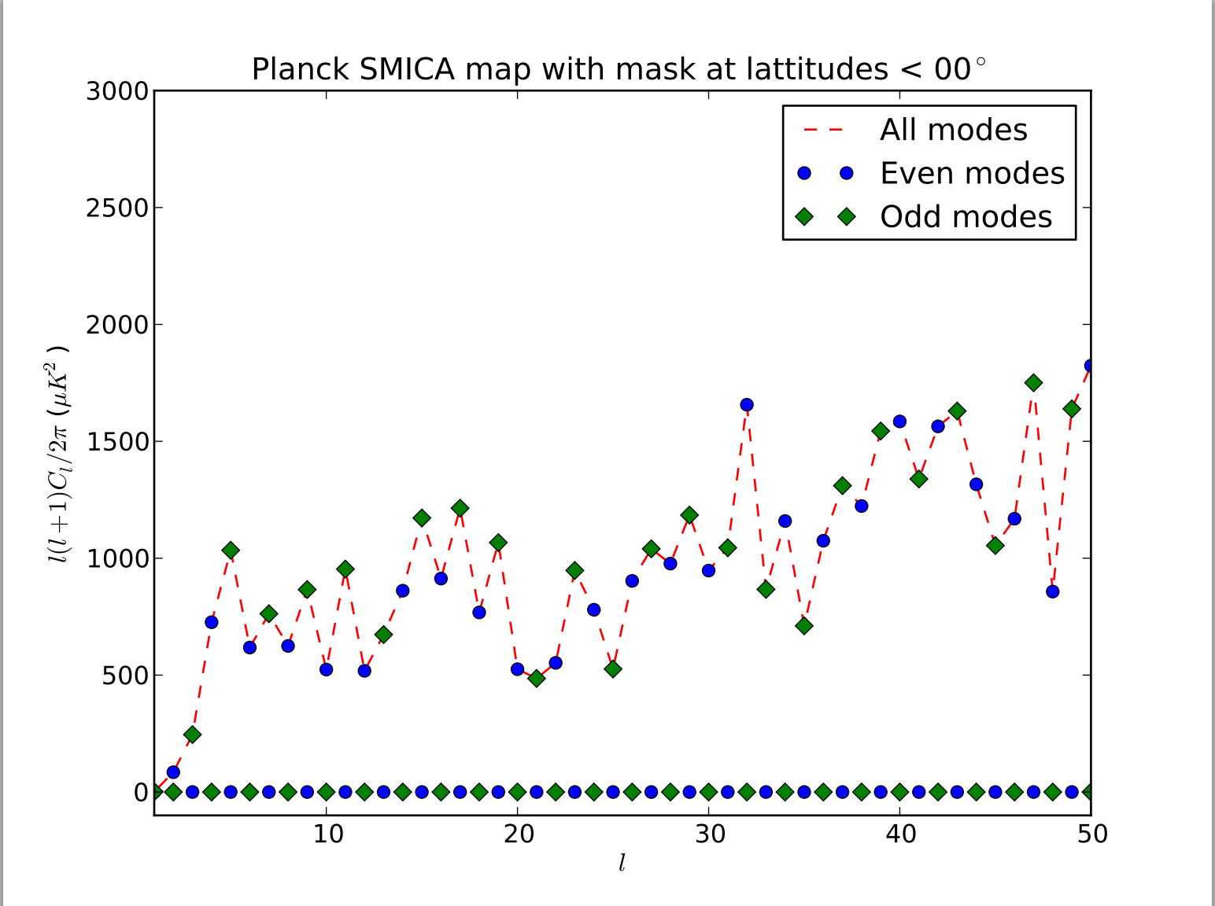
Parity anomaly
Plot by J. Muir, U. Pittsburgh

Slide 46
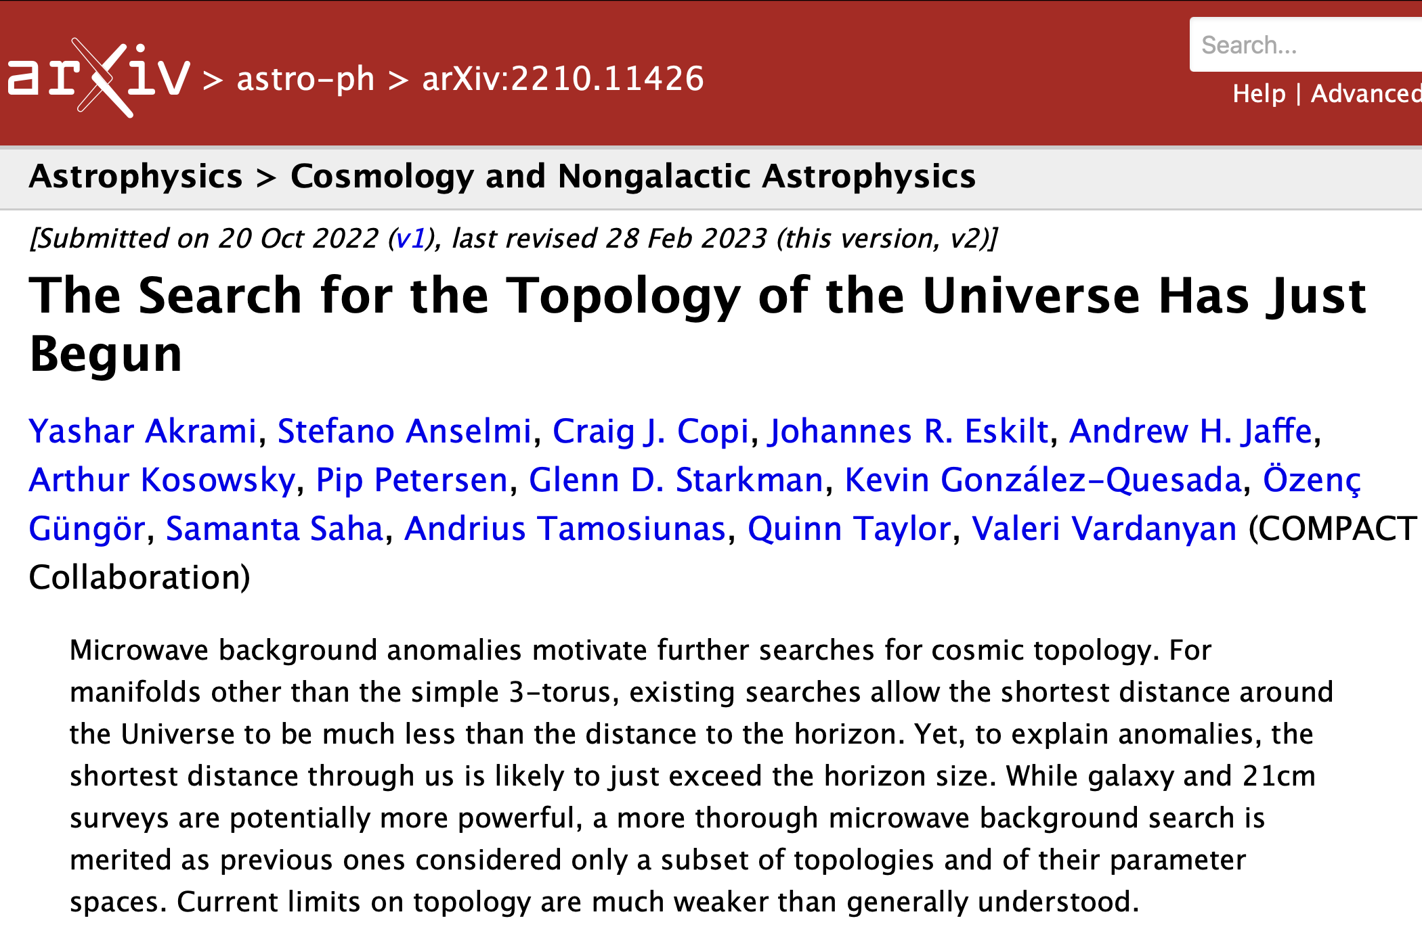
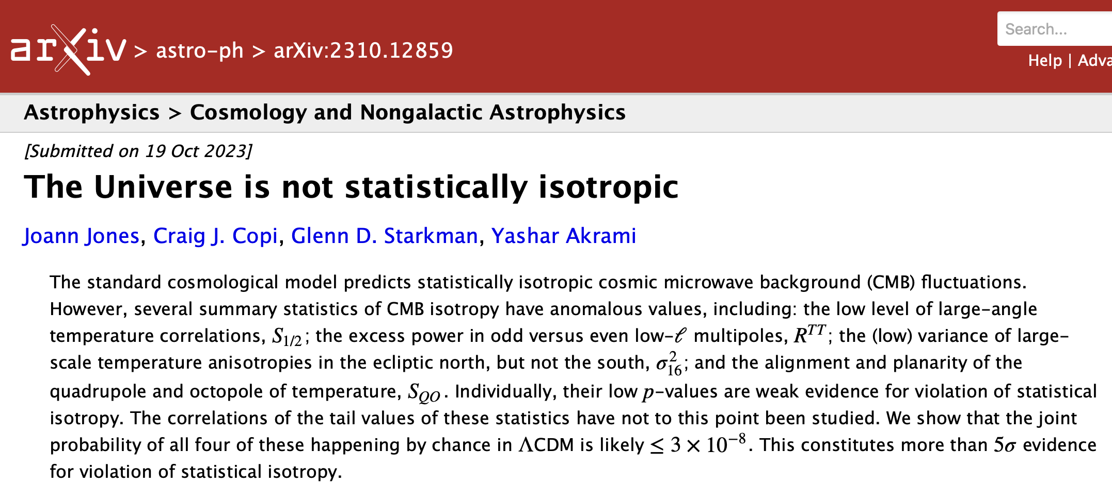
See talk by Joann Jones this afternoon

Slide 47
The Universe is NOT Statistically Isotropic

Slide 48
The End?

Slide 49
Okay, okay, but if I can’t explain the anomalies, can’t I just forget them?
Notes:
Compare S vs N. North looks much “quieter”

Slide 50


Primordial non-guassianity:
a cautionary tale
Idea:
$a_{ℓm}$ are NON-Gaussian
$δ\left(\vec{k}\right)$are NON-Gaussian

Slide 51



Primordial non-guassianity:
$$ΔΦ=∫d^{3}k δ\left(\vec{k}\right)e^{i\vec{k}\vec{∙x}}$$
$δ\left(\vec{k}\right)$are GRSI: $\left\langle δ\left(\vec{k}\right)δ^{∗}\left(\vec{k}′\right)\right\rangle ∝P\left(k\right)δ^{(3)}$(${\vec{k}}^{′}−\vec{k}$)
Odd n-point functions vanish, even ones are functions of P(k)
$δ\left(\vec{k}\right)$are NON-Gaussian
$\left\langle δ\left({\vec{k}}_{1}\right)δ\left({\vec{k}}_{2}\right)δ\left({\vec{k}}_{3}\right)\right\rangle ≡B({\vec{k}}_{1}$, ${\vec{k}}_{2}$, ${\vec{k}}_{3}$)
$B({\vec{k}}_{1}$, ${\vec{k}}_{2}$, ${\vec{k}}_{3}$) is a complicated object!

Slide 52



Primordial non-guassianity:
$B({\vec{k}}_{1}$, ${\vec{k}}_{2}$, ${\vec{k}}_{3}$) is a complicated object!
Simpler special cases,
b/c statistical homogeneity => ${\vec{k}}_{i}$ form a triangle
$B({\vec{k}}_{1}\text{, }{\vec{k}}_{2}\text{, }{\vec{k}}_{3}\text{)}=B\left(k_{1},k_{2},k_{3}\right)δ^{3}(\vec{k_{1}}+\vec{k_{2}}+\vec{k_{3}}\text{)}$
So, e.g.:
$$B^{equil}(k_{1},k_{2},k_{3}\text{)}\text{=6}A^{2}f_{NL}^{equil}\left\{−\frac{1}{k_{1}^{4−n_{s}}k_{2}^{4−n_{s}}}−\left(12→23\right)−\left(23→31\right)−\frac{1}{k_{1}^{4−n_{s}}k_{2}^{4−n_{s}}k_{3}^{4−n_{s}}}+\left[\frac{1}{k_{1}^{(4−n_{s})/3}k_{2}^{2(4−n_{s})/3}k_{3}^{4−n_{s}}}+5 perms\right]\right\}$$

Slide 53
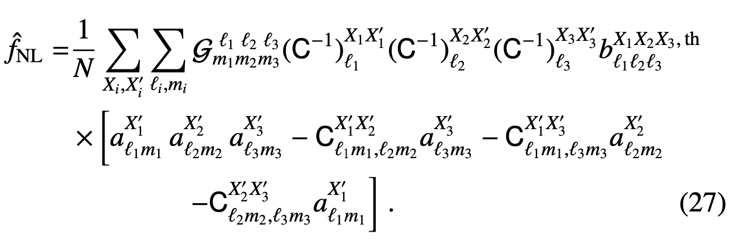



Primordial non-guassianity:
statistical isotropy =>
$⟨a_{ℓm}^{X}a_{ℓ^{′}m^{′}}^{Y}$ ${a^{Z}}_{ℓ^{′′}m^{′′}}⟩=𝓖_{mm^{′}m′′}^{ℓℓ^{′}ℓ^{′′}}b_{ℓℓ^{′}ℓ^{′′}}^{XYZ}$
XYZ=TTT,TTE,TEE,
EEE,TBB,EBB
$𝓖_{mm^{′}m′′}^{ℓℓ^{′}ℓ^{′′}}≡∫Y_{ℓm}(\hat{n})Y_{ℓ^{′}m^{′}}(\hat{n})$ $Y_{ℓ^{′′}m^{′′}}\left(\hat{n}\right)d^{2}\hat{n}̂$
Gaunt integral
Estimators of $f_{NL}$:
Diagonal covariance approximation, given SI
From Planck 2018 IX Constraints on PNG
Notes:
Planck 2018 Non-Gaussianity paper

Slide 54
Violation of SI and SH don’t imply
(or preclude) NG;
but they may make it much harder to measure
Notes:
Compare S vs N. North looks much “quieter”

Slide 55

All (?) NG statistical results assume SI
Violation of SI affects the bispectrum/f_{NL}, and $σ_{fNL}$
$$<a_{ℓm}^{X}a_{ℓ′m′}^{Y}a_{ℓ′′m′′}^{Z}> ≠𝓖_{mm^{′}m′′}^{ℓℓ^{′}ℓ^{′′}}b_{ℓℓ^{′}ℓ^{′′}}^{XYZ}$$
diagonal covariance approximation, given SI
Q: how would we even estimate f_{NL}?!
Notes:
X,Y,Z == T,E

Slide 56

$$<a_{ℓm}a_{ℓ′m′}a_{ℓ′′m′′}> ≠0$$
$implies NG distribution for$ $a_{ℓm}$
$$but how do you construct a summary statistic$$
and an estimator if
$<a_{ℓm}a_{ℓ′m′}^{∗}>≠C_{ℓ}δ_{ℓℓ′}δ_{mm′}$ ?
And if $<a a a a a a>≠<a a a a a a>$ _{SI} ?

Slide 57
If SI is false then how is the information on PNG to be extracted ?
< a_{l m} a*_{l’ m’}> = ?
< a_{l m} a_{l’ m’} a_{l’’ m’’}> = ?
< a_{l m} a_{l’ m’} a_{l’’ m’’} a_{l’’’ m’’’}> = ?

Slide 58
With so many anomalies, what do we do?
In preparation: Large-angle anomalies of the CMB and the evidence against statistical isotropy, Physics Reports
Notes:
Compare S vs N. North looks much “quieter”

Slide 59
Making Progress
Find a fundamental physics model, make testable predictions.
Make reasonable phenomenological extrapolations and test them.
Continue to test the “fluke hypothesis.”
i.e. test LCDM!

Slide 60
Testing the fluke hypothesis
Philosophy: assume LCDM is correct, predict how measured anomalies affect predictions for other observables, test them.
Note:
this is a fundamentally frequentist approach.
Notes:
Figure1.Histogram of ST'1=2 values for 105 simulations for con-strained (blacksolid) and unconstrained (reddashed)CDM realizations from WMAP7 parameters.The dashed lines show the 99- percentile and 99:9- percentile values for the constrained realizations.

Slide 61
Phenomenological extrapolations
Philosophy:
1. Assume statistical isotropy is violated, identify generic predictions
2. Assume each anomaly is “physical” and guess what that implies for other observables

Slide 62
Testing the fluke hypothesis
Phenomenological extrapolations
go hand in hand
Notes:
Figure1.Histogram of ST'1=2 values for 105 simulations for con-strained (blacksolid) and unconstrained (reddashed)CDM realizations from WMAP7 parameters.The dashed lines show the 99- percentile and 99:9- percentile values for the constrained realizations.

Slide 63
Example 1: Low N variance in E
Notes:
Figure1.Histogram of ST'1=2 values for 105 simulations for con-strained (blacksolid) and unconstrained (reddashed)CDM realizations from WMAP7 parameters.The dashed lines show the 99- percentile and 99:9- percentile values for the constrained realizations.

Slide 64
Low N variance in T

Slide 65


Phenomenological guess
Low variance in T
over a large region of the sky
$$⟹$$
Low variance in underlying curvature fluctuations
$$⟹$$
low variance in E-mode polarization
in that same region

Slide 66
What does LCDM say?
After all, T-E are correlated!
Notes:
Solid: LCDM
LCDM conditioned on SMICA map.

Slide 67
Constrained realizations
(testing the fluke hypothesis)
Create realizations of (best-fit) ΛCDM
Constrained to agree with observed T anomalies
Better/harder: constrained to agree with observed maps.
Augment with realizations of other physical quantities with correct covariance (eg. polarization, lensing potential)
Notes:
Figure1.Histogram of ST'1=2 values for 105 simulations for con-strained (blacksolid) and unconstrained (reddashed)CDM realizations from WMAP7 parameters.The dashed lines show the 99- percentile and 99:9- percentile values for the constrained realizations.

Slide 68
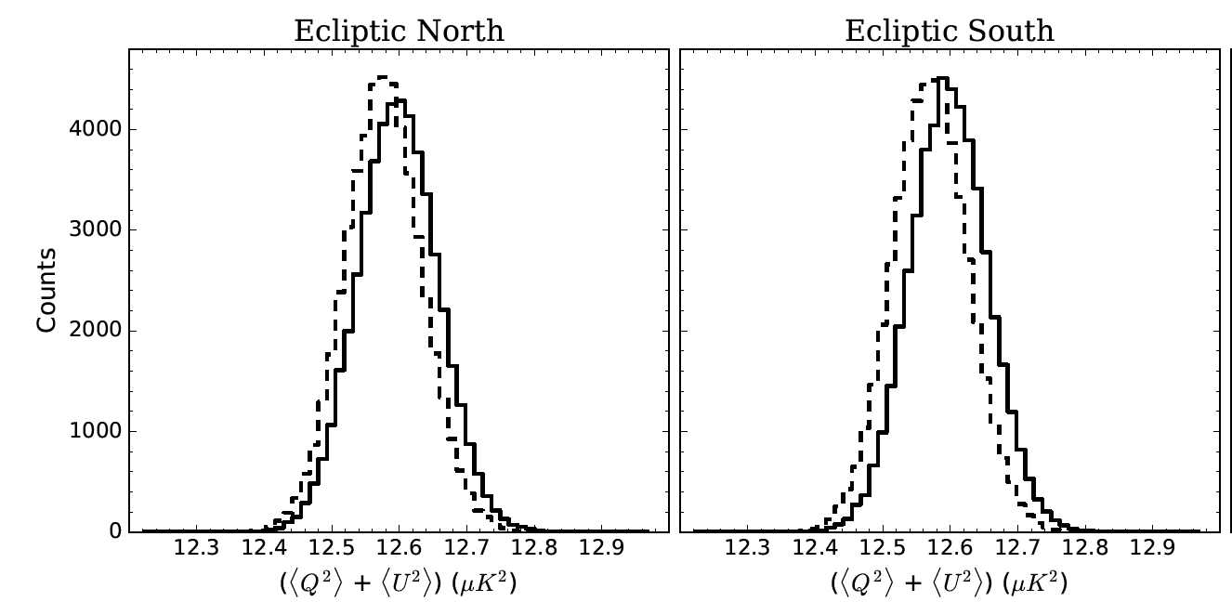
Observe:
a small reduction in the polarization variance
approximately equal in N and S
Notes:
Solid: LCDM
LCDM conditioned on SMICA map.

Slide 69
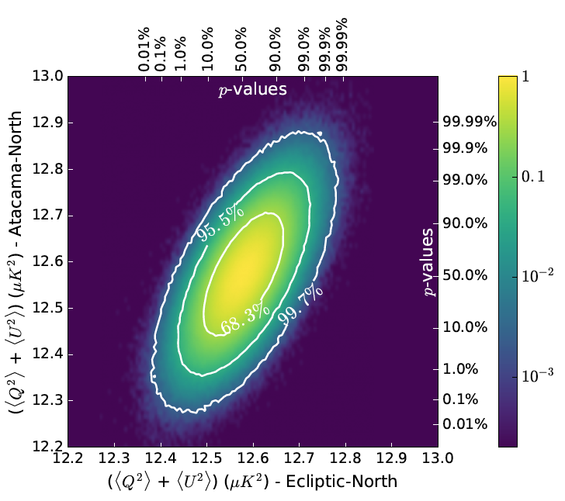
Test of the phenomenological guess
Look for reduced variance in North Ecliptic E
Recall: T variance was 10% supressed!
10% variance suppression => extremely low p-value

Slide 70
Example 2: Absence of angular correlation in Q,U,E
Notes:
Figure1.Histogram of ST'1=2 values for 105 simulations for con-strained (blacksolid) and unconstrained (reddashed)CDM realizations from WMAP7 parameters.The dashed lines show the 99- percentile and 99:9- percentile values for the constrained realizations.

Slide 71
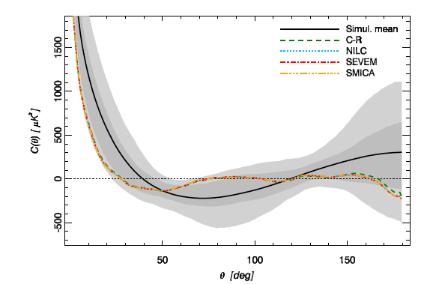

Slide 72

Phenomenological guess
Low correlation in T
$$⟹$$
Low correlation in curvature fluctuations
$$⟹$$
low correlation in Q,U,E polarization

Slide 73
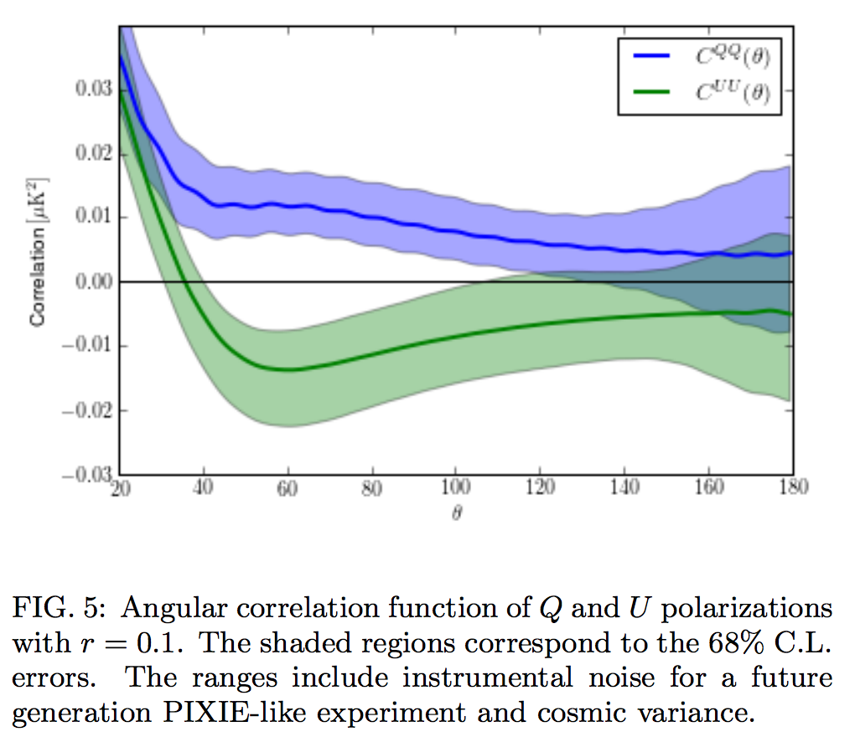
Constrained-LCDM QQ and UU correlations
A. Yoho, A. Aiola, C. Copi, A. Kosowsky, GDS (PRD91 (2015) 12, 123504)
Notes:
Implication – if the absence of TT correlations at large angles is due to an absence of \Phi\Phi correlations at large distances, then this should result in an absence of QQ/UU correlations

Slide 74
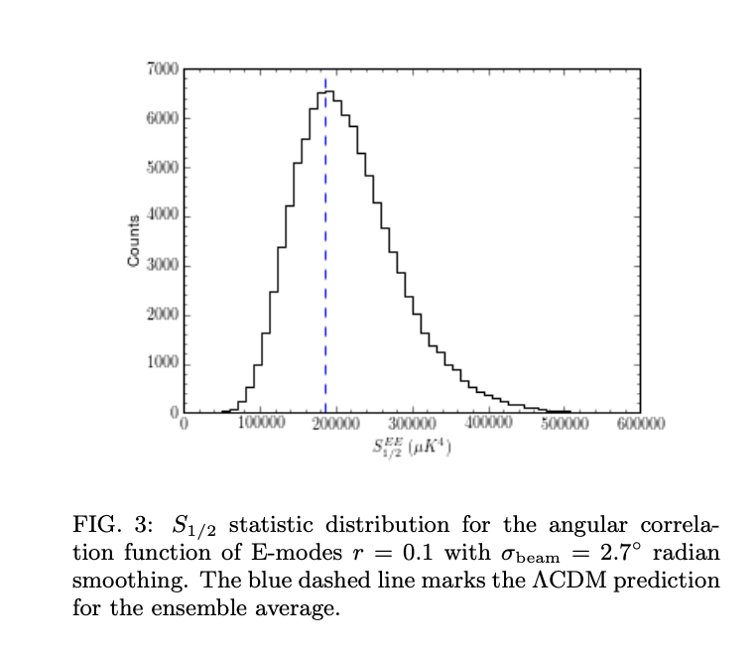
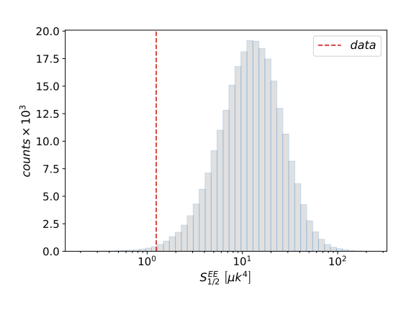
Constrained-LCDM EE correlations
A. Yoho, A. Aiola, C. Copi, A. Kosowsky, GDS (PRD91 (2015) 12, 123504)
S_{1/2} statistic for the angular correlation function of E-modes in Planck 2018 HFI 100
Lack-of-correlation anomaly in CMB large scale polarisation maps, C.Chiocchetta, A. Gruppuso, M.Lattanzi, P. Natoli, L. Pagano arXiv:2012.00024
Notes:
Implication – if the absence of TT correlations at large angles is due to an absence of \Phi\Phi correlations at large distances, then this should result in an absence of QQ/UU correlations

Slide 75
Example 3: Cosmological dipole
Notes:
Figure1.Histogram of ST'1=2 values for 105 simulations for con-strained (blacksolid) and unconstrained (reddashed)CDM realizations from WMAP7 parameters.The dashed lines show the 99- percentile and 99:9- percentile values for the constrained realizations.

Slide 76
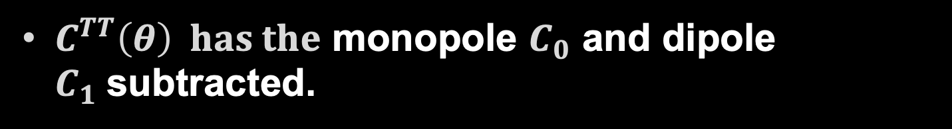

T – the cosmological dipole
$C^{TT}\left(θ\right) has the$ monopole $C_{0}$ and dipole $C_{1}$subtracted.
If $C^{TT}\left(θ\right)≃0$is physical, then $C_{1}$must be small
$C_{1}^{T}≲200{\left(μK\right)}^{2}$
vs.
$C_{1}^{LCDM}≃3300{\left(μK\right)}^{2}$
Q: can you detect the/this dipole?

Slide 77
New Models

Slide 78
New Models
List of new fundamental physics models known to explain all/most/several anomalies:
Requirements:
Break statistical isotropy
Affect scales that were causally disconnected until recently

Slide 79
New Models
Fundamental physics phenomena that break isotropy and are already in our theory:
Non-trivial cosmic topology

Slide 80
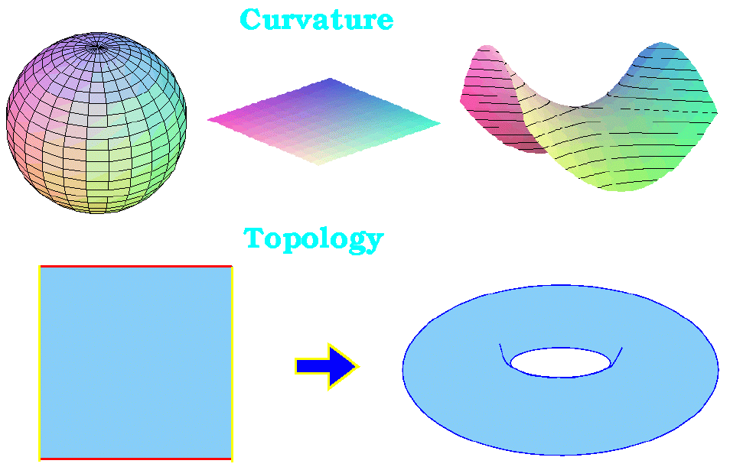
Cosmic Geometry
Curvature
Topology

Slide 81
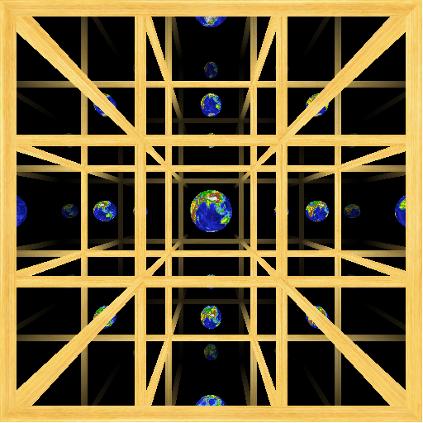
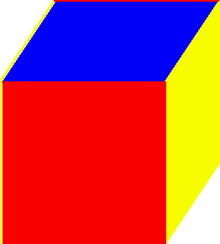
Three Torus
Same idea works in three space dimensions

Slide 82
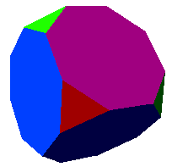
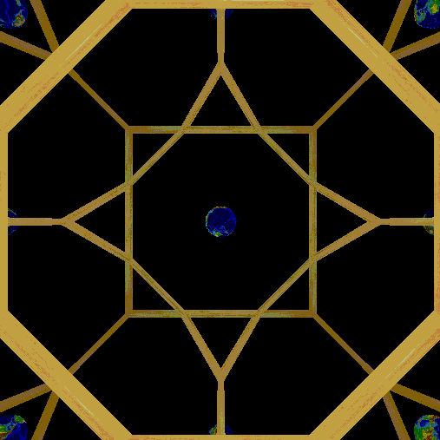
Spherical Topologies
This example only works in spherical space

Slide 83
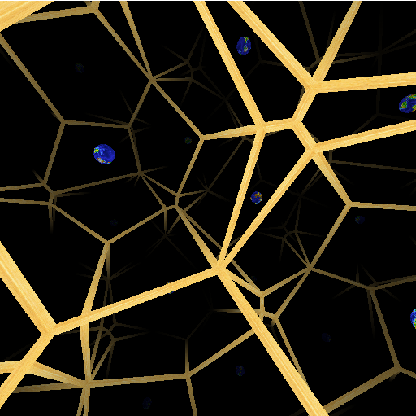
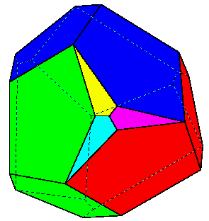
Infinite number of tiling patterns
This one only works in hyperbolic space

Slide 84
The consequences of broken statistical isotropy

Slide 85
A broken symmetry offers no protection
Consequence 1

Slide 86


Statistical isotropy
Forbids off–diagonal TT, EE, BB correlations:
$\left\langle a_{ℓm}^{X}a_{ℓ^{′}m^{′}}^{X∗}\right\rangle =C_{ℓ}^{X}δ_{ℓℓ′}δ_{mm′}$ , X=T,E,B
Forbids TB, EB correlations:
$\left\langle a_{ℓm}^{X}a_{ℓ^{′}m^{′}}^{B∗}\right\rangle =0$ , X=T,E
Common misconception:
this is due to parity invariance

Slide 87


Statistical anisotropy $⟹$
General Correlation matrix
$$\left\langle a_{ℓm}^{X}a_{ℓ^{′}m^{′}}^{Y∗}\right\rangle =C_{ℓmℓ′m′}^{XY}$$
Some terms require parity violation
Statistical anisotropy tied to statistical inhomogeneity
Statistical inhomogeneity $⟹$ parity violation
A. Samandar et al. (in preparation)

Slide 88
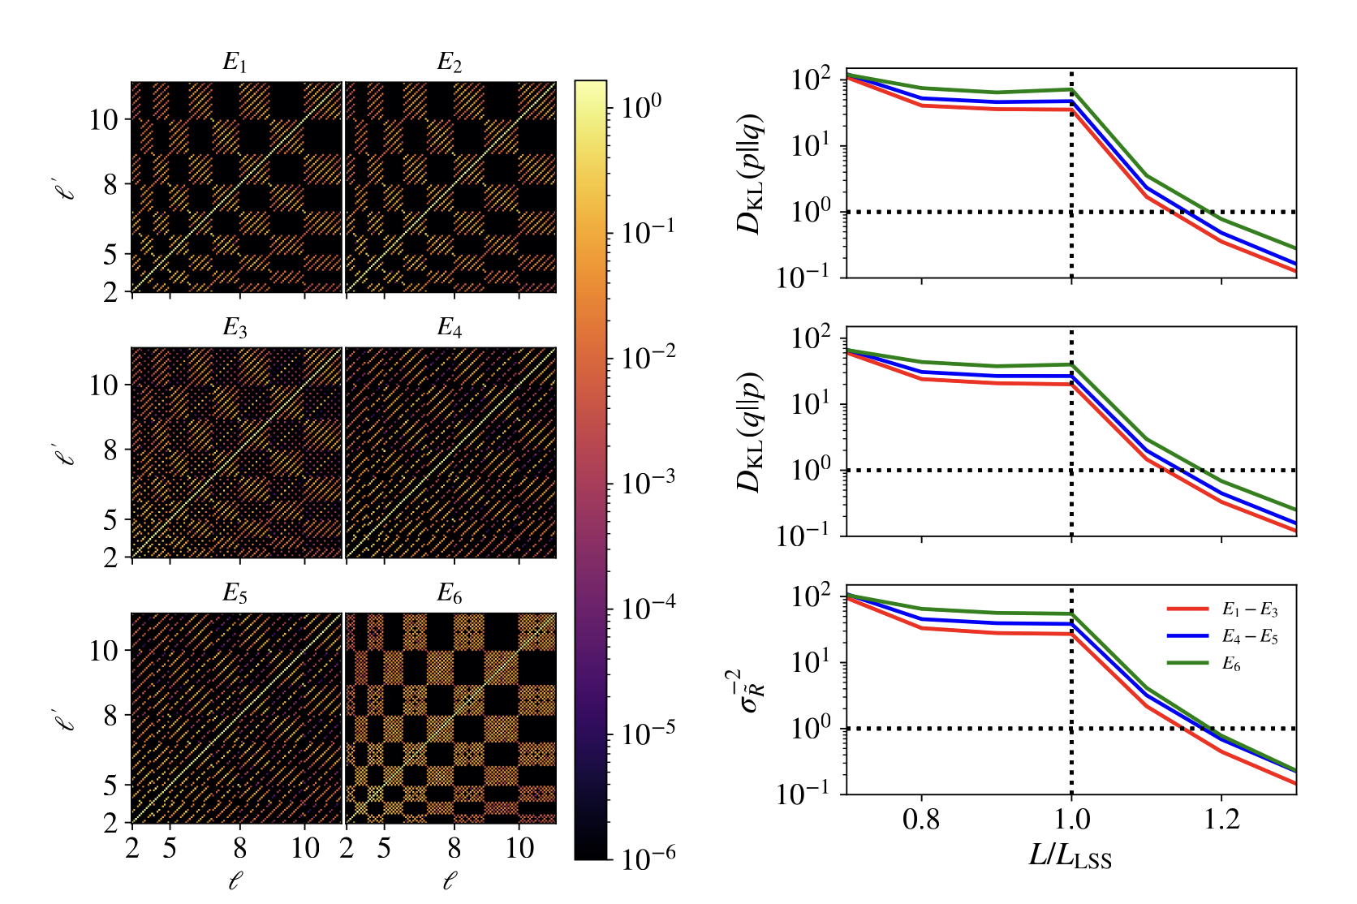
Normalized TT correlation matrices and KL divergence in some Euclidean manifolds

Slide 89
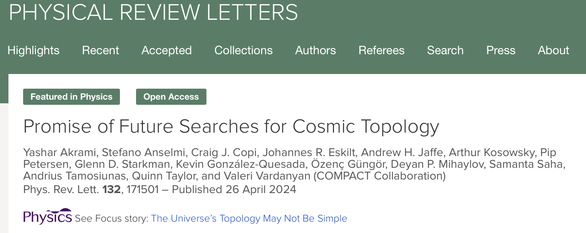
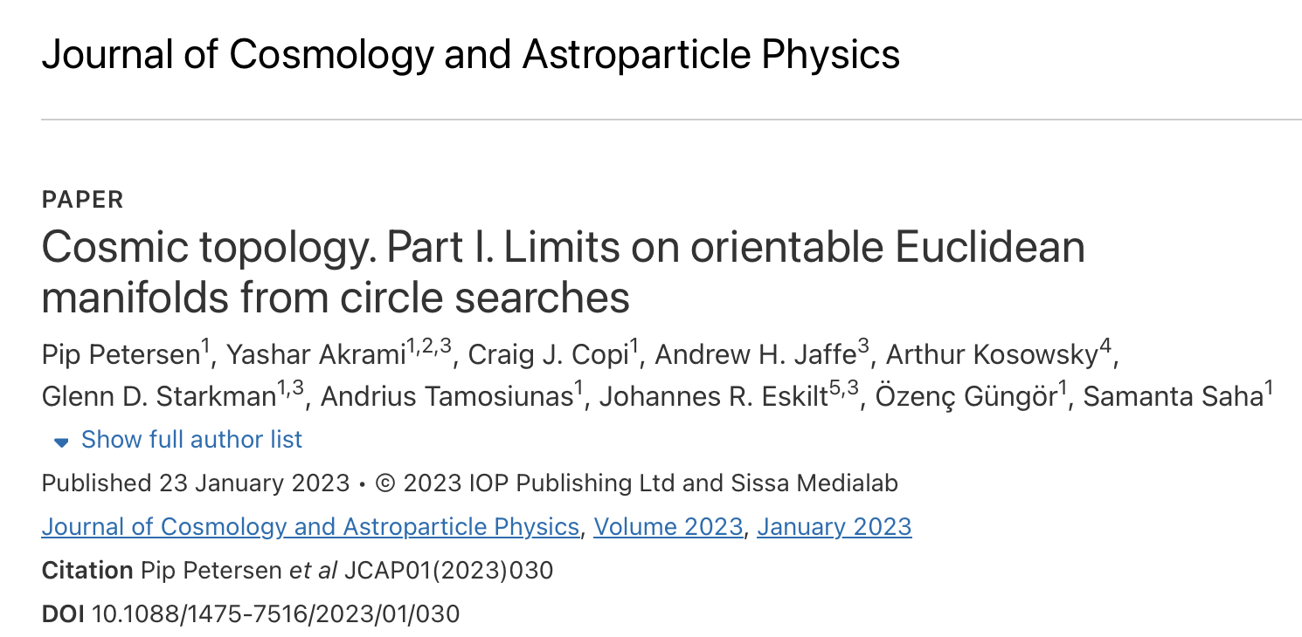
To hear more: Deyan Mihaylov seminar tomorrow!

Slide 90
SUMMARY
The CMB is NOT the realization
of a Gaussian random
statistically isotropic field.
The Universe is
NOT Statistically Isotropic

Slide 91
No proven “model” so far:
  Systematics
  Foregrounds
  Cosmology – topology?

Slide 92
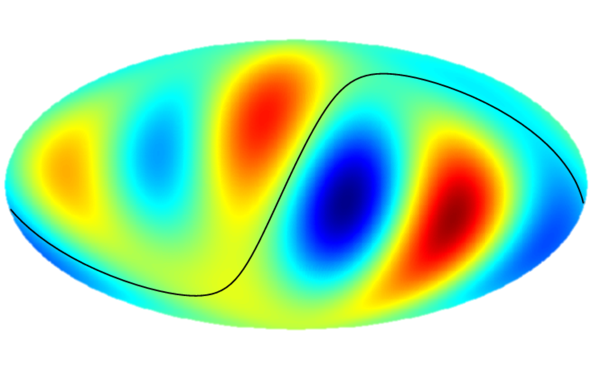
The cosmic orchestra may be playing a LCDM symphony,
But somebody gave the bass and tuba the wrong score.
They tried hard to keep it quiet. They failed.
We demand an explanation

