Slide 1
GEOMETRIC UNIFICATION OF ELEMENTARY PARTICLES
Christos Ragiadakos
arXiv:hep-th/1704.00321v3
JPCS 2912 (2024) 012015

Slide 2
Pseudo-Conformal Field Theory
PCFT achieves the goal of Einstein to unify all the existing interactions (gravity, electroweak, Higgs, gluonic).
Einstein’s metric is replaced by two pairs of interrelated Frobenius integrable systems (Lorentzian CR-structure), which coincides with the NP tetrad with κ=σ=0=λ=ν.
The leptons are solitonic lorentzian CR-structures with vanishing gluonic field. Every lepton implies a quark with non-vanishing gluonic field. The first generation (e,ν;u,d) is explicitly computed.
Minkowski spacetime is the boundary of SU(2,2) symmetric classical domain. Gravity measures the penetration in the domain. It also restricts the CP(3) surfaces to quadrics, cubics and quartics, which determine the three particle generations.

Slide 3
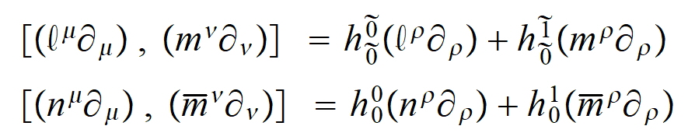
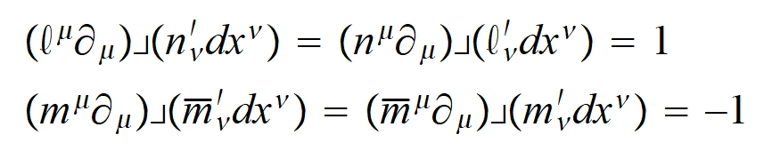
LORENTZIAN CR-STRUCTURE (1)
Spacetime is a 4-d manifold, which admits a tetrad with two real l, n and a complex vector m, viewed as a moving frame of Cartan (Stephani) and satisfying the following involutive relations
In the cotangent space the dual tetrad (a la Cartan) is defined with the relations

Slide 4
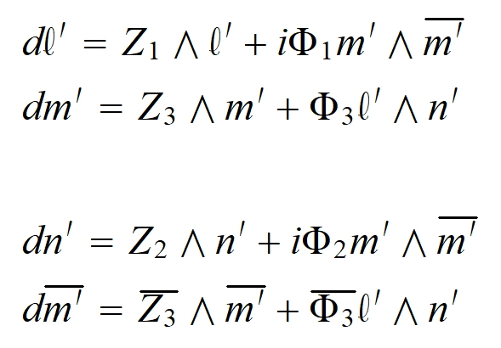
LORENTZIAN CR-STRUCTURE (2)
In the cotangent space the definition takes the form
In the following formulas we will not use the prime to distinguish the dual tetrad (cotangent space)

Slide 5
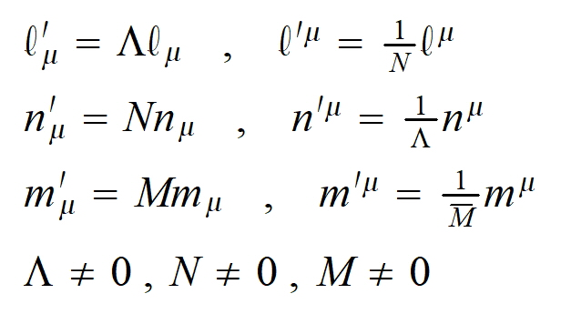
TETRAD-WEYL SYMMETRY (1)
The definition of the LCR-structure admits the following symmetry, which we will call tetrad-Weyl symmetry for the LCR-tetrad.

Slide 6
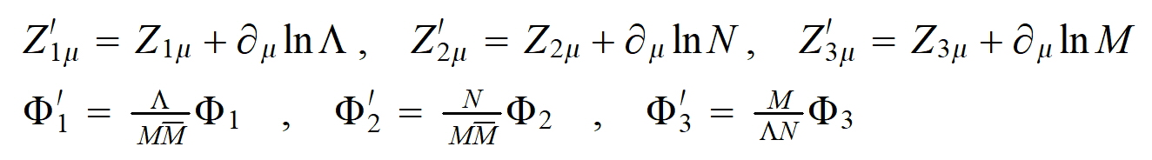
TETRAD-WEYL SYMMETRY (2)
The auxiliary fields transform as follows
Notice the essential difference between the tetrad-Weyl symmetry and the local lorentzian symmetry of the tetrads compatible with an Einstein metric, which does not preserve the LCR equations.

Slide 7
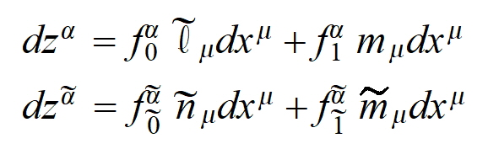
FROBENIUS THEOREM (1)
Because of the coexistence of real and complex variables, we have to complexify x into r=x+iy and apply the holomorphic Frobenius theorem. Then there are two pairs of complex variables such that
These LCR-structure coordinates provide an explicit embedding of the real 4-d manifold into a complex 4-d manifold. It is a restricted totally real CR-manifold, because only analytic transformations between tilded or untilded variables are permitted.

Slide 8
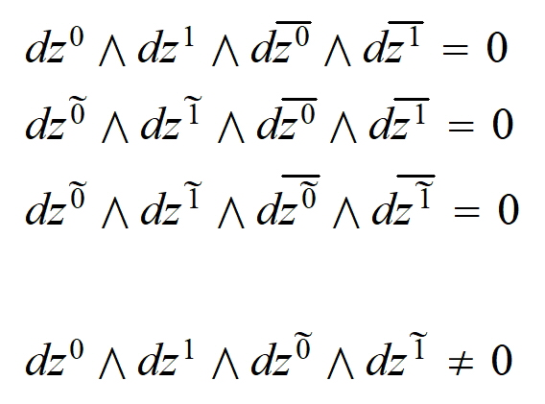
FROBENIUS THEOREM (2)
The reality conditions of the LCR-tetrad imply
The last condition is implied by the linear independence of the LCR-tetrad

Slide 9
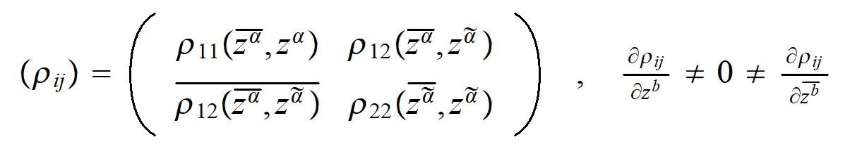
FROBENIUS THEOREM (3)
Hence the implicit embedding of the real 4-d manifold into the ambient complex 4-d manifold has the following hermitian form
Notice the precise dependence of the LCR-conditions on the LCR-structure coordinates. It is a special totally real CR-structure.

Slide 10
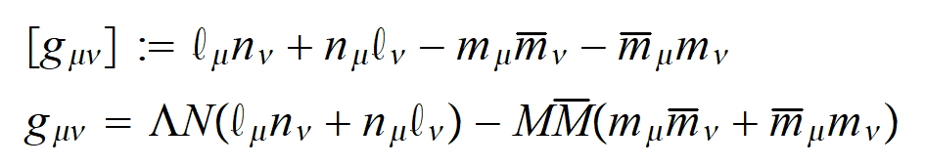
EMERGENCE OF EINSTEIN’S METRIC (1)
The LCR-tetrad reminds the Newman-Penrose null tetrad in GR. The NP formalism is the Cartan moving frame formalism adapted to the null tetrad.
Hence the LCR-tetrad defines the class of metrics
The second line gives the general form of a metric, which is not unique. In the NP formalism a LCR-tetrad has κ=σ=0=λ=ν. Such a null tetrad determines two principal null directions of the conformal tensor, because Ψ0=0=Ψ4.

Slide 11
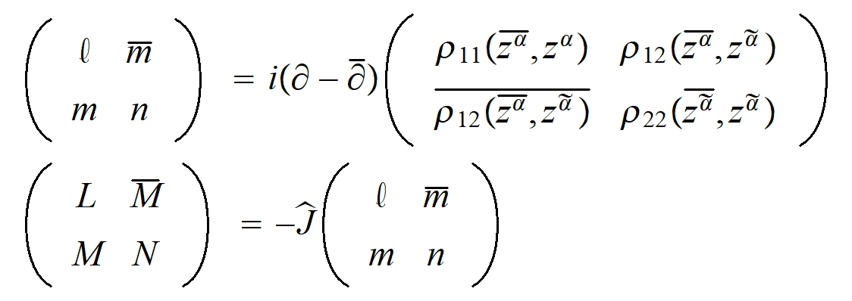
EMERGENCE OF EINSTEIN’S METRIC (2)
In the ambient complex manifold a non-uniquely determined Kaehlerian structure is defined
The induced submanifold is lagrangian with an Einstein metric, and tangent and normal bundles

Slide 12
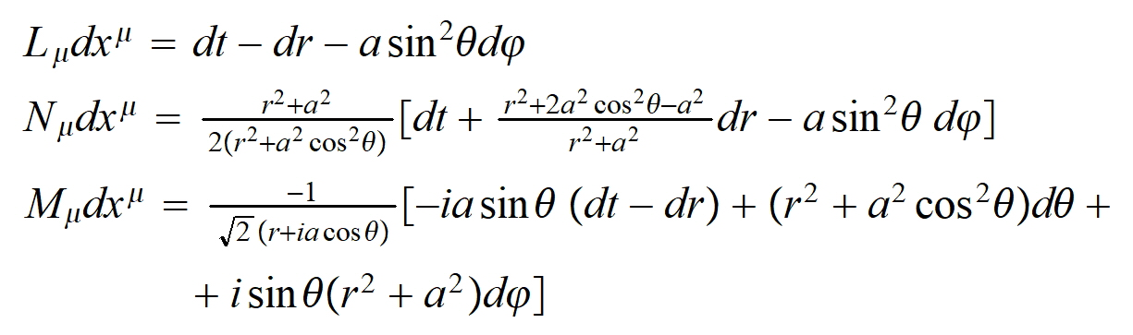
EMERGENCE OF EINSTEIN’S METRIC (3)
Hence the majority of Einstein’s metrics have no physical meaning in PCFT, because they do not admit at least two geodetic and shear free null congruences.
But do not worry, because the Kerr-Newman metric is compatible with a static LCR-structure, which we will identify with the electron. The flat LCR-tetrad is
where the tetrad-Weyl factors are assumed.

Slide 13

EMERGENCE OF EINSTEIN’S METRIC (4)
We adapted the Kerr-Schild ansatz into the LCR-tetrad and found a non “flat” LCR-tetrad, which is compatible with the KN metric as follows
where h(r)=-2mr+q^2 gives the KN metric, which has an electromagnetic potential proportional to the retarded null vector
The identification of the electromagnetic potential is not a computational accident.

Slide 14
EMERGENCE OF EINSTEIN’S METRIC (5)
Carter computed the moments of the KN manifold and found that its gyromagnetic ratio is g=2 like that of the electron. But this metric manifold cannot be identified with the electron, because its parameters show that the essential singularity is naked.
Metric manifolds need horizons to be accepted.
g=2 is not a computational accident.
The “KN” LCR-structure is regular, because the ray tracing shows that LCR-rays pass through the ring “essential singularity” to the other side in the spinorial complete U(2) manifold.
The Hawking-Penrose singularity theorem does not generally apply in the “KN” LCR-structure.

Slide 15
ELECTROWEAK AND “HIGGS” POTENTIALS (1)
Recall that in the tetrad-Weyl transformations
Φ1, Φ2 and Φ3 scalar functions are multiplicati-vely transformed with non-vanishing or diverging factors. Hence after a tetrad-Weyl transformation (outside their singularities) they can take only the 0 or 1 values. Hence they act as topological (relative) invariants, which may be used to classify the LCR-structures.

Slide 16
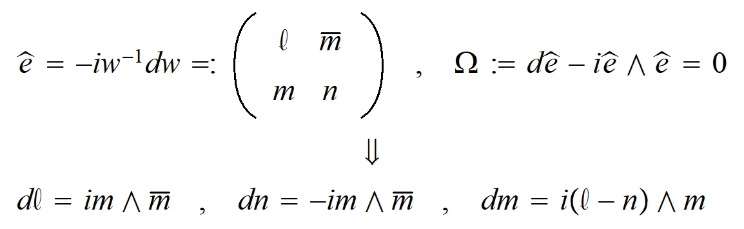
ELECTROWEAK AND “HIGGS” POTENTIALS (2)
We consider the following LCR-structure categories:
Degenerate for Φ1=Φ2=Φ3=0
Exotic matter for Φ1≠0 and Φ2=0 (or vice versa)
Normal matter for Φ1≠0 and Φ2≠0
The “natural U(2)” LCR-structure is

Slide 17
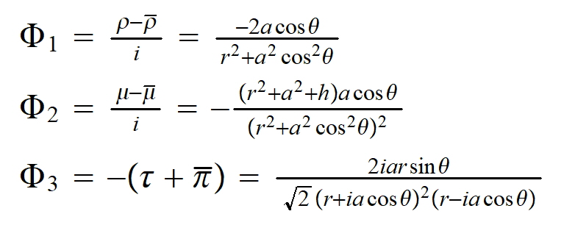
ELECTROWEAK AND “HIGGS” POTENTIALS (3)
The “KN” LCR-structure has the relative invariants
We make a tetrad-Weyl transformation to Φ1=1=-Φ2 such that Λ be the factor of the electromagnetic potential relative to the retarded null vector field.

Slide 18
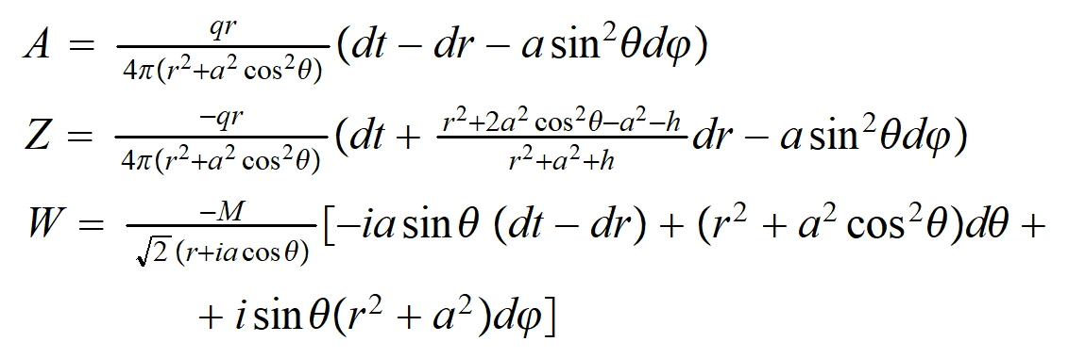

ELECTROWEAK AND “HIGGS” POTENTIALS (4)
The (singular) tetrad-Weyl transformation permits the electroweak potentials to take the forms
And the remaining real “Higgs” potential the form

Slide 19
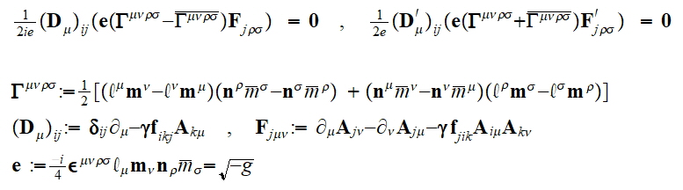
GLUONIC FIELD EQUATION AND QUARKS (1)
The tetrad-Weyl permits only the following 2 PDEs
Only the two (out of 3) self-dual forms are permitted. No source field is permitted!
The 2-d PCFT is the Polyakov action!

Slide 20
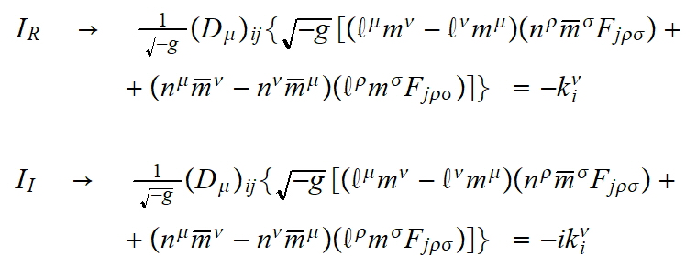
GLUONIC FIELD EQUATION AND QUARKS (2)
They reduce to the following PDEs with real sources
The second is the dual (magnetic monopole) of the first. The solution of the first PDE with the static (electron) LCR-structure is identified with the quark.
This is the origin of the lepton-quark correspondence!

Slide 21
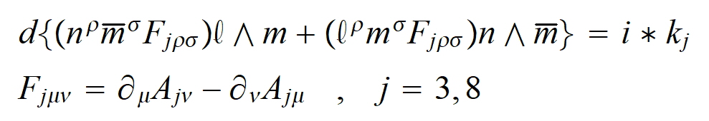
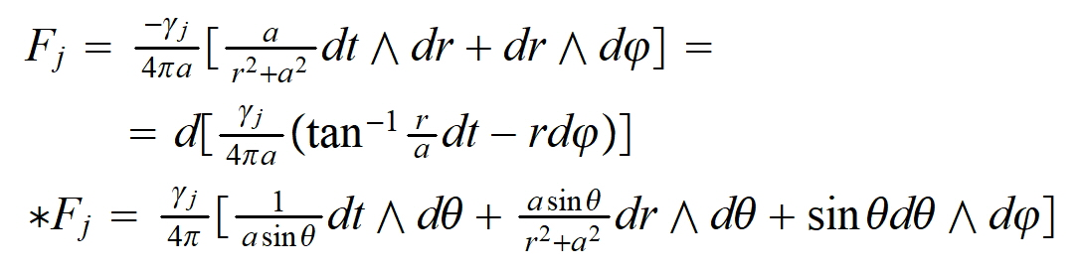
GLUONIC FIELD EQUATION AND QUARKS (3)
The abelian (Cartan subalgebra of SU(3)) PDE in differential Forms is
Using Stoke’s theorem we find the solution

Slide 22
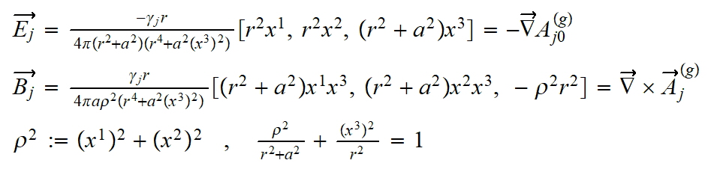
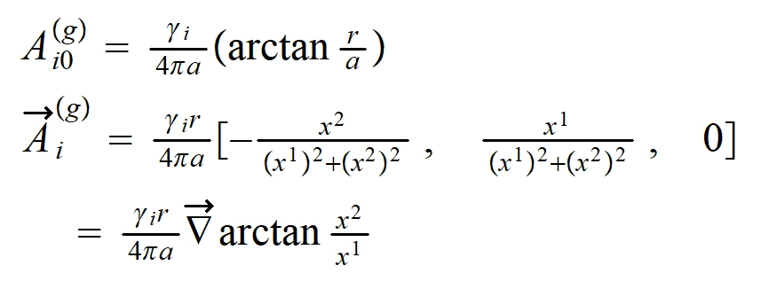
GLUONIC FIELD EQUATION AND QUARKS (4)
The chromoelectric and chromomagnetic fields
Notice the line singularity. The potentials are

Slide 23
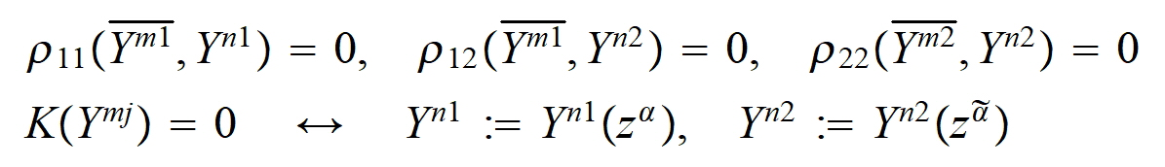
THE POINCARE GROUP (1)
The projectivized LCR-conditions are
Where the two points belong to a surface of CP(3). The maximal symmetry is SL(4,C). In the Cartan methodology this has to be viewed as the boundary of a domain being a smooth deformation of a classical domain. In the present case it is the SU(2,2) classical domain. The Poincare group is the affine subgroup in the SU(2,2) unbounded realization.

Slide 24
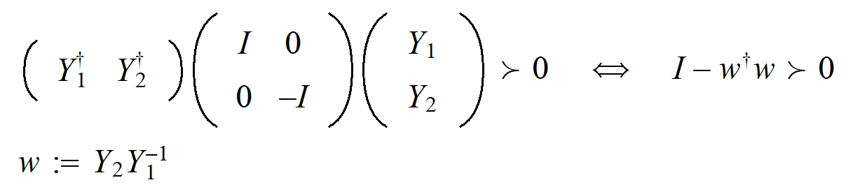
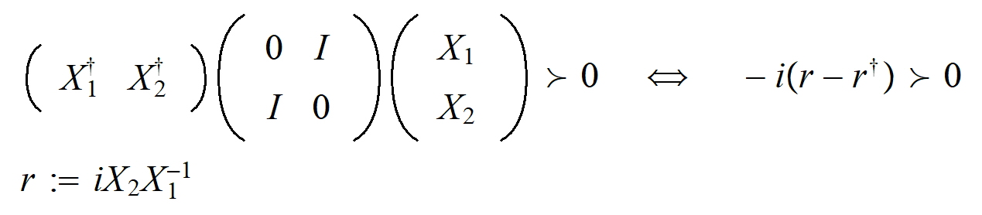
THE POINCARE GROUP (2)
The SU(2,2) symmetric classical domain in the bounded realization is
and in the unbounded realization is
The boundary of the bounded realization is the U(2) group manifold and the boundary of the unbounded realization is R4.

Slide 25
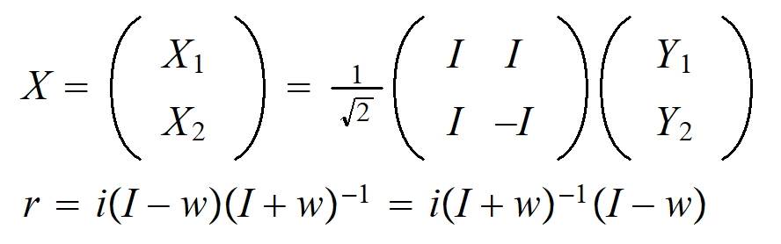
THE POINCARE GROUP (3)
The relation of these two realizations is the Cayley transformation
Notice that the point r=0 is a point of the surface R4, while the point w=0 is not a point of the boundary U(2).

Slide 26
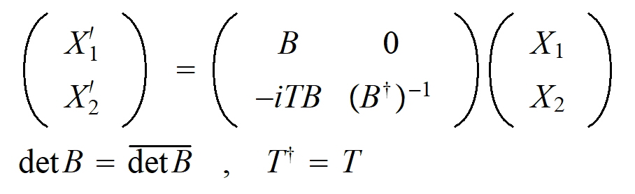
THE POINCARE GROUP (4)
The SU(2,2) transformation which preserves infinity det(X1)≠1 is PoincarexDilation group
This spinorial Poincare subgroup of SU(2,2) group is identified with the observed Poincare group.
Hence the static and the axially symmetric LCR-structures can be computed. Arrow of time fixed.
The structures of the boundary of the classical domain will be called “flat” LCR-structures.

Slide 27
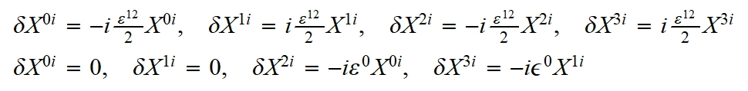
3 LEPTON AND QUARK GENERATIONS (1)
The z-rotation and t-translation automorphisms are
The automorphic axially symmetric and static quadratic Kerr polynomial is
The “KN” LCR-structure, identified with the electron and used to find its electroweak gauge field, is determined by this irreducible quadratic polynomial. I have not found other static irreducible polynomial up to 4-degree!

Slide 28
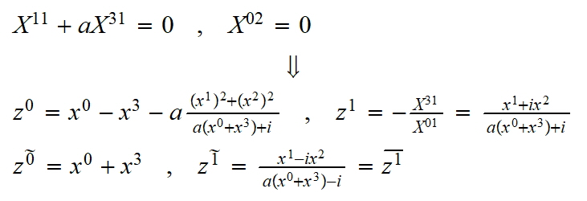
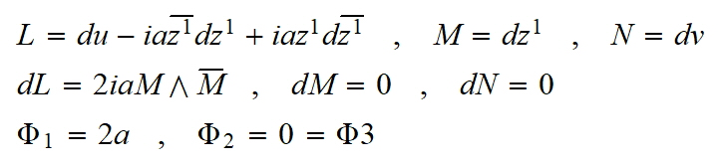
3 LEPTON AND QUARK GENERATIONS (2)
The massless retarded-translation automorphism implies the following reducible quadratic polynomial and the structure coordinates
The “flat” LCR-tetrad is exotic matter

Slide 29
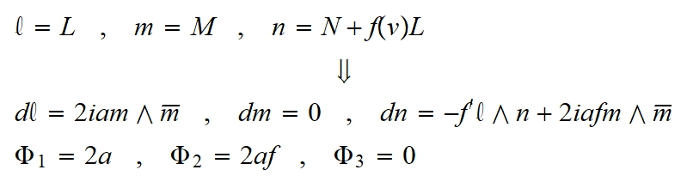
3 LEPTON AND QUARK GENERATIONS (3)
But after a Kerr-Schild ansatz we find
Which is a regular “non-flat” LCR-structure identified with the electron-neutrino.
It admits an electroweak gauge field and vanishing “Higgs” potential.

Slide 30
3 LEPTON AND QUARK GENERATIONS (4)
The geodetic and shear-free null congruences are principal null directions of the conformal tensor. They are given by the roots of the following quartic polynomial implied after a local Lorentz transformation on the NP scalars
It may have at most 4 roots, while we need two roots to determine the LCR-tetrad. Hence we have the three topological sectors of two, three and four roots. Electron and its neutrino are quadratic. It indicates to identify the other two cases with the muon and tau families (not computed).

Slide 31
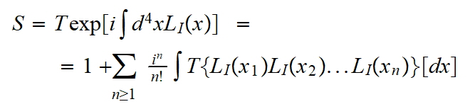
STANDARD MODEL DERIVATION (1)
THE BEGS PERTURBATIVE CAUSAL APPROACH
L. Schwartz and deRham properly formulated the generalized functions (distributions).
Hormander properly described the wavefront singularities and Gelfand the rigged Hilbert space.
Bogoliubov et.al. realized that the Dyson formula
is a kind of targeted harmonic expansion into representations of the Poincare group (free fields)

Slide 32
STANDARD MODEL DERIVATION (2)
THE BEGS CAUSAL APPROACH TO QFT
Epstein-Glaser found a way to properly define the product of the step function Θ(t-t’) with the other distributions in the time ordering.
Scharf et.al. used the Kugo-Ojima BRS method to eliminate order-by-order the unphysical modes of the vector free fields and so they generate the permitted interactions.
Starting from the precise free fields, they find the Standard Model with the proper relations between the masses and the coupling constants.
Starting from the spin-2 field, the Einstein-Hilbert action with a cosmological constant is found.

Slide 33
STANDARD MODEL DERIVATION (3)
THE BEGS CAUSAL APPROACH TO QFT
The BEGS causal approach is described very well in the two books of Scharf
"Finite Quantum Electrodynamics: The causal approach"
"Gauge Field Theories: Spin One and Spin Two"
They complete the two books of Bogoliubov et.al.
1) "Introduction to the Theory of Quantized Fields"
2) "Introduction to Axiomatic Quantum Field Theory"

Slide 34
THANK YOU
FOR YOUR ENDURANCE

