Slide 1

Gravitational memory as a theory guiding principle
Jann Zosso
3rd of September 2025
NEB-21, Recent Developments in Gravity, Corfu

Slide 2



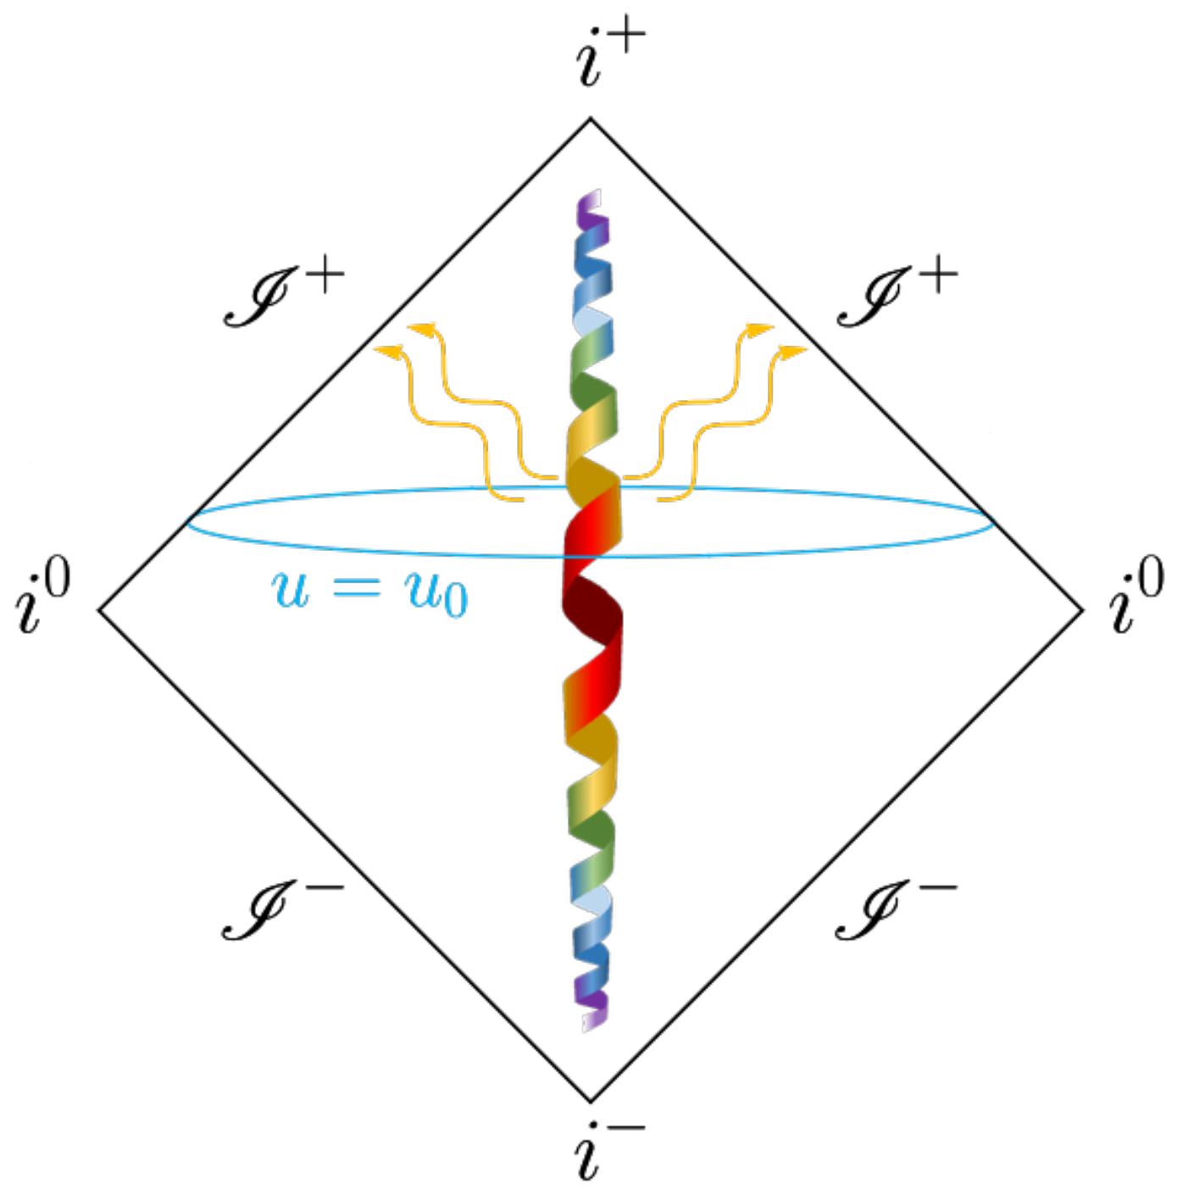
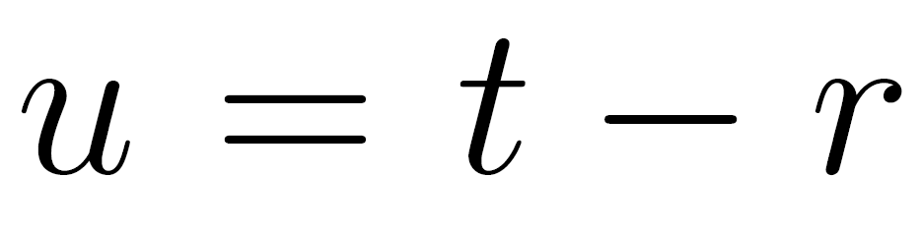



Gravitational Radiation
isolated source radiation zone
Perturbations at O(1/r)
[F. D'Ambrosio, JZ, et al. - arXiv:2201.11634]
1/5

Slide 3
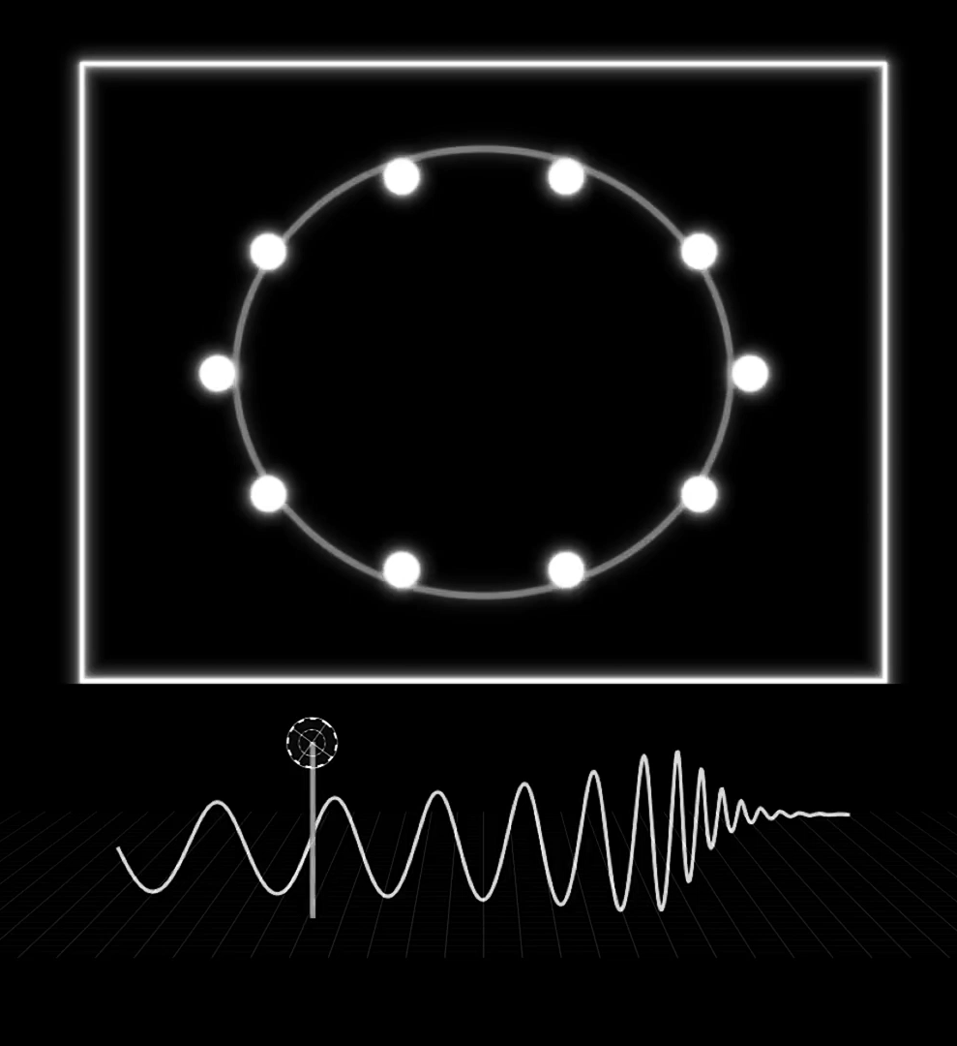
Gravitational Radiation
isolated source radiation zone
Perturbations at O(1/r)
Radiation = Waves + Memory
[F. D'Ambrosio, JZ, et al. - arXiv:2201.11634]
[Credit: PBS Space Time]
1/5

Slide 4
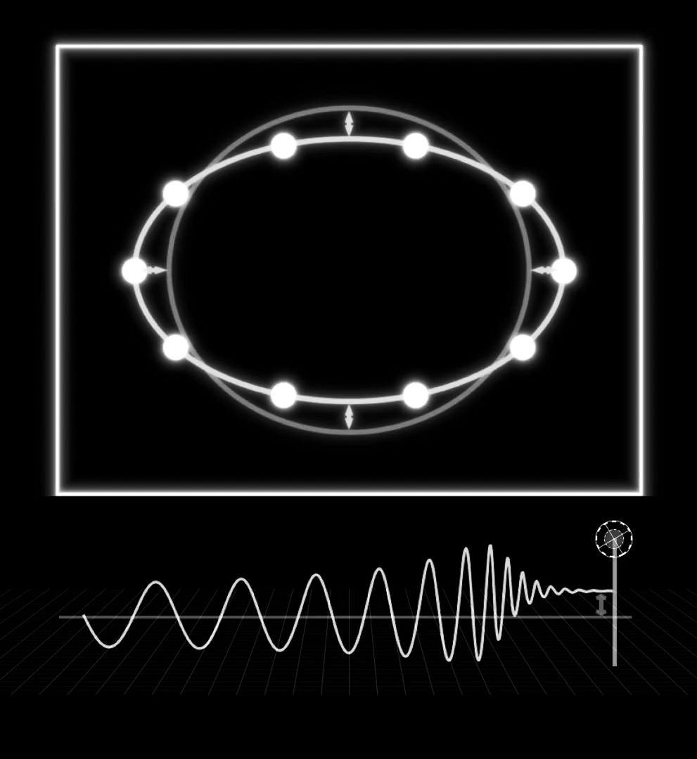
Gravitational Radiation
isolated source radiation zone
Perturbations at O(1/r)
Radiation = Waves + Memory
Is a leading order backreaction effect
probes the non-linearity of gravity
any gravitational radiation has memory
Is a manifestation of spacetime symmetries
VEV related through BMS supertranslations
A fundamental prediction of GR that has
not been measured yet!
[F. D'Ambrosio, JZ, et al. - arXiv:2201.11634]
[Credit: PBS Space Time]
1/5

Slide 5
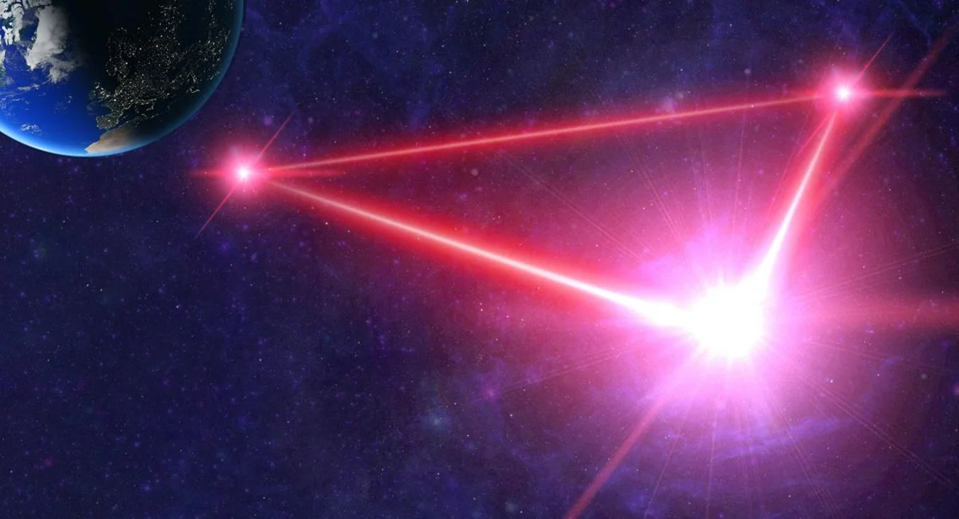
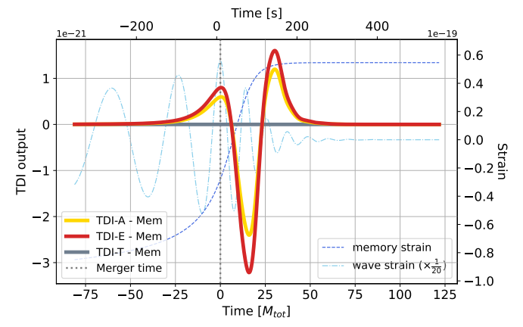
LISA Will measure memory
LISA (Laser Interferometer Space Antenna)
First space-based GW observatory! Expected launch: 2035
Simulation of the full time domain LISA response to memory
[Credit: Simon Barke – University of Florida]
Gravitational Memory
a secured new fundamental physics signal!
[S. Gasparotto, H. Inchauspé, JZ et al. - arXiv:2406.09228 ]
2/5

Slide 6
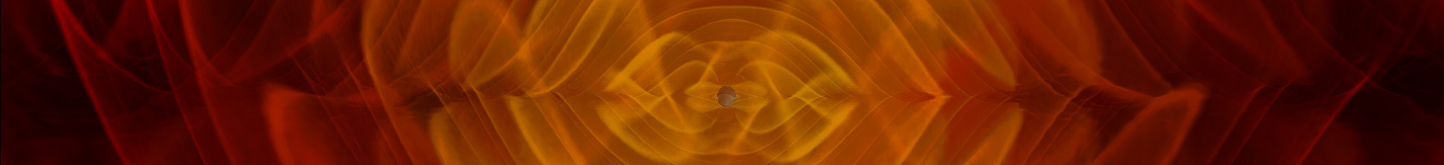
Isaacson approach to Memory
[Credit: NASA/C. Henze]
JZ - Continuing Isaacson's Legacy: A general metric theory perspective on gravitational memory and the non-linearity of gravity
arXiv:2505.17603
New levers to test GR
All dynamical dof contribute to memory
Complete Formula in Horndeski gravity
Critical directions of superluminal emission
L. Heisenberg, N. Yunes, JZ - Gravitational wave memory beyond general relativity
arXiv:2303.02021
JZ - Probing Gravity: Fundamental Aspects of Metric Theories and their Implications for Tests of General Relativity
arXiv.2412.06043
L. Heisenberg, G. Xu, JZ - Unifying Ordinary and Null Memory
arXiv.2401.05936
L. Heisenberg, B. Rosatello, G. Xu, JZ - Constraining superluminal Einstein-Æther gravity through gravitational memory
arXiv.2505.09544
L. Heisenberg, B. Rosatello, G. Xu, JZ - Gravitational memory in Generalized Proca Gravity
arXiv.2508.20545
Test # of gravitational dofs
Probe strong field merger dynamics
Constrain local Lorentz breaking
3/5

Slide 7
Isaacson approach to Memory
[Credit: NASA/C. Henze]
JZ - Continuing Isaacson's Legacy: A general metric theory perspective on gravitational memory and the non-linearity of gravity
arXiv:2505.17603
New levers to test GR
All dynamical dof contribute to memory
Complete Formula in Horndeski gravity
Critical directions of superluminal emission
L. Heisenberg, N. Yunes, JZ - Gravitational wave memory beyond general relativity
arXiv:2303.02021
JZ - Probing Gravity: Fundamental Aspects of Metric Theories and their Implications for Tests of General Relativity
arXiv:2412.06043
L. Heisenberg, G. Xu, JZ - Unifying Ordinary and Null Memory
arXiv:2401.05936
L. Heisenberg, B. Rosatello, G. Xu, JZ - Constraining superluminal Einstein-Æther gravity through gravitational memory
arXiv:2505.09544
L. Heisenberg, B. Rosatello, G. Xu, JZ - Gravitational memory in Generalized Proca Gravity
arXiv:2508.20545
Test # of gravitational dofs
Probe strong field merger dynamics
Constrain local Lorentz breaking
3/5

Slide 8
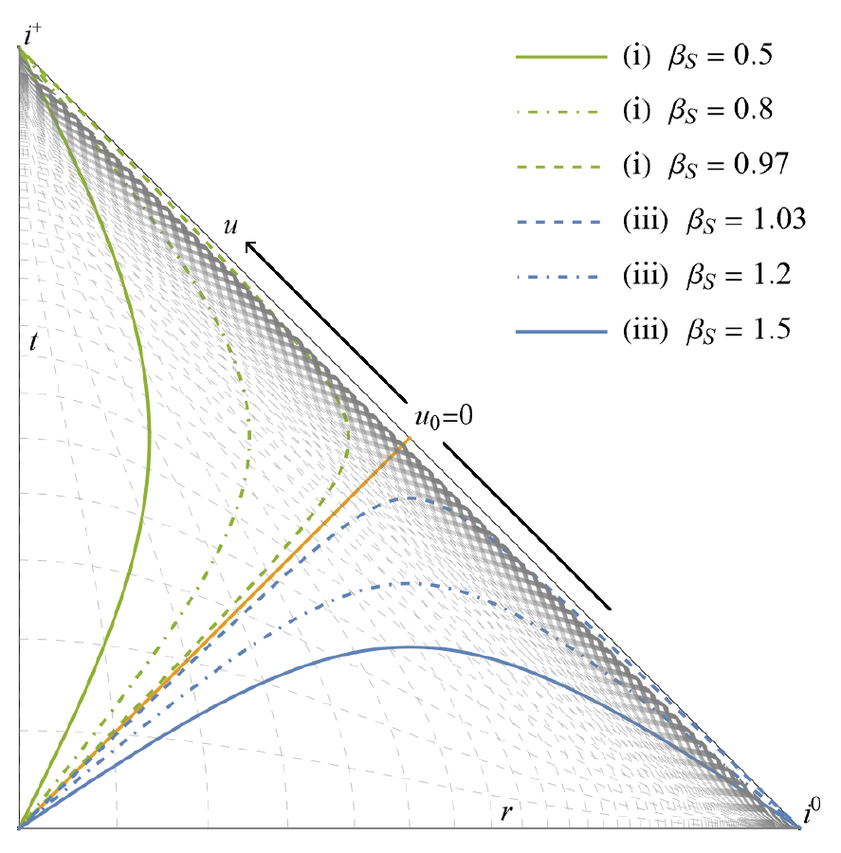
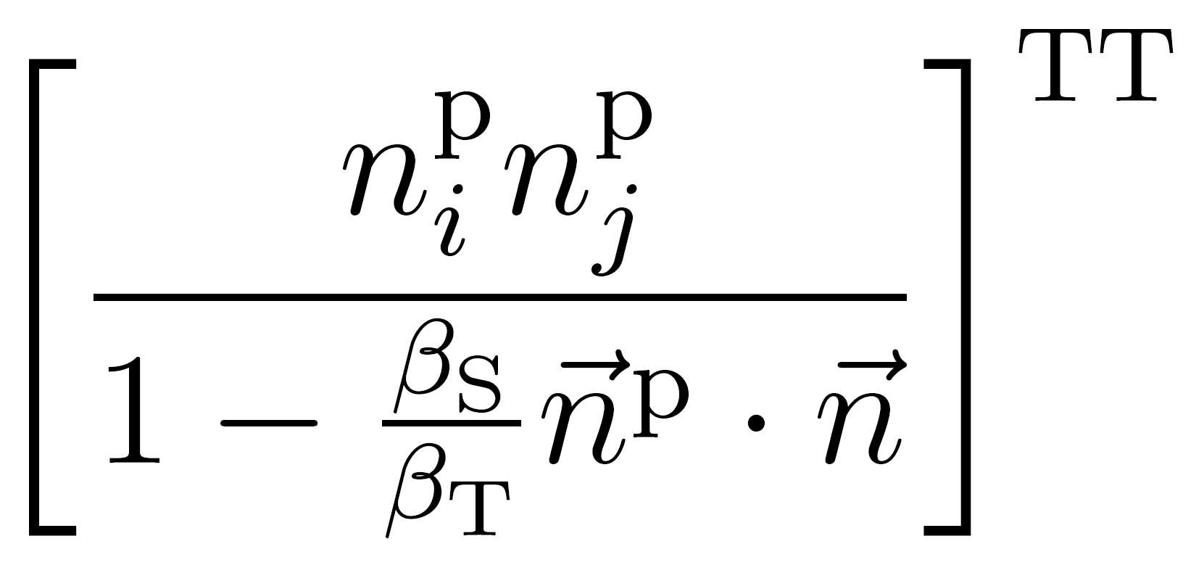
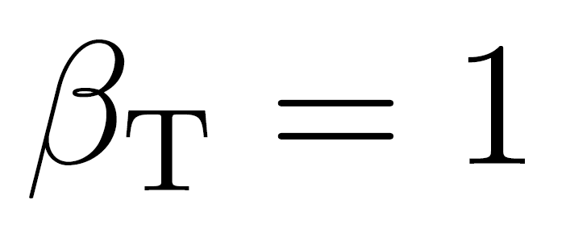
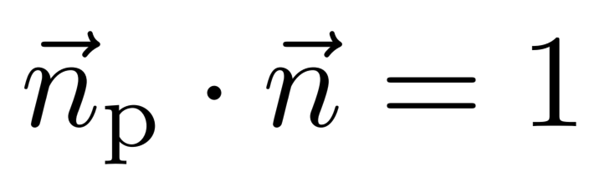
Critical directions of enhanced memory production​
β_{S} : group velocity of source waves
subluminal propagation
β_{S} < β_{T} = 1
superluminal propagation
β_{S} > β_{T} = 1
luminal propagation
β_{S} = β_{T} = 1
Memory factor
[L. Heisenberg, B. Rosatello, G. Xu, JZ - arXiv.2505.09544]
4/5

Slide 9
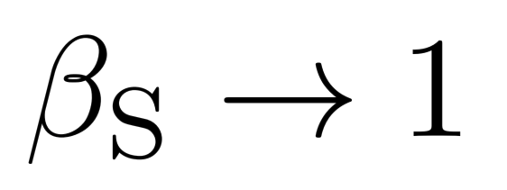
Critical directions of enhanced memory production​
β_{S} : group velocity of source waves
subluminal propagation
β_{S} < β_{T} = 1
superluminal propagation
β_{S} > β_{T} = 1
luminal propagation
β_{S} = β_{T} = 1
Memory factor
enhancement when
[L. Heisenberg, B. Rosatello, G. Xu, JZ - arXiv.2505.09544]
4/5

Slide 10
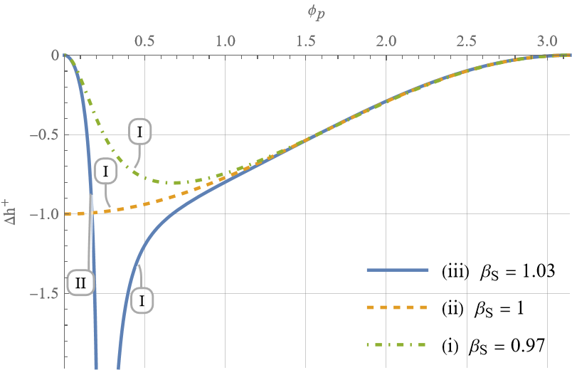
Critical directions of enhanced memory production​
β_{S} : group velocity of source waves
subluminal propagation
β_{S} < β_{T} = 1
superluminal propagation
β_{S} > β_{T} = 1
luminal propagation
β_{S} = β_{T} = 1
Memory factor
enhancement when
[L. Heisenberg, B. Rosatello, G. Xu, JZ - arXiv.2505.09544]
4/5

Slide 11
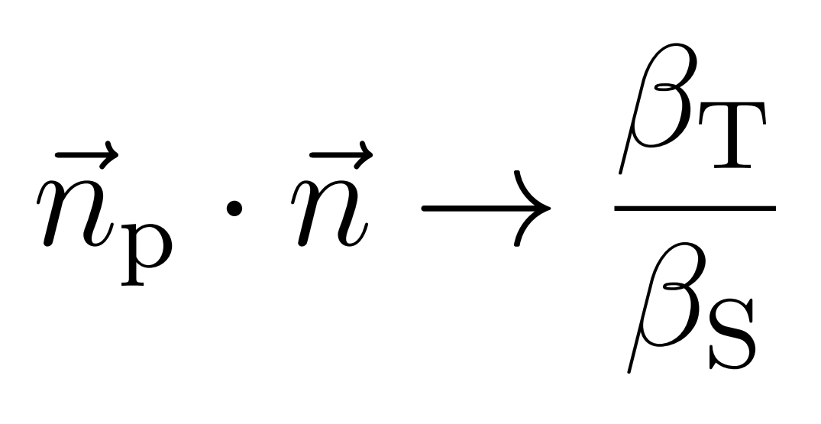
Constrain local lorentz breaking
β_{S} : group velocity of source waves
superluminal propagation
Memory factor
enhancement when
[L. Heisenberg, B. Rosatello, G. Xu, JZ - arXiv.2505.09544]
4/5

Slide 12
Constrain local lorentz breaking
β_{S} : group velocity of source waves
superluminal propagation
L. Heisenberg, B. Rosatello, G. Xu, JZ - Constraining superluminal Einstein-Æther gravity through gravitational memory. arXiv:2505.09544
Conjecture tight constraint of superluminal Einstein-Aether gravity
Memory factor
enhancement when
[L. Heisenberg, B. Rosatello, G. Xu, JZ - arXiv.2505.09544]
4/5

Slide 13
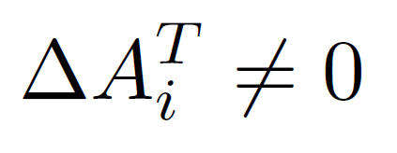
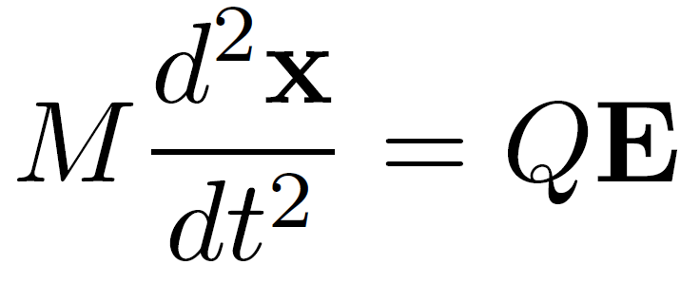
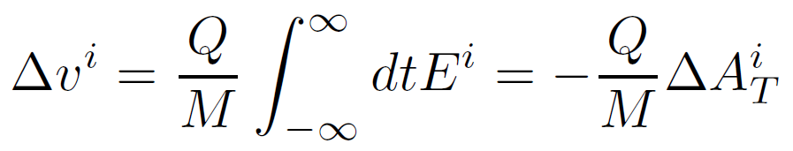
Electromagnetic memory
[L. Bieri and D. Garfinkle - arXiv:1307.5098]
Memory component in radiation
Consequence: velocity kick
5/5

Slide 14
Electromagnetic memory
[L. Bieri and D. Garfinkle - arXiv:1307.5098]
Memory component in radiation
Consequence: velocity kick
Encompasses key properties of memory:
Linear in transverse electric field (also linear in Q)
Manifestation of asymptotic U(1) symmetry and soft factors
Universal dependence on outgoing (and incoming) charges
5/5

Slide 15
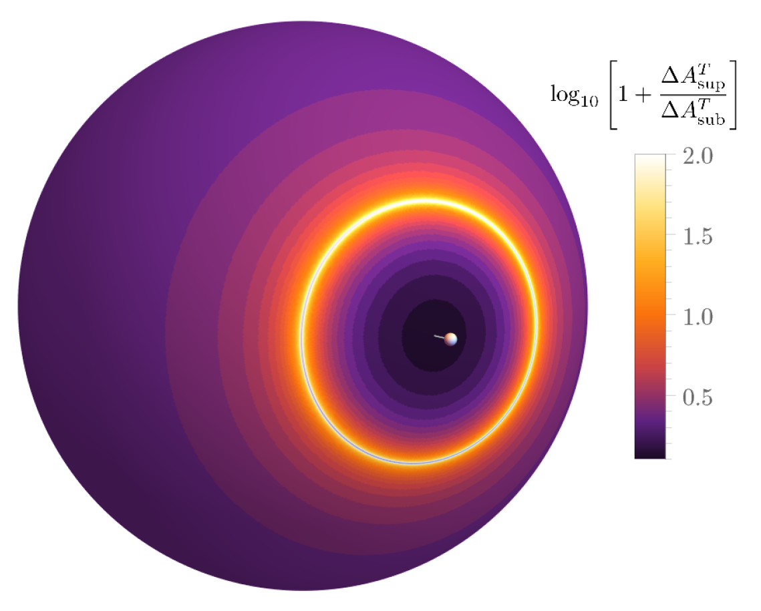
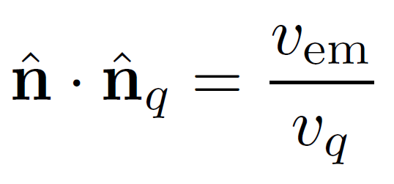
Electromagnetic memory
JZ - Enhanced Electromagnetic Memory
arXiv.2507.09555
Memory component in radiation
Consequence: velocity kick
Encompasses key properties of memory:
Linear in transverse electric field (also linear in Q)
Manifestation of asymptotic U(1) symmetry and soft factors
Universal dependence on outgoing (and incoming) charges
enhancement about
critical directions
5/5

Slide 16
What to REmember
Secured New Fundamental Physics Signal
First single event detection with LISA?!
Every GW event has memory
New avenues to test GR
Merger dynamics - measure non-linearity of gravity!
Number of radiative dofs
Constrain local Lorentz breaking
Observational window deep into radiation theory
Radiation ≠ Waves
BMS symmetries / Soft theorems / Electromagnetic Memory
1
2
3

Slide 17
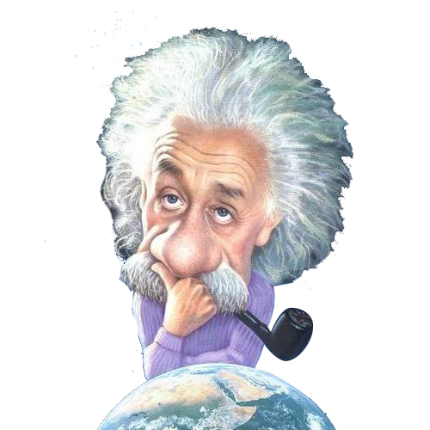

Thank you for the attention
?

Slide 18
Bonus

Slide 19
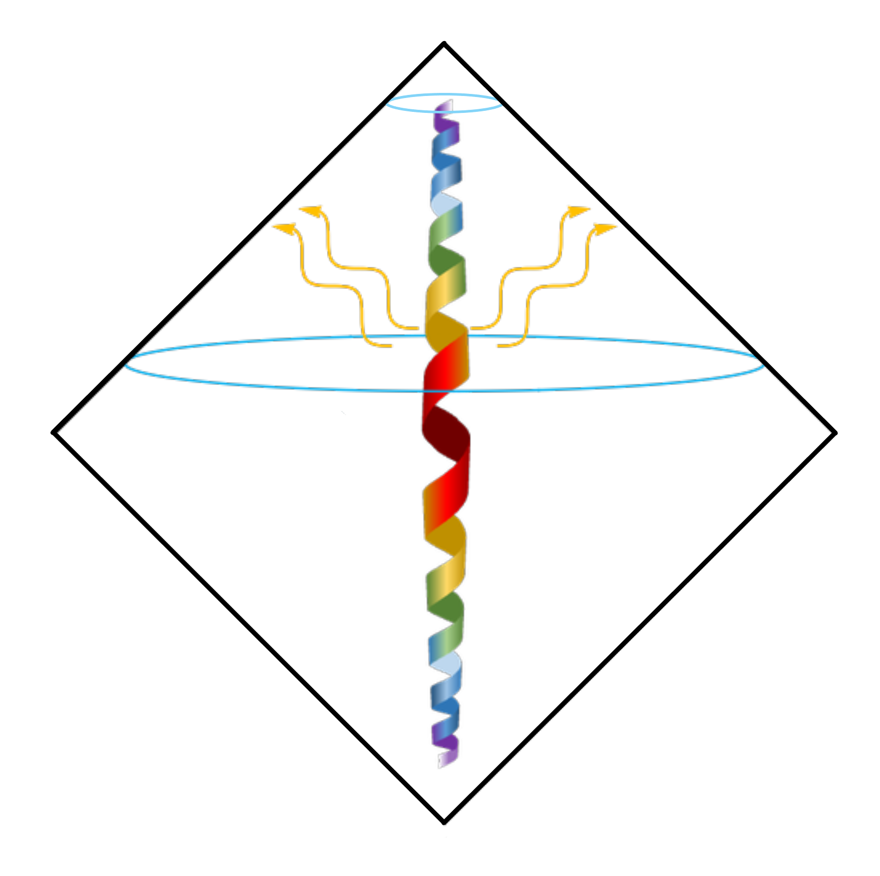
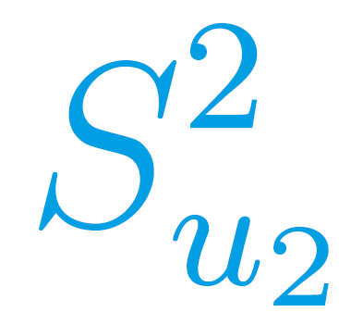

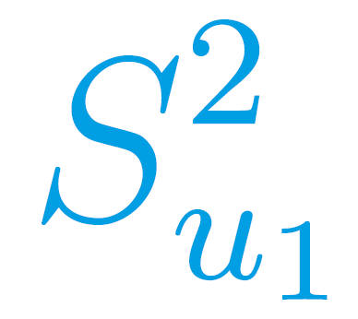

Gravitational Radiation
isolated source radiation zone
Perturbations at O(1/r)
Radiation = Waves + Memory
Is a leading order backreaction effect
probes the non-linearity of gravity
any gravitational radiation has memory
Is a manifestation of spacetime symmetries
[F. D'Ambrosio, JZ, et al. - arXiv:2201.11634]
[Credit: PBS Space Time]
1/6

Slide 20
Gravitational Radiation
isolated source radiation zone
Perturbations at O(1/r)
Radiation = Waves + Memory
Is a leading order backreaction effect
probes the non-linearity of gravity
any gravitational radiation has memory
Is a manifestation of spacetime symmetries
VEV related through BMS supertranslations
A fundamental prediction of GR that has
not been measured yet!
[F. D'Ambrosio, JZ, et al. - arXiv:2201.11634]
[Credit: PBS Space Time]
1/6

Slide 21
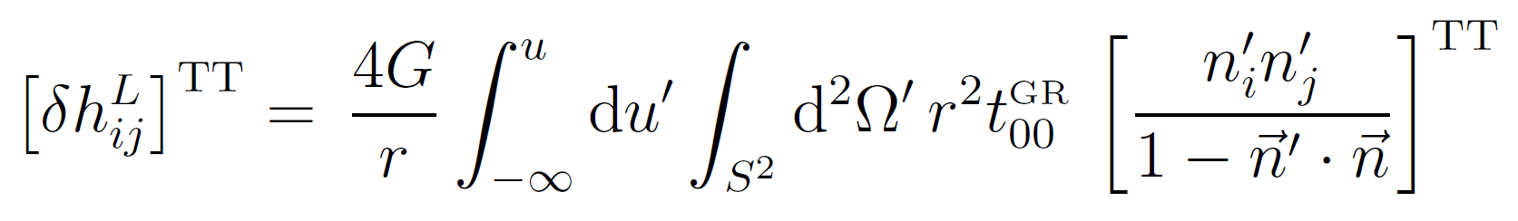
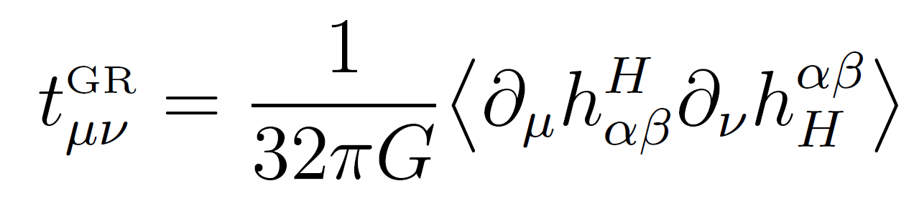
Gravitational Memory - Isaacson Approach
Conclusions
Asymmetric emission of GW energy-momentum sources memory
Direct measure of non-linearity of gravity
Memory is a low frequency contribution to radiation
Radiation ≠ Waves
isolated source
where
[F. D'Ambrosio, JZ, et al. - arXiv:2201.11634]
4/7

Slide 22
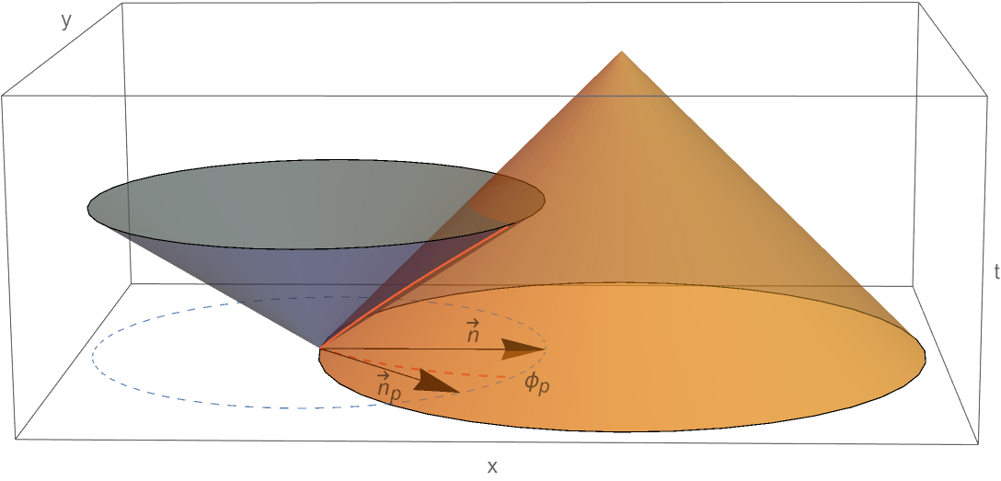
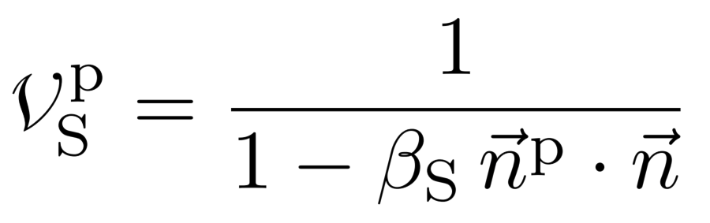
Constrain local lorentz breaking
β_{S} : group velocity of scalar waves , β_{T} = 1
superluminal propagation
Green's function factor
enhancement when
[L. Heisenberg, B. Rosatello, G. Xu, JZ - arXiv.2505.09544]
5/6

Slide 23
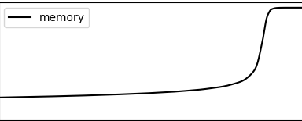
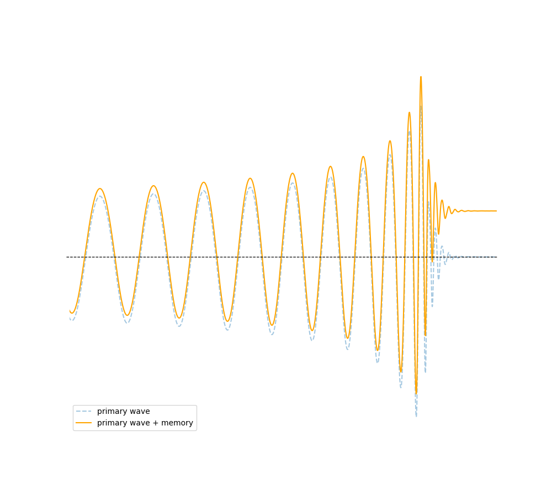
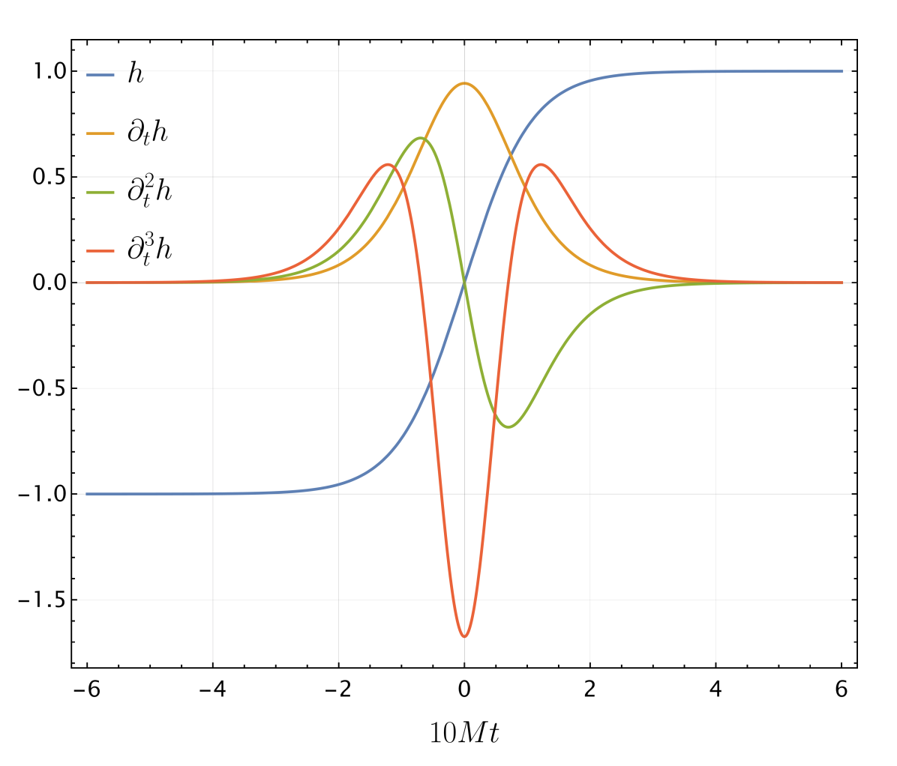
LISA Will Measure Memory
memory in time domain
How can we measure memory with Interferometeres?
Limited frequency band (due to noise)
Measure the sharp raise at merger
time
Memory signal in TDI time series of LISA
Measure 3rd derivative of strain
[S. Gasparotto, H. Inchauspé, JZ et al. - arXiv:2406.09228 ]
11/16

Slide 24
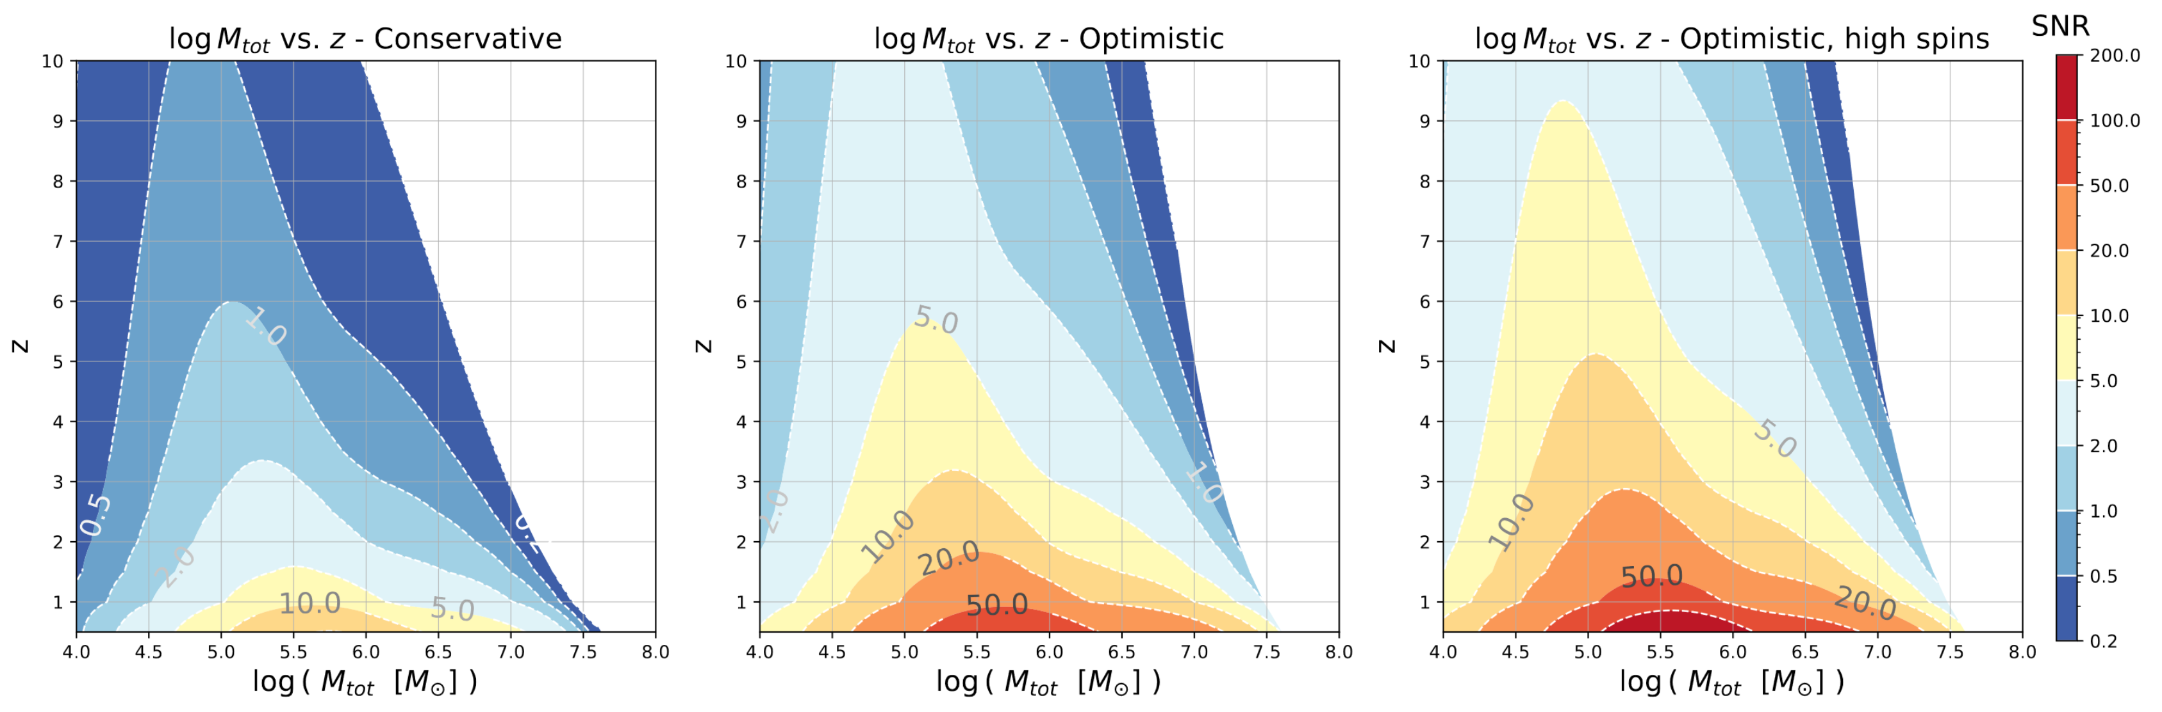
Measuring Memory with LISA
1
Comparison to noise: Signal to Noise Ratio SNR (detection at SNR > 5)
Redshift z: z=0.5 means D=2000 Mpc / z=4 means D=5000 Mpc
(Milky Way diameter: 0.03 Mpc / distance between galaxies: 5 Mpc / radius of observable universe: 14000 Mpc)
Median inclination and sky position, q=2.5
mass ratio q = M1/M2
Optimal inclination and sky position, q=1
Optimal inclination and sky position, q=1 and high spin
12/16

Slide 25
Metric Theories of Gravity
Physical metric g | minimal/universal coupling to matter
Local normal coordinates | g η
+ non-minimal fields ψ | 2+N dynamical degrees of freedom
Metric Theory of Gravity
Einstein-Equivalence-Principle
In free-fall, all non-gravitational experiments are equivalent
3/6

Slide 26
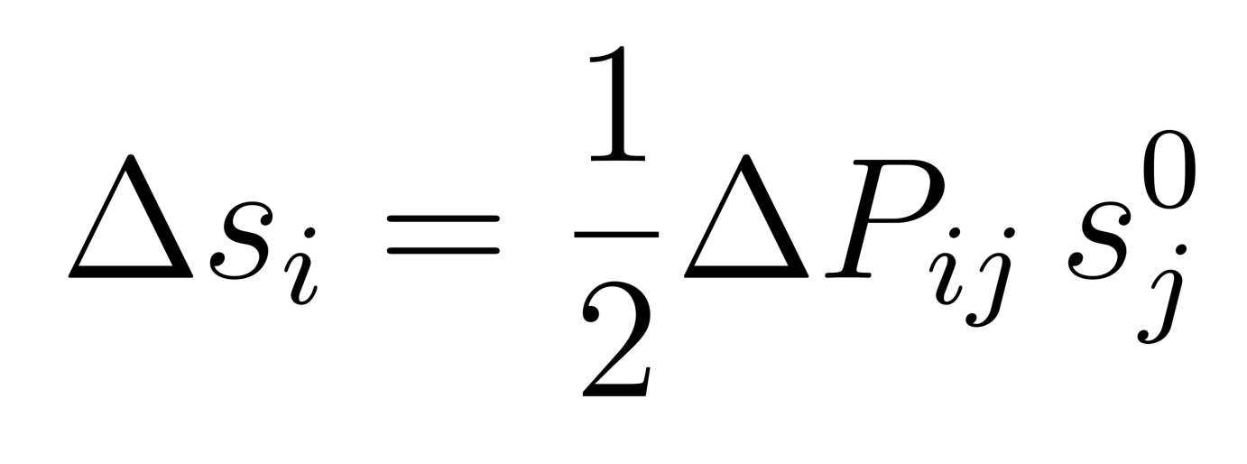
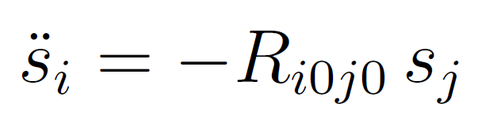
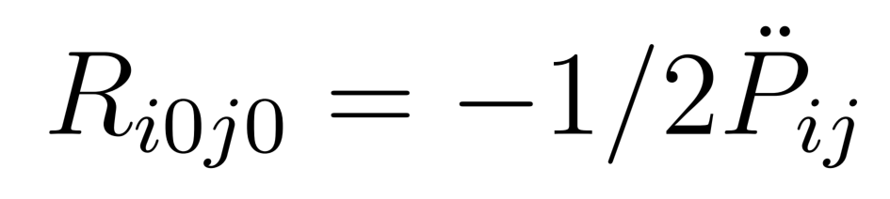
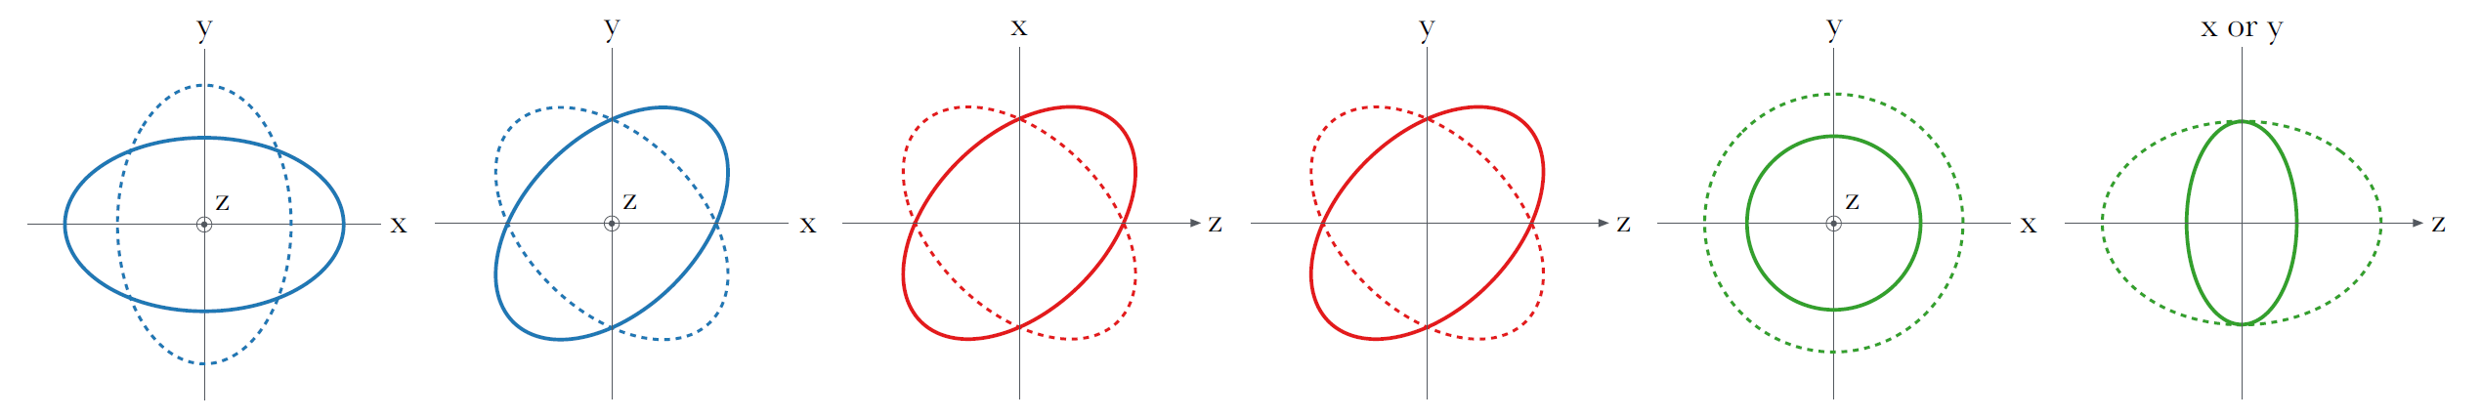
Metric Theories of Gravity
Physical metric g | minimal/universal coupling to matter
Local normal coordinates | g η
+ non-minimal fields ψ | 2+N dynamical degrees of freedom
Metric Theory of Gravity
GW response: Geodesic deviation
Polarizations: 6 | 2 tensor, 2 vector, 2 scalar
6 components
GW traveling in direction z
[T. Callister, et al. - arXiv:1704.08373]
4/7

Slide 27
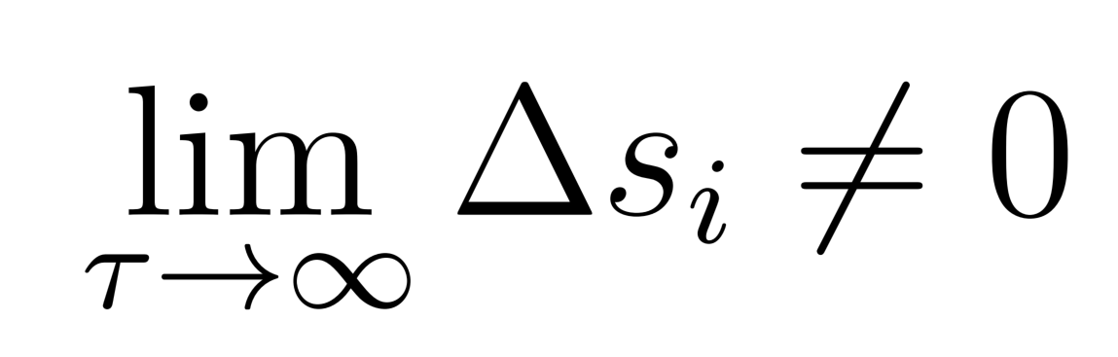
Metric Theories of Gravity
Physical metric g | minimal/universal coupling to matter
Local normal coordinates | g η
+ non-minimal fields ψ | 2+N dynamical degrees of freedom
Metric Theory of Gravity
GW response: Geodesic deviation
Polarizations: 6 | 2 tensor, 2 vector, 2 scalar
Memory: Non-vanishing displacement tensor / vector / scalar GW memory
4/7

Slide 28
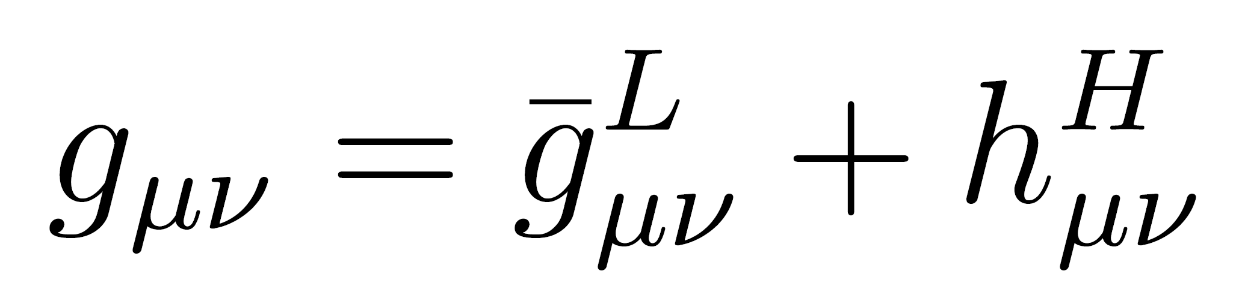
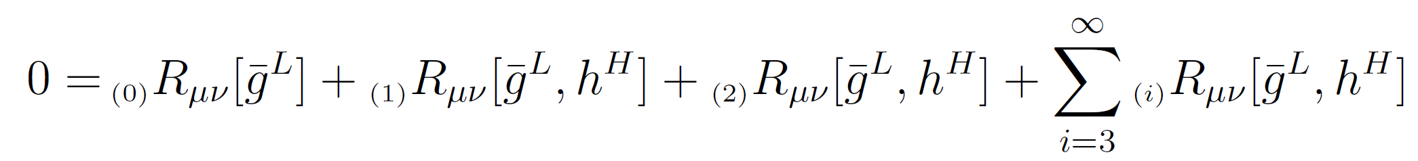
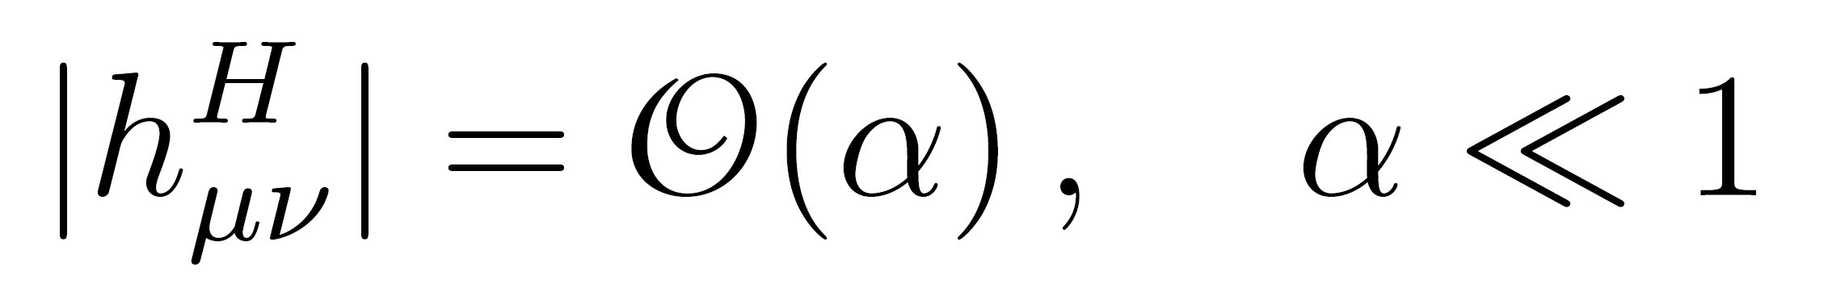
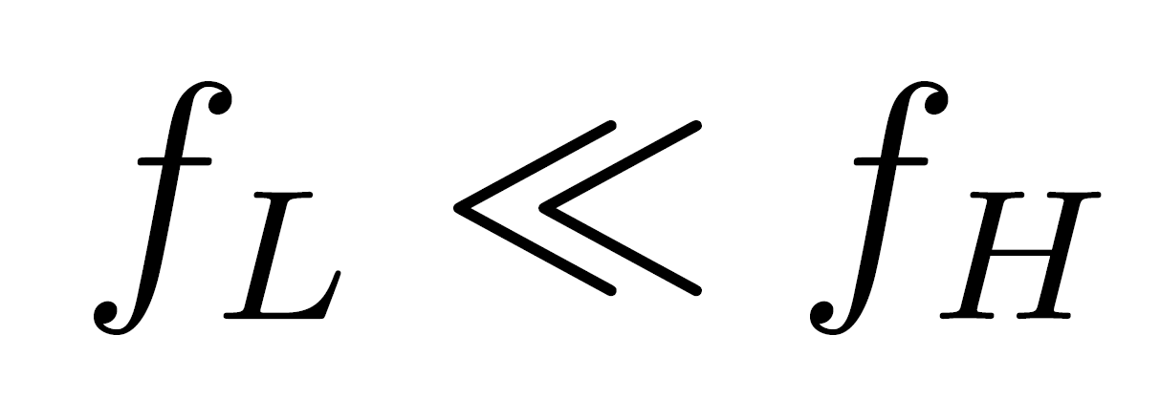
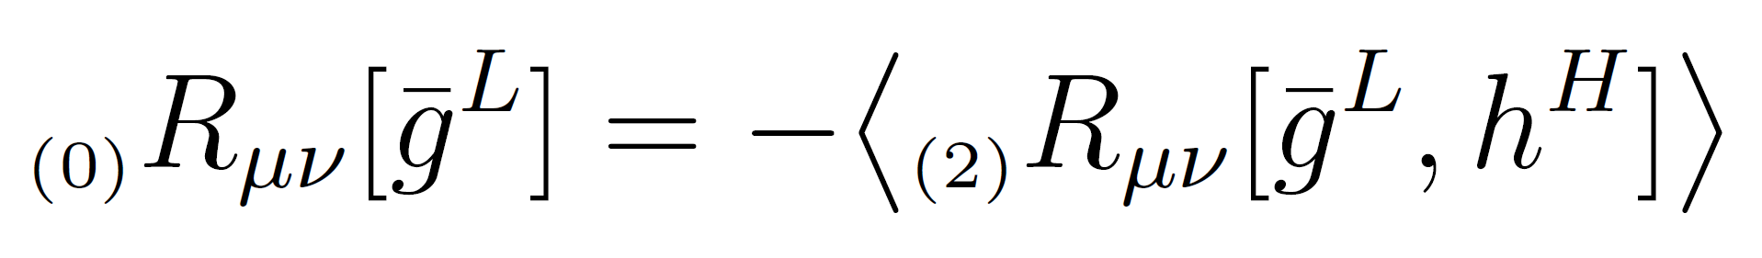
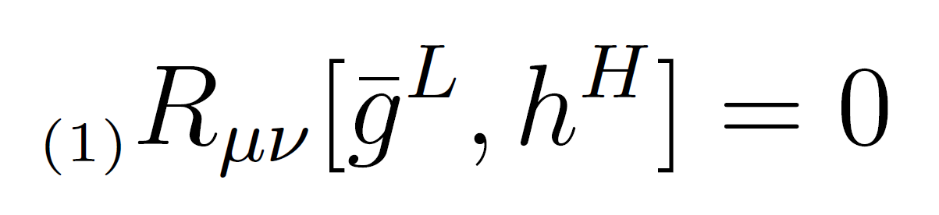
Gravitational Waves – Isaacson Approach
Vacuum Einstein Equations
f_{L}
f_{H}
f_{L}
f_{H}
leading order
f_{L}
f_{H} modes backreact onto background geometry
energy momentum (pseudo)tensor
?
O(α² f_{H}²)
f_{H}
propagation equation
O(α f_{H}²)
4/16

Slide 29
Gravitational Waves – Isaacson Approach
Isaacson Equations - standard textbook exercise, see e.g.
"Gravitation" - Misner Thorne Wheeler (1973)
"Gravitational Waves: Volume 1" - Maggiore (2007)
leading order
f_{L}
f_{H} modes backreact onto background geometry
energy momentum (pseudo)tensor
?
O(α² f_{H}²)
f_{H}
propagation equation
O(α f_{H}²)
4/16

Slide 30
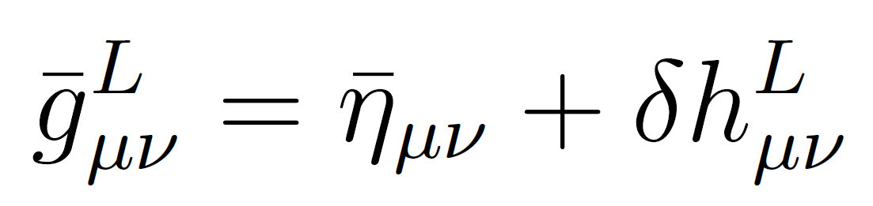
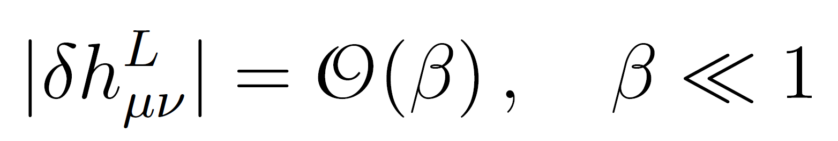
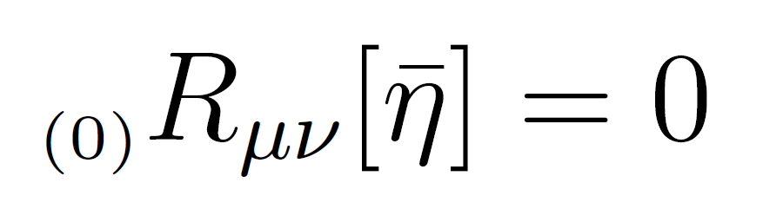
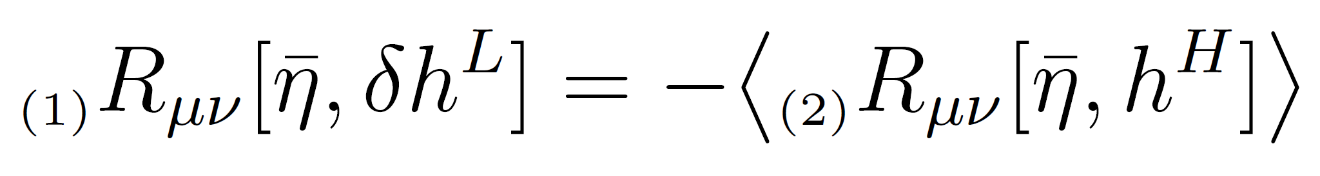
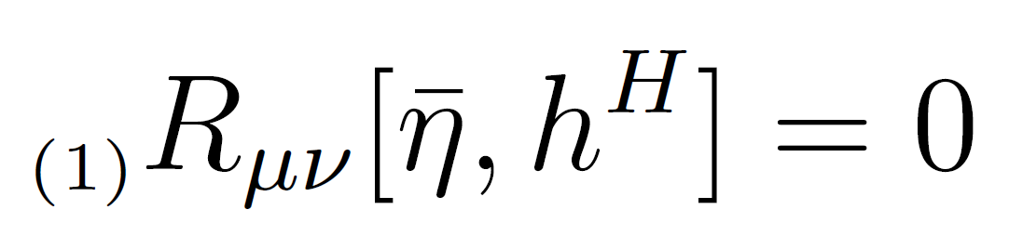


Isaacson Approach - solve the leading order Equations
Split into homogeneous an inhomogeneous solution
where
leading order
β $\sim \text{α}\text{2} \frac{\text{f}\text{H}\text{2}}{\text{f}\text{L}\text{2}}$
O(β f_{L}²)
O(α² f_{H}²)
$$\text{α}≪ \frac{\text{f}\text{L}}{\text{f}\text{H}}$$
hierarchy of small scales
can solve for
δh^{L}
O(α f_{H}²)
5/16

Slide 31
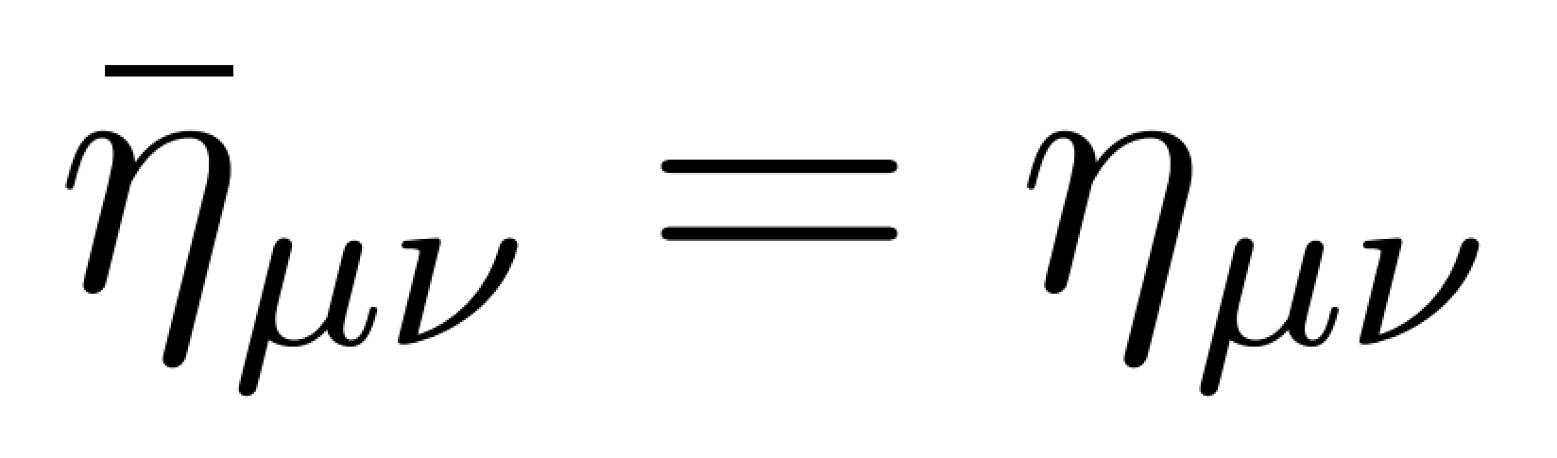
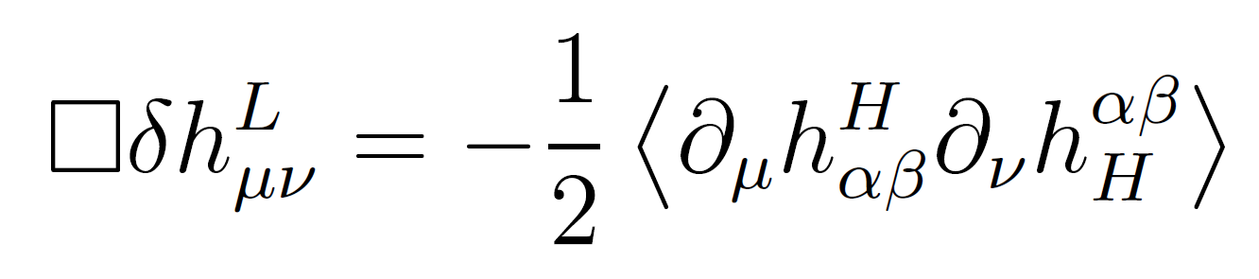
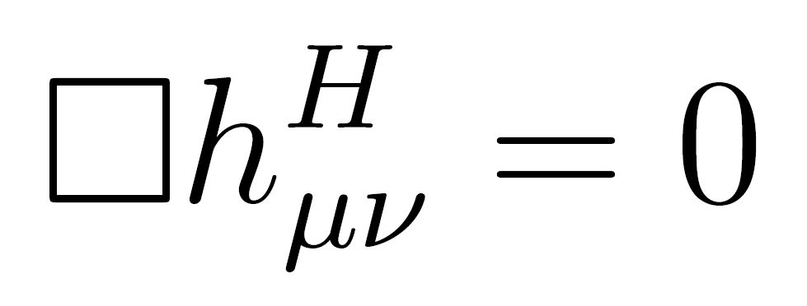

Isaacson Approach – solve the leading order Equations
Assume an isolated matter source of radiation Solve equations far away in the "radiation zone"
Perturbations at O(1/r)
GW Energy-Momentum
leading order
f_{L}
In GR, two degrees of freedom:
two polarizations
f_{H}
5/16

Slide 32



Example – Scalar-Vector-Tensor Theories
[L. Heisenberg - arXiv:1801.01523]
[L. Heisenberg - arXiv:1402.7026]
[G. W. Horndeski - J. Math. Phys. 17 (1976) 1980–1987]
[G. W. Horndeski - Int. J. Theor. Phys. 10 (1974) 363–384]
Most general massless theory with second-order equations of motion
physical metric g
+ non-minimal fields φ and A
Massless - No φ potential for simplicity
6/7

Slide 33




Example – Scalar-Vector-Tensor Theories
Most general massless theory with second-order equations of motion
physical metric g
+ non-minimal fields φ and A
Massless - No φ potential for simplicity
Dynamical degrees of freedom:
Gravitational polarizations:
2 + 2 + 1 = 5 massless dofs
h
a
φ
2 tensor + 1 breathing (if σ $\text{≠}$0)
,
6/7

Slide 34


Tensor Memory in SVT Theories
[L. Heisenberg, N. Yunes, JZ - arXiv:2303.02021]
Most general massless theory with second-order equations of motion
physical metric g
+ gravitational fields φ and A
5 dynamical dofs: h, a, φ
Tensor Null Memory in SVT Theories
Each dynamical dof contributes
not only the polarizations of gravitational waves
7/7

