Slide 1
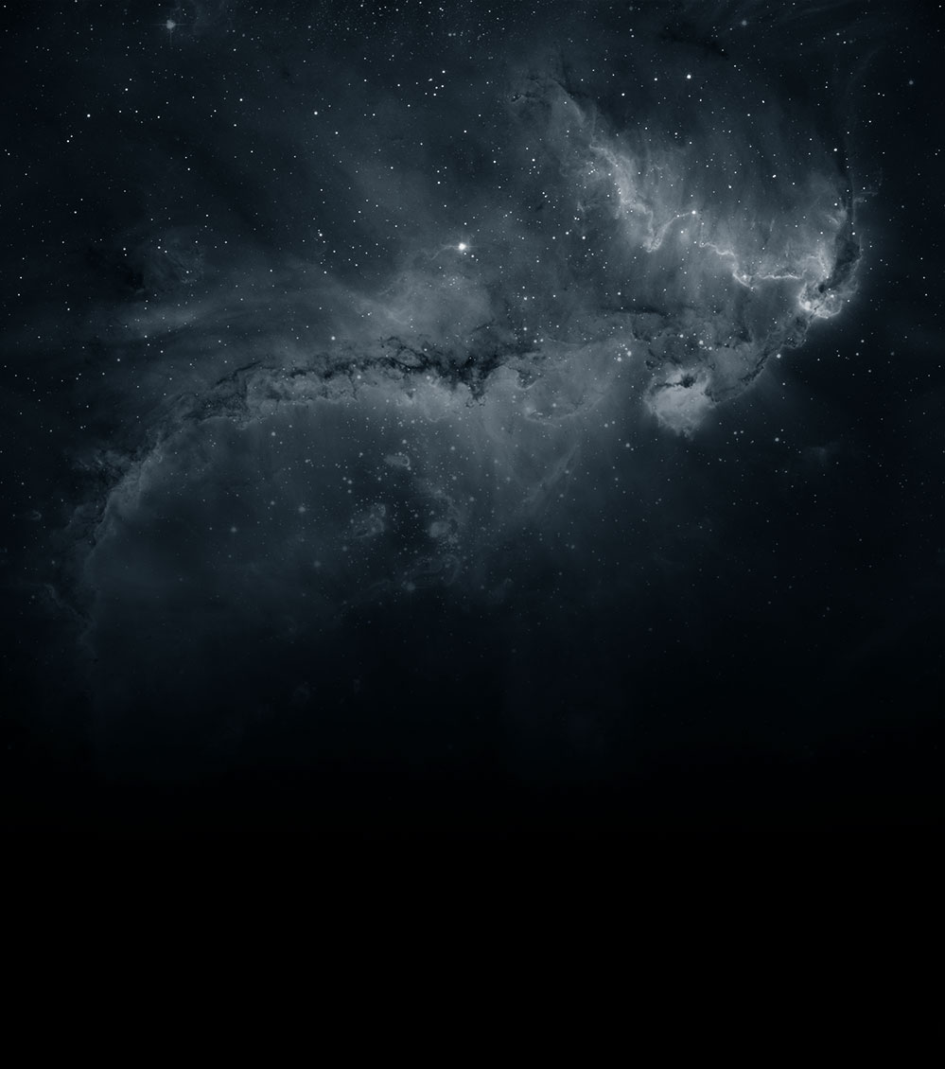


Causality with Gravity
or Positivity in the Sky
Claudia de Rham
Abdus Salam Centre for Theoretical Physics
1st Sept 2025

Slide 2



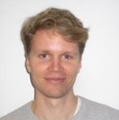




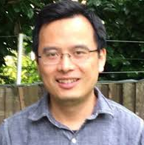

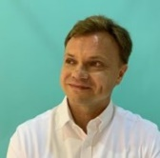
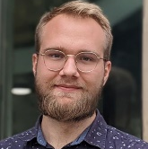




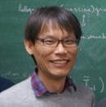
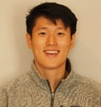


Wiseman
or Positivity in the Sky
Causality with Gravity
Alberte
Rumbutis
Held
Jaitly
Heisenberg
Noller
Momeni
Zhou
Carrillo-
Gonzalez
Tolley
Kozuszek
Klapanek
Jazayeri
Margalit
Melville
Pozsgay
Zhang
Chen
Tokareva
Franckfort
Claudia de Rham
Abdus Salam Centre for Theoretical Physics
1st Sept 2025

Slide 3
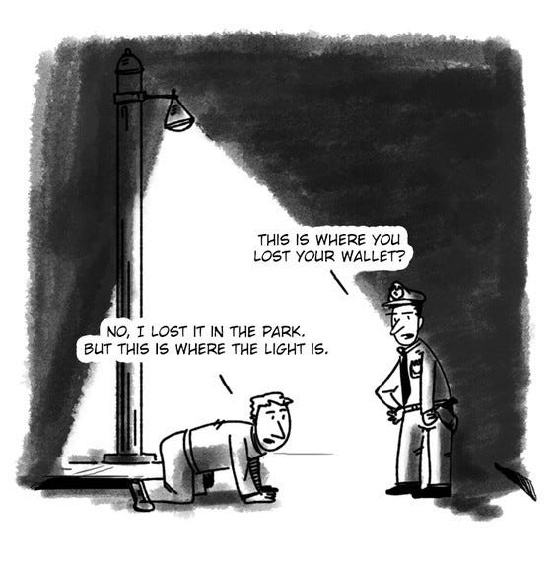
Guiding our searches for new discoveries

Slide 4
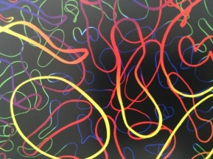
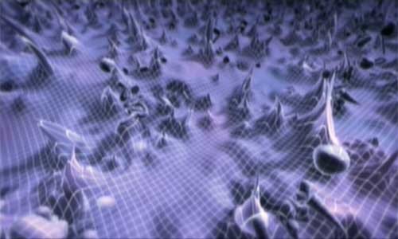
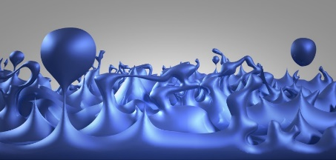

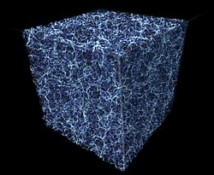
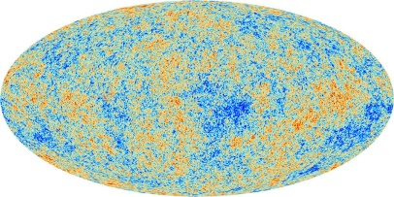
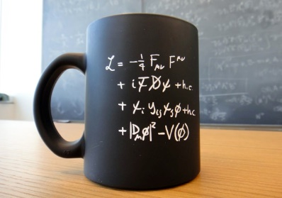
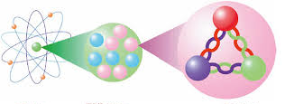
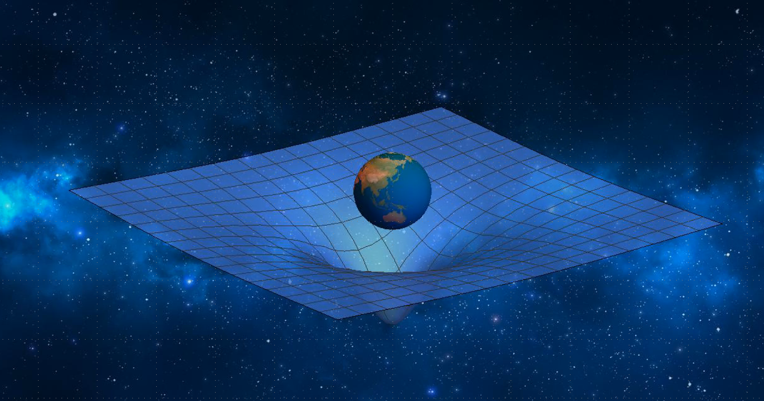
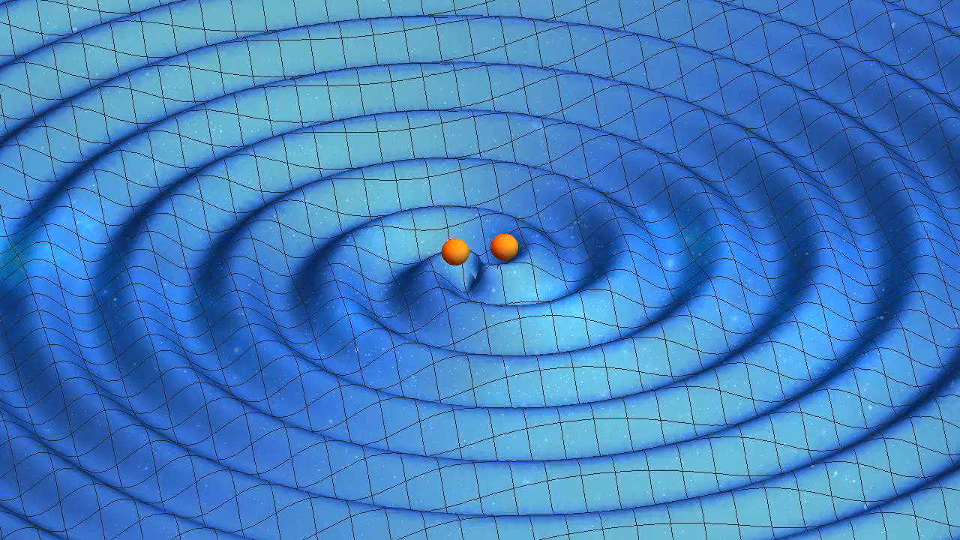
?
?
?
Causality
lamppost guiding searches for new physics

Slide 5
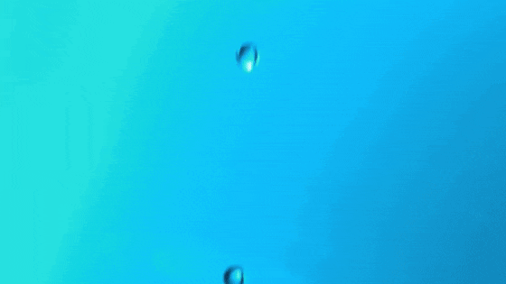



Causality
Source
time t
time
Response
time t

Slide 6
Acausality
Source
time t
time
Response
time t

Slide 7

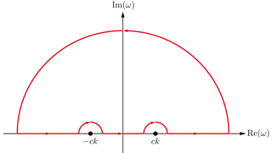

Response to a Signal
Signal
time t
Response
time t

Slide 8
Response to a Signal
Technically, the statement
of causality requires knowledge
at infinite frequency
or infinite energy
Signal
time t
Response
time t

Slide 9
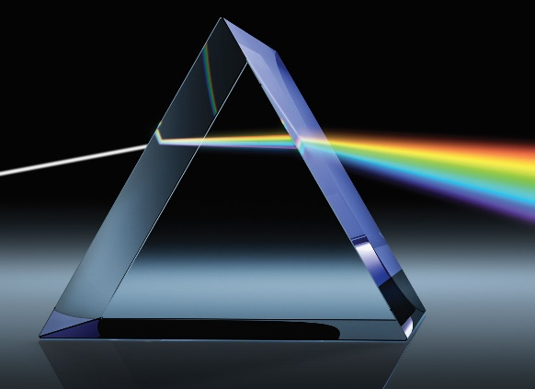
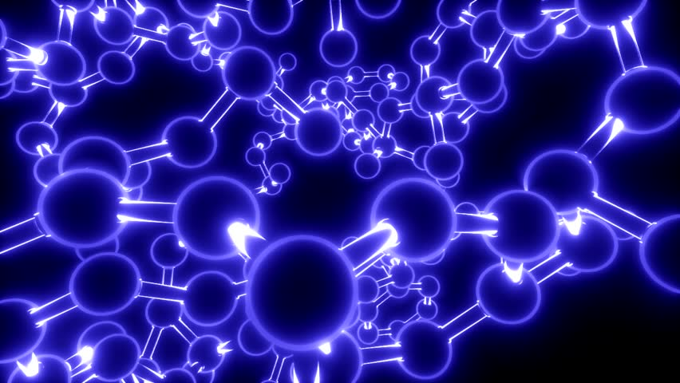



Deflection angle
$$θ$$
$$θ_{2}$$
$$θ_{1}$$
How different colors are deflected tells us about how light interacts with the medium
Positive interactions with the medium should always slow light down
Related to
“positivity” rules

Slide 10
Assumptions on the UV Completion
1. Unitarity,
2. Locality,
3. Poincaré,
4. Causality
Weak-
coupling
translation
time-dependent
vacuum
S-matrix
bootstrap
Positivity
Bounds
Tree-level
weak-coupling
Specific
string theory
compactification
boosts
locality
Assumptions

Slide 11

Assumptions on the UV Completion
1. Unitarity,
2. Locality,
3. Poincaré,
4. Causality
Weak-
coupling
translation
time-dependent
vacuum
S-matrix
bootstrap
Positivity
Bounds
Tree-level
weak-coupling
Specific
string theory
compactification
boosts
locality
Lotus in
Swamplandia
Assumptions

Slide 12
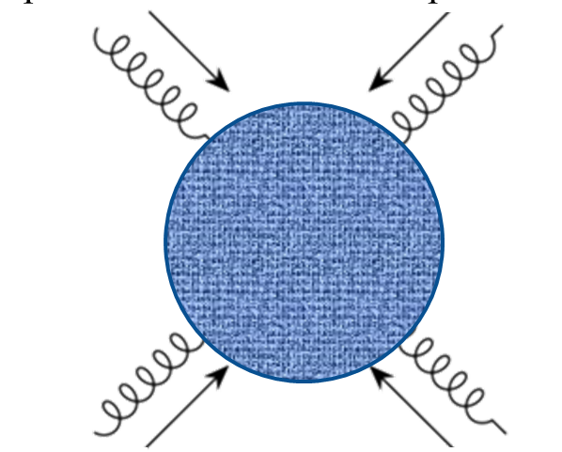
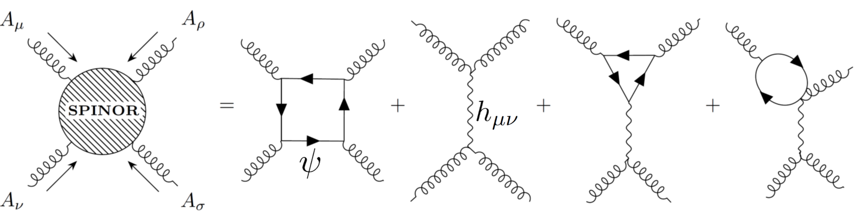
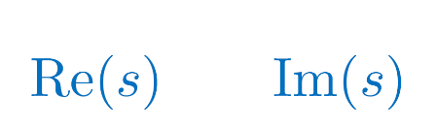
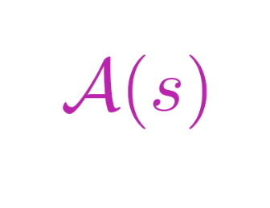
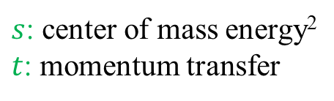

Low-energy Scattering
+…
: $2−2$ elastic scattering amplitude
$s$: center of mass energy²
$t$: momentum transfer

Slide 13
Low-energy Scattering
: $2−2$ elastic scattering amplitude
$s$: center of mass energy²
$t$: momentum transfer
Region where low-energy EFT is valid
UV completion

Slide 14

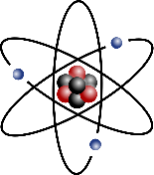
Analyticity - Causality
Causality
– encoded by requirement of analyticity –
is what connects UV to IR
UV completion
EFT

Slide 15
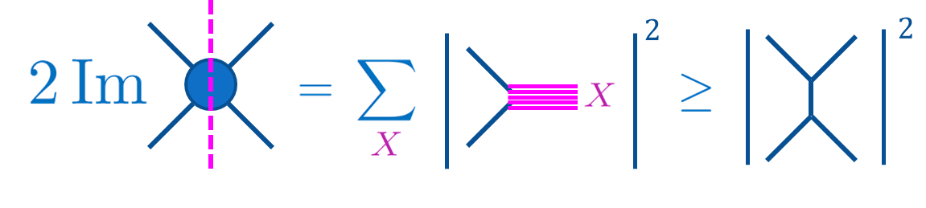
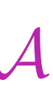
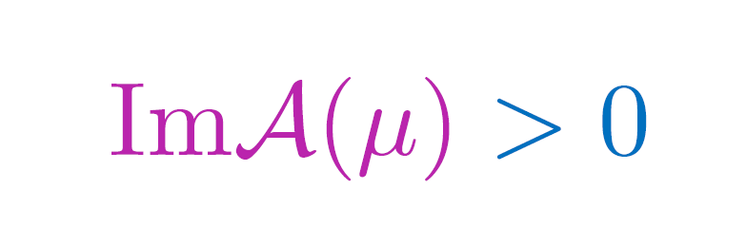
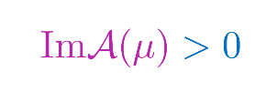
Non-Gravitational EFT
Unitary (optical theorem)
Lorentz invariant (crossing symmetry)
UV completion
: $2−2$ elastic scattering amplitude
$$m^{2}$$
$${3m}^{2}$$
$${4m}^{2}$$

Slide 16
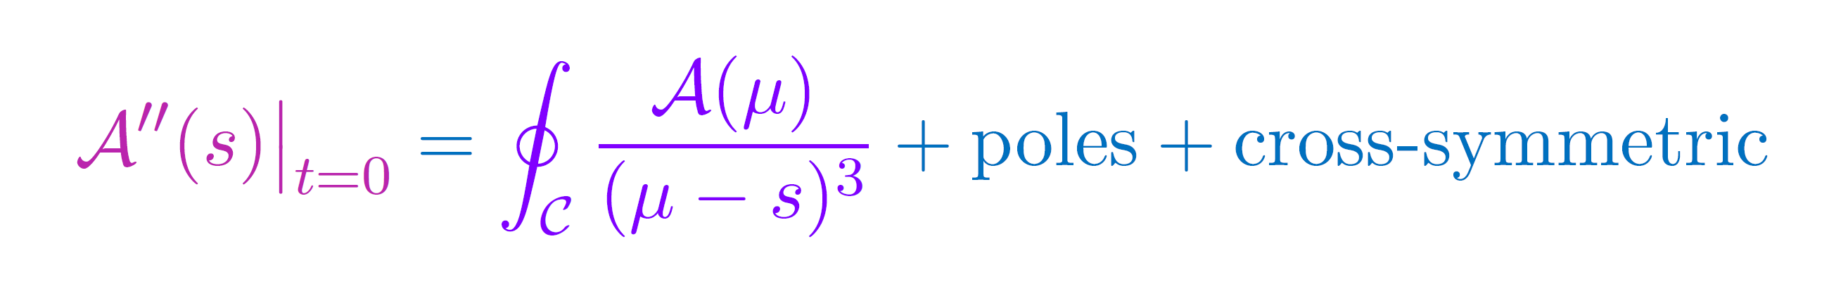

Non-Gravitational EFT
Unitary (optical theorem)
Lorentz invariant (crossing symmetry)
CAUSAL (analyticity)
UV completion

Slide 17
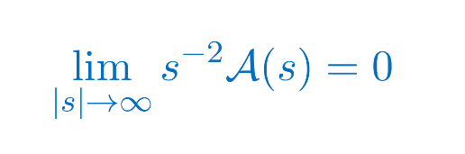

Non-Gravitational EFT
Unitary (optical theorem)
Lorentz invariant (crossing symmetry)
CAUSAL (analyticity)
Local (Froissart Bound)
UV completion
Pham and Truong 1985
Ananthanarayan, Toublan and Wanders, 1994
Adams et. al. 2006

Slide 18

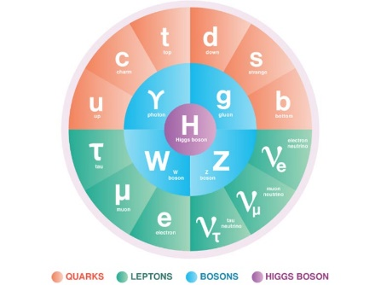

Non-Gravitational EFT
CoM Energy
Unitary (optical theorem)
Lorentz invariant (crossing symmetry)
CAUSAL (analyticity)
Local (Froissart Bound)
positivity bounds
(applied to low-energy
scattering amplitude
or refractive index)
Low-energy
EFT
(sub)luminal sound speed

Slide 19
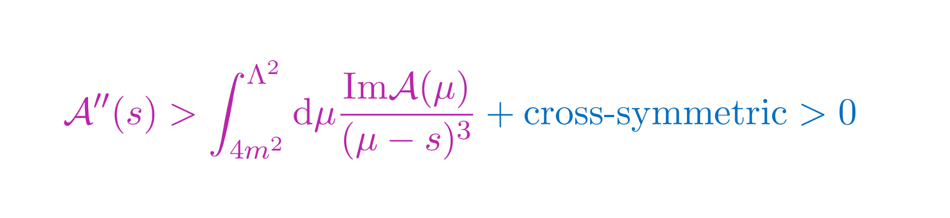
Ext 1. Improved Bounds
This part of the branchcut is calculable within the LEEFT and can be removed
LEEFT
valid
Subtracting our knowledge

Slide 20
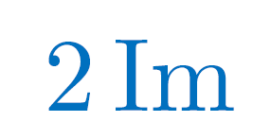
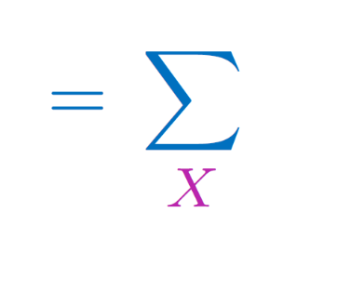
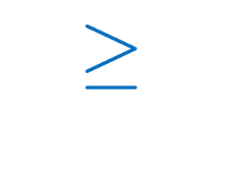

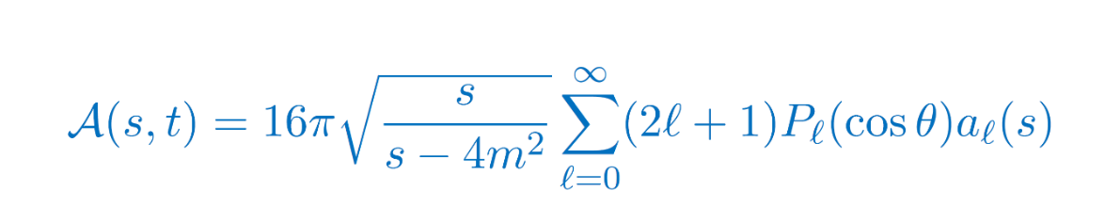
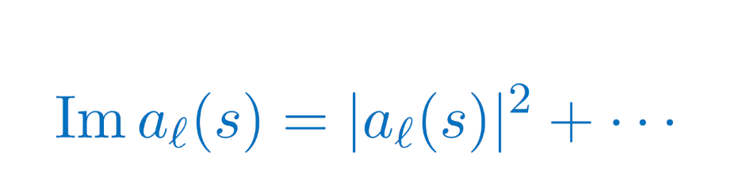
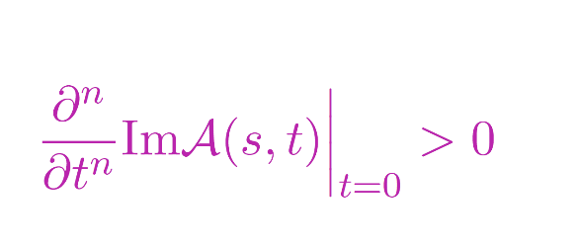
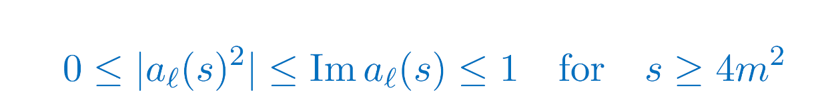
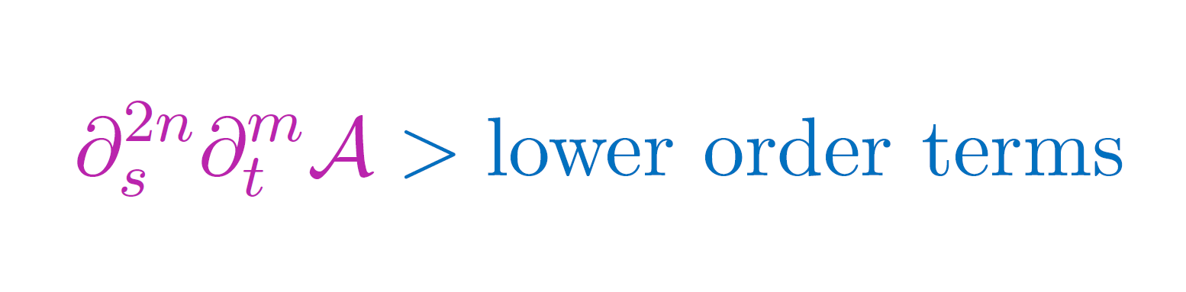
Ext 2. Beyond Forward Limit
$$2$$
$$2$$
The optical theorem carries an infinite more information than $σ>0$
with Andrew, Scott, Zhou

Slide 21
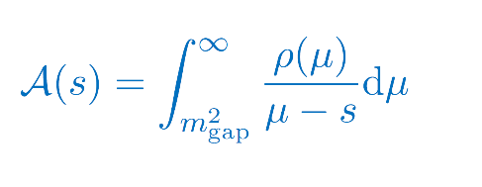
Ext 3. Non-linear bounds
Positive properties of Legendre/Gegenbauher polynomials imply further `EFT-Hedron’ bounds
Arkani-Hamed, Huang, Huang, 2012.15849
Chiang, Huang, Rodina, Weng, 2105.02862
For a dispersion relation
defining the Hankel matrices
Positivity of spectral representation implies positivity of each matrix
Moreover, full $s↔u↔t$crossing symmetry further implies a set of “null constraints”
which can further tighten these non-linear bounds
Tolley, Wang, Zhou, 2011.02400
Caron-Huot, Van Duong, 2011.02957
Sinha, Zahed, 2012.04877
Compact bounds on Det $H_{n}$

Slide 22
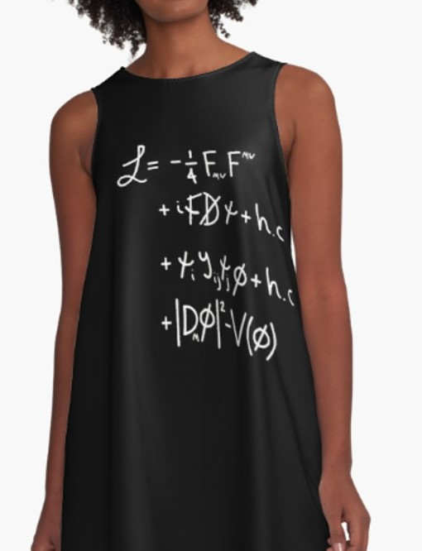
Probing Physics Beyond the Standard Model
+ new interactions
New Physics Beyond this
Standard Model

Slide 23
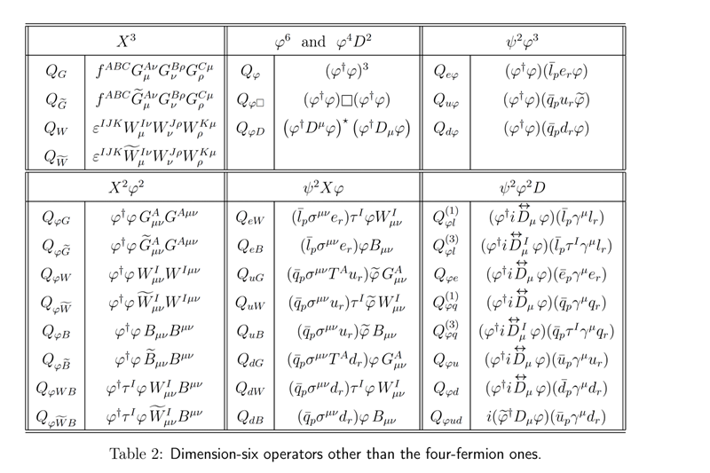
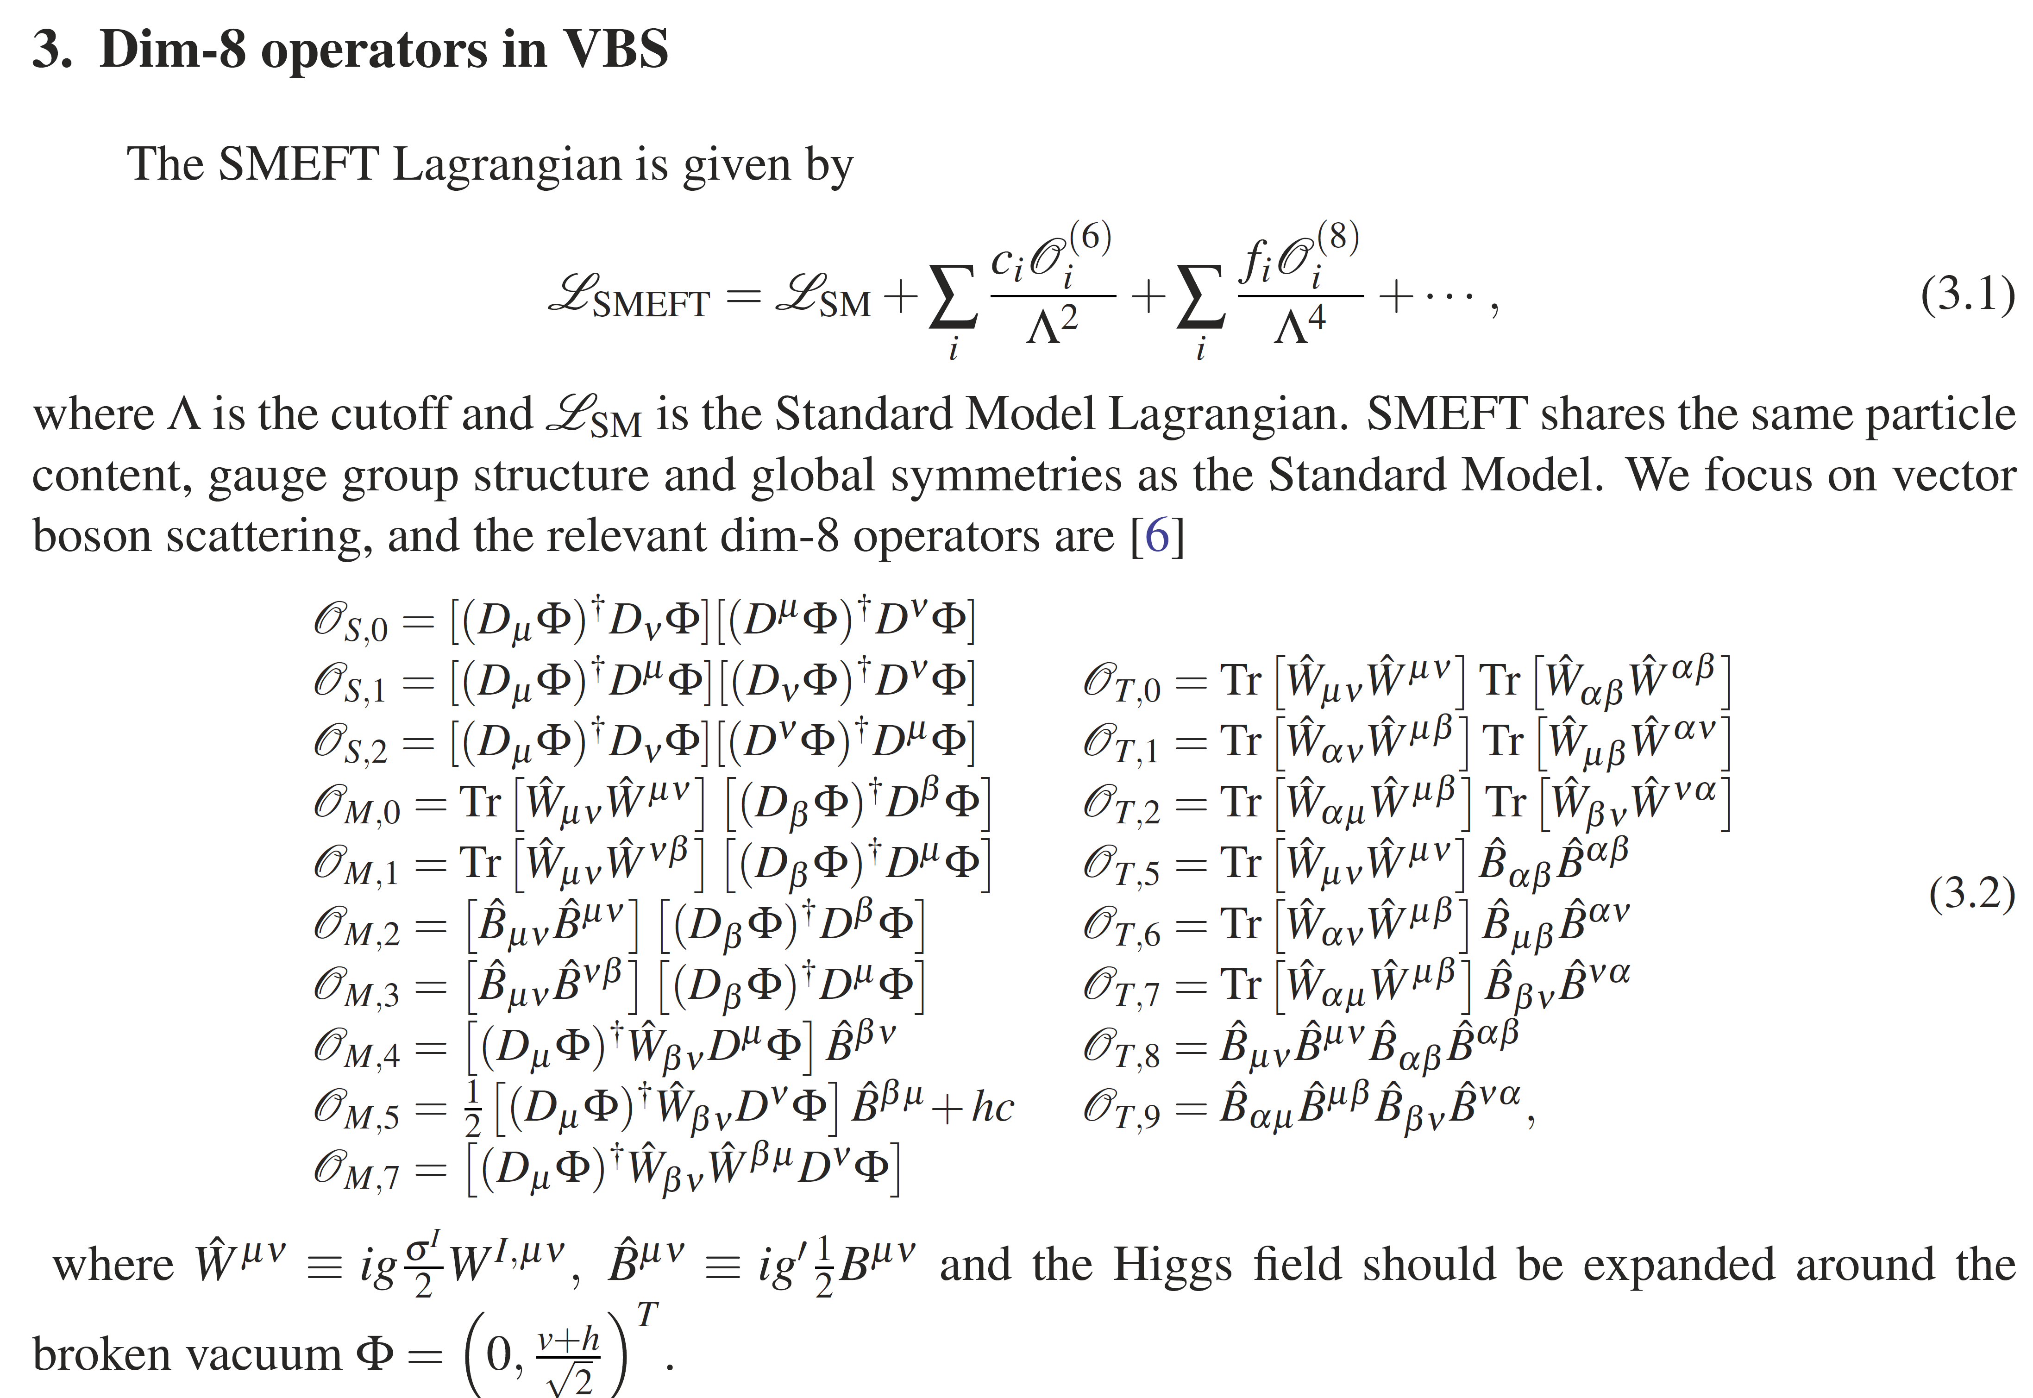
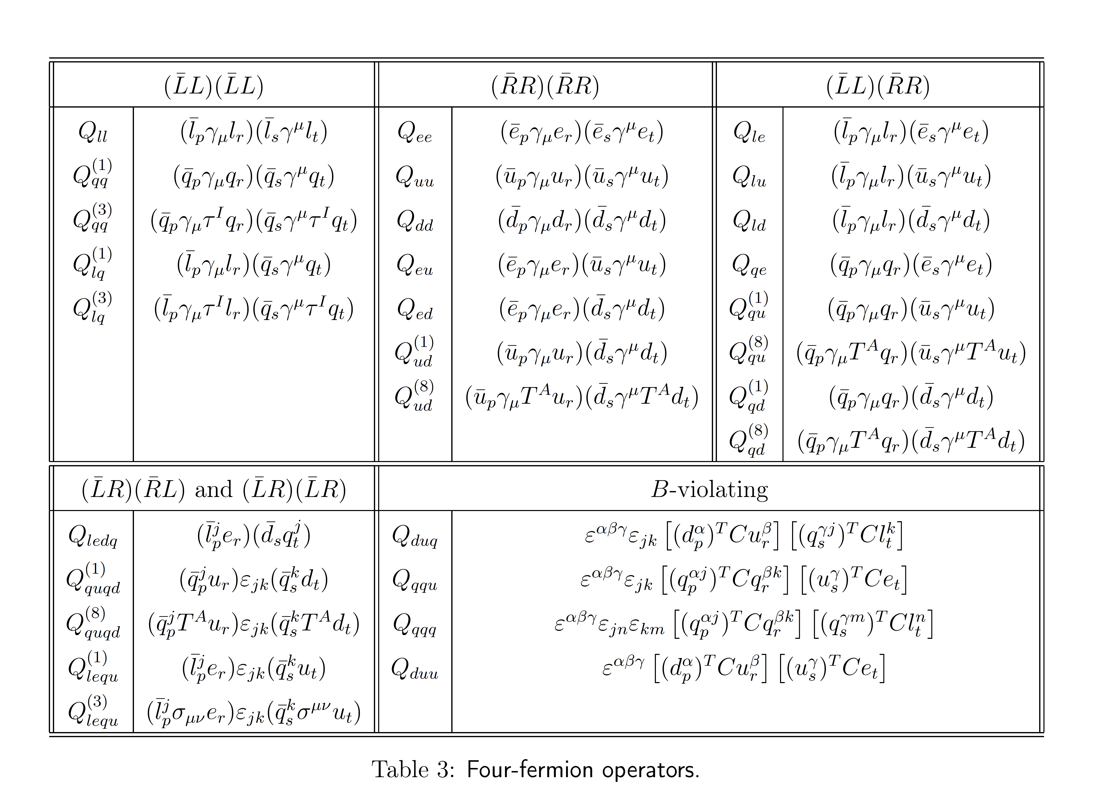
Probing Physics Beyond the Standard Model
SMEFT for up to dim-8 bosons couplings (Higgs and W, Z bosons)
18-dimensional parameter space
+ new interactions
New Physics Beyond this
Standard Model
SMEFT includes 44,807 dim-8 operators

Slide 24
Probing Physics Beyond the Standard Model
Positivity bounds reduce allowed region
Only about 0.7% of the naïve parameter space satisfies existing bounds
CMS
constraints
Positivity
constraints from causality
+ new interactions
New Physics Beyond this
Standard Model
Zhang & Zhou, 2020

Slide 25

SMEFT – Fermionic sector
Flavor-preserving and violating dim-8 operators
From Remmen & Rodd, 2004.02885
Constraint on ratio between flavor-violating operators and preserving ones
Flavor-violating Wilson coefficients are bounded by flavor-conserving one
Certain operators targeted by upcoming $μ→3e$ experiments can already be precluded
Results consistent with Minimal Flavor Violation, Bonnefoy, Gendy, Grojean, 2011.12855
Notes:
Cabibbo-Kobayashi-Maskawa

Slide 26







Multiple scattering
Naively increasing the number of fields increases the dimensionality of the phase space
But number of constraints also increases

Slide 27





Multiple scattering
Naively increasing the number of fields increases the dimensionality of the phase space
But number of constraints also increases
Coefficients of $Z_{2}$-breaking operators bounded by $Z_{2}$- preserving ones…
& similarly for other global field space symmetries Bal & de Rham, to appear

Slide 28
Non-Gravitational EFT
CoM Energy
Unitary (optical theorem)
Lorentz invariant (crossing symmetry)
CAUSAL (analyticity)
Local (Froissart Bound)
positivity bounds
(applied to low-energy
scattering amplitude
or refractive index)
Low-energy
EFT
(sub)luminal sound speed

Slide 29
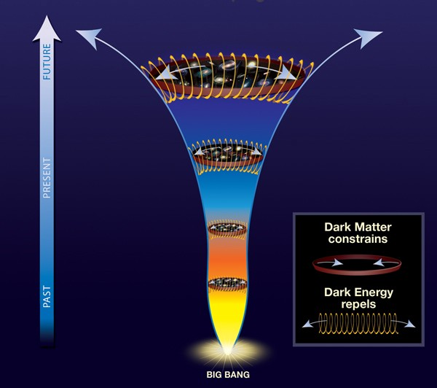

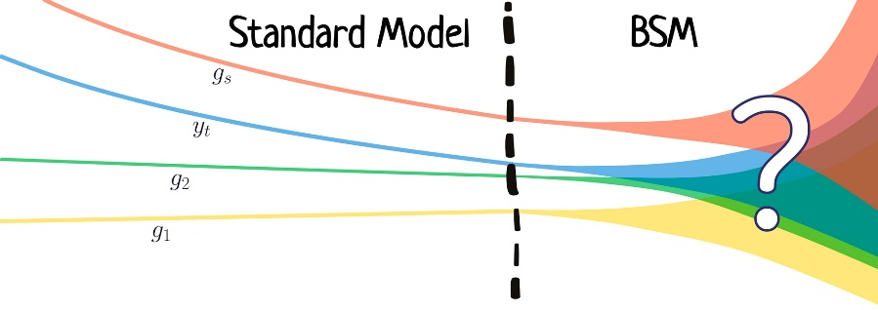
Positivity Constraints on…
Beyond Standard Model
dark energy
Gravitational Waves
dark matter
Black Holes
Cosmological GWs
Inflation
Physics Beyond the Standard Model

Slide 30

Applications to EFT of Cosmology
- absence of S-matrix
- lack of Lorentz invariance/crossing symmetry
- ambiguous connection with analyticity
- gravitational exchange pole
Direct application to cosmology is more subtle due to:
Directions in progress:
Cosmological bootstrap on correlators (only perturbative)
No constraints from UV completion (analyticity, non-perturbative UV unitarity still need to be formulated)
Arkani-Hamed, Baumann, Lee & Pimentel, 1811.00024
Baumann, Duaso Pueyo, Joyce, Lee & Pimentel, 1910.14051, 2005.04234
see Sleight & Taronna for Bootstrapping Inflationary Correlators in Mellin Space, 1907.01143, 2007.09993
Iacobacci, Sleight &Taronna, Correlators and Källén-Lehmann 2401.16591

Slide 31
Applications to EFT of Cosmology
- absence of S-matrix
- lack of Lorentz invariance/crossing symmetry
- ambiguous connection with analyticity
- gravitational exchange pole
Direct application to cosmology is more subtle due to:
Directions in progress:
Cosmological bootstrap on correlators (only perturbative)
Alternative approach is to focus on approximate S-matrix with broken boosts
Full formalism still under development
CdR & Melville 1703.00025
Grall & Melville 2102.05683
Melville & Pimentel 2309.07092, 2404.05712
See also work by Creminelli, Janssen & Senatore, 2207.14224
but assuming conformal invariance & 3d

Slide 32
Applications to EFT of Cosmology
- absence of S-matrix
- lack of Lorentz invariance/crossing symmetry
- ambiguous connection with analyticity
- gravitational exchange pole
Direct application to cosmology is more subtle due to:
Directions in progress:
Cosmological bootstrap on correlators (only perturbative)
Approximate S-matrix with broken boosts
Constrain Wilson coefficients defined around Minkowski vacuum and translate into constraints around cosmological backgrounds (requires adiabatic assumptions)
1904.05874, 1905.08816, 1906.11840, 1908.08644, 2103.06855, 2103.11195, …

Slide 33

Applications to EFT of Cosmology
- absence of S-matrix
- lack of Lorentz invariance/crossing symmetry
- ambiguous connection with analyticity
- gravitational exchange pole
Direct application to cosmology is more subtle due to:
Directions in progress:
Cosmological bootstrap on correlators (only perturbative)
Approximate S-matrix with broken boosts
Constrain Wilson coefficients defined around Minkowski vacuum
Use Infrared causality as a proxy for positivity
Worked developed with Carrillo Gonzalez, Chen, Jaitly, Margalit, Pozsgay, Tokareva, Tolley & Zhang
Carrillo Gonzalez, Bounds on EFT’s in an expanding universe, 2312.07651
Carrillo Gonzalez & Céspedes, Causality Bounds on the Primordial Power Spectrum, 2502.19477

Slide 34
Applications to EFT of Cosmology
- absence of S-matrix
- lack of Lorentz invariance/crossing symmetry
- ambiguous connection with analyticity
- gravitational exchange pole
Direct application to cosmology is more subtle due to:
Directions in progress:
Cosmological bootstrap on correlators (only perturbative)
Approximate S-matrix with broken boosts
Constrain Wilson coefficients defined around Minkowski vacuum
Use Infrared causality as a proxy for positivity

Slide 35
Applications to EFT of Cosmology
- absence of S-matrix
- lack of Lorentz invariance/crossing symmetry
- ambiguous connection with analyticity
- gravitational exchange pole
Direct application to cosmology is more subtle due to:
Directions in progress:
Cosmological bootstrap on correlators (only perturbative)
Approximate S-matrix with broken boosts
Constrain Wilson coefficients defined around Minkowski vacuum
Use Infrared causality as a proxy for positivity

Slide 36

Constraints on Low-energy Models
Example of Cosmological model with parameters $c_{B,M,T}$
Constraints from observations
CMB, BAO, redshift space distortion,…
with Melville and Noller

Slide 37

Constraints on Low-energy Models
Example of Cosmological model with parameters $c_{B,M,T}$
Constraints from observations
CMB, BAO, redshift space distortion,…
Constraints from causality and consistent high energy completion (Positivity Priors)
with Melville and Noller

Slide 38
Applications to EFT of Cosmology
- absence of S-matrix
- lack of Lorentz invariance/crossing symmetry
- ambiguous connection with analyticity
- gravitational exchange pole
Direct application to cosmology is more subtle due to:
Directions in progress:
Cosmological bootstrap on correlators (non-perturbative example)
Approximate S-matrix with broken boosts
Constrain Wilson coefficients defined around Minkowski vacuum
Use Infrared causality as a proxy for positivity
Worked developed with Carrillo Gonzalez, Chen, Jaitly, Margalit, Pozsgay, Tokareva, Tolley & Zhang
Carrillo Gonzalez, Bounds on EFT’s in an expanding universe, 2312.07651
Carrillo Gonzalez & Céspedes, Causality Bounds on the Primordial Power Spectrum, 2502.19477

Slide 39


Non-Gaussianities
with Sadra Jazayeri and Andrew Tolley, 2025

Slide 40
Applications to EFT of Cosmology
- absence of S-matrix
- lack of Lorentz invariance/crossing symmetry
- ambiguous connection with analyticity
- gravitational exchange pole
Direct application to cosmology is more subtle due to:
Directions in progress:
Cosmological bootstrap on correlators (only perturbative)
Approximate S-matrix with broken boosts
Constrain Wilson coefficients defined around Minkowski vacuum
Use Infrared causality as a proxy for positivity
Worked developed with Carrillo Gonzalez, Chen, Jaitly, Margalit, Pozsgay, Tokareva, Tolley & Zhang
Carrillo Gonzalez, Bounds on EFT’s in an expanding universe, 2312.07651
Carrillo Gonzalez & Céspedes, Causality Bounds on the Primordial Power Spectrum, 2502.19477

Slide 41







Goldsone Boson without Gravity
$$φ$$
$$φ$$
Goldstone
boson
Higgs
$$φ$$
$$φ$$
Subluminality
Positivity
bounds
Asymptotic
Causality
Infrared
Causality
$c$: speed of light in vacuum

Slide 42


Positivity vs Causality

Slide 43


No Gravity
With Gravity
Without gravity, there is in principle no limit to
how much/for how long we can interact
With gravity, anything living on the spacetime inexorably curves the geometry.
There is a limit to “stacking”
Rules of positivity are different

Slide 44
Goldsone Boson without Gravity
$$φ$$
$$φ$$
Goldstone
boson
Higgs
$$φ$$
$$φ$$
Subluminality
Positivity
bounds
Asymptotic
Causality
Infrared
Causality
$c$: speed of light in vacuum

Slide 45






Goldsone Boson with Gravity
$$φ$$
$$φ$$
Goldstone
boson
Higgs
$$φ$$
$$φ$$
Subluminality
(in Einstein frame)
Positivity
bounds
Asymptotic
Causality
Infrared
Causality
$c$: speed of light in vacuum

Slide 46
Goldsone Boson with Gravity
$$φ$$
$$φ$$
Goldstone
boson
Higgs
$$φ$$
$$φ$$
Subluminality
(in Einstein frame)
Positivity
bounds
Asymptotic
Causality
For applications to Cosmology, see:
Carrillo Gonzalez, 2312.07651
Bounds on EFT’s in an expanding universe
Carrillo Gonzalez & Céspedes, 2502.19477
Causality Bounds on the Primordial Power Spectrum
Infrared
Causality

Slide 47



High-energy
Sens inverse
?
Region where low-energy
description is valid: IR

Slide 48


High-energy
Photon-Graviton
(hAhA)
?
with Alberte, Jaitly, Tolley, 2021-2023

Slide 49







Flowing down
High-energy
Things may start
negatively….
We would have expected
at worse by very small amount
$$−$$
?
Scale of
Quantum
Gravity
$$≳−{10}^{−110}{eV}^{−4}$$
Positive contributions
to the amplitude
But should end up
positively….
We would have expected
to end up with a
positive amount
$$\sim \frac{1}{m^{4}}$$
$$\sim {10}^{−23}{eV}^{−4}$$
Electron mass

Slide 50


Flowing down
High-energy
Things may start
negatively….
We would have expected
at worse by very small amount
$$−$$
?
Scale of
Quantum
Gravity
$$≳−{10}^{−110}{eV}^{−4}$$
Positive contributions
to the amplitude
But should end up
positively….
We actually end up with
a large negative contribution
$$\sim \frac{−1}{m^{2}M_{Pl}^{2}}$$
$$\sim {−10}^{−67}{eV}^{−4}$$
Electron mass

Slide 51

Flowing down
High-energy
Things must start very negatively by an amount
that knows about mass of lightest particle….
by $at least\sim \frac{−1}{m^{2}M_{Pl}^{2}}$
?
Scale of
Quantum
Gravity
Positive contributions
to the amplitude
But should end up
positively….
We actually end up with
a large negative contribution
$$\sim \frac{−1}{m^{2}M_{Pl}^{2}}$$
$$\sim {−10}^{−67}{eV}^{−4}$$
Electron mass

Slide 52

Flowing back up
High-energy
?
The scale of the lightest massive particles has to be built in
within UV quantum gravity behaviour
Scale of
Quantum
Gravity
$$\sim \frac{−1}{m^{2}M_{Pl}^{2}}$$
with Jaitly and Tolley, 2023
Electron mass
consistent with Caron-Huot & Li, Aug 2024

Slide 53
Flowing back up
High-energy
?
The scale of the lightest massive particles has to be built in
within UV quantum gravity behaviour
Scale of
Quantum
Gravity
* New physics manifest itself through other
operators in the EFT
Not an Option
* New BSM physics lead to cancellations
Not an Option
* New physics affects Regge behaviour…
(e.g. higher-spin tower at low-scale ~ 10⁴ TeV)
$$\sim \frac{−1}{m^{2}M_{Pl}^{2}}$$
Electron mass

Slide 54




Approximate Positivity to WGC
Requirements from unitarity, causality, locality and Lorentz invariance only demand
The WGC is not trivially satisfied for any EFT that enjoys unitarity, causality, locality and Lorentz invariance – there must be more to it
Low-energy gravitational EFTs do not need to be
strictly subluminal to be causal.

Slide 55







Graviton Scattering
$$h_{μν}$$
$$h_{αβ}$$
=
+…
Contribution to
Regge slope
$$h_{ab}$$
$$h_{cd}$$
Same observation occurs in other gravitational amplitudes
loops contributions to Regge residue ($s→∞$) are:
* not as small as naively expected
* and not small because of IR physics
The scale of the lightest massive particles has to be built in within
UV quantum gravity behaviour
with Jaitly and Tolley, 2023

Slide 56

Positivity in the Sky
In need for more fundamental description for Particle Physics, Cosmology, Dark Matter, Dark Energy, Inflation, Gravity, Black Holes,…
S-matrix bootstrap program provides neutral and agnostic model-independent lampposts to guide our searches for new discoveries
Constraints consistent with
string theory but do not rely on it
New class of inverse bootstrap
guides our understanding of high energy (well-beyond what will be reached experimentally)

Slide 57





Causality: Towards new Opportunities
While powerful, current positivity bounds have not yet reached their full potential
1. Positivity Limited to 2→2 scattering statements
2. Gravitational pole spoils full applicability
Current causality
can go beyond
3. Need of more precise dictionary with actual (gravitational) observables
real world, not empty & Minkowski as required by S-matrix bootstrap bounds

Slide 59






Weak Gravity Conjecture
Consider a new BSM U(1)
Extremal Black Hole
evaporates
$$Q≤M$$
(to avoid naked singularity)
$$Q=M$$
(in units of $\sqrt{2}$Mpl)
For every $U(1)$, there must be a
massive charged particle with $Q≥M$
Arkani-Hamed, Motl, Nicolis, Cumrun, hep-th/0601001
Harlow, Heidenreich, Reece & Rudelius, 2201.08380

Slide 60


U(1) EFT
Weyl Curvature
Redresses BH mass and charge
New BH extremality condition is:

Slide 61


U(1) EFT
Weyl Curvature
Redresses BH mass and charge
New BH extremality condition is:
Kats, Motl & M. Padi, hep-th/0606100
Cheung & Remmen, 1407.7865
Hamada, Noumi & Shiu, 1810.03637
Extremal BHs can evaporate
without leading to naked singularity and
without postulating a massive charged particle with $Q≥M$
(other than BHs themselves).
If
Do positivity bounds impose $C>0$ ?

Slide 62








Unitarity + Causality with Gravity
Graviton exchange spoils analyticity
$$=$$
$$+ …$$
$$h_{μν}$$
???
t-channel pole from gravity exchange compromises positivity bound

Slide 63





Gravitational bounds
Gravity generically allows for some mild negativity
with Alberte, Jaitly and Tolley
2007.12667, 2012.05798
Confirmed using finite impact parameters bounds
Caron-Huot, Mazac, Rastelli & Simmons-Duffin, 2102.08951
Can be derived using “Infrared Causality”,
Chen, CdR Margalit & Tolley, 2112.05031, 2309.04534
arguments based on “Asymptotic Causality” (CEMZ 1407.5597) would fail

Slide 64


Assumptions
There is a limit where Massless Loops can be ignored
Amplitude respects Froissart-like Bound
Regge behaviour
Graviton loops are Mpl suppressed (in fact $\sim M_{Pl}^{−4}$)
Spin$<2$ massless loops do not contribute the $s^{2}$ unless non-local IR-UV mixing
Expected to be valid for $D≥5$
For $D=4$, IR divergences makes it more subtle
Arises in weakly coupled string theory
Can be argued for more universally if amplitude satisfies a dispersion relation
in physical region with 2 subtractions
4. Analyticity away from real $s$-axis, 5. Unitarity, 6. Crossing symmetry, …
in 1st Riemann sheet

Slide 65








Regge Behaviour
2
In DL without graviton loops:
$$=$$
$$h_{μν}$$
$$+ …$$
$$t$$
2
Full behavior may
be different
$$t$$

Slide 66











hX$→$hX
Graviton loops
not present in
Other Light fields (eg photon)
0
Massive fields

Slide 67






Branchcut
Poles from other (spin$<2$) light fields are harmless
Loops from other light fields contribute to but at best as
Other Light fields (eg photon)
0
Massive fields

Slide 68
Branchcut
0
Massive fields

Slide 69



hAhA: graviton-photon scattering
0
Massive fields
Alberte, Jaitly, Tolley + CdR, 2111.09226

Slide 70

hAhA: graviton-photon scattering
No other local and covariant operator that would affect amplitude at that level.
New BSM physics cannot help (improved positivity bounds applied above $m_{e}$ would lead to same result)

Slide 71


Flowing down to the IR
“Unknown” UV completion
New physics enters
Scale of
Quantum
Gravity
Electron
mass
hAhA
(graviton-photon scattering in SM)

Slide 72

Flowing down to the IR
Things may start
negatively….
Expect at worse:
Scale of
Quantum
Gravity
Positive contributions
to the amplitude
Contribute positively as
Electron
mass
But should end up
positively….

Slide 73
Flowing down
High-energy
Things may start
negatively….
We would have expected
at worse by very small amount
$$−$$
?
Scale of
Quantum
Gravity
$$≳−{10}^{−110}{eV}^{−4}$$
Positive contributions
to the amplitude
But should end up
positively….
We would have expected
to end up with a
positive amount
$$\sim \frac{1}{m^{4}}$$
$$\sim {10}^{−23}{eV}^{−4}$$
Electron mass

Slide 74
Flowing down
High-energy
Things may start
negatively….
We would have expected
at worse by very small amount
$$−$$
?
Scale of
Quantum
Gravity
$$≳−{10}^{−110}{eV}^{−4}$$
Positive contributions
to the amplitude
But should end up
positively….
We actually end up with
a large negative contribution
$$\sim \frac{−1}{m^{2}M_{Pl}^{2}}$$
$$\sim {−10}^{−67}{eV}^{−4}$$
Electron mass

Slide 75
Flowing down
High-energy
Things must start very negatively by an amount
that knows about mass of lightest particle….
by $at least\sim \frac{−1}{m^{2}M_{Pl}^{2}}$
?
Scale of
Quantum
Gravity
Positive contributions
to the amplitude
But should end up
positively….
We actually end up with
a large negative contribution
$$\sim \frac{−1}{m^{2}M_{Pl}^{2}}$$
$$\sim {−10}^{−67}{eV}^{−4}$$
Electron mass

Slide 76
Flowing back up
High-energy
?
The scale of the lightest massive particles has to be built in
within UV quantum gravity behaviour
Scale of
Quantum
Gravity
$$\sim \frac{−1}{m^{2}M_{Pl}^{2}}$$
with Jaitly and Tolley, 2023
Electron mass
consistent with Caron-Huot & Li, Aug 2024

Slide 77
Flowing back up
High-energy
?
The scale of the lightest massive particles has to be built in
within UV quantum gravity behaviour
Scale of
Quantum
Gravity
* New physics manifest itself through other
operators in the EFT
Not an Option
* New BSM physics lead to cancellations
Not an Option
* New physics affects Regge behaviour…
(e.g. higher-spin tower at low-scale ~ 10⁴ TeV)
$$\sim \frac{−1}{m^{2}M_{Pl}^{2}}$$
Electron mass

Slide 78
Graviton Scattering
$$h_{μν}$$
$$h_{αβ}$$
=
+…
Contribution to
Regge slope
$$h_{ab}$$
$$h_{cd}$$
Same observation occurs in other gravitational amplitudes
loops contributions to Regge residue ($s→∞$) are:
* not as small as naively expected
* and not small because of IR physics
The scale of the lightest massive particles has to be built in within
UV quantum gravity behaviour

Slide 79
Positivity in the Sky
In need for more fundamental description for Particle Physics, Cosmology, Dark Matter, Dark Energy, Inflation, Gravity, Black Holes,…
S-matrix bootstrap program provides neutral and agnostic model-independent lampposts to guide our searches for new discoveries
Constraints consistent with
string theory but do not rely on it
New class of inverse bootstrap
guides our understanding of high energy (well-beyond what will be reached experimentally)

Slide 80
Causality: Towards new Opportunities
While powerful, current positivity bounds have not yet reached their full potential
1. Positivity Limited to 2→2 scattering statements
2. Gravitational pole spoils full applicability
Current causality
can go beyond
3. Need of more precise dictionary with actual (gravitational) observables
real world, not empty & Minkowski as required by S-matrix bootstrap bounds

Slide 81




Two Subtractions
Amplitude should admit a dispersion relation with 3 subtractions
(assuming no massless loops)
In $D≥5$, we would expect from perturbative string theory
take it as an assumption in $D=4$
0

Slide 82


Regge Behaviour
$$=$$
$$h_{μν}$$
$$+ …$$
Pole must be hidden in

Slide 83
Regge Behaviour
2
In DL without graviton loops:
$$=$$
$$h_{μν}$$
$$+ …$$
$$t$$
2
Full behavior may
be different
$$t$$

Slide 84







Regge
0
near $t=0$
residue of Regge pole
$t−$dependence of Regge residue and slope
typically expected to enter at string scale M*
or scale $≫$ SM physics
Regge slope

Slide 85




Subtracting Regge
0
3 subtractions
Regge behaviour
Finite &
positive

Slide 86


Subtracting Regge
0

Slide 88
Small Superluminality – without gravity
As soon as a “substance” allows the tiniest superluminal speed,
nothing prevents us from stacking it so as to end up with a significant/observable “time advance”
time
Speed of
light
Speed of
light
$$Δt$$
Faster than light
space

Slide 89
No Gravity
With Gravity
As soon as a “substance” allows the tiniest SL,
nothing prevents us from stacking it so as to end up with a significant/observable “time advance”
Anything living on the spacetime inexorably curves the geometry.
There is a limit to “stacking”
Not always meaningful
violation of causality

Slide 90
Goldstone Boson without Gravity
$$φ$$
$$φ$$
Goldstone
boson
Higgs
$$φ$$
$$φ$$
Subluminality
Positivity
bounds
Asymptotic
Causality
Infrared
Causality

Slide 91
Goldstone Boson with Gravity
$$φ$$
$$φ$$
Goldstone
boson
Higgs
$$φ$$
$$φ$$
Subluminality
(in Einstein frame)
Positivity
bounds
Asymptotic
Causality
Infrared
Causality

Slide 92
Positivity vs Causality
Carrillo Gonzalez, CdR, Pozsgay, Tolley, 2207.03491

