Slide 1


Secondary Gravitational Waves as probes of the early Universe and Gravity
Based on :
B: S. Basilakos, S: E. Saridakis, N: D. Nanopoulos, M: N. Mavromatos, P: T. Papanikolaou
Tzerefos 2025 (in prep.), Tzerefos, PBSM 2025, BNP Tzerefos 2023, BNP Tzerefos 2023 and
P Tzerefos BS 2022.
Charalampos (Haris) Tzerefos
NKUA and NOA
chtzeref@phys.uoa.gr
Corfu, 2/9/2025

Slide 2
Gravitational Waves
Single- source waves
Multi- source superposition
BH- BH merger events etc, distinct waveforms
Astrophysical
Cosmological
Eg unresolved compact binaries
Inflation, Phase transitions etc
(Scalar induced 2nd order) Gravitational waves

Slide 3
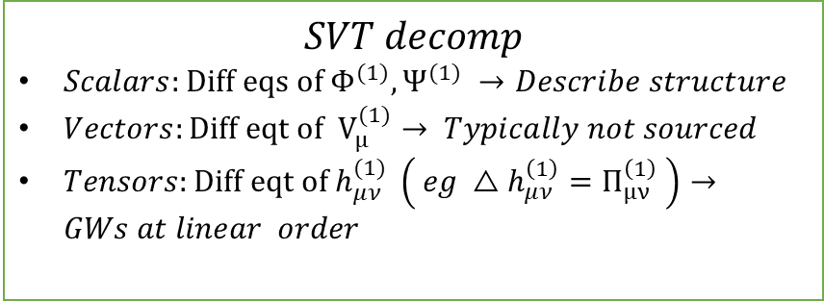
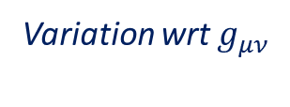
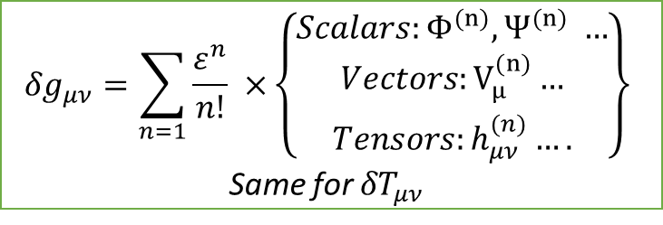
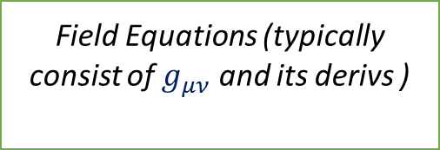
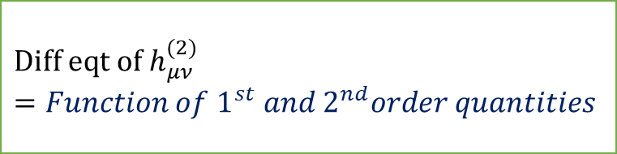
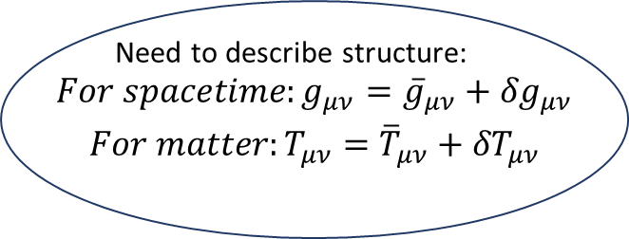

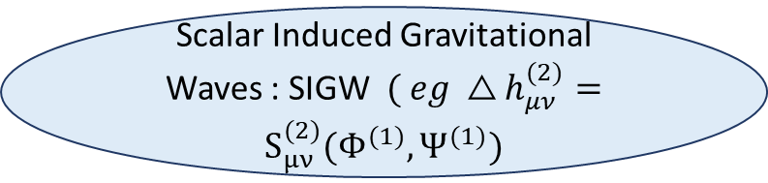
What are these secondary GWs?
Cosmological Principle: The metric is homogeneous and isotropic
Need to describe structure: $\begin{aligned}For spacetime:{g_{μν}=\overline{g}}_{μν}+{δg}_{μν} \\ For matter:{T_{μν}=\overline{T}}_{μν}+{δT}_{μν}\end{aligned}$
$${δg}_{μν}=\sum_{n=1}{\frac{ε^{n}}{n!} ×}\left\{\begin{aligned}Scalars:Φ^{(n)},Ψ^{(n)} … \\ Vectors:V_{μ}^{(n)}… \\ Tensors:h_{μν}^{(n)}….\end{aligned}\right\}$$
Same for ${δT}_{μν}$
Gravitational Action (aka combinations of geometric tensors like R)
Field Equations (typically consist of $g_{μν}$ and its derivs )
Expansion to 2nd order, focusing only on $h_{μν}^{\left(2\right)}$
Variation wrt $g_{μν}$
Expansion to 1st order
$${Diff eqt of h}_{μν}^{(2)}=Function of{ 1}^{st} and{ 2}^{nd}order quantities$$
Source term
$$SVT decomp$$
$Scalars:{Diff eqs of Φ}^{(1)},Ψ^{(1)} →Describe structure$
$Vectors:{Diff eqt of V}_{μ}^{(1)}→ Typically not sourced$
$Tensors:{Diff eqt of h}_{μν}^{(1)} \left( eg △h_{μν}^{\left(1\right)}=Π_{μν}^{\left(1\right)} \right)→GWs at linear order$
Focusing only on 1st order scalars
Scalar Induced Gravitational Waves : SIGW $( eg △h_{μν}^{(2)}=S_{μν}^{(2)}(Φ^{(1)},Ψ^{(1)})$

Slide 4










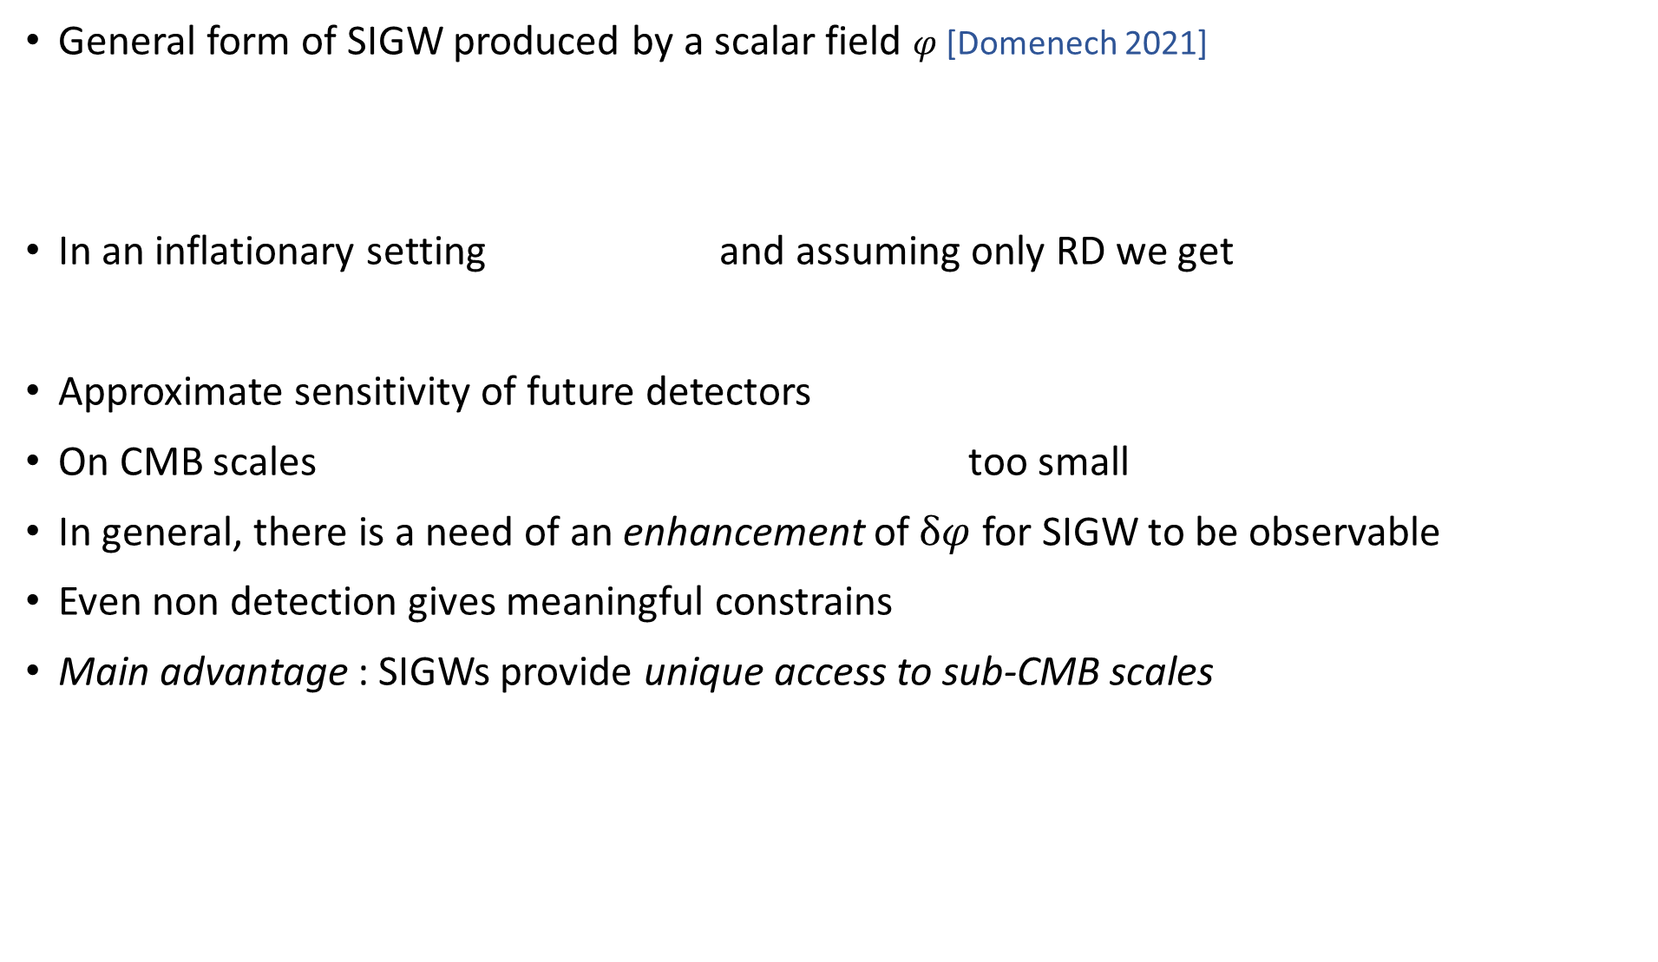
Intuition about SIGWs
General form of SIGW produced by a scalar field $φ$ [Domenech 2021]
In an inflationary setting and assuming only RD we get
Approximate sensitivity of future detectors
On CMB scales too small
In general, there is a need of an enhancement of $δφ$ for SIGW to be observable
Even non detection gives meaningful constrains
Main advantage : SIGWs provide unique access to sub-CMB scales

Slide 5





Essentials of SIGWs in GR
Working in the Newtonian gauge, the 2nd order tensor perturbations are described as follows
Their equation of motion in fourier space is
The source term is
At the end, the spectral abundance of GWs can be given by
and
The kernel is a complicated function which describes the time evolution of the potentials (via transfer functions).

Slide 6
Common sources of SIGWs
Enhanced curvature perturbations during inflation
→ Large scalar fluctuations at small scales ( eg via inflection points )→ strong SIGWs
Preheating and resonances
→ Nonlinear dynamics of inflaton and spectator fields
Primordial black holes (PBHs)
→ Poisson/isocurvature fluctuations in PBH distributions
Cosmological phase transitions
→ Strong transitions (e.g. GUT, EW scale) amplify scalar inhomogeneities
Sudden transitions between eras
→ e.g. Early Matter Domination → Radiation Domination ("poltergeist mechanism")
Isocurvature modes from spectator fields
→ Generate additional SIGW channels
This talk!

Slide 7
General concept
Inflation
(Ultra light) PBHs
Induce
Adiabatic perturbations
Isocurvature perturbations
Early Matter Domination era
Sudden transition
(Poltergeist mechanism )
Radiation Domination era
(Scalar induced 2nd order) Gravitational waves

Slide 8
Sources of eMDs we considered
The source with which we were primarily preoccupied is a gas of ultra- light PBH.
It was first studied in [Papanikolaou, Vennin, Langlois, JCAP, 2021] and we applied it to various works, among which the most notable are:
Its pioneering extension to an f(R) gravity theory in [T. Papanikolaou, C. Tzerefos, S. Basilakos, E.N. Saridakis, JCAP, 2022] and then [Papanikolaou, 2025]. Currently, I am refining that approach in [ C. Tzerefos, in prep ].
Its production in a no-scale SUGRA model in [S. Basilakos , D.V. Nanopoulos, T. Papanikolaou, E.N. Saridakis, C. Tzerefos, PLB, 2024]
We also considered BSM cosmological models with particular reheating processes, which induce an eMD.
Flipped SU(5) theory in [S. Basilakos , D.V. Nanopoulos, T. Papanikolaou, E.N. Saridakis, C. Tzerefos ,PLB, 2023]
String – inspired Axion- Chern- Simmons – Running- Vacuum cosmology [ C. Tzerefos, T. Papanikolaou, S. Basilakos , E.N. Saridakis, N.E. Mavromatos PRD, 2025].

Slide 9



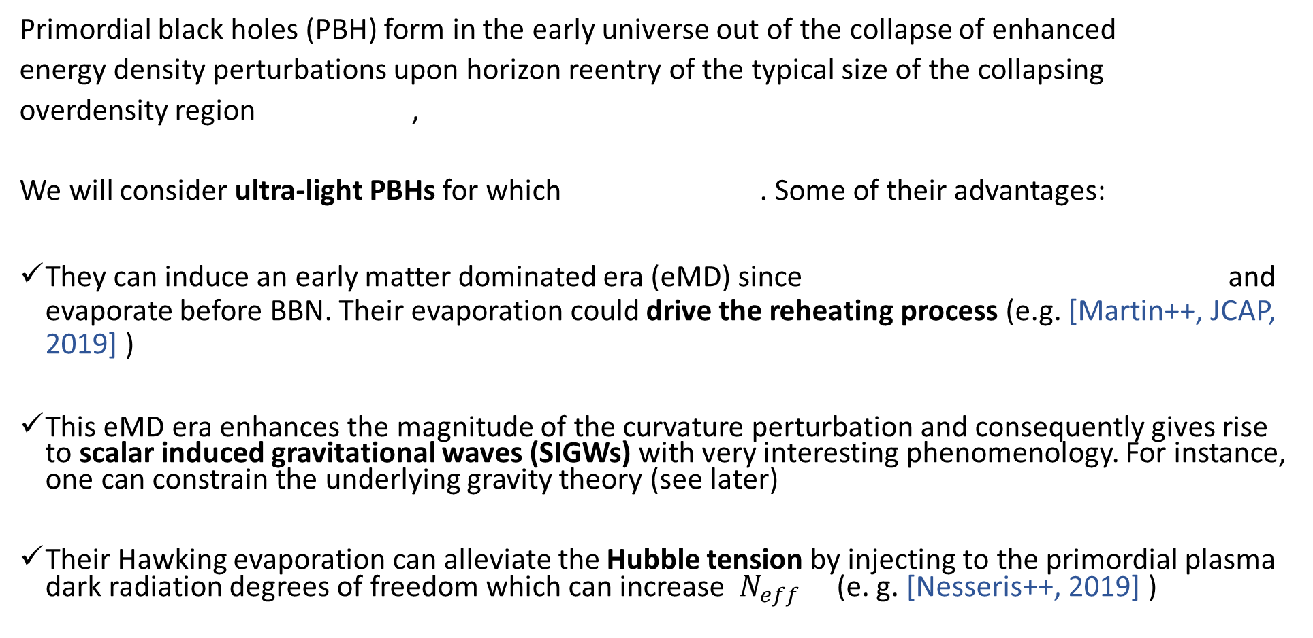
What are ultra-light PBHs
Primordial black holes (PBH) form in the early universe out of the collapse of enhanced
energy density perturbations upon horizon reentry of the typical size of the collapsing
overdensity region ,
We will consider ultra-light PBHs for which . Some of their advantages:
They can induce an early matter dominated era (eMD) since and evaporate before BBN. Their evaporation could drive the reheating process (e.g. [Martin++, JCAP, 2019] )
This eMD era enhances the magnitude of the curvature perturbation and consequently gives rise to scalar induced gravitational waves (SIGWs) with very interesting phenomenology. For instance, one can constrain the underlying gravity theory (see later)
Their Hawking evaporation can alleviate the Hubble tension by injecting to the primordial plasma dark radiation degrees of freedom which can increase $N_{eff}$ (e. g. [Nesseris++, 2019] )

Slide 10



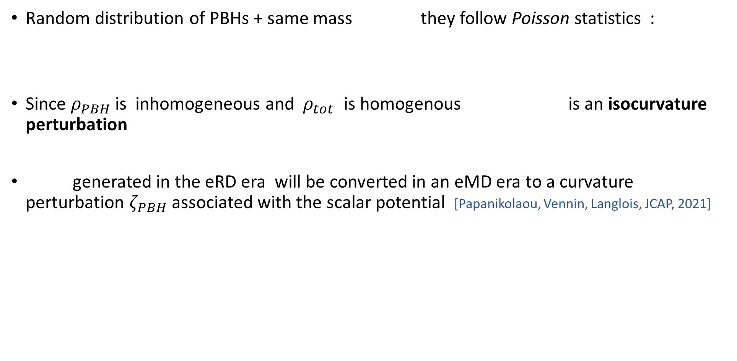
SIGWs from Poisson fluctuations of a gas of PBHs in GR
Random distribution of PBHs + same mass they follow Poisson statistics :
Since $ρ_{PBH}$is inhomogeneous and $ρ_{tot}$ is homogenous is an isocurvature perturbation
generated in the eRD era will be converted in an eMD era to a curvature perturbation $ζ_{PBH}$ associated with the scalar potential [Papanikolaou, Vennin, Langlois, JCAP, 2021]

Slide 11
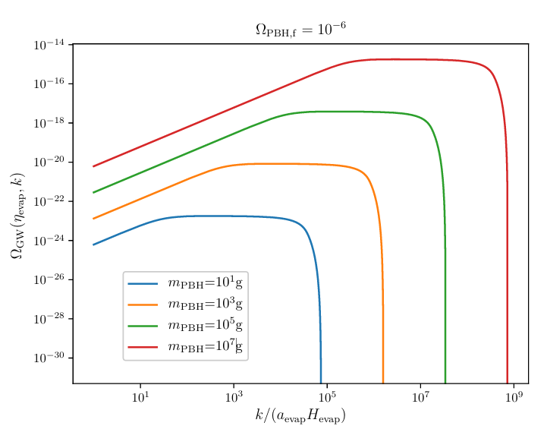
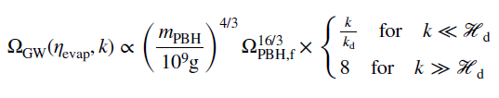
SIGWs from Poisson fluctuations of a gas of PBHs in GR

Slide 12
A) First application
We first implemented all these ideas in a model of no-scale SUGRA
[S. Basilakos , D.V. Nanopoulos, T. Papanikolaou, E.N. Saridakis, C. Tzerefos ,PLB, 2023]

Slide 13
String Theory
Supersymmetry
Simplest realisation
Wess- Zumino
Superstring Theory
Suitable embedding
+ non-perturbative deformations
No-scale Supergravity
Low energy limit
Starobinski-like Inflation
PBHs
Adiabatic perturbations
Isocurvature perturbations
Early Matter Domination era
GWs in nHz
(NANOgrav)
GWs in Hz
(close to BBO)
GWs in kHz

Slide 14






Theoretical introduction
The most general (N=1) SUGRA is characterized by two functions: The Kahler potential K, which is a Hermitian function of the matter scalar field and quantifies its geometry, and a holomorphic function of the fields called superpotential W. V is the scalar potential :
and , and which are chiral superfields.
Τhe simplest globally supersymmetric model is the Wess-Zumino one, which is characterized by one single chiral superfield and the following superpotential: , with a mass term and a trilinear coupling term
with

Slide 15






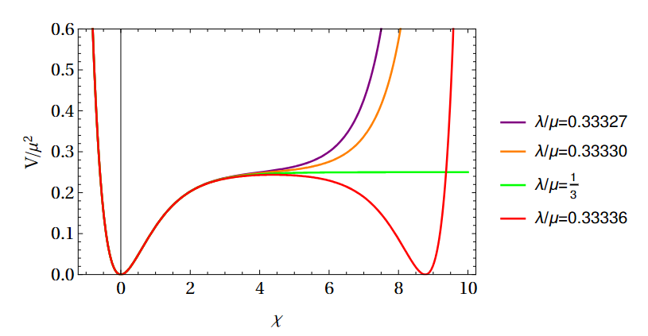


No-scale Wess-Zumino (NSWZ) SUGRA
In order to facilitate early universe inflationary scenarios, we shall embed this model in the context of no-scale supergravity by matching the field to the modulus field and the field to the inflaton. The corresponding Kahler potential for this construction is
Remarkably, by setting , and making a transformation of in order to obtain a canonical kinetic term, one obtains Starobinski inflation for and
[Ellis, Nanopoulos, Olive, PRL, 2013],
[Nanopoulos, Spanos, Stamou, PRD, 2020]
Fig. from [Nanopoulos, Spanos, Stamou, PRD, 2020]

Slide 16



NSWZ SUGRA inflection point inflation
A common mechanism to produce PBHs is via the use of inflationary potentials with inflection points aka points where which induce the so-called ultra slow roll inflation (USR)
To realize such set-ups, one can introduce the following non-perturbative deformations to the Kahler potential first introduced in [Nanopoulos, Spanos, Stamou, PRD, 2020]:
with a and b real constants
At the end, one obtains the following potential

Slide 17
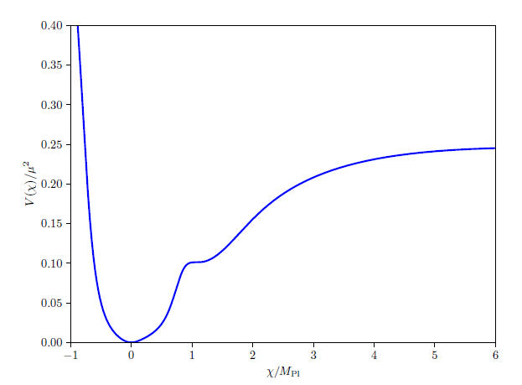
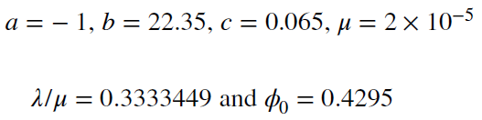
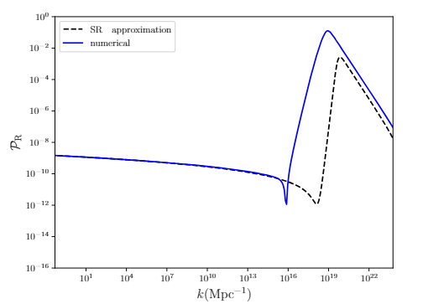

Ultra light PBHs in no-scale SUGRA
Our modified potential gives rise to the following power spectrum given our choice of fiducial parameters:

Slide 18

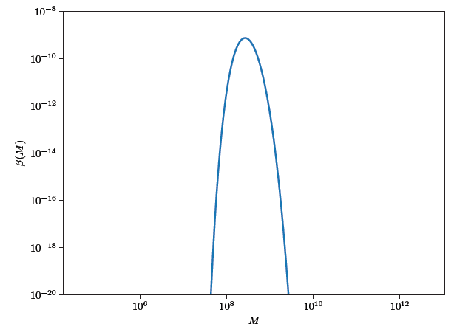
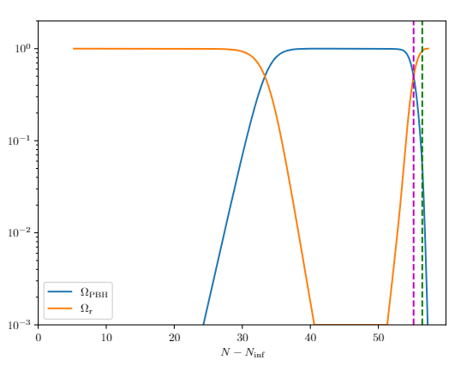

eMD driven by PBHs
Since an eMD era driven by them arises
To find their mass function we use peak theory and obtain:
Taking into account their Hawking evaporation
Note: We treat mass function as monochromatic eMD to lRD sudden

Slide 19
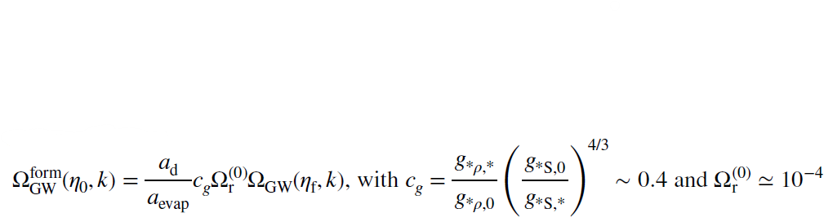
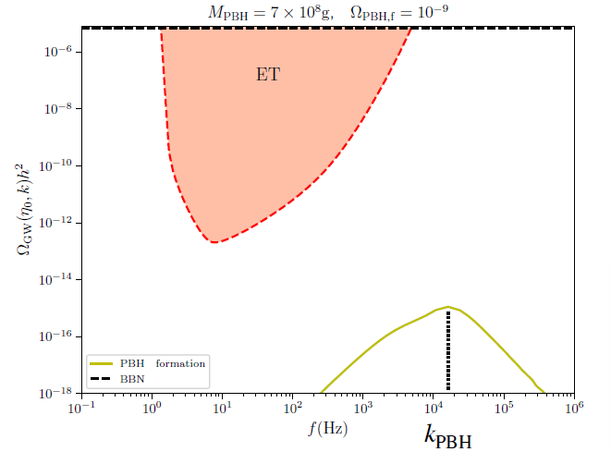
The relevant GW sources and their spectrum
Inflationary adiabatic perturbations GWs with two peaks
i) GWs are produced by the enhancement of (peaked at ) ) at PBHs scales peaked at the kHz range [Kohri, Terada, PRD, 2018 ]

Slide 20

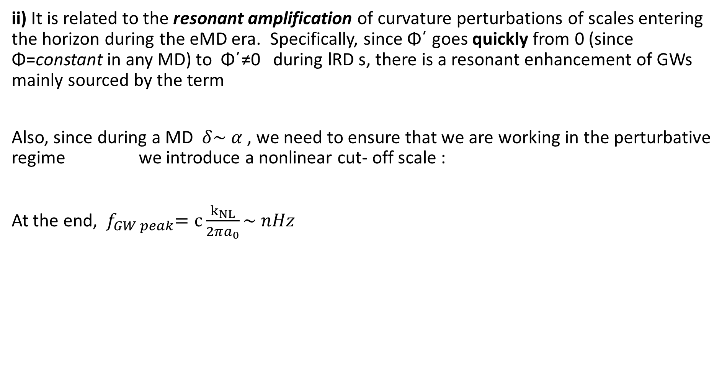
Inflationary adiabatic perturbations
ii) It is related to the resonant amplification of curvature perturbations of scales entering the horizon during the eMD era. Specifically, since Φ΄ goes quickly from 0 (since Φ=constant in any MD) to Φ΄≠0 during lRD s, there is a resonant enhancement of GWs mainly sourced by the term
Also, since during a MD $δ\sim α$ , we need to ensure that we are working in the perturbative regime we introduce a nonlinear cut- off scale :
At the end, ${ f}_{GW peak}=c\frac{k_{NL}}{2πa_{0}}\sim nHz$

Slide 21
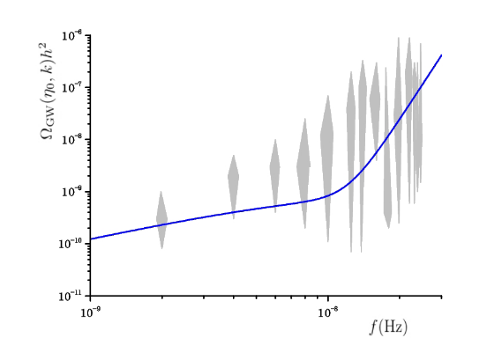

Inflationary adiabatic perturbations
This GW signal peaks at the nHz frequency range and is in agreement with NANOGrav/PTA GW data.

Slide 22
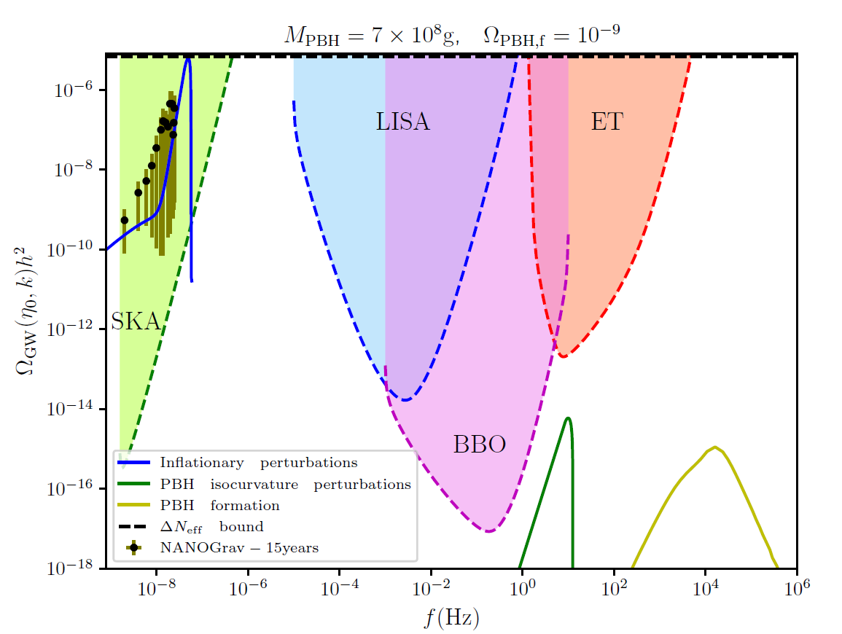
The complete three-peaked signal
A simultaneous detection of all three peaks could be an indication in favor of no-scale SUGRA, or the presence of eMDs by PBHs in general

Slide 23
Bi) Further application
A similar set-up naturally exists in the for flipped SU(5)x U(1) theory
[S. Basilakos , D.V. Nanopoulos, T. Papanikolaou, E.N. Saridakis, C. Tzerefos ,PLB, 2023]

Slide 24
String Theory
Supersymmetry
Simplest realisation
Leptogenesis
Superstring Theory
Wess- Zumino
Neutrino masses
Low energy limit
No-scale Supergravity
Flipped SU(5) x U(1)
Suitable embedding
Inflaton decay
Starobinsky-like Inflation
Quark, charged lepton masses
Strong reheating
Inclusion of non-perturbative deformations
Incoherent flaton transition
GWs in nHz
(NANOgrav)
GUT phase transition
PBHs
GWs in kHz
(close to BBO)
Flaton decay
GWs in Hz
Standard model
Sudden transition to RD
eMD
GW in nHz

Slide 25
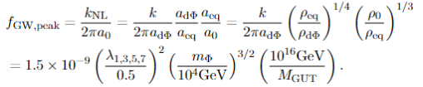
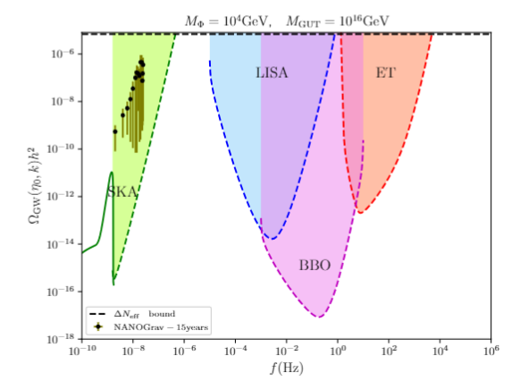
GW signal from an eMD era in flipped SU(5)
This time, instead of the PBH, the eMD is induced by the flaton field, a field responsible for the GUT phase transition (eg [Ellis, Garcia, Nagata, Nanopoulos, Olive, JCAP, 2019])
Again, the transition from eMD to lRD is sudden there is the same resonant amplification, with frequency:

Slide 26


Bii) Further application
A prolonged reheating which induces an eMD also occurs in string – inspired Axion- Chern- Simmons – running- vacuum cosmology [ C. Tzerefos, T. Papanikolaou, S. Basilakos , E.N. Saridakis, N.E. Mavromatos PRD, 2025].
Depending on the parameters, the reheating period can be prolonged and is driven by the (sudden) decay of the axion field a(x).

Slide 27






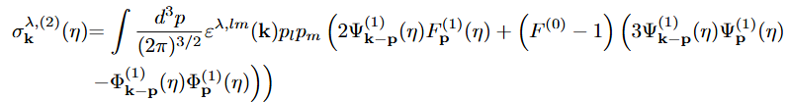

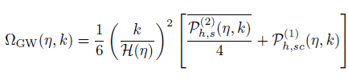



SIGWs in $f(R)$
Extra polarization: Scalaron
GR
For this model, so the SIGW is GR

Slide 28
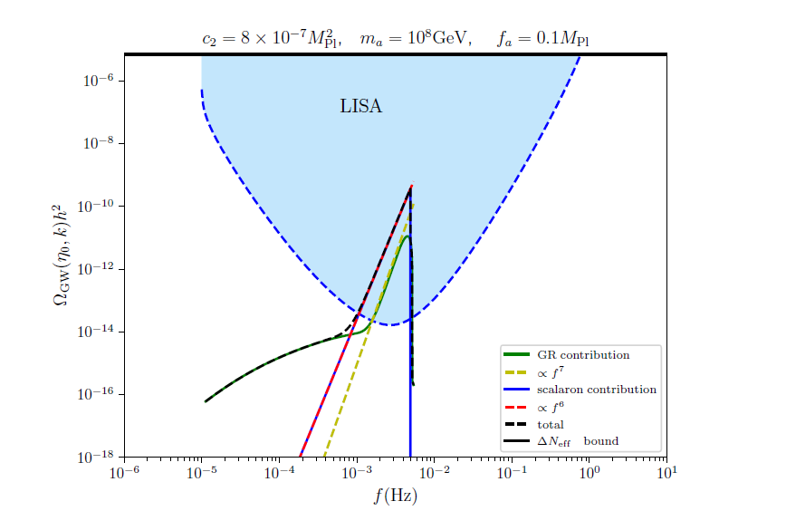
Choices for dominant Scalaron signal
Characteristic signal for any f(R) with

Slide 29
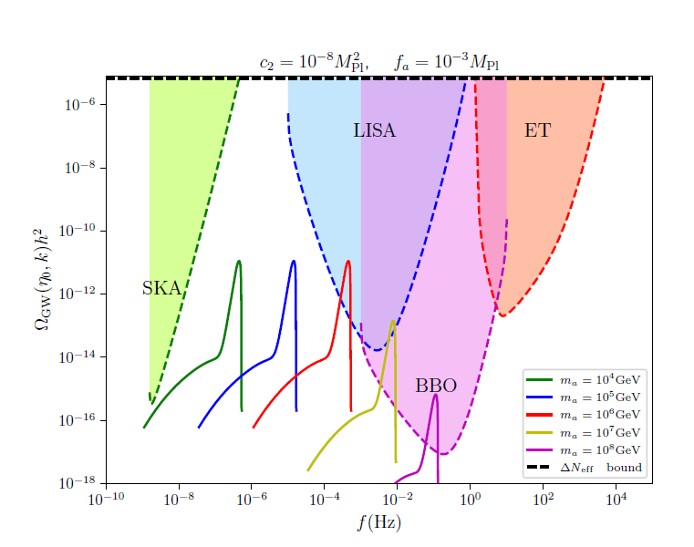
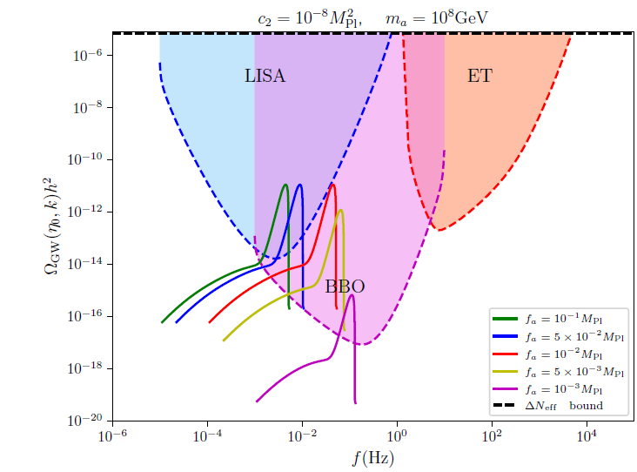

Parameter combinations of comparable $Ω_{res}$and $Ω_{scal}$in aCSRVM

Slide 30
Conclusions
We studied SIGWs in various contexts, mainly: eMD to lRD transitions and those coming from PBH themselves.
We ve also worked to extend the usual GR formulation of SIGW and calculated them in f(R) gravity, thus allowing direct gravitational theory probing.
In the cosmological models we studied, we uncovered interesting phenomenology which is potentially detectable by future observations.
We also argued that even current observations can be explained by this portal, most notably the NANOgrav signal by this no-scale construction.
In general, by harnessing this phenomenology we can learn new cosmological aspects as well as investigate the gravitational theory directly.
Τhank you!

Slide 31
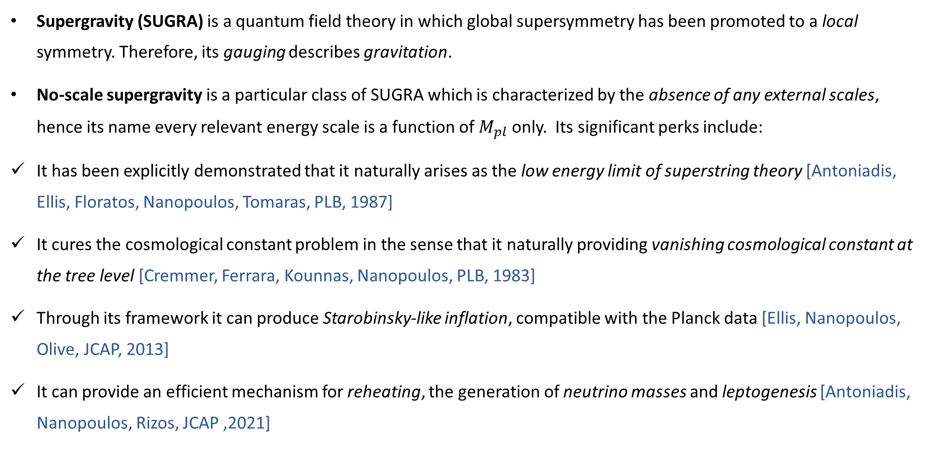
Theoretical introduction for no- scale SUGRA
Supergravity (SUGRA) is a quantum field theory in which global supersymmetry has been promoted to a local symmetry. Therefore, its gauging describes gravitation.
No-scale supergravity is a particular class of SUGRA which is characterized by the absence of any external scales, hence its name every relevant energy scale is a function of $M_{pl}$ only. Its significant perks include:
It has been explicitly demonstrated that it naturally arises as the low energy limit of superstring theory [Antoniadis, Ellis, Floratos, Nanopoulos, Tomaras, PLB, 1987]
It cures the cosmological constant problem in the sense that it naturally providing vanishing cosmological constant at the tree level [Cremmer, Ferrara, Kounnas, Nanopoulos, PLB, 1983]
Through its framework it can produce Starobinsky-like inflation, compatible with the Planck data [Ellis, Nanopoulos, Olive, JCAP, 2013]
It can provide an efficient mechanism for reheating, the generation of neutrino masses and leptogenesis [Antoniadis, Nanopoulos, Rizos, JCAP ,2021]

Slide 32

EXTRA application
We assumed the existence of a similar gas of PBHs and parametrizing via its $Ω_{PBH,f}$and $m_{PBH}$ and studied these SIGWs in the framework of $f(R)$ gravity, with Starobinski $f\left(R\right)=R+R^{2}/6M^2$ as a case study
[T. Papanikolaou, C. Tzerefos, S. Basilakos, E.N. Saridakis, JCAP, 2022]

Slide 33
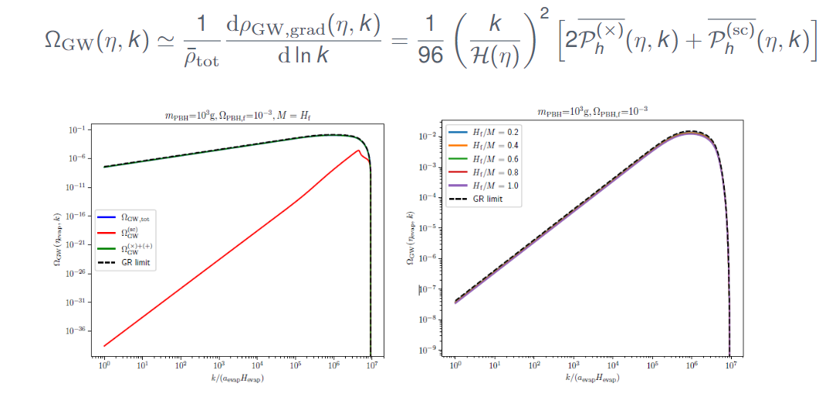
SIGWs in Starobinski

Slide 34
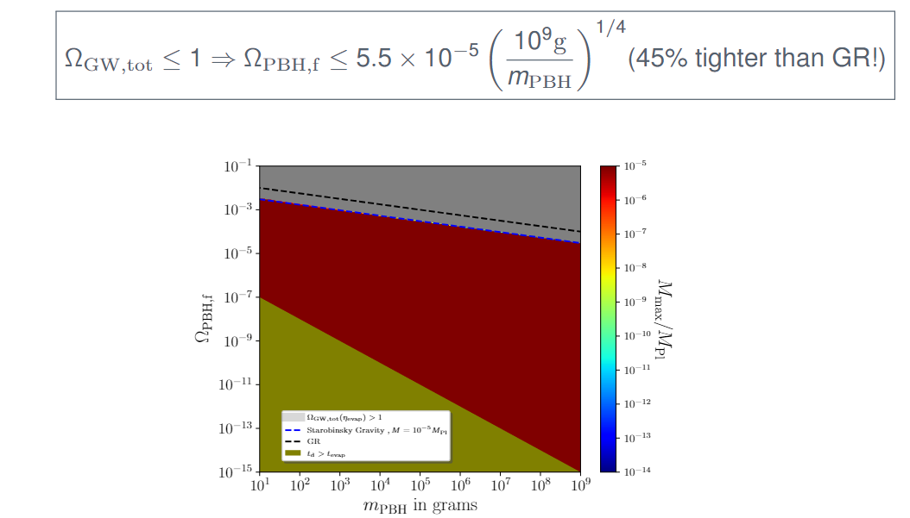
SIGWs in Starobinski

Slide 35
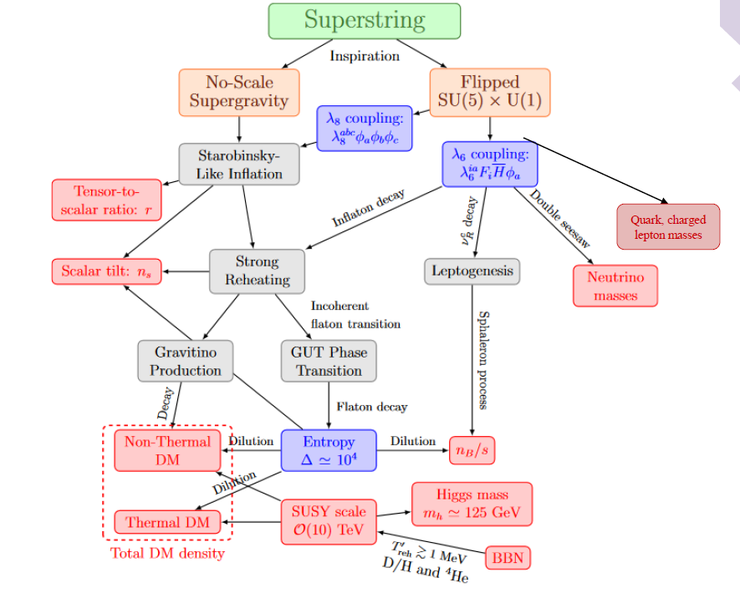
Appendix: SU(5) flipped outline

