Slide 1



Emission Of Gravitational Waves From A
Radially Infalling Star in a Schwarzschild
Black Hole Using the LSZ Formalism
This presentation was made possible with the support of the ASPACE-Q Team and PRODEXRoLISASpace
Student: George Cristache ^{1,2}
Supervisors: Prof. Dr. Virgil Băran ²
CS II Dr. Laurențiu Caramete¹
CS III Dr. Ana Caramete¹
Affiliations: ¹⁾ Institute of Space Science, INFLPR Subsidiary
²⁾ Faculty of Physics, Bucharest University

Slide 2
STRUCTURE
The alternative: Exchange gravitons
Memory effects; Wilson Lines
Scattering and probability amplitude
Coherent States
Notes:
SCRIPT

Slide 3
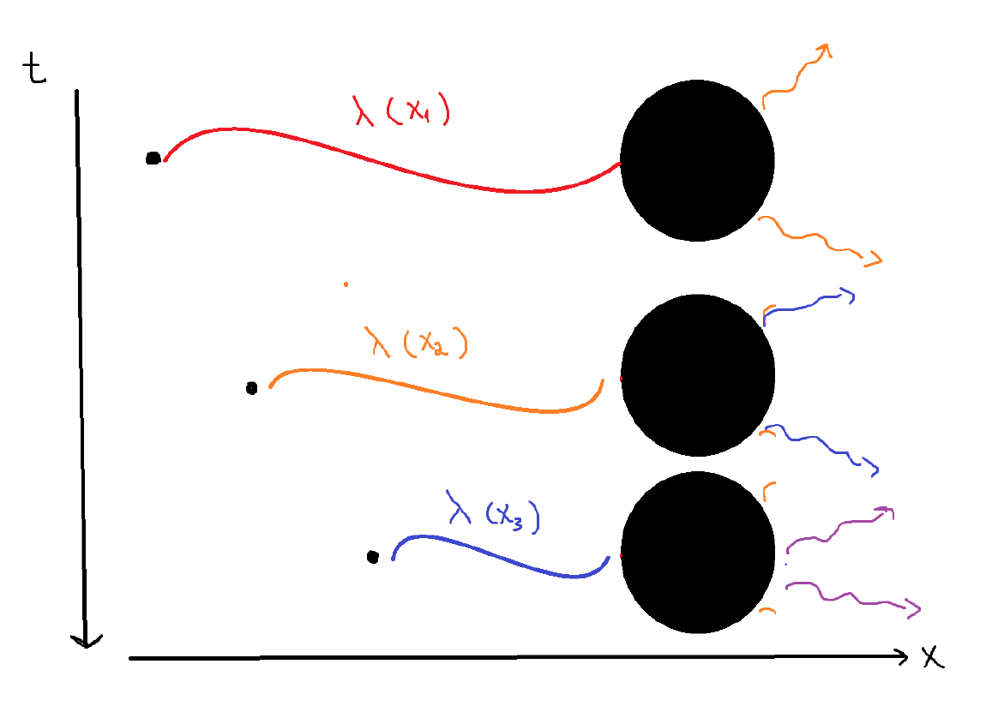
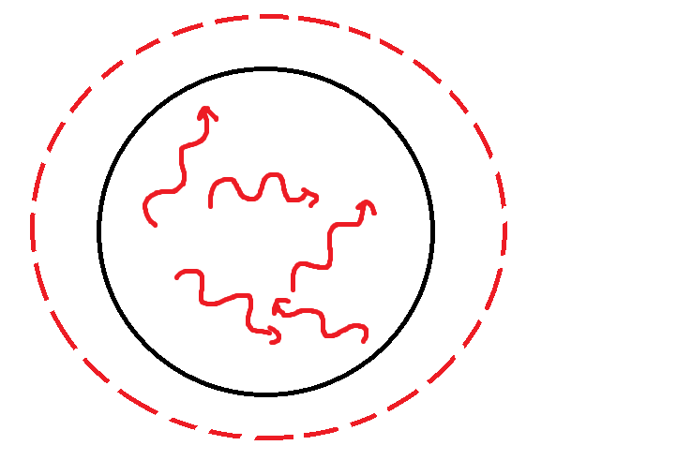




Exchange Gravitons
Auxiliary current
T.Rug, 2015

Slide 4



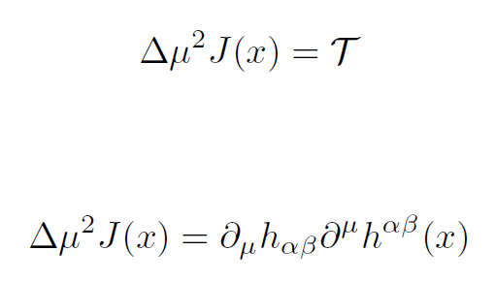
Scattering E.F.E*
Source term
Equation of motion for the bound state
Effective mass shift
Take spatial average and integrate by parts

Slide 5



Integration by parts shifts the derivative
Equation not invertible; contract on both sides (Operator-Valued Distributions)

Slide 6
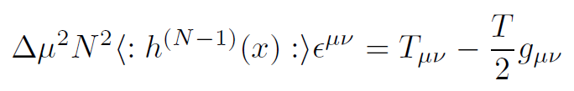
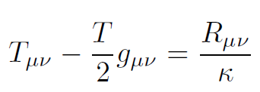

Use E.F.E.
Polarization
tensor
Ricci Tensor
Graviton Condensate

Slide 7
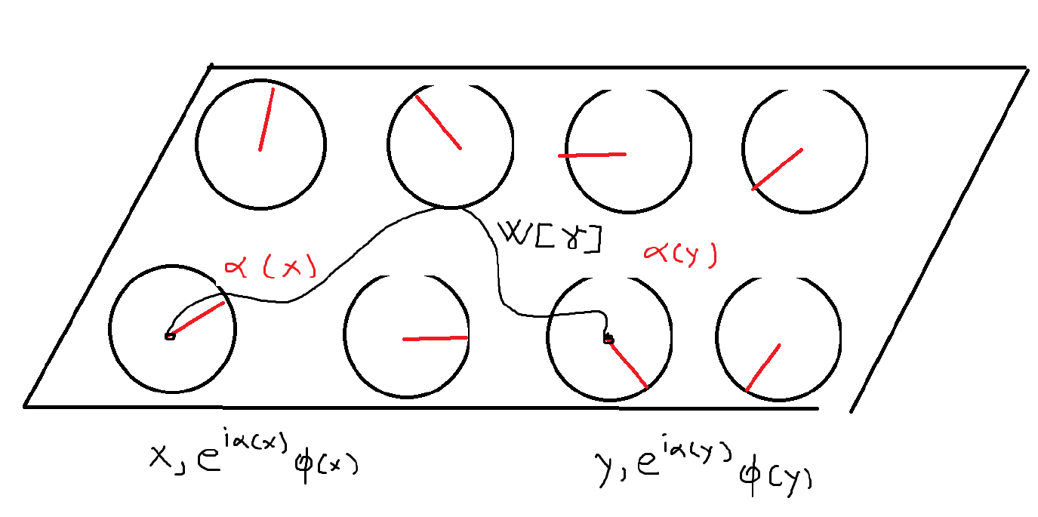
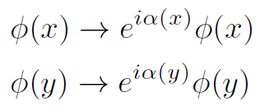
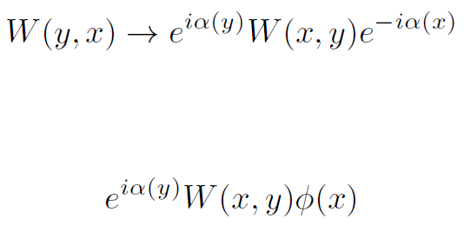
Wilson Lines and Currents
Local gauge transformation
Schematic representation of a U(1) fiber bundle section. Each spacetime point is paired with a group element (phase)
Seek an object which transports the field such that it preserves the symmetry
Schwartz,2014

Slide 8

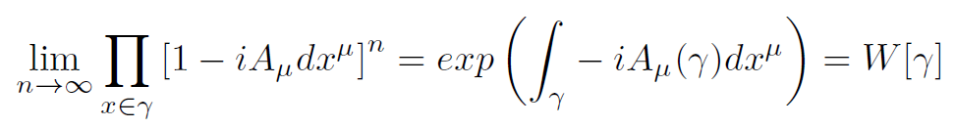
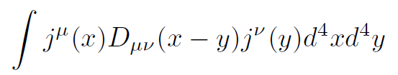

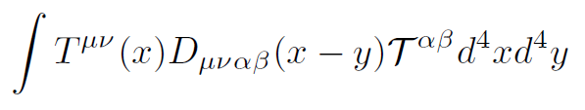

The connection
Assume W has a Taylor expansion for neighbouring tangent spaces

Slide 9
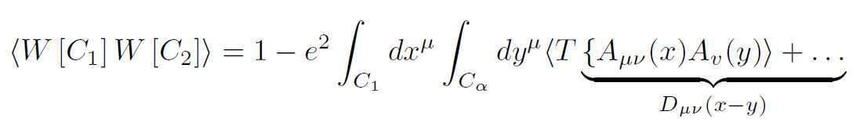
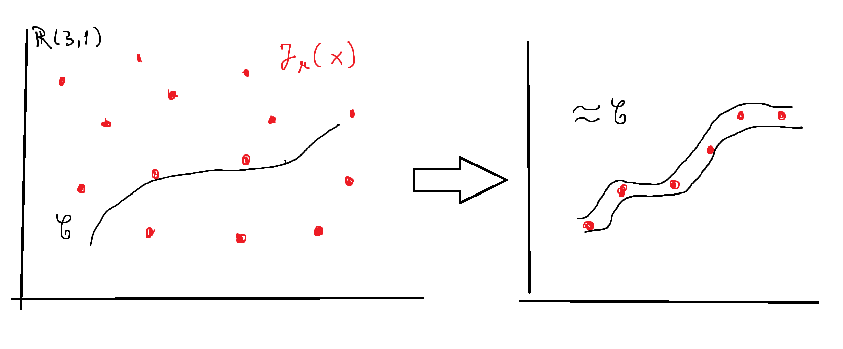

By contracting two Wilson Lines we get the propagator
For a localized current the volume integral collapses to a line integral
Heavy currents acquire a phase due to interactions with the soft background

Slide 10

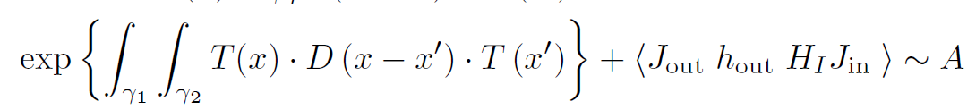
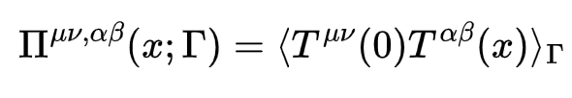
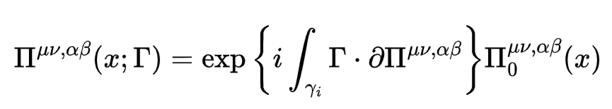
RESULTS
The Scattering Amplitude
Probability for a single graviton exchange
Total Probability
Probability of Black Hole excitation
Probability for multiple exchanges
Propagator to first order approximation
Current acquires a phase due to the background gravitons

Slide 11
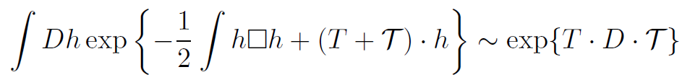
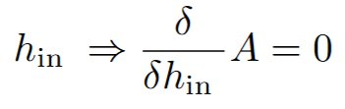
RESULTS (cont’d)
Effective action approach
Main idea: the scattered gravitons which travel to the detector are the ones with maximum probability of emission w.r.t. the input field

Slide 12
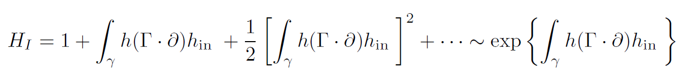
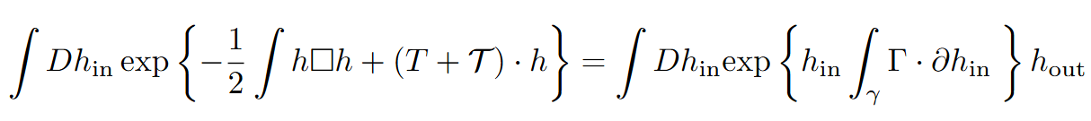
The interaction Hamiltonian
Extremize
How to interpret ?
Amplitude of the emitted GW; take the limit as h approaches the mass shell

Slide 13

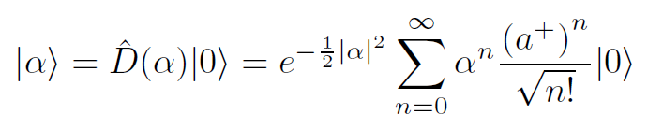
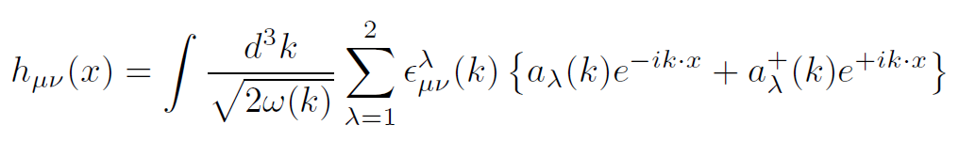
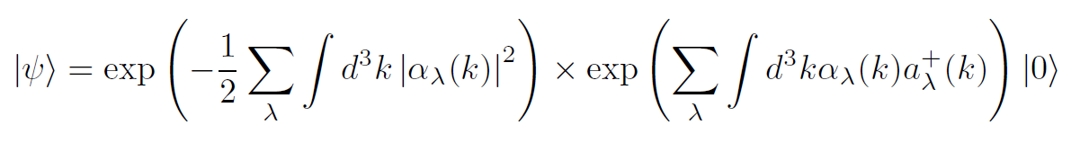
Coherent States
Definition of coherent states; complex eigenvalues
Ali Ramadhan, 2020
Generating coherent states as an exponential of Fock states
Generalize to fields; infinite collection of S.H.O.’s
Simultaneous eigenstate of every annihilation operator of momentum k and polarization lambda
Normalization factor

Slide 14
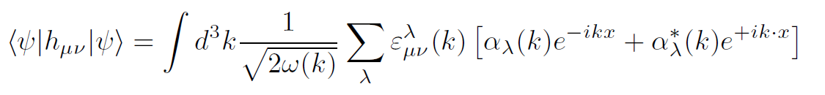

Classical field
Amplitude
Propagating the result to null infinity using the retarded Green’s Function we find a result similar to (3.9) from Maggiore:
Modulo the phases acquired by the currents and a nonlocal term

Slide 15
Conclusions and Future Work
Possible extra-polarizations of gravitons
Black-Hole decay via coherent states; gravitational waves
The background contributes to memory effects
Rigurous proof for Graviton Condensates
Series expansion and collective effects of constituent gravitons
Mass-shift term via Bethe-Salpeter equation
Further investigation of possible scalar modes; Horndeski Theory
Memory terms and connection with Post-Newtonian-Expansion
Thermodynamic-Ensamble aspects and extension to other types of binaries/orbits; direct interraction with matter and Information Paradox

Slide 16
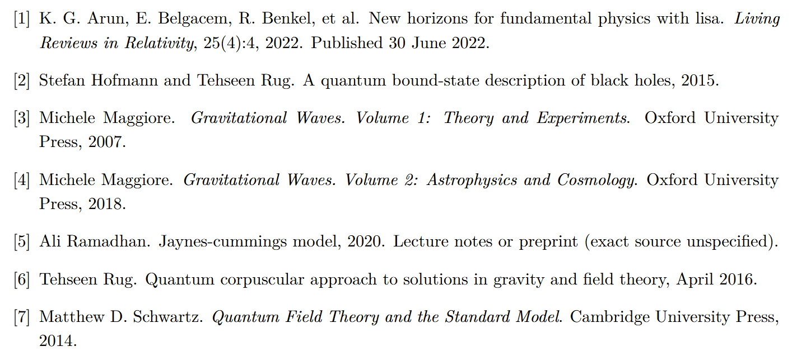
Bibliography

Slide 17
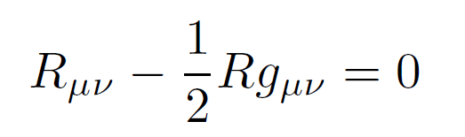
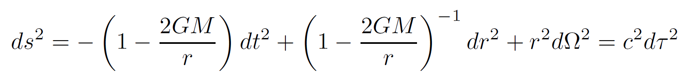
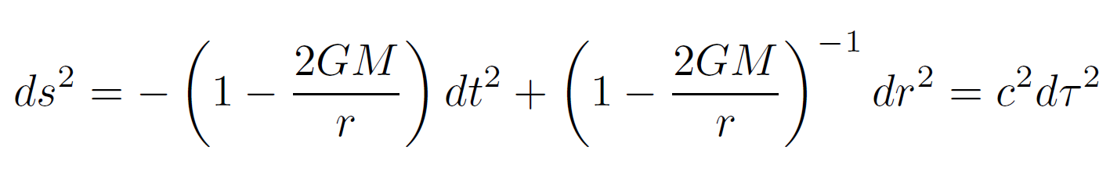
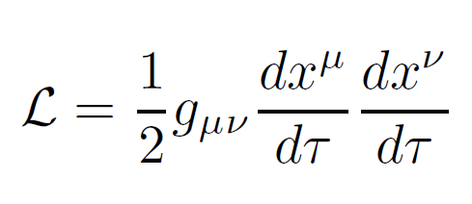
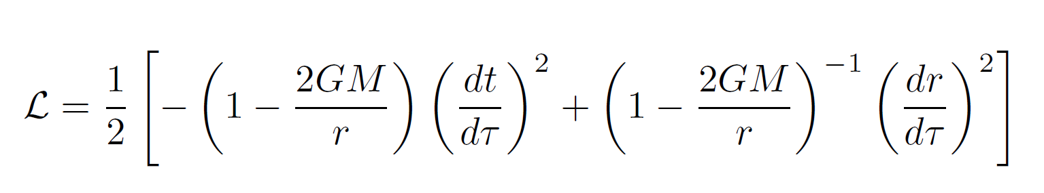
Radial infall; Schwarzschild BH

Slide 18
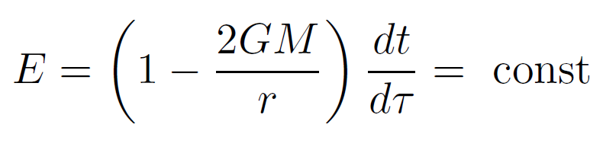
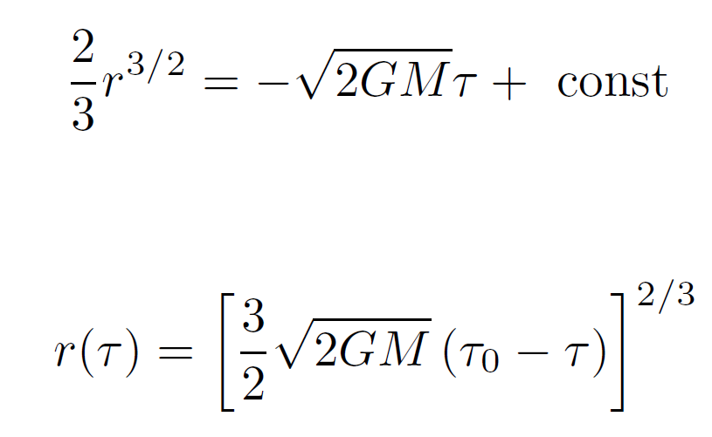
Constant of motion
E.O.M.

