Slide 1
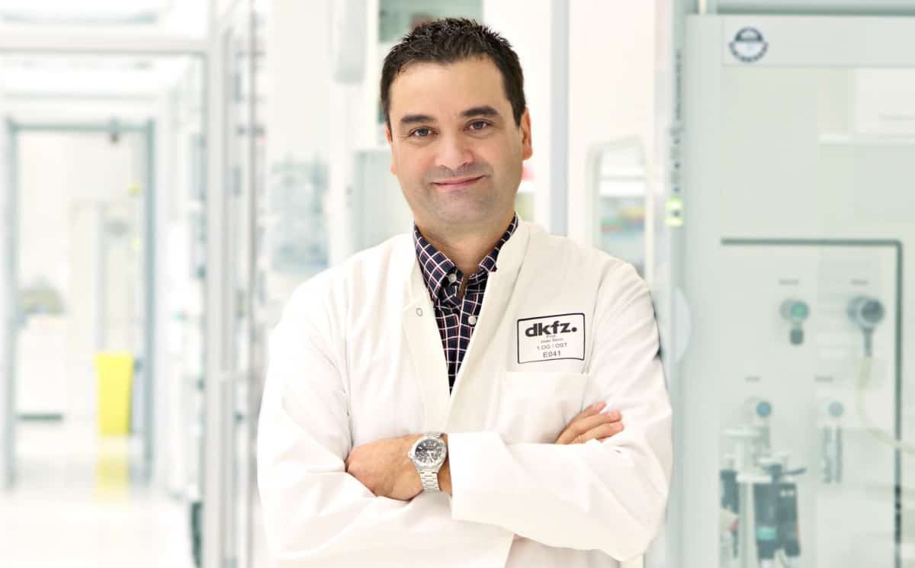
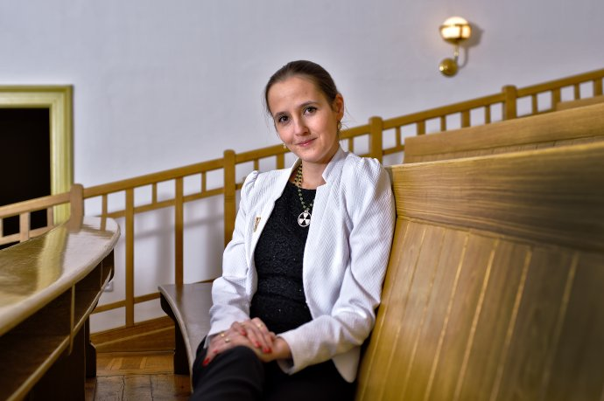
Radiation Biology and Radiopharmaceutical
Research at the DKFZ
Joao Seco, Martina Benešová-Schäfer
DKFZ, German Cancer Research Center, Heidelberg Germany
Kick-off meeting
3-4 April 2025
Thessaloniki, Greece

Slide 2
Brief Introduction: DKFZ, German Cancer Research Center

Slide 3
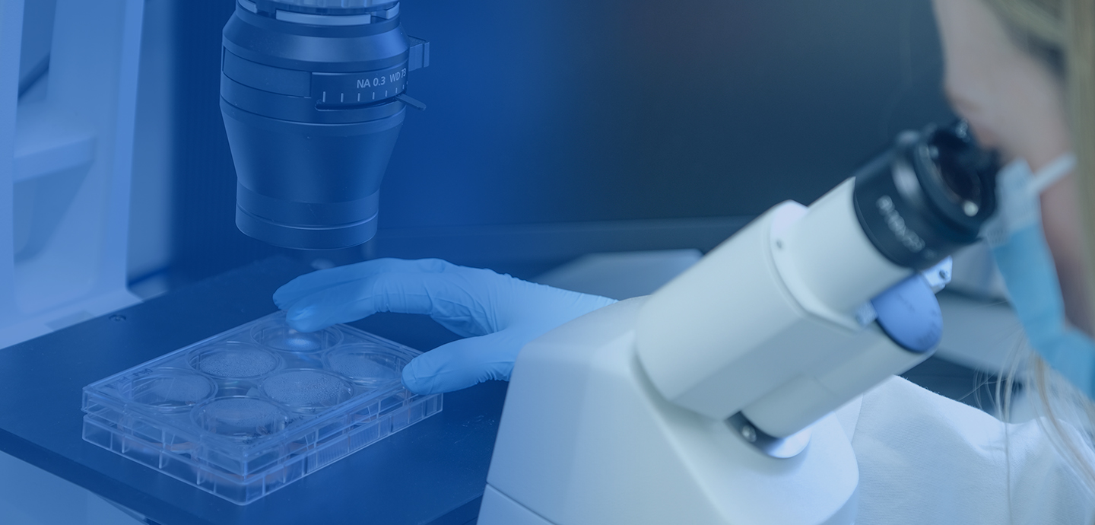
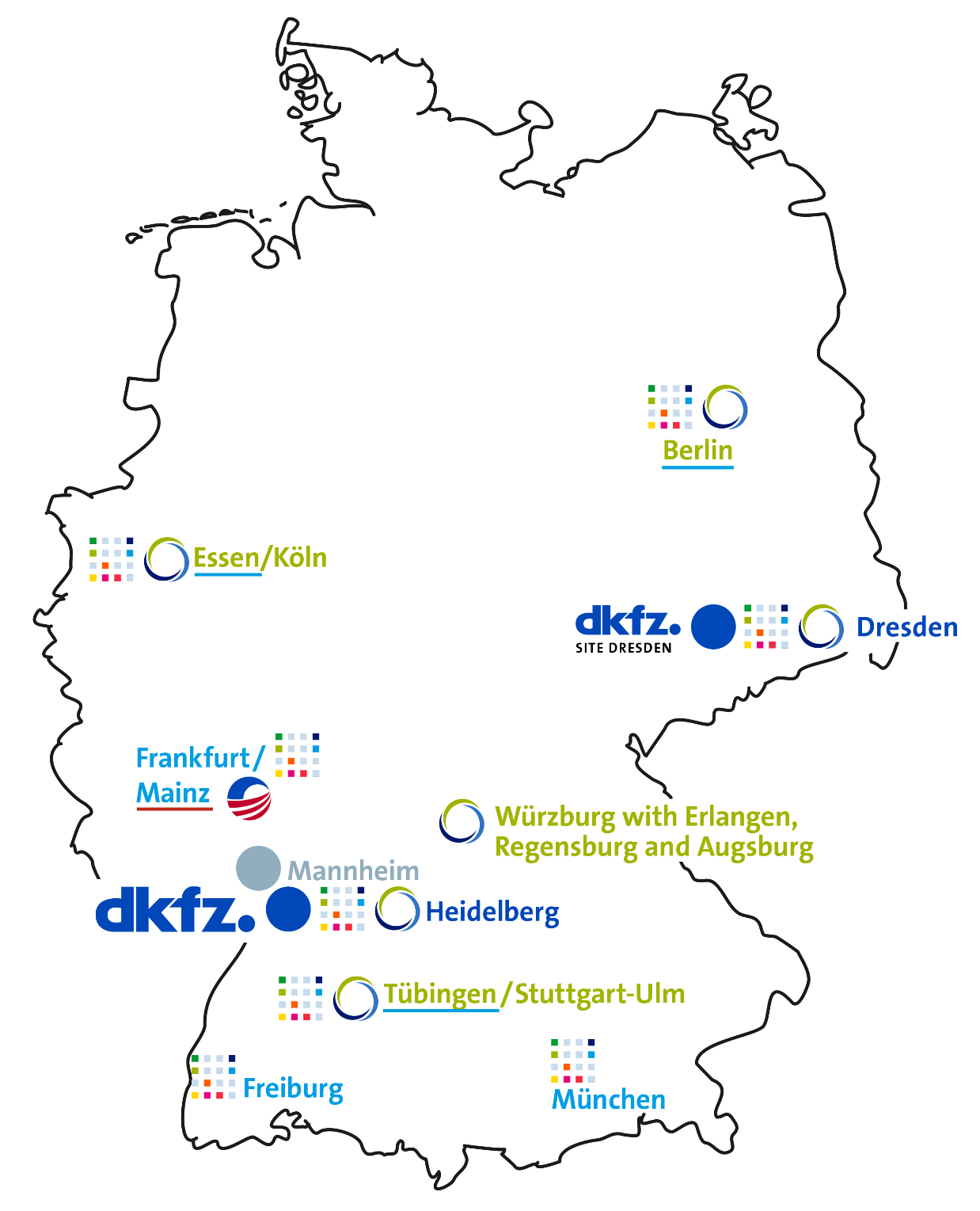
Seco/Benešová-Schäfer
DKFZ Key Facts
3,500 employees
1,500 scientists (>800 internationals, >80 nations)
600 PhD students, 400 postdocs
Largest Cancer Research Center in Europe
Translational centers with UMCs
8 DKTK sites (11 UMCs)
6 NCT sites (11 UMCs)
Top position in Germany and internationally
2 Nobel laureates
55 ERC Grants
2,500 Publications
Nature Index: 5
www.dkfz.de
Notes:
Some basics about DKFZ

Slide 4
DKFZ Interactions with other WPs
T4.4 Leader. Collaborating within: WP4 UL, Biokosmos, GNP
T2.3 Secondments and good practices exchange (DKFZ, GSI, others)
T6.2 Master Classes in Particle Therapy (M7-M48) [Leader: GSI]
Additional Training possible via

Slide 5
Training Component –
I'm currently the Chair of ESMPE European School of Medical Physics Experts (ESMPE)
https://smrd2025.efomp.org/

Slide 6
Research Topics at the DKFZ

Slide 7
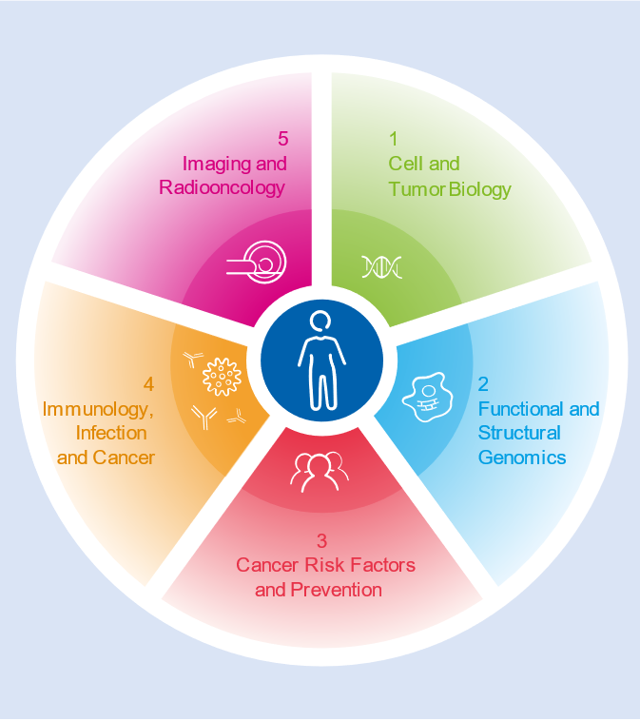
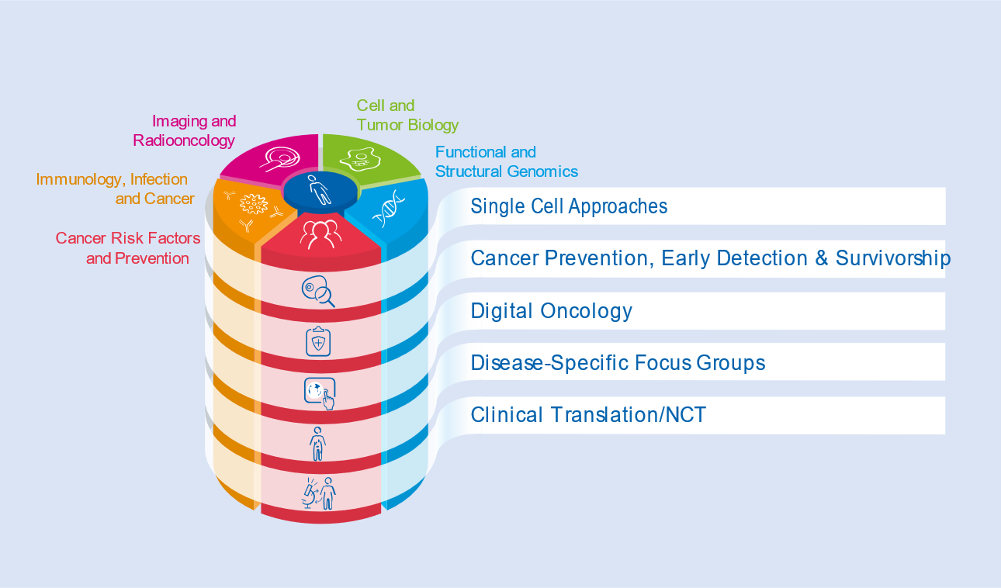
Seco/Benešová-Schäfer
DKFZ Science
www.dkfz.de

Slide 8
Expertise in Radiation Biology and Single Cell Analysis of Radiation Effects
Seco Lab

Slide 9
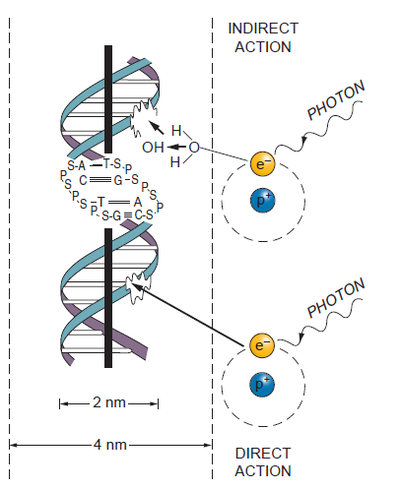
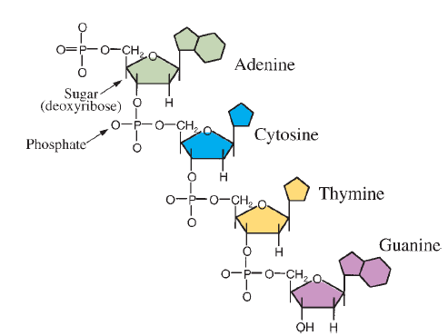

Slide 10
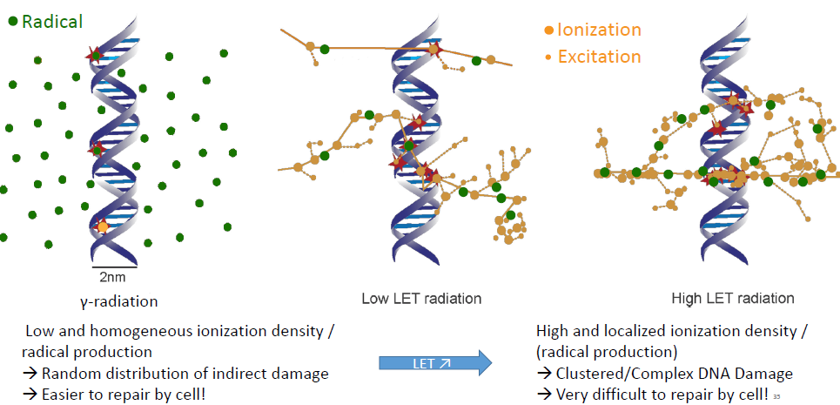

Slide 11
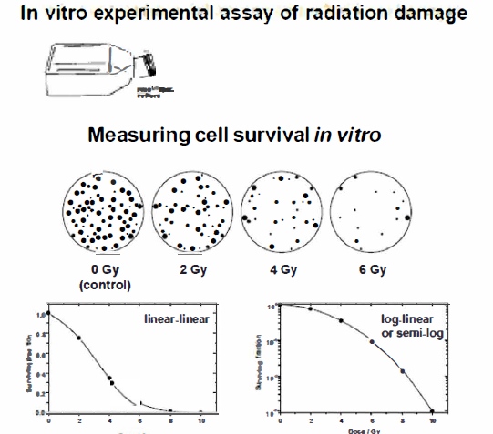
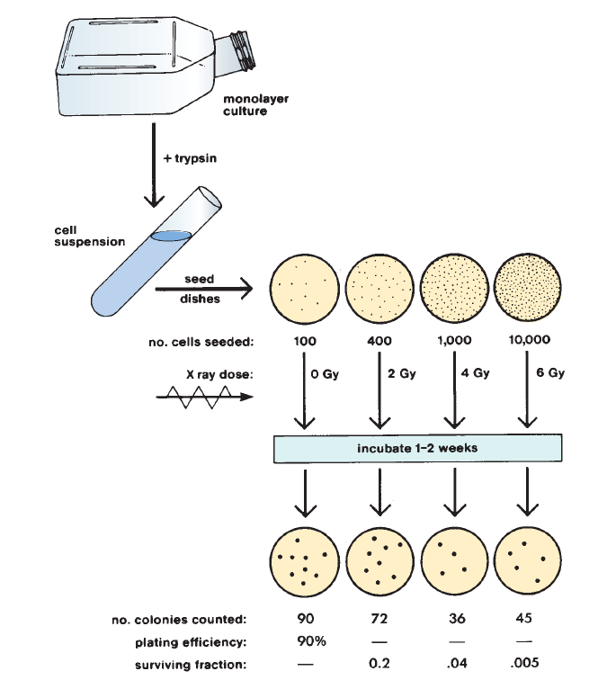
Cell Survival Curves

Slide 12
Single Cell Analysis of Radiation Effects

Slide 13
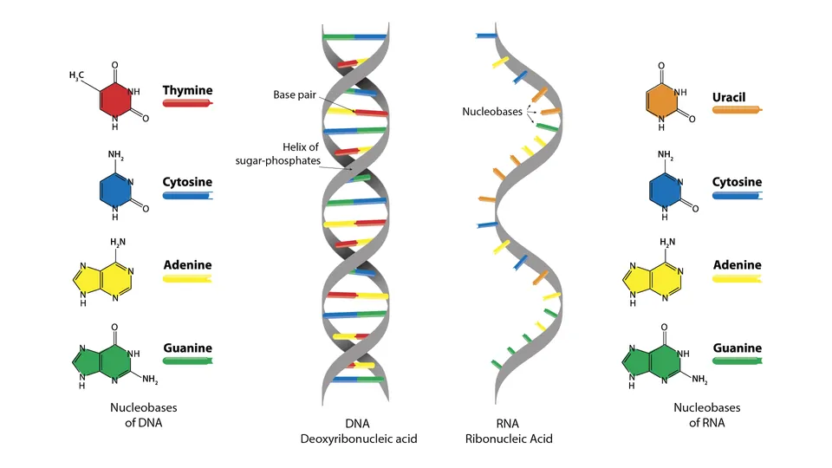
What is RNA Sequencing???
DNA
RNA
To understand the order/ structure of the molecule
DNA/RNA sequencing is the process of determining the nucleotide order of a given fragment.
Nowadays, these techniques are developed to determine ALL the DNA or RNA content of a cell (big data; -omics; high-throughput analyses)
Figure: Structure of DNA and RNA molecule, linear molecules
Ref: https://assets.technologynetworks.com/production/dynamic/images/content/296719/what-are-the-key-differences-between-dna-and-rna-296719-960x540.webp?cb=13068678
03/04/2025 | Page 1/20

Slide 14
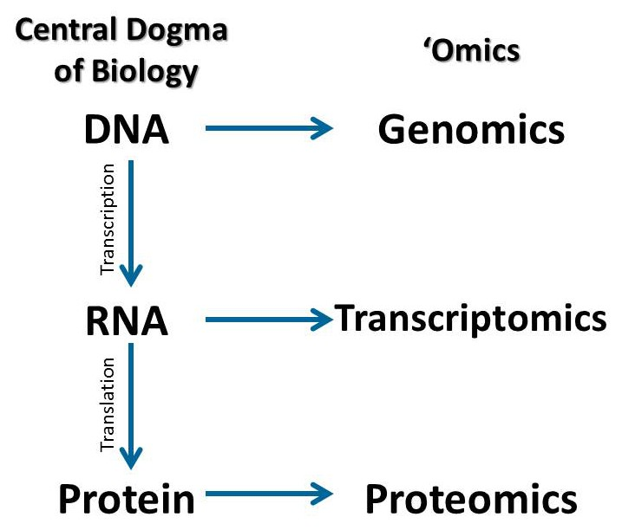
Trip back to Biology Lessons in School!
Every individual has a unique genome, the sequence of base pairs that code all of the genetic information.
DNA –> storage of genetic information
RNA -> used for understanding mechanisms taking place within cells and their interaction with the environment.
Proteins -> used for functional execution
Figure: The connection between the Central Dogma of Biology and the type of ‘Omics data obtained from each molecule.
Ref: https://wildlifesnpits.wordpress.com/wp-content/uploads/2015/11/centraldogma2-e1447797497421.jpg?w=388
03/04/2025 | Page 2/20

Slide 15
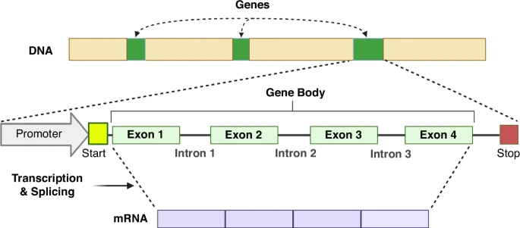
Reasons to study RNA sequencing…
A really helpful aspect of transcriptomics is that they are smaller than genomes. Genomes contain “junk DNA,” introns in genes, and structural repetitive regions such as centromeres and telomeres which are not transcribed, thus they are not sequenced in transcriptomics projects.
Transcriptomes are tissue specific so a researcher also reduces the amount of data because they are only sequencing one tissue and the genes expressed in that tissue (e.g. leaves, liver, blood, etc).
The whole RNA content of the cell (transcriptome) contains all the information that the cell needs to execute its function under specific conditions. As such, it offers insights on gene regulation, disease states, and cellular responses.
RNAseq of an irradiated cell reflects all the active gene changes in response to the features of the irradiation (e.g. type, dose, time after treatment).
Figure: Retention of genetic material after transcription
Ref: https://media.springernature.com/lw685/springer-static/image/art%3A10.1038%2Fs41390-024-03674-7/MediaObjects/41390_2024_3674_Fig2_HTML.png?as=webp
03/04/2025 | Page 3/20

Slide 16
Expertise in Radiopharmaceutical Research
Benešová-Schäfer Lab
Intro to
RadioThera(g)nostics

Slide 17
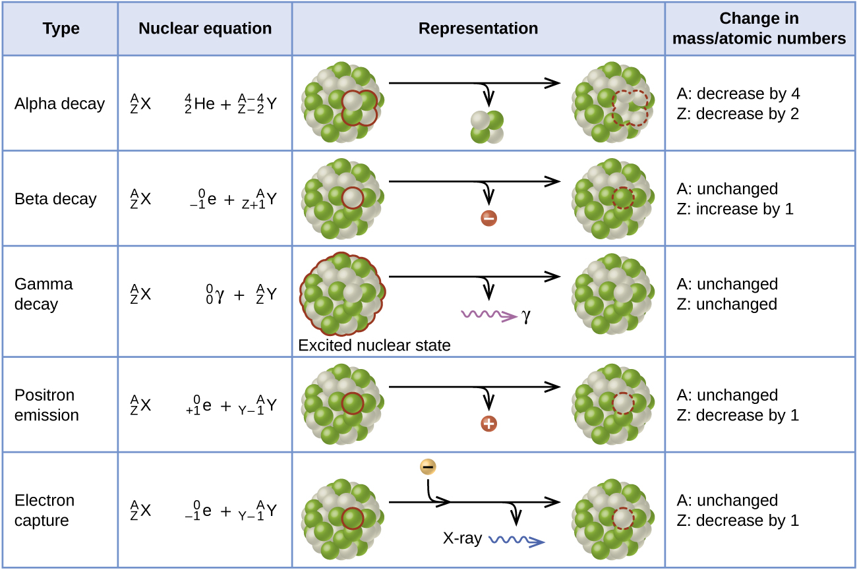
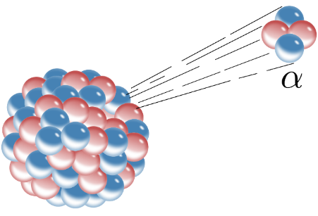
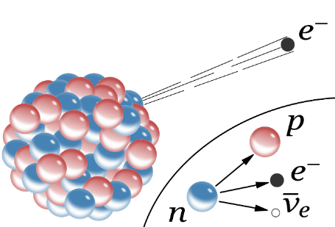
Radioactive Elements
Alpha radiation – helium nuclei
Beta radiation – electrons/positrons
Gamma radiation
Types of radioactive decay
Alpha radiation
β⁻
Beta radiation
[1]
2 protons + 2 neutrons
proton
electron
electron neutrino
[2]
neutron
[3]
[1] Inductiveload (https://commons.wikimedia.org/wiki/File:Alpha_Decay.svg), „Alpha Decay“, marked as public domain, more details on Wikimedia Commons: https://commons.wikimedia.org/wiki/Template:PD-self
[2] Inductiveload (https://commons.wikimedia.org/wiki/File:Beta-minus_Decay.svg), „Beta-minus Decay“, marked as public domain, more details on Wikimedia Commons: https://commons.wikimedia.org/wiki/Template:PD-self
[3] openstax CNX – Radioactive Decay. Accessed from https://cnx.org/contents/IbTLTDQM@1.6:RSq8dk2S@1/Radioactive-Decay on 12.02.2021
Notes:
Alphastrahlung oder α-Strahlung ist eine ionisierende Strahlung, die beim Alphazerfall, einer Art des radioaktiven Zerfalls von Atomkernen, auftritt. Große Atomkerne spucken kleine Atomkerne aus. Radium 226. Die Alpha-Teilchen haben eine ziemlich große Geschwindigkeit: Zwischen 15.000 bis 20.000 Kilometer pro Sekunde! Allerdings besitzt die Strahlung nur eine geringe Reichweite und lässt sich schon durch ein Blatt Papier oder eine dünne Alu-Folie abschirmen.
Betastrahlung oder β-Strahlung ist eine ionisierende Strahlung, die bei einem radioaktiven Zerfall, dem Betazerfall oder Betaübergang, auftritt. Beim Beta-Zerfall werden in der Regel negativ geladene Elektronen aus dem Kern geschleudert. Man spricht dann vom Beta-Minus-Zerfall. (Es gibt auch einen Beta-Plus-Zerfall, doch der ist unter den natürlichen Radionukliden viel seltener.) Die Elektronen, die die Strahlung ausmachen, kommen übrigens nicht aus dem Nichts: Sie entstehen dadurch, dass sich im Atomkern ein Neutron in ein Proton und ein Elektron umwandelt: Cäsium-137 - ein Beta-Minus-Strahler
Atomkerne zerfallen von selbst in andere Kerne.

Slide 18
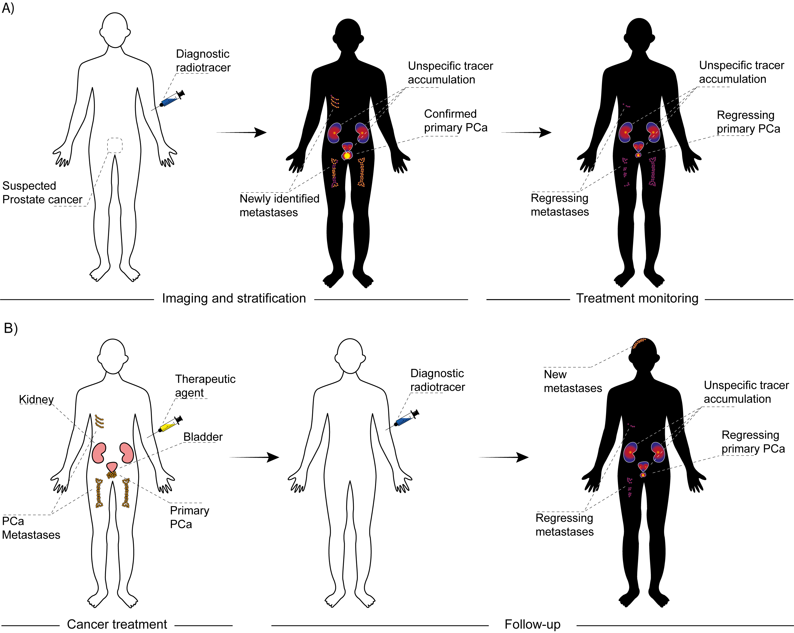
Seco/Benešová-Schäfer
Unique Feature: Radiothera(g)nostic Tandem
RadioThera(g)nostics = RadioTherapy + RadioDiagnostics (therapeuein + gnosis)
„We see what we treat“
„We treat what we see“
Bakos, Roscher, Granados, and Benešová. Nuklearmediziner 2020, 43(04): 275.
Notes:
Theranostics as a way to go for us.

Slide 19
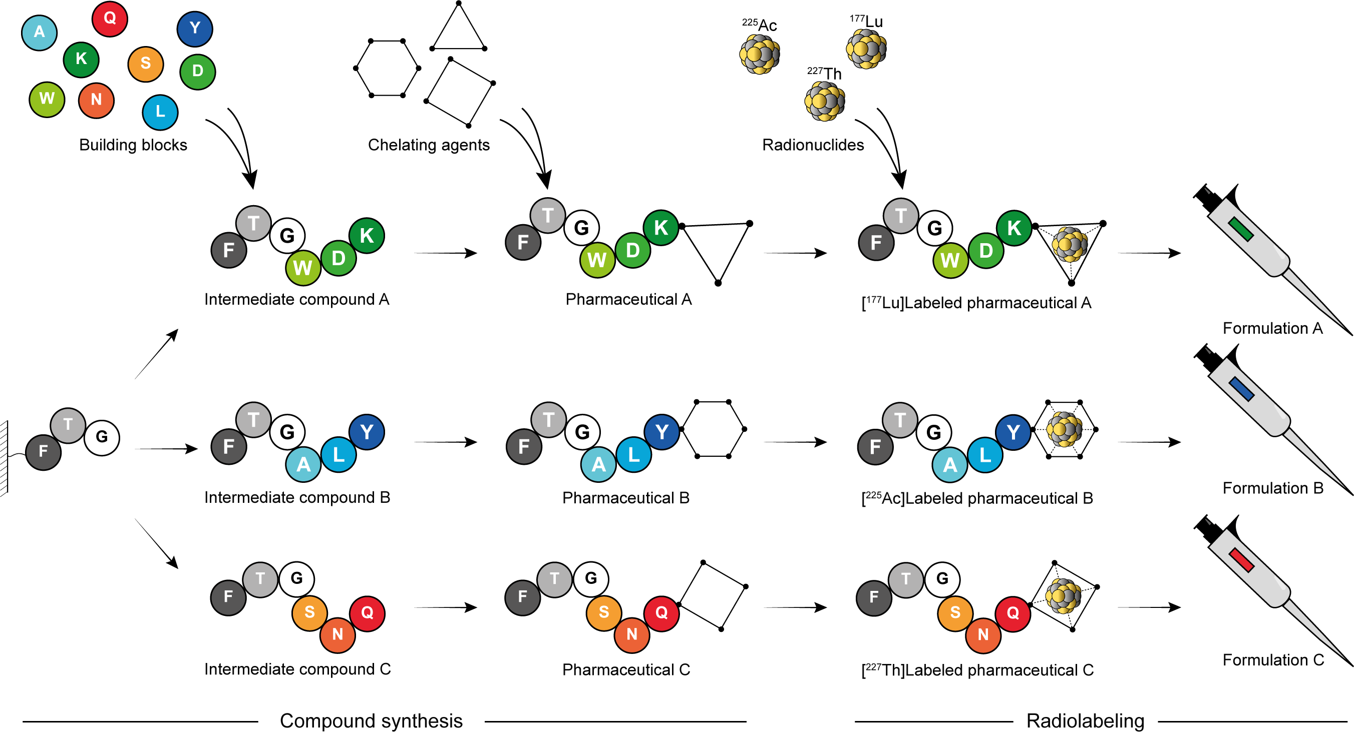
Seco/Benešová-Schäfer
Radiopharmaceuticals‘ Development
Notes:
You can mention that we do the design and synthesis of new ligands.

Slide 20
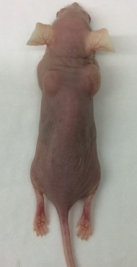
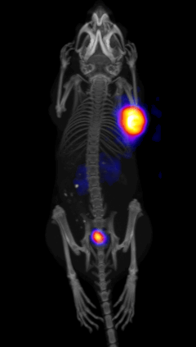
Seco/Benešová-Schäfer
Radiopharmaceuticals‘ Preclinical Evaluation
In Vitro Experiments
In Vivo/Ex Vivo Experiments
Tumor-bearing mice
Tumor
Cancer cells
Radiolytic (in)stability
PET/SPECT Imaging
Binding affinity
Biodistribution
Therapy studies
Biodistribution
Therapy studies
Cell uptake & internalization
Cytotoxicity
Notes:
You can mention that we know how to do in vitro, in vivo and ex vivo.

Slide 21
Seco/Benešová-Schäfer
From Bench to Patient and Back
Two treatment cycles with [²²⁵Ac]Ac-PSMA-617
Radionuclide production and separation
Development of chelating systems
Definition of cancer-specific targets
Identification of target-specific ligands
Synthesis of compounds' library
14 MBq
Radiolabeling and radio-QC
In vitro experiments (cell lines)
In vivo experiments (animals)
Lead structures' optimization
Clinical transfer (first-in-human)
PSA: 1301 ng/mL
PSA: <0.5 ng/mL
Approval & authorization (routine use)
Patient's scans derived from Morgenstern et al, Curr Radiopharm 2018, 11(3): 200–208.
Notes:
We are (were) able to do the full developmental pathway.

Slide 22
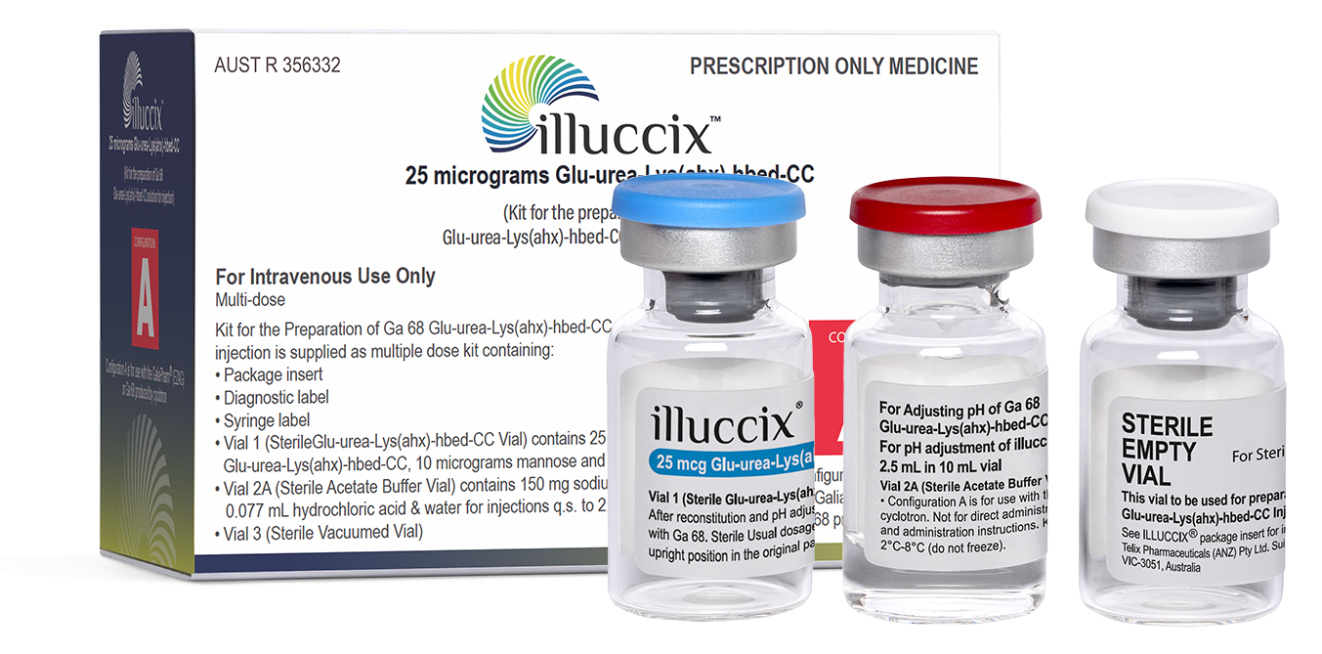
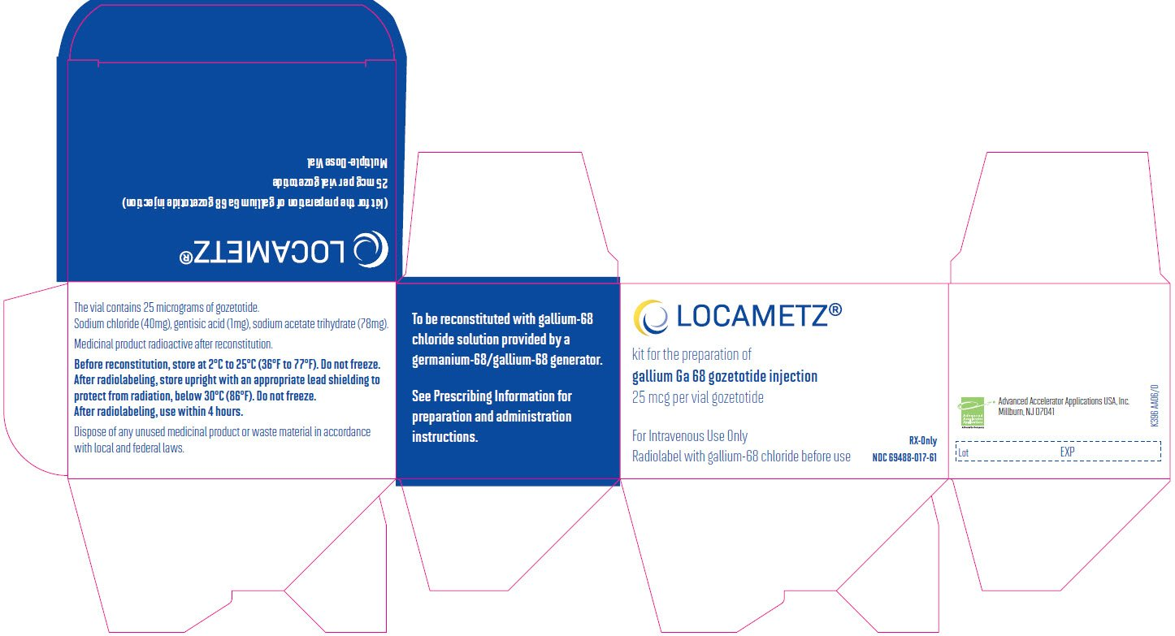
Seco/Benešová-Schäfer
illuccix® & LOCAMETZ®
Diagnostic [⁶⁸Ga]Ga-PSMA-11
[⁶⁸Ga]Ga-PSMA-11
No Advertisement
No Advertisement
Developed in 2010, first-in-human in 2011, non-patented, published in 2012, produced by ABX from 2013
Marketing authorization by Telix Pharmaceuticals (illuccix®), in USA, South America & Australia, 2021
Marketing authorization by Novartis (LOCAMETZ®) in USA, Canada & Europe, 2022
Eder et al, Bioconjugate Chem 2012; 23(4): 688–697; Patient's scan acquired from Afshar-Oromieh et al, EJNMMI 2012, 39(6): 1085–1086.
Notes:
Proved by approved ligands.

Slide 23
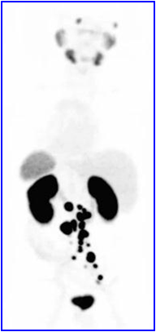
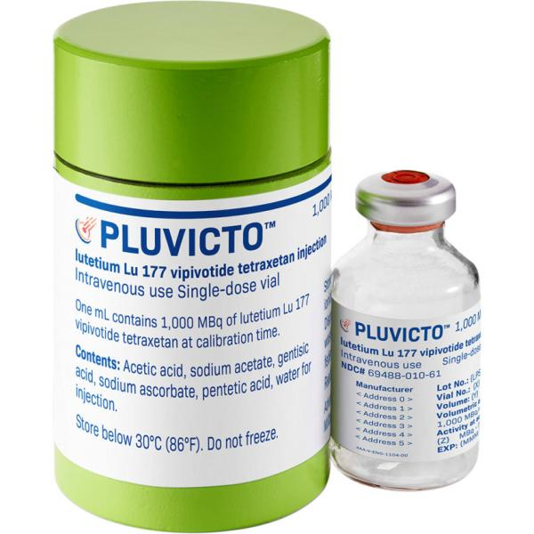
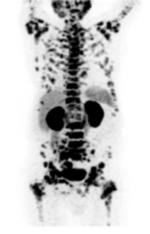
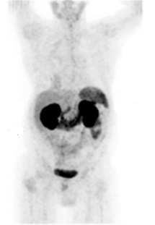
Seco/Benešová-Schäfer
PLUVICTO®
Theranostic ([¹⁷⁷Lu]Lu-)PSMA-617
Diagnostic
[⁶⁸Ga]Ga-PSMA-617
1 h post-injection
Developed at the DKFZ in 2013
First-in-human at the UKHD in 2013
Patented in 2013
Published in 2015
FDA & EMA approval in 2022
Marketing authorization by Novartis (PLUVICTO®) in 2023
Diagnostic
[⁴⁴Sc]Sc-PSMA-617
1 h post-injection
19 h post-injection
Therapeutic
[¹⁷⁷Lu]Lu-PSMA-617
Image of the Year 2015
Single dose
No Advertisement
Therapeutic
[²²⁵Ac]Ac-PSMA-617
Three cycles
Afshar-Oromieh, Hetzheim, Kratochwil, Benešová et al, JNM 2015, 56(11): 1697–1705;
Kratochwil, Giesel, Eder, Afshar-Oromieh, Benešová et al, EJNMMI 2015, 42(6): 987–988; Kratochwil et al, JNM 2016, 57(12): 1941–1944;
Eppard, de la Fuente, Benešová et al, Theranostics 2017, 7(18): 4359–4369.
Notes:
Proved by approved ligands.

Slide 24
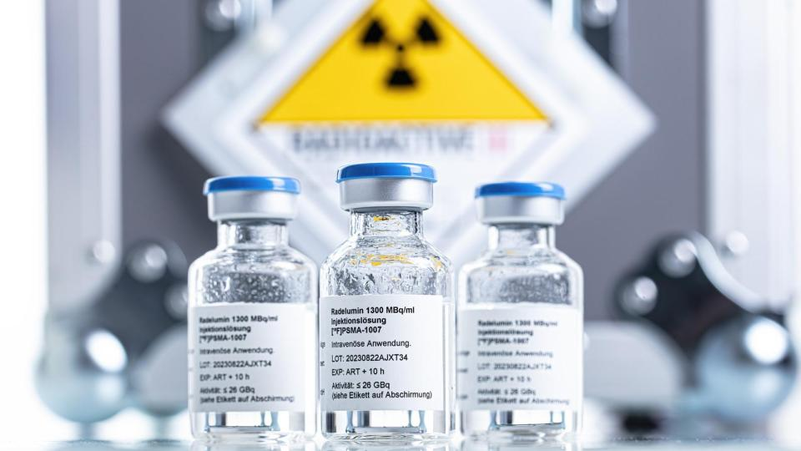
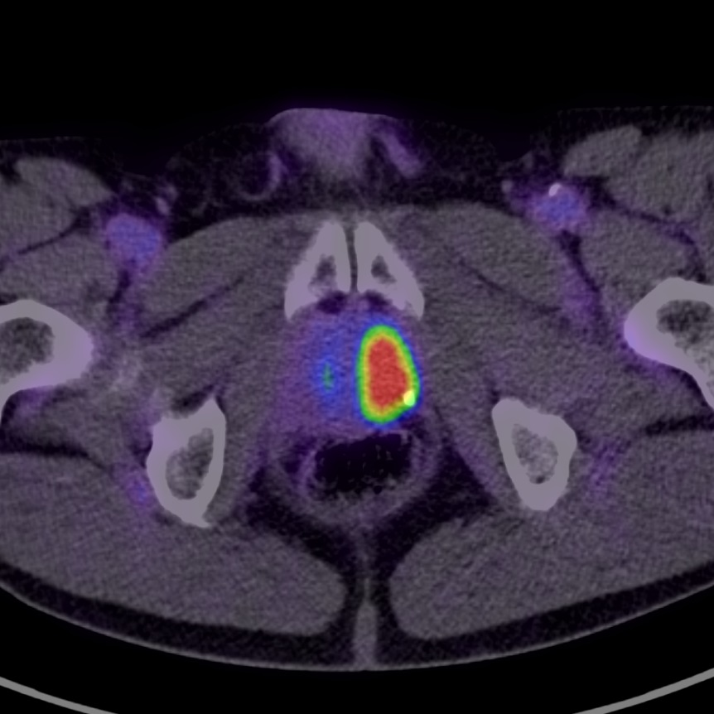
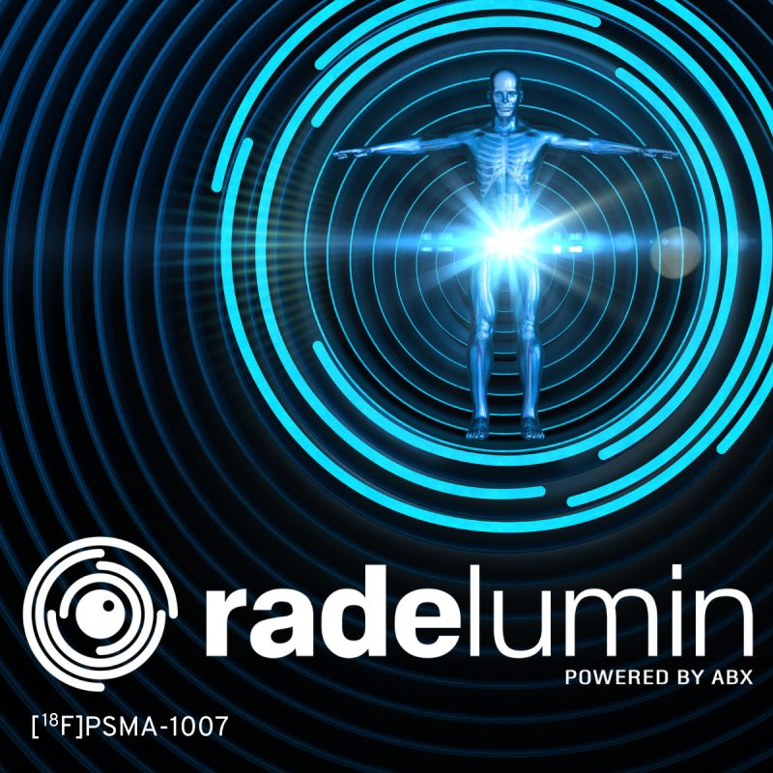
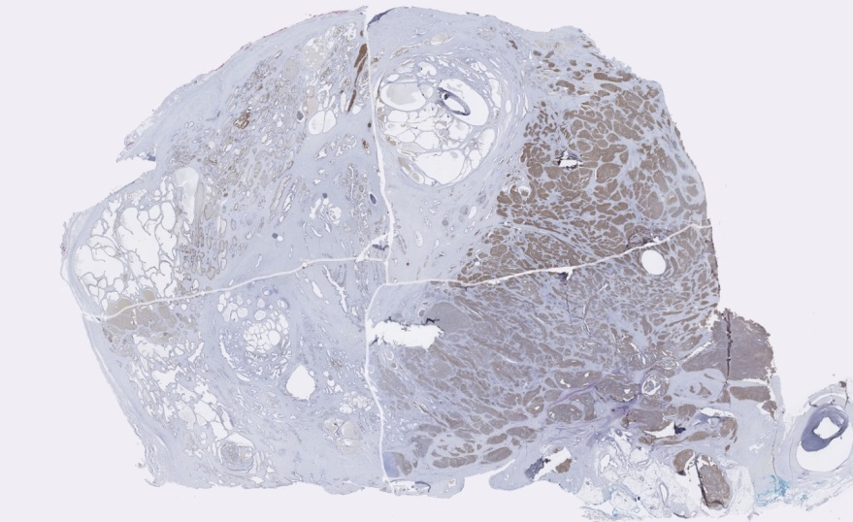
Seco/Benešová-Schäfer
Radelumin®
Diagnostic [¹⁸F]PSMA-1007
PSMA-1007
[¹⁸F]PSMA-1007
No Advertisement
2 h post-injection
Developed in 2015, first-in-human in 2015, patented in 2015, published in 2016
Marketing authorization by ABX (Radelumin®) in AT, BE, F, D, IT, LU, ES & NL, 2022/2023
Patient's scans acquired from Giesel, Cardinale, Schäfer, Neels, Benešová et al, EJNMMI 2016, 54: 1929–1930; Cardinale, Schäfer, Benešová et al, JNM 2017; 58(3): 425–431.
Notes:
Proved by approved ligands.

Slide 25
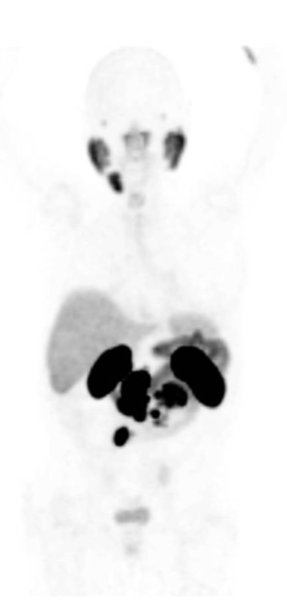
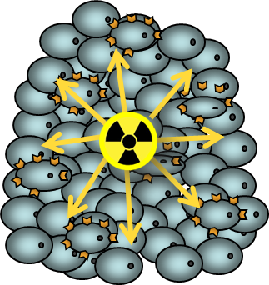
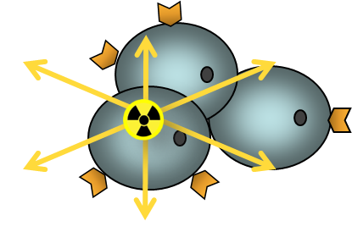
Seco/Benešová-Schäfer
Focus: Personalized Radionuclides
[⁹⁰Y]Y-PSMA-617
[¹⁷⁷Lu]Lu-PSMA-617
[²²⁵Ac]Ac-PSMA-617
Candidate for β-therapy
Candidate for β-therapy
Candidate for α-therapy
Patient´s scans compiled based on Rathke et al, JNM 2019, 60(6): 806–811.
Notes:
We focus on matching the radionuclides for patients, disease art and stage, etc.

Slide 26
Seco/Benešová-Schäfer
Focus: Treatment Resistance and Remission
[¹⁷⁷Lu]Lu-PSMA-617
[²²⁵Ac]Ac-PSMA-617
¹⁷⁷Lu
²²⁵Ac
PSA = 294 ng/mL
PSA = 419 ng/mL
PSA = 4 ng/mL
Resistance
Progression
Partial Remission
Patient´s scans acquired from Kratochwil et al, JNM 2016, 57(12): 1941–1944.
Notes:
We focus on matching on the treatment resistance development and management.

Slide 27
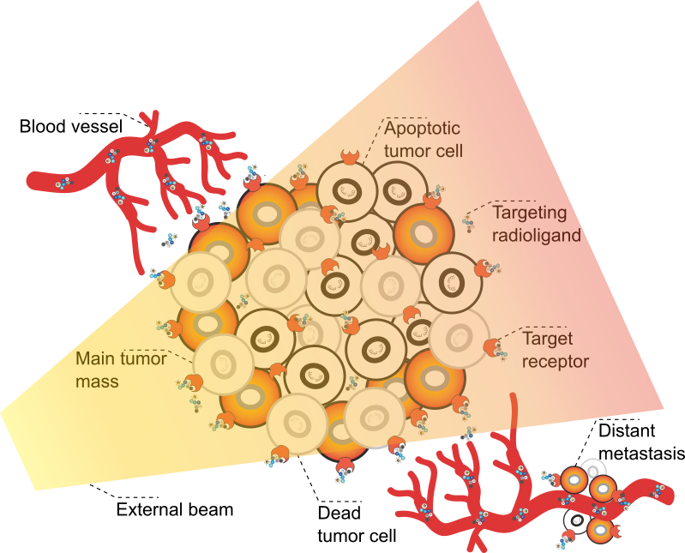
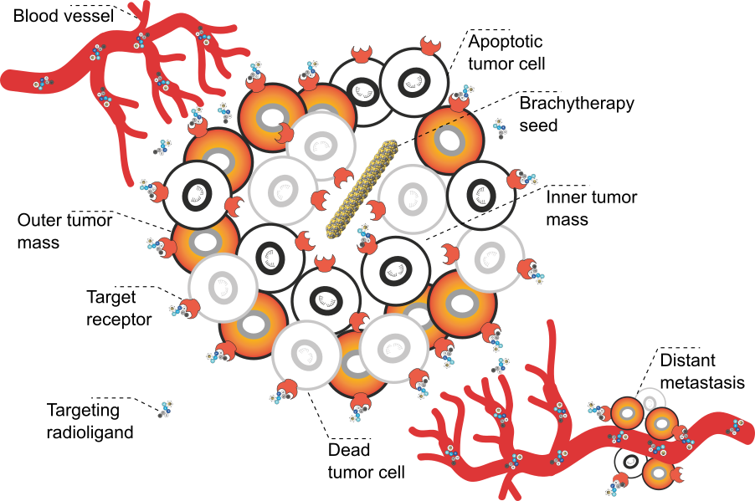
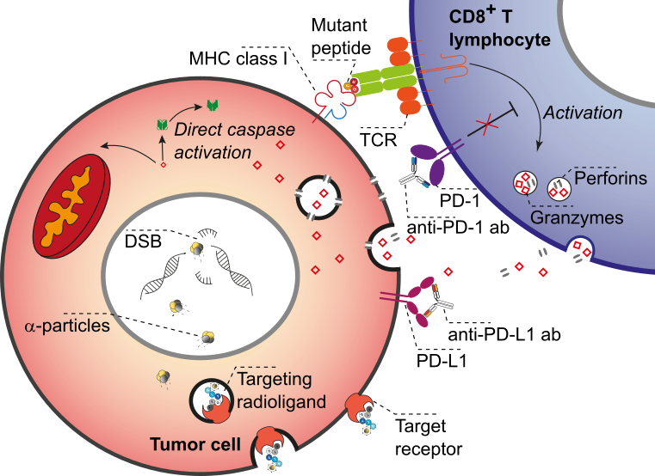
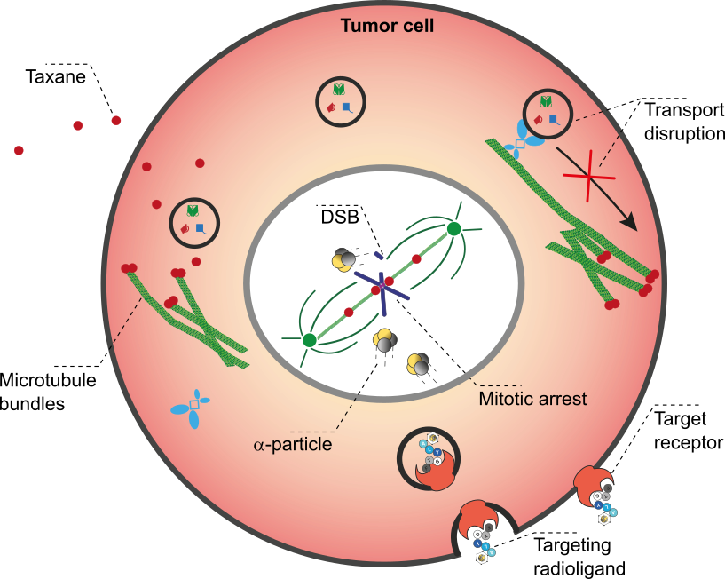
Seco/Benešová-Schäfer
Focus: Combination Therapies
TRNT & External Beam Radiation Therapy
TRNT & Brachytherapy
Local
TRNT & Immunotherapy
TRNT & Chemotherapy
Systemic
Winter, Amghar …. and Benešová-Schäfer. Pharmaceuticals 2024, 17(8): 1031.
Notes:
One way how to improve radionuclide therapies is combination therapy.

Slide 28
Seco/Benešová-Schäfer
Radionuclides & Targets in Pipeline
Diagnostic (PET) | Therapeutic (Beta) | Therapeutic (Alpha) | Theranostic Matched-pairs | Planned/Wished
F-18 | Lu-177 | Ra-223/-224 | Copper | Sc-43/-44/-47
Ga-68 |  | Ac-225 | Lead | Tb-161
Zr-89 |  | Th-227 |  | At-211
Multi-Faceted Molecular Targets in Cancer Research
HER1-4 (BCa/Lung, Ab clinical evaluation) | SMO (PDAC; smols) in development
ER & PR (BCa, smols) in development | GAL-2 (PDAC; peptidomimetics) in vivo
KiSS-1R (TNBC, peptidomimetics & smols) in vivo | RAGE (PDAC; peptidomimetics & smols) in vitro
Nectin-4 (Lung, Ab) clinical evaluation | DOR (Lung; peptidomimetics) in vitro
MUC-1 (BCa, Ab) in development | EpCAM (PCa, BCa; peptidomimetics) in vitro
Notes:
Our nuclides and targets portfolie (beyond PCa and PSMA)

Slide 29
DKFZ Interactions with other WPs
T4.4 Leader. Collaborating within: WP4 UL, Biokosmos, GNP
T2.3 Secondments and good practices exchange (DKFZ, GSI, others)
T6.2 Master Classes in Particle Therapy (M7-M48) [Leader: GSI]
Additional Training possible via

Slide 30
Training Component –
I'm currently the Chair of ESMPE European School of Medical Physics Experts (ESMPE)
https://smrd2025.efomp.org/

Slide 31
QUESTIONS ???

Slide 33
Brief Introduction: Joao Seco and Martina Benešová-Schäfer

Slide 34
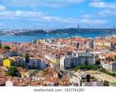
Joao Seco
Education and Background
Education and Training
Bachelor «Theoretical Physics» - Univ of Lisbon
Master «Solid State and Condensed Matter Physics» - Univ of Lisbon/Univ of Paris
PhD «Medical Physics in area of Operations Research» - ICR, London UK
Postdoctoral Experience
Postdoctoral Researcher «Monte Carlo tools for Radiation Therapy» - ICR, London UK
Postdoctoral Researcher «4D MC tools for Xray and Protons» - MGH/HMS Boston, USA
DABR «Therapeutic Medical Physics» - Harvard Medical School (HMS), Boston USA
Professor Appointments (2016):
Division Head «Biomedical Physics in Radiation Oncology» DKFZ, Heidelberg
Chair of Medical Physics – Department of Physics and Astronomy, Univ Heidelberg
Images from top to bottom: Heidelberg (DE), Villigen (CH), Zürich (CH) and Berlin (D).
Notes:
If you need to introduce me.

Slide 35
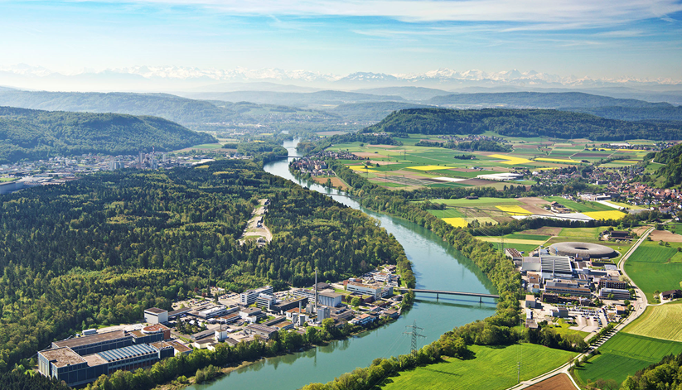
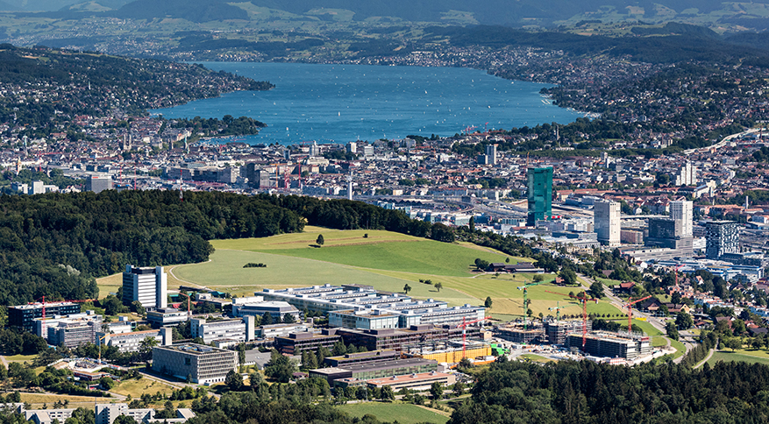
Martina Benešová-Schäfer
Education and Background
Bachelor «Clinical & Toxicological Analysis»
Magister «Nuclear Chemistry»
Charles University, Department of Inorganic Chemistry, Prague, Czech Republic
Ph.D. «Radiopharmaceutical Chemistry»
Ruperto-Carola University, Faculty of Biosciences, Heidelberg, Germany
German Cancer Research Center (DKFZ), Division of Radiopharmaceutical Chemistry, Heidelberg, Germany
Postdoctoral Researcher «Radionuclide Production»
Postdoctoral Researcher «Drug Development»
Paul Scherrer Institute (PSI), Center for Radiopharmarmaceutical Sciences, Villigen, Switzerland + ITM Swiss Federal Institute of Technology (ETH), Institute of Pharm. Sciences, Zürich, Switzerland + Merck & Cie
Junior Research Group Leader «Molecular Biology of Systemic Radiotherapy»
Junior Research Group Leader «Translational Radiotheranostics»
Bayer, Targeted Alpha Therapies (TαT) Unit, Berlin, Germany
German Cancer Research Center (DKFZ), Heidelberg, Germany
Images from top to bottom: Heidelberg (DE), Villigen (CH), Zürich (CH) and Berlin (D).
Notes:
If you need to introduce me.

Slide 36
WPx: title
WP |  | WP Leader:
Work Package Name
Start Month |  | End Month
Effort |  | WP Contributors: | (Institutes)
Objectives

Slide 37
WPx: title
Tasks | Title | Task Leader

Slide 38
WPx Deliverables
Del. | Title | Lead Partner | Dissemination Level | Due On

