Slide 1
WP3: LINAC design dedicated to radioisotope production and other societal applications
Fanouria Antoniou^{1,2}, Amer Ajanovic ⁸, Andrej Debenjak³ , Andreas Karydas⁴, Christos Katsifas⁶, Anastasios Lagogiannis⁴, Theano Lampoudi⁵, Dimitris Lampoudis⁵, Alessandra Lombardi², Yannis Papaphilippou², Primož Pelicon⁷, Chara Petridou¹, Dimos Sampsonidis¹, Spyros Tzamarias¹,Tina Vodopivec³
¹AUTH, ²CERN, ³COSYLAB, ⁴NCSRD , ⁵YFOS , ⁶AMTH , ⁷IJS, ⁸UNSA
Kick-off meeting
3-4 April 2025
Thessaloniki, Greece

Slide 2
LINear Accelerators (LINACs) as medical facilities
LINACs are versatile machines commonly used in medical facilities for cancer treatment, particularly in radiation therapy.
  Generation of high energy beams that can precisely target tumors to destroy cancerous cells while minimizing damage to surrounding healthy tissue.
LINAC technology is well-established for radiation therapy, however, its application for radioisotope production and medical imaging is relatively new.
Current, commonly used radioisotope production methods:
  Nuclear reactors using highly enriched uranium with associated concerns about global availability, safety, and environmental issues
  Cyclotrons, limited to a narrow range of radioisotopes
LINACs advantages: tunable energy levels, high beam intensities, and flexibility in target material selection ➔Enables the production of a broad range of radioisotopes.
LINACs technical challenges, requiring innovative solutions :
  Optimization of LINAC parameters for efficient radioisotope production
  Integrating LINACs with medical imaging systems

Slide 3
The IFIGENEIA proposal
Local LINAC facility (in the Balkans) for producing diverse, marketable radioisotopes.
  Compact, cost-effective and environmentally friendly option
  Can be situated in close proximity to hospitals.
  Tunability that allows for adjusting energy levels, currents and targets
  Enabling the production of a broad range of radioisotopes.
Inspired also by a similar facility to become operational in 2025 in the USA (West Valley City, Utah): NUSANO
  Shares similarities with CERN LINAC4 frontend
  Aligns with the objectives of the European medical radionuclides program PRISMAP
  Makes this Excellence hub proposal timely for following an equivalent paradigm and bridging the present technology gap in Europe.

Slide 4
The IFIGENEIA proposal
A staged approach:
  Initially, starting with a portable radiofrequency (RFQ) of 2-5 MeV to be used:
    for studies of cultural heritage,
    for industrial applications, and
    as irradiation facility for clinical tests.
  In the second phase, a LINAC facility (~20 MeV):
    For radioisotope production
    Can contribute to university education for accelerator physicists, medical physicists, biologists, and medical doctors.
  In the long-term, it can be extended to a cancer treatment facility (up to 40-50 MeV), and the studies will involve different beam parameters for different ranges of isotopes.
The feasibility study of a staged LINAC is poised to address all the issues on a wide variety of radioisotopes, supply chains, and availability to radiopharmaceuticals, researchers, and clinicians.

Slide 5
WP3: Objectives
WP | 3 | WP Leader: | AUTH
Work Package Name | LINAC design dedicated to radioisotope production and other societal applications
Start Month | 1 | End Month | 48
Effort | 170 total person-months | WP Contributors: | AUTH, BIOKOSMOS, AMTH, CERTH, GNP, NCSRD, YFOS, UL, IJS, COSYLAB, IAS, TALOS, UCY, SHSO, UNSA, GSI, DKFZ, CERN
Objectives
Design of the prototype of the proton/ion LINAC-RFQ and the basic RFQ for the LINAC; Development of the front-end applications in radioisotopes and cultural heritage field; feasibility study of fast elemental imaging using pulsed proton beam; demonstration application in culture

Slide 6
WP3: Tasks
Tasks | Title | Task Leader
T3.1 T3.2 T3.3 T3.4 T3.5 T3.6 | LINAC/RFQ design and beam dynamics studies (M1-M42) Beam parameters and hardware specifications for different operational scenarios (M1-M36) Targets’ optimization and handling for different isotope production scenarios (M7-M42) Control system development project plan (M7-M46) Study of the Safety and Radiation protection requirements (M7-M46) Development of Computational tools (M7-M46) | AUTH CERN AUTH COSYLAB NCSRD AUTH

Slide 7
WP3: Staff effort and task participation
Participant | Person-Months | Tasks involved
AUTH | 25 | T1-6
BIOKOSMOS | 6 | T3, T5
AMTH | 4 | T1
CERTH | 16 | T6
GNP | 2 | T5
NCSRD | 9 | T1, 5
YFOS | 10 | T1
UL | 8 | T5
IJS | 18 | T1
Participant | Person-Months | Tasks involved
COSYLAB | 38 | T4
IAS | 1 | T4
TALOS | 3 | T1
UCY | 2 | T2
SHSO | 3 | T5
UNSA | 4 | T1, T2
GSI | 1 | T2
DKFZ | 4 | T2, T3, T5
CERN | 16 | T1-6
Notes:
Person months me Kostos
Appendix

Slide 8
T3.1 Description
T3.1 LINAC/RFQ design and beam dynamics studies
Development of a prototype design for the first stage of a proton LINAC-RFQ: designing the basic RFQ and accelerating structure unit aimed at achieving a maximum proton energy of 2-5 MeV, specifically tailored for archaeometry purposes.
The front-end application for cultural heritage endeavors will encompass designing various components such as the switching magnet, beamline, ion optics, and proton beam exit nozzle into the air.
A compact arrangement for gamma, X-ray, and particle spectroscopic systems will be devised to facilitate the detection of Particle Induced X-ray (PIXE), Gamma Emission (PIGE), and Rutherford Backscattered (RBS) protons.
Feasibility study on fast elemental imaging utilizing pulsed proton beams.
These developments aim to demonstrate the efficiency of Ion Beam analysis (PIXE, PIGE, and RBS) in examining archaeological and artistic objects, shedding light on ancient craftsmanship, artistic techniques, and conservation requirements.
Task Leader: AUTH

Slide 9
T3.1 LINAC/RFQ design and beam dynamics studies
Start Date: | M1
End Date: | M42
Task Leader: | AUTH
Task Contributors: | AUTH, AMTH, NCSRD, YFOS, IJS, TALOS, CERN
Del. | Deliverable Title | Lead Partner | Diss. Level | Due On
D3.1 | LINAC-RFQ prototype design (Document, report) | AUTH |  | M15
D3.2 | Applications in cultural heritage (Demonstrator, pilot, prototype) | AUTH |  | M15
Mx | Milestone Title | Lead Partner | Mean of verification | Due On
M2 | First version of LINAC-RFQ prototype (D3.1) | AUTH | D3.1 | M24
M3 | First versions of Apps for cultural heritage | AUTH | D3.2 | M24
M10 | Completion of LINAC Design | AUTH | D3.1 | M9
M11 | AI/ML Model Validation (D3.1) | AUTH | D3.1 | M18
M12 | LINAC Prototype Testing (D3.1) | AUTH | D3.2 | M18

Slide 10
T3.2 Description
T3.2 Beam parameters and hardware specifications for different operational scenarios
Design different options of a LINAC, proton/helium accelerator, capable of energies reaching up to 20 MeV/u.
Relevant parameters will be decided upon through collaboration with experts, defining the accelerator parameters including the current repetition rate, pulse length, and final energy.
An end-to-end dedicated simulation of all parts of the accelerator: the source, the radiofrequency quadrupole (RFQ), standard drift-tube LINAC (DTL), or inter-digital H-mode (IH) DTL, with adaptations made to meet target requirements.
Past demonstrations have proven the high current capability necessary for the proton accelerator. More studies required for the heavy ion accelerator.
Task Leader: CERN

Slide 11
T3.2 Beam parameters and hardware specifications for different operational scenarios
Start Date: | M1
End Date: | M36
Task Leader: | CERN
Task Contributors: | AUTH, UCY, UNSA, DKFZ, CERN
Del. | Deliverable Title | Lead Partner | Diss. Level | Due On
D3.3 | Beam parameters and hardware specifications (Document, report) | AUTH |  | M24
Mx | Milestone Title | Lead Partner | Mean of verification | Due On
 | Beam parameters and hardware specifications | AUTH |  | M24

Slide 12
T3.2 Methodology
T3.2 Beam parameters and hardware specifications for different operational scenarios
Option 1 – 352 MHz proton accelerator – up to 20 MeV
  Define parameters together with target experts : current repetition rate pulse length final energy
  End to end simulation of source , radiofrequency quadrupole, drift tube linacs or IH.
    Structures are already designed, we need a throughout simulation and adapt the parameters to target needs.
    High current capability has already been demonstrated
Option 2 – 750 MHz proton and helium accelerator – up to 20 MeV/u
  Define parameters together with target experts : current repetition rate pulse length final energy
  End to end simulation of source , radiofrequency quadrupole, drift tube linacs or IH.
    Structures are already designed we need a throughout simulation and adapt the parameters to target needs
    High current capability not demonstrated , needs source R&D to reduce emittance (ongoing in CERN, in collaboration with AUTH).

Slide 13
T3.3 Description
T3.3 Targets’ optimization and handling for different isotope production scenarios
Concerning the 750 MHz proton and helium accelerator capable of reaching up to 20 MeV/u, the following actions will be implemented:
Definition of parameters in collaboration with target experts, for optimal isotope production: current repetition rate, pulse length, and final energy.
End-to-end simulation of the source, radiofrequency quadrupole, and drift tube linacs and accelerating structures, which have already been designed, will be conducted to thoroughly assess and adapt parameters to meet requirements, including efficiency of targets.
The high current capability, which has not yet been demonstrated, will require source R&D to reduce emittance and optimise brightness.
Task Leader: AUTH, NCSRD

Slide 14
T3.3 Targets’ optimization and handling for different isotope production scenarios
Start Date: | M7
End Date: | M42
Task Leader: | AUTH
Task Contributors: | AUTH, BIOKOSMOS, DKFZ, CERN
Del. | Deliverable Title | Lead Partner | Diss. Level | Due On
D3.5 | Study of the Safety and Radiation protection requirements (Document, report) | NCSRD |  | M24
Mx | Milestone Title | Lead Partner | Mean of verification | Due On
 | Study of the Safety and Radiation protection requirements (Document, report) | NCSRD |  | M24

Slide 15
T3.4 Description
T3.4 Control system development project plan
The first step involves gathering use cases, requirements, and specifications for the accelerator control system. This will entail conducting interviews with experts, operators, external end-users and identifying applicable legislation and standards to ensure a comprehensive understanding of needs.
These inputs will serve as the foundation for creating a high-level design, architecture, budget estimates and reviewing hardware options with partners. The focus will be on crafting a flexible design that addresses various LINAC use cases while minimizing potential delays.
A paramount consideration will be placed on cost efficiency, aiming to achieve this with a minimal number of hardware/software solutions. The design process will also take into account indirect costs such as repairs, maintenance, training, upgrades, support, purchasing, and licenses.
The design will encompass the integration of devices with diverse control interfaces, loops, data throughputs, and security requirements. Guidelines will be specified for the archival of operational data, development of Graphical UI, and high-level application development frameworks.
Task Leader: COSYLAB

Slide 16
T3.4 Control system development project plan
Start Date: | M7
End Date: | M46
Task Leader: | COSYLAB
Task Contributors: | AUTH, CERN, CERTH, IJS, BIOKOSMOS
Del. | Deliverable Title | Lead Partner | Diss. Level | Due On
D3.4 | Control system project plan (Document, report) | COSYLAB | SEN - Sensitive | M36
Mx | Milestone Title | Lead Partner | Mean of verification | Due On
 | Control system project plan (Document, report) | COSYLAB |  | M36

Slide 17
T3.4 Key considerations
T3.4 Control system development project plan
Longevity: Ensure the control system can adapt to technological changes and continue operating efficiently throughout the facility's lifetime.
Modularity: Design each part of the control system to be as independent as possible to minimize unintended impacts on other subsystems.
Scalability: Ensure the control system can handle increased loads and expanded functionalities as the facility grows or its operational requirements change.
Performance: Facilitate fast data acquisition and short response times for subsystems that require high performance.
Data Access: Provide easy access to necessary data and ensure it is stored for as long as needed.
Usability: Make the control system intuitive for all users, with a coherent UI and well-documented functions.
Task Leader: COSYLAB
Notes:
Longevity. The facility is expected to be in operation for several decades. The design of the control system must allow continued operation throughout the lifetime of the facility. It needs to be possible to efficiently adapt the control system to the requirements and technological changes during the lifetime of the facility.
Modularity. Each part of the control system should be as independent as possible. If it is changed the unintended impact on the other subsystems must be minimal.
Scalability: Ensure the control system can handle increased loads and expanded functionalities as the facility grows or its operational requirements change. This includes the ability to integrate new technologies and accommodate additional subsystems without significant redesign.
Performance. Some subsystems may require fast data acquisition and/or short response times. The control system needs to be designed in such a way that it facilitates the desired performance.
Data Access. The control system needs to expose all necessary data to the users and keep the required information stored for as long as needed.
Usability. For all the users (engineers, operators, physicists), the control system must be as intuitive to comprehend as possible. The UI interface should be coherent, and functions documented.

Slide 18
T3.4 Methodology (1/3)
T3.4 Control system development project plan
Use cases
  Input from engineers, physicists, operators and end-users
High level machine specifications
  To complement the use cases
  Relevant for selection of critical technologies
    High precision, fast reaction times, high data throughputs, etc.
Device list
  Location and number of all controllable devices, sensors and actuators (and their controllers)
Device interfaces
  Signal and connection types for all devices
  Protocol descriptions
  SDKs and APIs
Task Leader: COSYLAB
Notes:
a.k.a – table of content

Slide 19
T3.4 Methodology (2/3)
T3.4 Control system development project plan
Control system architecture
  Identifying hardware defined in other deliverables (form factor, controllers, expansion cards, PLCs, network equipment, etc.)
  Software stack (Control system module, OS drivers, databases, GUI and user tools)
  Development, deployment and maintenance protocols
  Naming, archiving, and UI conventions
Machine-wide Control System components
  Devices: RF components/controllers, vacuum sensors and actuators, magnet power supplies, beam diagnostics
  Systems: machine protection, timing triggering and synchronization
  Services: such as alarms, archiving, logging
  UI: Engineering and operator GUIs
Task Leader: COSYLAB
Notes:
a.k.a – table of content

Slide 20
T3.4 Methodology (3/3)
T3.4 Control system development project plan
Configuration
  Control system deployment configuration and device-specific parameters
  Service and machine-wide systems configuration
Control system integration
  Integration lab & test bench
    How to approach prototyping, development, long-term testing, acceptance procedures, and training
Control system project plan
  Timeline
  Resources
  Budget
Task Leader: COSYLAB
Notes:
a.k.a – table of content

Slide 21
T3.4 Interactions with other Tasks
T3.4 Control system development project plan
Control System is the one that ties all other subsystems together and orchestrates their behavior.
Cosylab’s experience tells us Control System is only ~10% of an accelerator project (in terms of personnel, funds, complexity)
  Control System is the one subsystem that ties all other subsystems together and orchestrates their behavior
  However, because it heavily relates to design choices and hardware, it comes last, and
  Is often severely underestimated in when and how important it should be handled
Who do we count on:
T3.1 AUTH – LINAC/RFQ design
T3.2 CERN – hardware specifications
T3.3 AUTH – operations/productions scenarios
Also: IJS, CERTH, YFOS, AMTH
Task Leader: COSYLAB
Notes:
a.k.a – table of content
Who do we count on: ti majo največ časa na to pisano in so zdej prepoznani, lahko da kdo preveč/premalo - ampak kdorkoli, ki dela na dizajnu pospeševalnika, rabimo inpute.

Slide 22
T3.5 Description
T3.5 Study of the Safety and Radiation protection requirements
A comprehensive study to assess the safety and radiation protection requirements associated with the operation of the LINAC facility and radioisotope production processes within the IFIGENEIA project.
Evaluation of relevant regulations, guidelines, and best practices, to identify potential hazards, radiation exposure risks, and mitigation strategies to ensure the safe and secure operation of the facility.
Key activities: risk assessments, development of safety protocols and procedures, and implementation of radiation shielding measures to protect personnel, the public, and the environment.
Training and awareness programs to educate personnel on safety protocols and promote a culture of radiation safety and compliance throughout the project lifecycle.
Task Leader: NCSRD

Slide 23
T3.5 Study of the Safety and Radiation protection requirements
Start Date: | M7
End Date: | M46
Task Leader: | NCSRD
Task Contributors: | AUTH, BIOKOSMOS, GNP, NCSRD, UL, SHSO,DKFZ, CERN
Del. | Deliverable Title | Lead Partner | Diss. Level | Due On
D3.5 | Study of the Safety and Radiation protection requirements (Document, report) | NCSRD |  | M24
Mx | Milestone Title | Lead Partner | Mean of verification | Due On
 | Study of the Safety and Radiation protection requirements (Document, report) | NCSRD |  | M24

Slide 24
Radioprotection
T3.5 Study of the Safety and Radiation protection requirements
According to Greek and European Legislation:
(Supervised by the Greek Atomic Energy Commission)
Π.Δ. 101/2018 – FEK 194/A/20.11.2018
Decision 4B/261 – FEK 2460/21.06.2019
Directive 2013/559/Euratom
Best practices as described by IAEA
Limits
Category | Effective Dose (mSv/y) | Regulation | Restrictive Dose (mSv/y) | Regulation
Occupational | 20 | Π.Δ. 101/2018 | 5 | Internal Lab
Max for Occupational | 50 |  | 20 | Decision 4B/261
Public | 1 |  | 0.3 | Decision 4B/261
Pregnant | 1 |  | 0.3 | Decision 4B/261

Slide 25
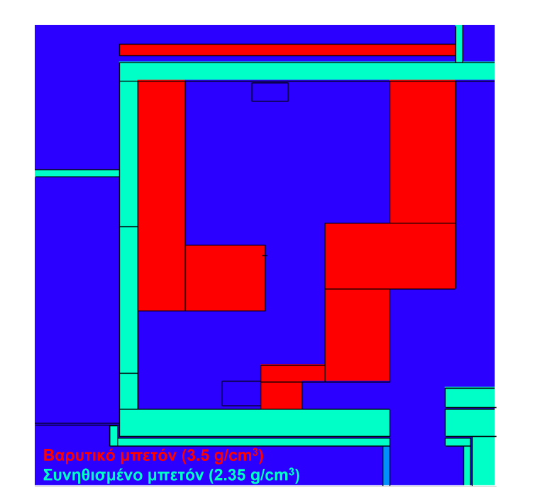
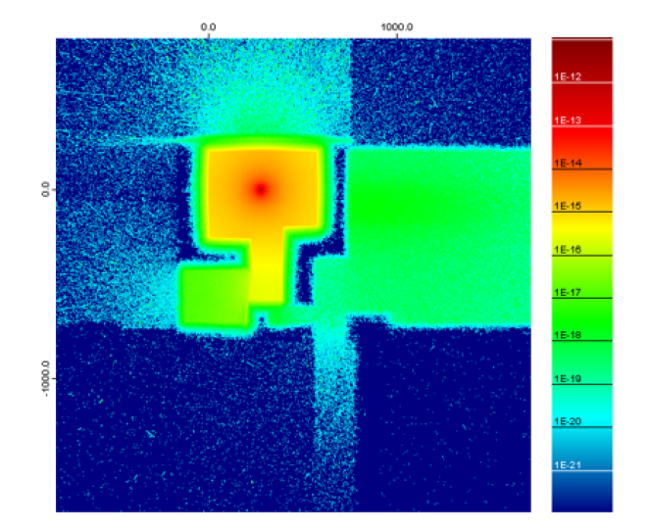
Radioprotection example
T3.5 Study of the Safety and Radiation protection requirements
Shielding of a 17 MeV proton Cyclotron (using MCNP6 code)

Slide 26
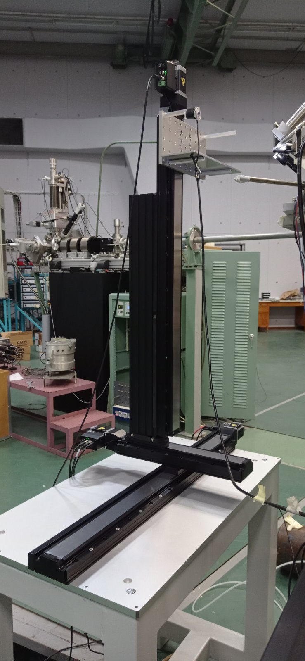
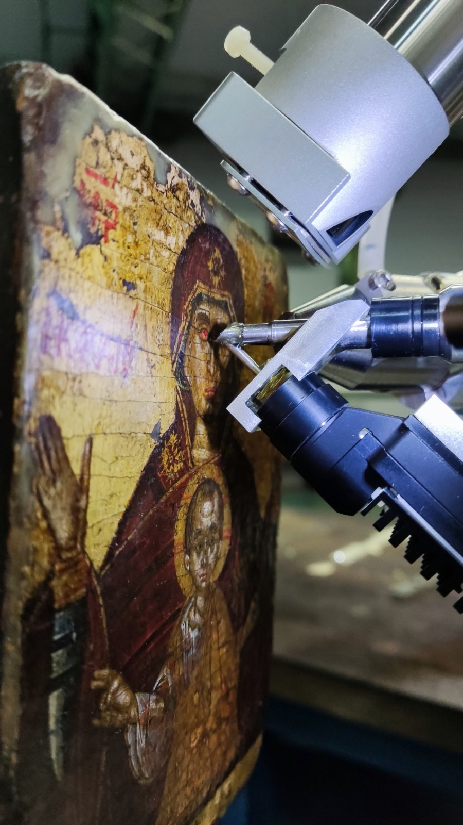
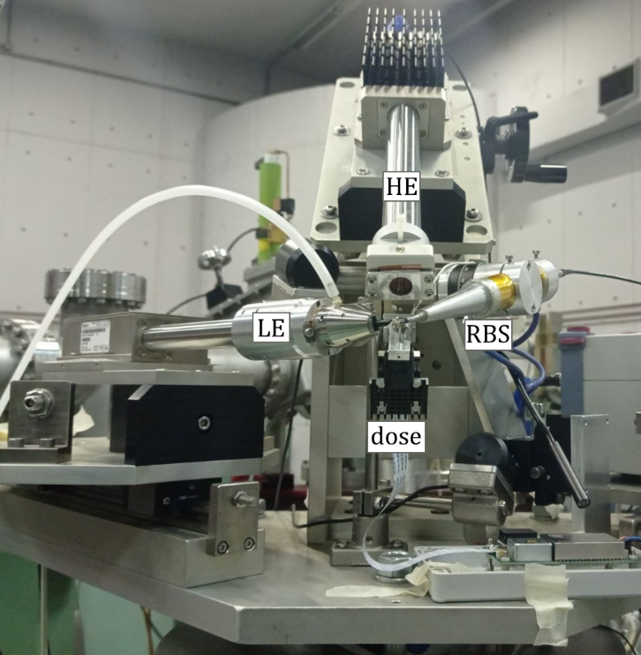
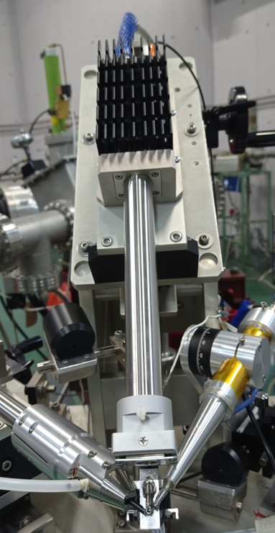
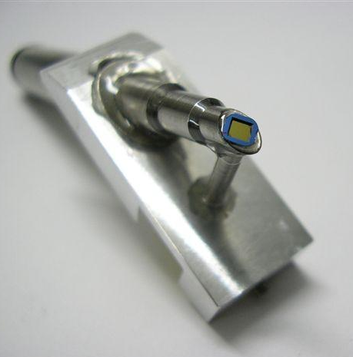
The new external IBA set-up at NCSR Demokritos

Slide 27
First quantitative results
T3.5 Study of the Safety and Radiation protection requirements
26 CRMs
APM | Geological | Biological | Gold alloys
NIST 2783 | IAEA Soil 7 | NIST 1571 | Fischer ABKMF
UCD High | IAEA Chinese Ceramic | GBW07605 | Fischer ABLLI
UCD New | NIST 679 | NOAA MA-A-2 | Fischer ABSBL
 | ISE 952 | NOAA 1566a | Fischer ABQAQ
Glass | GBW07307 | Dorm2
NIST 1412 | GBW07316 | Tort 2B | Bronze alloys
NIST 620 |  | NIST 177c | NIST 1107
BAM S005 |  | IAEA A13
 |  | CTA-VTL-2

Slide 28
Limits of Detection for Glass matrix
Limits of Detection: 3.05 MeV protons, 15nA, 7μC, ~ 8 min

Slide 29
T3.6 Description
T3.6 Development of Computational tools
This is a horizontal task supporting the technical WPs.
It concerns the development of simulation, optimisation & modelling tools based on classical and ML/AI algorithms to be used on the simulation and computational studies of the above tasks (T3.1 – T3.5). This task will also offer computational modelling support to the tasks of WP4

Slide 30
T3.6 Development of Computational tools
Start Date: | Μ7
End Date: | Μ46
Task Leader: | AUTH
Task Contributors: | CERN, DKFZ, COSYLAB, CERTH,
Del. | Deliverable Title | Lead Partner | Diss. Level | Due On
Mx | Milestone Title | Lead Partner | Mean of verification | Due On
11 | AI/ML Model Validation | AUTH | D3.1 | 18

Slide 31
T3.6 Methodology
T3.6 Development of Computational tools
The Development of Computational Tools task will provide simulation, modeling, and AI-driven optimization to enhance WP3 (Accelerators) and WP4 (Radiopharmaceuticals).
T3.1 LINAC/RFQ Design & Beam Dynamics
  Particle-in-cell (PIC) and FEM simulations for RFQ and LINAC design.
  AI-driven optimization to minimize beam losses.
T3.2 Beam Parameters & Hardware Specifications
  ML-based predictive models for operational stability.
  AI-enhanced tuning for beam transport efficiency.
T4.5 Pre-Clinical Studies (Animal Models)
  AI-based image processing for PET/SPECT analysis.
  Computational models for biodistribution and dosimetry as well as for pharmacokinetics and pharmacodynamics.

Slide 32
T.3.6 Timetable - Resources
T3.6 Development of Computational tools

Slide 33
WP3 Deliverables
Del. | Title | Lead Partner | Task associated | Due On
D3.1 | LINAC-RFQ prototype design (Document, report) | AUTH | T1, T6 | 15
D3.2 | Applications in cultural heritage (Demonstrator, pilot, prototype) | AUTH | T1, T6 | 15
D3.3 | Beam parameters and hardware specifications (Document, report) | AUTH | T2, T6 | 24
D3.4 | Control system project plan (Document, report) | COSYLAB | T4, T6 | 36
D3.5 | Study of the Safety and Radiation protection requirements (Document, report) | NCSRD | T3, T5, T6 | 24

Slide 34
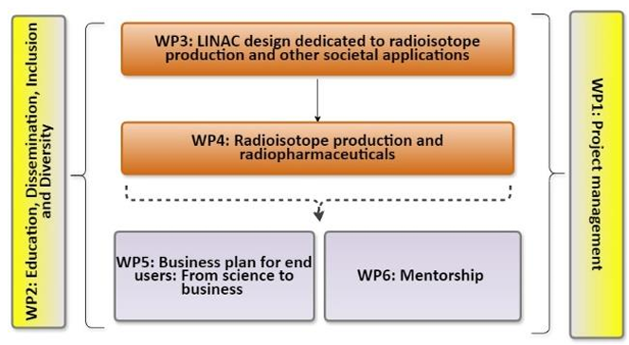
Potential interactions with other WPs
Collaboration with WP4:
  Strong collaboration and information exchange with WP4 to define the optimal set of parameters
  T4.2 Identify best Isotopes for production with LINAC
Collaboration with WP5:
  Cost estimations for different accelerator components
  Operational costs
  ….
Collaboration with WP6:
  T6.1 Accelerator School
Collaboration with WP2:
  T2.1 Communication and dissemination activities and planning
  T2.2 Skills training and Trainers’ training
  T2.3 Secondments and good practices exchange

Slide 35
Relevant national & international research and innovation activities
TIARA: The main objective of TIARA is to create a dedicated structure to exchange expertise and to facilitate and support the setting-up of joint R&D programmes and education and training in the field of Accelerator Science and Technology in Europe.
  TIARA consortium has already expressed its strong support to IFIGENEIA project as an important step towards translating particle accelerator technologies to society, in particular to the medical field.
ARIES: ARIES is an Integrating Activity project which aims to develop European particle accelerator infrastructures. (CERN)
  CERN will transfer to IFIGENEIA project all the acquired knowledge regarding the accelerator infrastructures that will be valuable for the future LINAC development.
iFAST: iFAST tackles challenges faced by future accelerators and helps to develop breakthrough technologies of multiple accelerator platforms (CERN)
  IFIGENEIA will benefit from iFAST as CERN will offer its knowledge for the design of future accelerators, promoting innovation in the accelerator community
EuroCirCol: The project is a conceptual design study for a post-LHC research infrastructure based on an energy-frontier 100 TeV circular hadron collider.
  CERN’s experience in the design study implemented in EuroCirCOl as part of the Future Circular Collider study proposing a post-LHC project will benefit IFIGENEIA.
SEEIIST: South East European International Institute for Sustainable Technologies (GNP).
  IFIGENEIA will benefit from the cutting-edge technologies, such as the ones developed at CERN1 , GSI2 and other hi-tech research laboratories.

Slide 36
WP3 Milestones
Summary of milestones
  Month 9 (end of November): First version of LINAC-RFQ prototype (D3.1)
  Month 18 : AI/ML Model Validation (D3.1)
  Month 18 : LINAC Prototype Testing (D3.1)
  Month 24 : First version of LINC-RFQ prototype (D3.1)
  Month 24 : First versions of Apps for cultural heritage (D3.2)
  Month 36 : Final Implementation Phase (D3.2)

Slide 37
WP3 organization
Monthly meetings with all members (preferable with minutes)
Status report and next steps to be reported by each task leader
A place for discussion and exchange between the members of the WP
Guidance by the parenting institutes
Invited members of other WPs linked to ours for information exchange and collaboration
First meeting with all TL to define mailing list and discuss organizational issues within the next weeks (date to be defined soon)

Slide 38
Extra slides

Slide 39
D3.1 – LINAC-RFQ prototype design
A comprehensive prototype design for a proton LINAC-RFQ system that can be used for non-invasive, high-precision analysis of ancient artifacts, for applications in archaeometry, including the analysis of cultural heritage artifacts.
Deliverable will be updated in months 24 and 48
Involved institutes: CERN, AUTH, YFOS, COSYLAB, NCSRD, …?
Lead Beneficiary: AUTH
Notes:
Propose a first meeting in May, at CERN, with YFOS and CERN experts.

Slide 40
D3.2 – Applications in cultural heritage
Report on cultural heritage applications which will involve a series of analytical activities aimed at advancing archaeometric research and conservation practices. To ensure the highest quality and analytical sensitivity of the results, both external IBA facilities at NCSRD and JSI will undergo a thorough evaluation to optimize their performance, driving key upgrades in their setup and configuration. This multi-site approach will enhance the precision and reliability of the data, supporting both research and conservation goals.
Deliverable will be updated in month 48.
Involved institutes: AUTH, NCSRD, JSI, TALOS (?), …
Lead Beneficiary: AUTH

Slide 41
D3.3 – Beam parameters and hardware specifications
A detailed set of specifications for a proton LINAC accelerator operating at a frequency of 352 MHz and capable of reaching beam energies of up to 20 MeV. This deliverable will provide the foundational data and design parameters needed to move forward with the construction and testing of the proton LINAC accelerator.
Involved institutes: AUTH, CERN, YFOS (?), COSYLAB, UCY, UL, DKFZ, …
Deliverable will be updated in month 48.
Lead Beneficiary: AUTH

Slide 42
D3.4 – Control system project plan
Document which will detail the control system's sub-components, functionalities, and use cases, serving as a key reference for stakeholders, especially those involved in LINAC’s technical and operations design. It will define the approach for developing and implementing the LINAC control system, outlining the full scope of work tailored to IFIGENEIA’s LINAC requirements.
Deliverable will be updated in month 36.
Involved institutes: COSYLAB, AUTH, CERN, IJS, ….
Lead Beneficiary: COSYLAB
UPDATED by Cosylab

Slide 43
D3.5: Study of the Safety and Radiation protection requirements
Study for the new accelerator unit which will comply with radiation protection standards to ensure the safety of personnel, the public, and the environment, as per national regulations and IAEA guidelines. Key safety measures will include accident prevention and analysis, proper training for exposed workers, radiological protection protocols, and maintaining optimal public safety.
Deliverable will be updated in month 48.
Involved institutes: NCSRD, AUTH, CERN, COSYLAB, BIOKOSMOS (?), ….
Lead Beneficiary: NCSRD

